Slide 1
Introduction to Python
Conditionals (part 1)

Slide 2
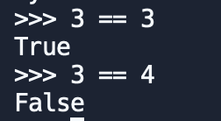
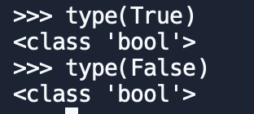
Boolean expressions
A boolean expression is an expression that is either true or false.
Example using the equal operator == the expressions compare two operands and produces True if they are equal and False otherwise:
True and False are special values that belong to the class bool in Python.

Slide 3
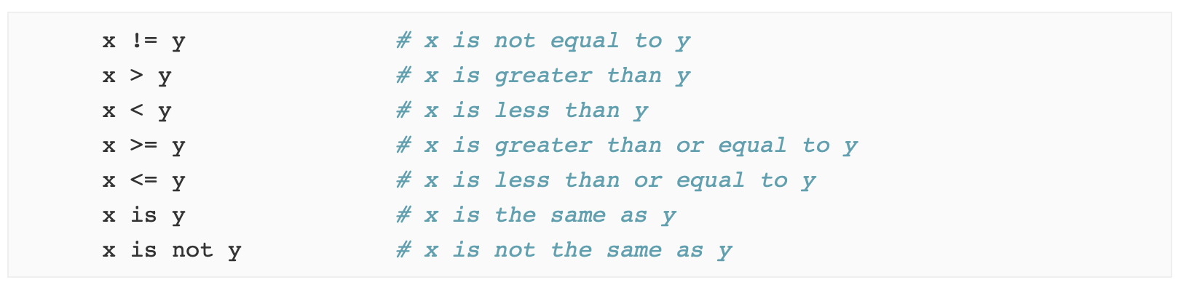
More comparison operators
The print() function prints the specified message to the screen. Let’s try:

Slide 4
Logical Operators
There are three logical operators: and, or, and not. The semantics (meaning) of these operators is similar to their meaning in English.
Example:
When do you think the result of these expressions is True?
For Python any nonzero number is interpreted as "true"
x > 0 and x < 10
n%2 == 0 or n%3 == 0
>>> 15 and True
True

Slide 5
Conditional execution
Conditional statements allows to check conditions and change the behavior of our programs. The simplest form is the if statement:
The boolean expression after the if statement is called the condition. We end the if statement with a colon character (:) and the line(s) after the if statement are indented.
Statements like this are called compound statements because they stretch across more than one line.
There is no limit on the number of statements that can appear in the body, but there must be at least one.
if x > 0 :
print('x is positive')
CONDITION

Slide 6
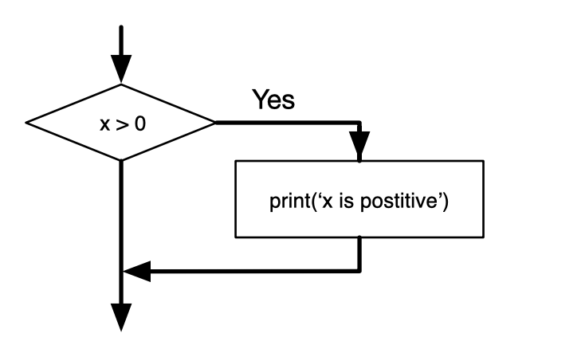
if Logic
if x > 0 :
print('x is positive')
If the logical condition is true, then the indented statement gets executed. If the logical condition is false, the indented statement is skipped

Slide 7
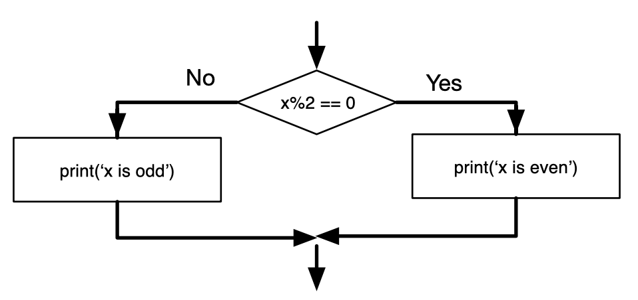
Alternative execution
When there are two possibilities and the condition determines which one gets executed.
if x%2 == 0 :
print('x is even')
else :
print('x is odd')
The alternatives are called branches
Here we have 2 branches

Slide 8
PAIR - PROGRAMMING
WORK ON “02 LAB - CONDITIONALS 1”
COMPLETE YOUR DAILY LOG PROGRAMMING
QUESTIONS?

