Slide 1
Introduction to Python
Introduction

Slide 2
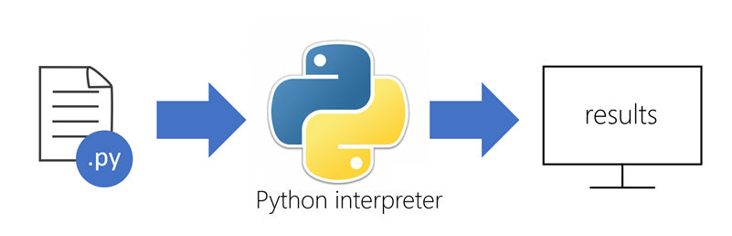
What is Python?
Python is an object-oriented programming language => Based around “classes” and “objects”
Python is high-level => Simple and easy to read
Python is interpreted => The code goes to the interpreter, which reads the code and then executes it

Slide 3
Python Reserved Words
Have special meaning to Python.
Should not be used as a name for a variable.
and | as | assert | class | continue | def
del | elif | else | except | finally | for
from | global | if | import | in | is
lambda | nonlocal | not | or | pass | raise
return | try | while | with | yield

Slide 4
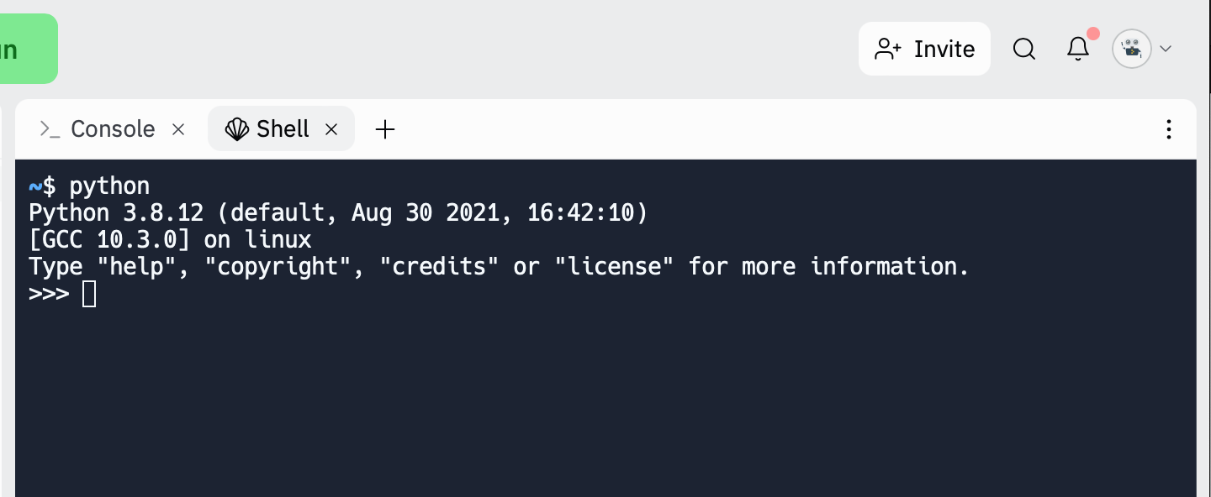
Let’s write some Python code
Open your Replit
Type python on the shell and the Python interpreter will start to work

Slide 5
Let’s write some Python code
The print() function prints the specified message to the screen. Let’s try:
>>> print('Hello world!')
Hello world!
Tasks:
Try to print other messages
How do you print a number?

Slide 6
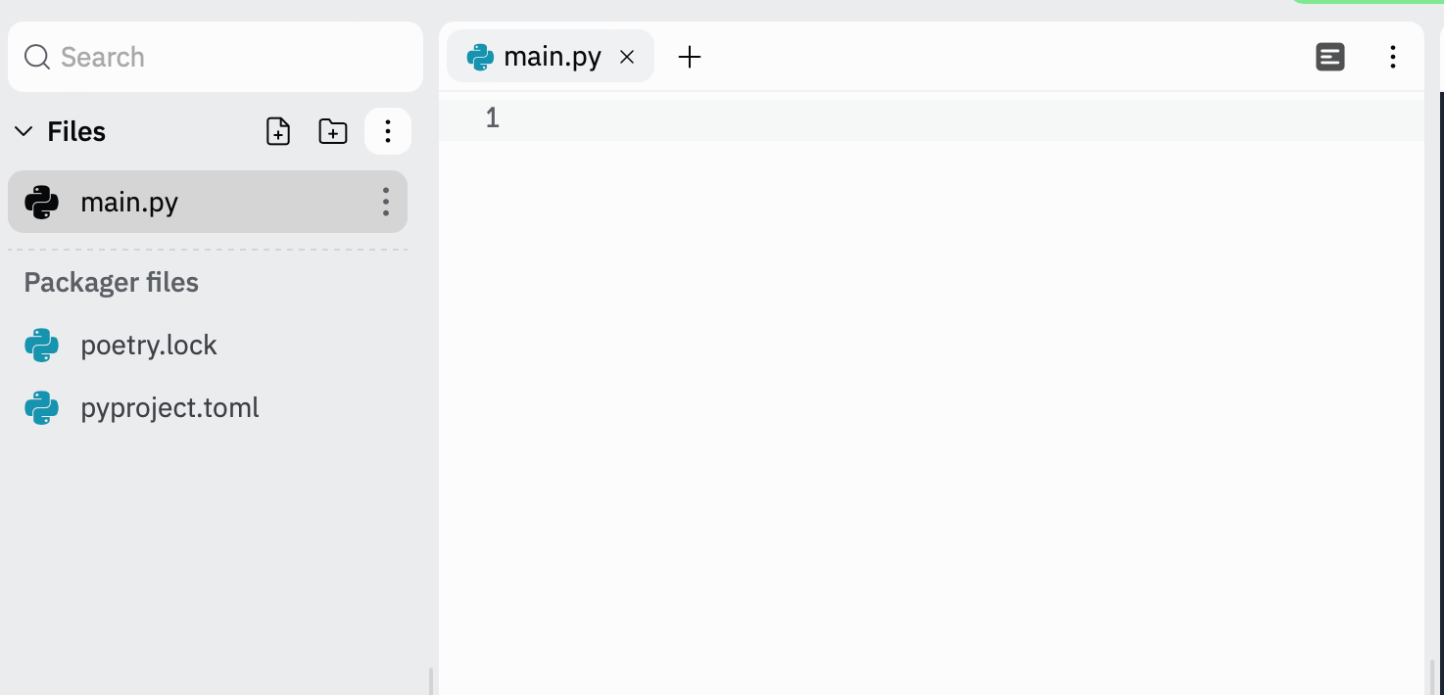
Writing a program
On your Replit create a file main.py. It will contain your Python code. This file is called script.
NOTE: Python scripts always have .py as extension.
Notes:
Typing commands into the Python interpreter is a great way to experiment with Python's features, but it is not recommended for solving more complex problems.

Slide 7
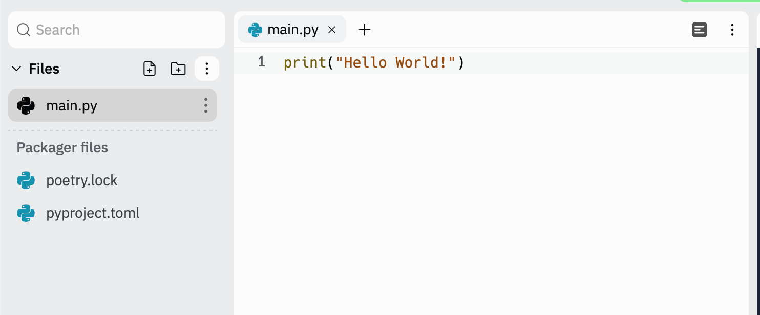
Writing a program
Let’s write in your script the code that prints our traditional Hello World! by typing it inside print() function.

Slide 8
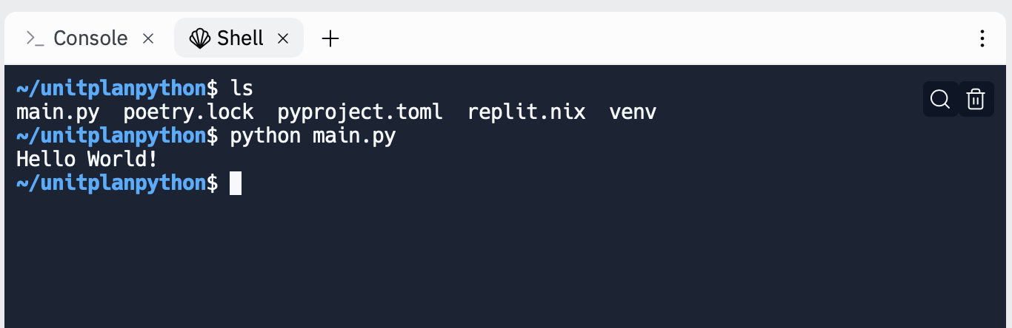
Running your script
Go to the shell in Replit
Type python main.py (make sure you are in the directory where the script is located)
Your program will be executed and you will see the result in the shell
Add more lines of code using the function print()
Then, run your script from the shell again

Slide 9
INDIVIDUAL ACTIVITY
WORK ON “00 LAB - INTRODUCTION”
COMPLETE YOUR DAILY LOG PROGRAMMING
QUESTIONS?

