Slide 1
Introduction to Python
Variables

Slide 2
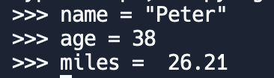
What is a variable?
A variable is a name that refers to a value. This means that when you create a variable you reserve some space in memory to store your value.
Python assign a value to a variable using the equal sign (=).
Here are some examples:
STRING
INTEGER
FLOATING POINT

Slide 3
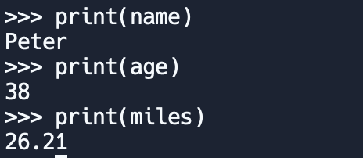
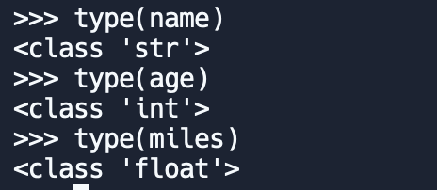
Working with variables
We can use a print statement to display the value of a variable:
The type of a variable is the type of the value it refers to.
Python uses the method type() to return the class type of the argument (object) passed as parameter

Slide 4
Variable names
Programmers generally choose names for their variables that are meaningful and document what the variable is used for.
Variable names can be arbitrarily long.
They can contain both letters and numbers, but they cannot start with a number.
It is legal to use uppercase letters.
Begin variable names with a lowercase letter.
The underscore character (_) can appear in a name. It is often used in names with multiple words, such as my_name or favorite_color.
Variable names can start with an underscore character, but we generally avoid doing this unless we are writing library code for others to use.

Slide 5
Reserved words
Remember special words have special meaning to Python.
Should NOT be used as a name for a variable.
and | as | assert | class | continue | def
del | elif | else | except | finally | for
from | global | if | import | in | is
lambda | nonlocal | not | or | pass | raise
return | try | while | with | yield

Slide 6
Statements
A statement is a unit of code that the Python interpreter can execute. We have seen two kinds of statements: print being an expression statement and assignment.
A script usually contains a sequence of statements. If there is more than one statement, the results appear one at a time as the statements execute.
For example, the script
produces the output
print(1)
x = 2
print(x)
1
2

Slide 7
Operators and operands
Let’s write in your script the code that prints our traditional Hello World! by typing it inside print() function.
Operators are special symbols that represent computations like addition and multiplication. The values the operator is applied to are called operands.
+ | addition
- | subtraction
* | multiplication
/ | division
** | exponentiation

Slide 8
Expressions
An expression is a combination of values, variables, and operators.
A value all by itself is considered an expression, and so is a variable.
Examples (assuming that the variable x has been assigned a value):
15
x
x + 5
If you type the expression 1 +1 in the Python console, it will display 2 as output the interpreter evaluates it and displays the result.
However, an expression all by itself doesn't do anything in a script. So, if you type 1 + 1 in your script you will not get 2

Slide 9
Order of operations
For expression with more than one operator Python follows mathematical convention (PEMDAS)
Example:
2 * (3-1) = 4
1+1)**(5-2) = 8
What is the result for the following expressions?

Slide 10
INDIVIDUAL ACTIVITY
WORK ON “01 LAB - VARIABLES”
COMPLETE YOUR DAILY LOG PROGRAMMING
QUESTIONS?

