Slide 1
Introduction to Python
Conditionals (part 2)

Slide 2
Warm-up
This table contains names of basketball players, their teams and state.
Player | State | Team
Giannis Antetokounmpo | Wisconsin | Milwaukee Bucks
Kevin Durant | New York | Brooklyn Nets
Stephen Curry | California | Golden State Warriors
Nikola Jokic | Colorado | Denver Nuggets
Joel Embiid | Philadelphia | Philadelphia 76ers
Work with a partner and think on how you would write a condition(s) including the player name and the state to get the team.

Slide 3
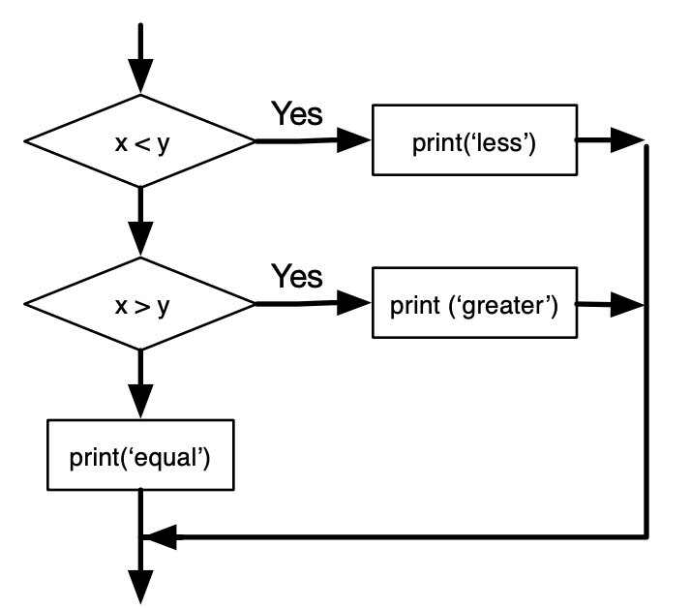
Chained conditionals
We use them when we have more than 2 branches.
if x < y:
print('x is less than y')
elif x > y:
print('x is greater than y')
else:
print('x and y are equal')
No limit on the number of elif statements.
The else clause has to be at the end, but there doesn't have to be one.

Slide 4
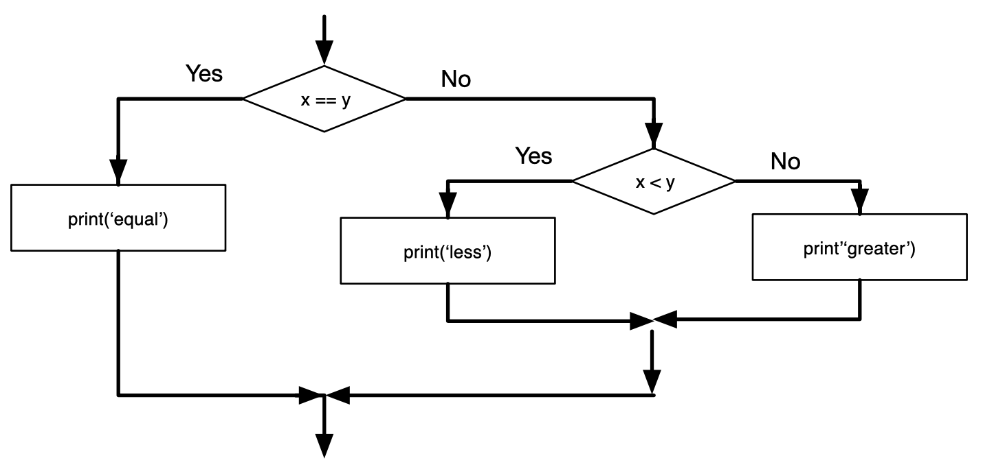
Nested conditionals
if x == y:
print('x and y are equal')
else:
if x < y:
print('x is less than y')
else:
print('x is greater than y')
One conditional can be nested within another.
We could have written the three-branch example like this:

Slide 5
PAIR-PROGRAMMING
WORK ON “03 LAB - CONDITIONALS 2” WITH A PARTNER
COMPLETE YOUR DAILY LOG PROGRAMMING
QUESTIONS?

