Slide 1
TOWER OF HANOI
Recursive Algorithm

Slide 2
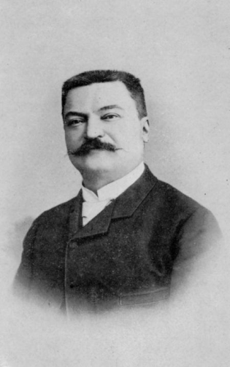
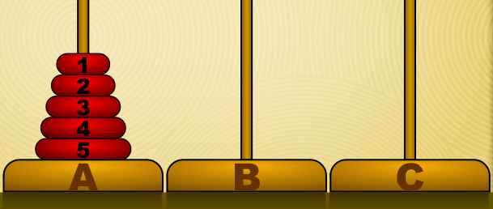
Origins
The french mathematician Édouard Lucas invented the Tower of Hanoi puzzle around 1883.
It is associated with a legend of an Indian temple:
It was used to increase mental discipline of young priests.
64 gold rings stacked on one of three post.
Recreate the stack on another post: move 1 ring at a time, smaller ring on top of a larger one.
How long would it take?
At a rate of one movement per second -> 2⁶⁴ − 1 sec. = 585 billion years > 42 times the age of a universe
Édouard Lucas (1842-1891)
Notes:
It is associated with a legend of a Hindu temple where the puzzle was supposedly used to increase the mental discipline of young priests. In the legend the young priests were given 64 gold rings stacked neatly on one of three posts. Each ring rested on a slightly larger ring. The priests' goal was to re-create the stack on a different post by moving rings, one at a time, to another post with the rule that a larger ring could never be placed on top of a smaller ring. Using mathematics, you can calculate that even when the priests found the most efficient way to solve the problem, and moved the rings at a rate of one per second, it would take almost 585 billion years to finish the job. That is more than 42 times the age of the universe!

Slide 3
Rules
Move one ring at a time
No ring may be placed on top of a ring that is smaller than it.
Let’s get some practice at https://www.mathplayground.com/logic_tower_of_hanoi.html(mute the tab so you do not get annoyed by the sound)
Notes:
Ask students how many movements did they do in the warm up activity?

Slide 4
Activities
https://www.mathplayground.com/logic_tower_of_hanoi.html (mute the tab so you do not get annoyed by the sound)
How many moves for 1 ring from tower A to tower C?
How many moves for 2 rings from tower A to tower C?
How many moves for 3 rings from tower A to tower C?

Slide 5
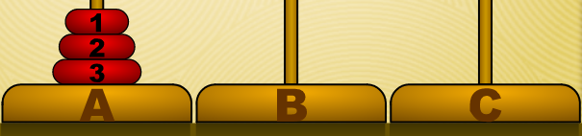
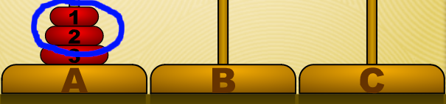
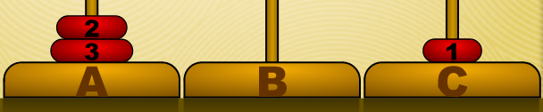

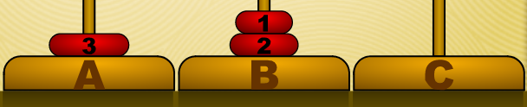
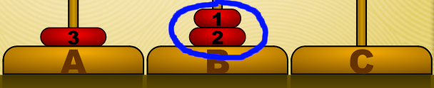
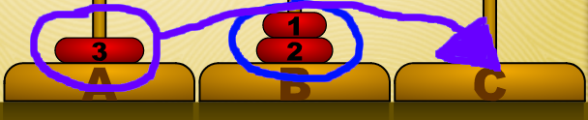



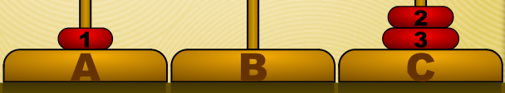
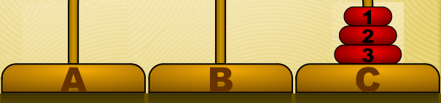
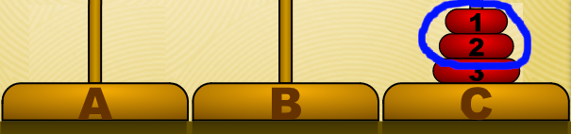
Solution for 3 rings
1. Small from A to C
T(2, A, B, C)
2. Medium from A to B
3. Small from C to B
T(1, A, C, B)
4. Large from A to C
5. Small from B to A
T(2, B, C, A)
6. Medium from B to C
7. Small from A to C

Slide 6
Solution for 3 rings
Small from A to C
Medium from A to B
Small from C to B
Large from A to C
Small from B to A
Medium from B to C
Small from A to C
T(2, A, B, C)
T(1, A, C, B)
T(2, B, C, A)

Slide 7
Solution for 3 rings
Small from A to C
Medium from A to B
Small from C to B
Large from A to C
Small from B to A
Medium from B to C
Small from A to C
T(1, A, C, B)
T(2, A, B, C)
T(1, A, B, C)
T(1, C, B, A)
T(3, A, C, B)
T(1, A, C, B)
T(1, B, A, C)
T(2, B, C, A)
T(1, B, C, A)
T(1, A, C, B)

Slide 8
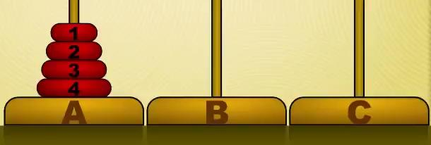
Solution for 4 ring (first step)

Slide 9
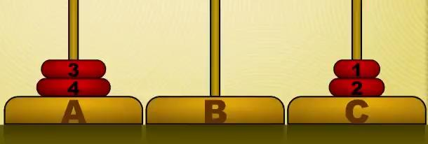
Solution for 4 ring (second step)

Slide 10
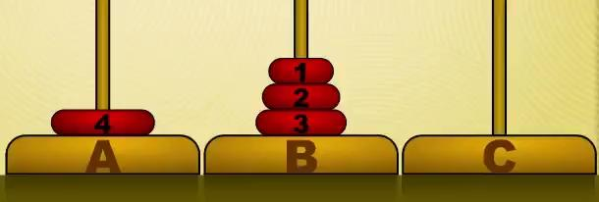
Solution for 4 ring (third step)

Slide 11
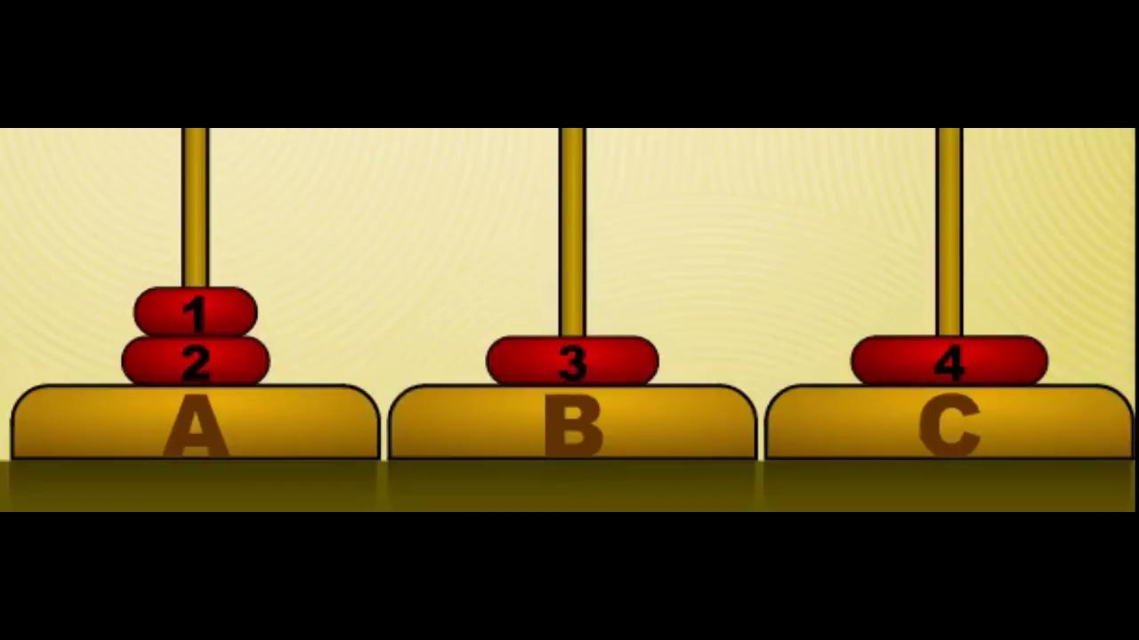
Solution for 4 ring (last step)

Slide 12
Recursion
Recursion
Small from A to B
Medium from A to C
Small from B to C
Large from A to B
Small from C to A
Medium from C to B
Small from A to B
T(1, A, B, C)
T(2, A, C, B)
T(1, A, C, B)
T(1, B, C, A)
T(3, A, B, C)
T(1, A, B, C)
T(1, C, A, B)
T(2, C, B, A)
T(1, C, B, A)
T(1, A, B, C)
T(1, A, C, B)
T(4, A, C, B)
Ring from A to C
Small from B to C
Medium from B to A
Small from C to A
Large from B to C
Small from A to B
Medium from A to C
Small from B to C
T(1, B, C, A)
T(2, B, A, C)
T(1, B, A, C)
T(1, C, A, B)
T(3, B, C, A)
T(1, B, C, A)
T(1, A, B, C)
T(2, B, C, A)
T(1, A, C, B)
T(1, B, C, A)

Slide 13
Recursion: factorial (classic example)
6! = 6 x 5 x 4 x 3 x 2 x 1
n! = n x (n-1) x (n-2) x (n-3) x …… x 2 x 1
The factorial of a number is equal to the starting
number multiplied by the factorial of the number
immediately below it:
n! = n x (n-1)!
(n-1)! = (n-1) x (n-2)!
(n-2)! = (n-2) x (n-3)!
…..
2! = 2 x 1!
1! = 1
*** Fun fact: Google recursion :)
Definition: Recursion is a programming technique using a function or algorithm that calls itself one or more times until a specified condition is met at which time the rest of each repetition is processed from the last one called to the first.

Slide 14
Recursion
Recursion
Small from A to B
Medium from A to C
Small from B to C
Large from A to B
Small from C to A
Medium from C to B
Small from A to B
T(1, A, B, C)
T(2, A, C, B)
T(1, A, C, B)
T(1, B, C, A)
T(3, A, B, C)
T(1, A, B, C)
T(1, C, A, B)
T(2, C, B, A)
T(1, C, B, A)
T(1, A, B, C)
T(4, A, C, B)
T(1, A, C, B)
Ring from A to C
Small from B to C
Medium from B to A
Small from C to A
Large from B to C
Small from A to B
Medium from A to C
Small from B to C
T(1, B, C, A)
T(2, B, A, C)
T(1, B, A, C)
T(1, C, A, B)
T(3, B, C, A)
T(1, B, C, A)
T(1, A, B, C)
T(2, B, C, A)
T(1, A, C, B)
T(1, B, C, A)

Slide 15
Recursion
Recursion
Small from A to B
Medium from A to C
Small from B to C
Large from A to B
Small from C to A
Medium from C to B
Small from A to B
T(2, A, C, B)
T(n, A, C, B):
T(3, A, B, C)
T(1, A, B, C)
T(n-1, A, B, C)
T(2, C, B, A)
Move ring from A to C
T(4, A, C, B)
T(1, A, C, B)
T(n-1, B, C, A)
Large from A to C
Small from B to C
Medium from B to A
Small from C to A
Large from B to C
Small from A to B
Medium from A to C
Small from B to C
T(2, B, A, C)
T(3, B, C, A)
T(1, B, C, A)
T(2, B, C, A)

Slide 16
Numbers of moves
Number of rings (N) | Number of Moves ((2**N)-1) | 2**N
1 | 1 | 1
2 | 3 | 4
3 | 7 | 8
4 | 15 | 16
5 | 31 | 32
6 | 63 | 64
7 | 127 | 128
8 | 255 | 256
Minimal number of moves required = 2^{n} − 1
Where, n= number of rings.
For 3 rings: 2³ − 1 = 7 movements

Slide 17
Individual assignment
Choose one of the following assignments (you will have a starter code):
MILD: Write a function to move n rings from source tower to destination tower and print the moves of each ring.
MEDIUM: Write a function to move n rings from source tower to destination tower and print the moves of each ring and the total number of moves.
SPICY: Write a function to move n rings from source tower to destination tower and print the moves of each ring, the list of rings on each tower after each move and the total number of moves.

