Slide 1
Bias in Algorithms
Ms. Novillo

Slide 2
AGENDA
Warm-up activity
Mini Lesson: Definitions - Discussion
Practice: Identify bias (simple algorithm)
Exit Slip

Slide 3
What is an algorithm?
An algorithm is a set of instructions that a computer follows.
Examples:
Google search
Algorithms to create targeted ads in our social media feeds

Slide 4
Warm-up
Go to Google Images https://images.google.com/
Search: professor
Groups (2 or 3) answer the following questions:
Who do you see?
Who did you expect to see? Who is missing?
How does the information provided by these images influence you?
Does this tell us anything about how the population is represented or misrepresented?
Notes:
1. Who do you see? Fictional characters: Indiana Jones, Robin Williams (Dead Poets Society), Professor X (X-Men), stereotypes, no diversity. White males mostly.
2. Who do you expect to see? / Who is missing? More women, more people of color, people of all ages, more diversity, real-life professors
3. How does the information provided by these images influence you? Professors all dress alike in tweed/corduroy jackets, with patches on the elbow, ties, etc. Professors are easily identified by how they dress. Reinforces stereotypes.
4. Does this tell us anything about how population is represented or misrepresented? Wrong! Very dated, vintage clothing. Most professors at my my university don’t dress this way. Professors are individuals and dress accordingly.

Slide 5
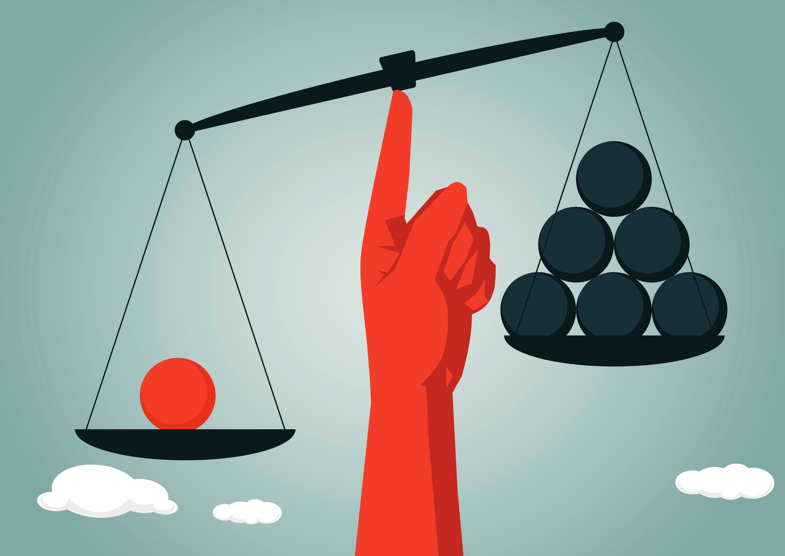
Bias
Prejudice in favor of or against one thing, person, or group compared with another, usually in a way considered to be unfair.

Slide 6
What is the problem with algorithms?
Usually, algorithms are designed for good use.
They seem to be neutral as they follow a set of instructions.
But…. in fact, they are often biased.
Algorithmic bias: Create outcomes based on preference for someone or a group of people over another.
Notes:
Algorithms can spread fake information and can discriminate against people by constructing data sets based on perceived identities and stereotypes.

Slide 7
Bias in algorithms: sources
Sometimes biases in algorithms are unintentional:
When people create algorithms, they cannot consider all the cases that could arise.
AI algorithms learn from data generated from human behaviors and decisions.
When there is not enough data to train the algorithm, it could affect the accuracy of predictions.
Or they can be intentional.

Slide 8
Let’s explore some biases in algorithms
Amazon’s recruiting algorithm was biased against women
The algorithm gave candidates scores
It penalized applications that included the word “women”
The algorithm was not assigning a correct rating to female applicants for technical jobs, such a software engineer positions.
In 2015, Amazon realized the problem and stopped using the algorithm.
Notes:
Amazon wanted to remove human bias present in human recruiters that is why decided to create an algorithm
L. Where the bias come from? It uses historical data. Women did not work in technical jobs in the past so this generates bias. But society change, now more women work in this kind of jobs, however the algorithms do not reflect that change.
Algorithms were trained by observing patterns in resumes submitted to the company over a 10-year period. Most came from men.

Slide 9
Let’s explore some biases in algorithms
Mortgage algorithms
Bias in mortgage algorithms caused 80% of Black applicants to be denied (Forbes, 2021)
Minorities are less like approved for home loans
White people and people from minority groups evaluated different
Banks want to avoid risk (minorities stereotypes: low incomes, difficulty finding jobs)

Slide 10
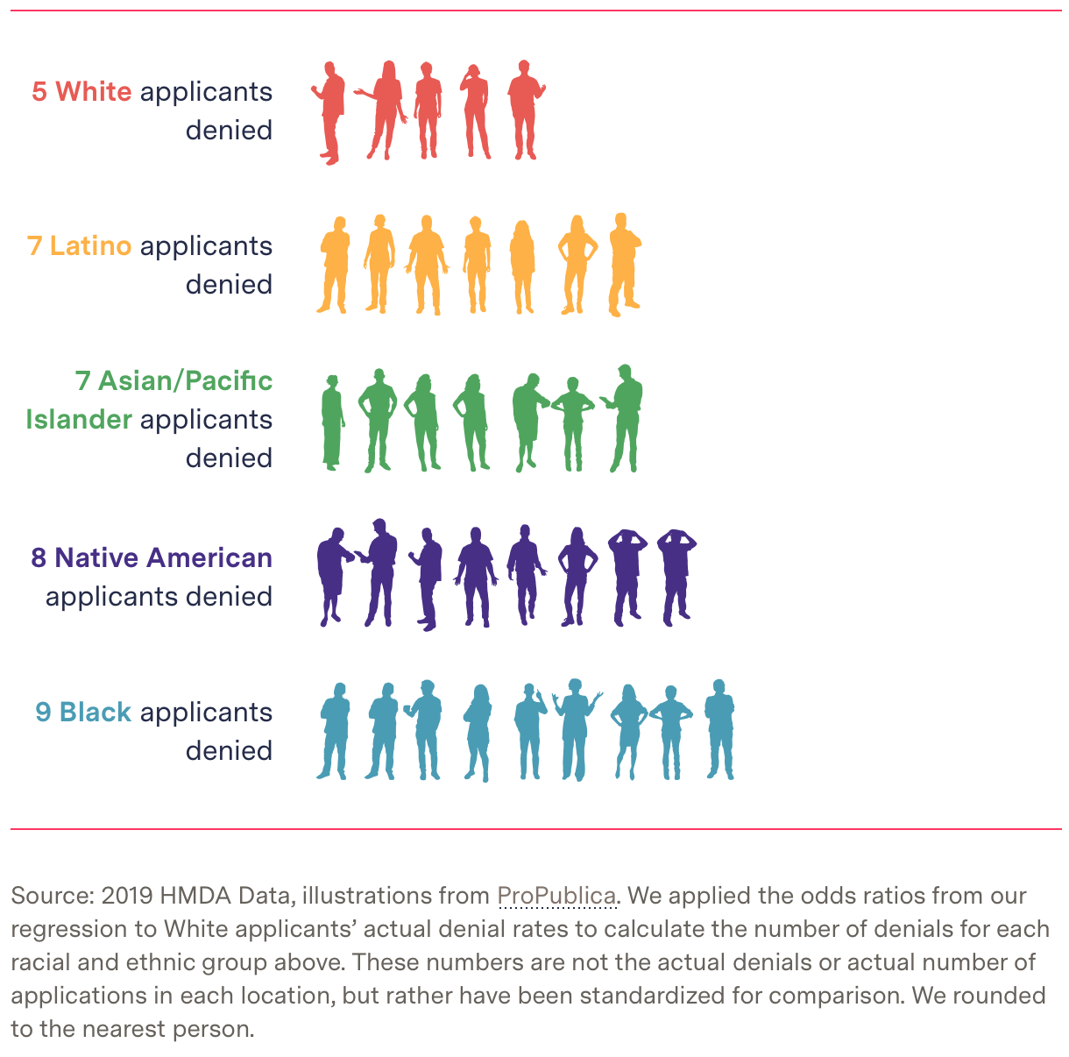
Group of 100 people with the same characteristics: Income Education level Profession Credit score Downpayment
Notes:
In recent years, banks can not use race as an attribute in mortgage applications.
So, how do you think banks can still introduce bias in their algorithms?
Zip code: Depending where they life they can know what race is predominant
Level of education, profession: People from the minorities often do not go to college. Professions that produce lower incomes could be discriminated.

Slide 11
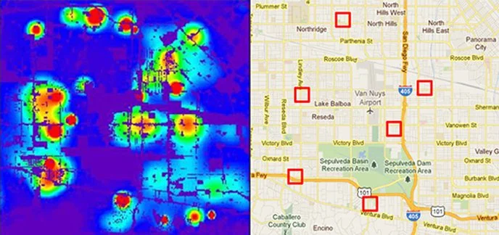
One more example
Predictive policing algorithm: Artificial intelligence algorithms that predict where crimes will occur.
The intention is to reduce human bias in the police department
Police officers are sent to neighborhoods of racial minorities, regardless of the crime in the area.
Algorithms predict crimes where more police reports where made (police concentration, human bias)
Notes:
If more police officers go to neighborhoods of racial minorities of course there are going to be more reports than the neighborhoods where there are not many police officers.
That is why there is bias agains the minorities neighborhoods.

Slide 12
Have you seen any algorithmic bias in the applications you use every day?
Notes:
Facebook: Over the last 5 years, Facebook has faced controversies over the potential for discrimination on its ad platform. Their algorithms can exclude users from certain race or ethnical group to have ads about housing or employment.
Health systems: Say that people from minorities are the ones who get sick more often. But is not true, the reality is that these people does not go to wellness visits as the White people (insurance, time).
Music recomendation algorithms: Gender bias

Slide 13
Python algorithm: Selecting players for my basketball team (starting five)
GitHub repo: https://github.com/jnovillo/cs_lessons -> algorithm_bias
Name | Offensive Rating | Defensive Rating | Overall Rating | Donation
Sophie * | 8 | 9 | 9 | 110
Kate * | 7 | 2 | 4 | 200
Avery | 10 | 9 | 10 | 50
Isabelle * | 2 | 4 | 3 | 500
Kylee * | 3 | 8 | 6 | 300
Emma | 9 | 5 | 5 | 80
Mia * | 5 | 5 | 5 | 300
Valentina | 6 | 10 | 8 | 80
Camila | 7 | 10 | 8 | 100
Olivia | 2 | 4 | 3 | 50
Notes:
Is my algorithm biased?
How can we make it fair?

Slide 14
Practice
1. Modify the function my_top_5 to select the top 5 players based on their overall rating.
2. Create a function select_best_def_off(defensive_players_num, offensive_players_num), the function must receive 2 arguments defensive_players_num, offensive_players_num which are integer that indicates how many defensive and offensive players you want in the team. Your function should sort the data to get the best defensive and offensive players.
Eg:
select_best_def_off(2, 3) This means my team will have the 2 best defensive players and the 3 best offensive_players from my list of players
Note: Make sure you do not have duplicate names in your team
and your team has 5 players

Slide 15
Please complete your exit slip
Thank you!!!

