Slide 1
ExG DSP/Classifier Generator in Chisel
Adelson Chua, Justin Doong, Ryan Kaveh, Cem Yalcin, and Rachel Zoll
EE 290C Fall 2018

Slide 2
Wellness Monitor - Motivation
Software tools/libraries exist for everything:
EEGLAB in Matlab
Biomedical Genomics Library, WFDB in Python
An expressive, type generic hardware generator can be easily integrated into an automated design exploration
Block architectures (e.g., classifiers) can be switched out to perform holistic benchmarks
Labeled Data
Feature Reduction
&
Accuracy Checking
Hardware Generator
Simulation,
Synthesis,
Benchmarking
GDS II
High Level Parameters
MATLAB/Python
Scala + CHISEL
Scala + CHISEL +
FIRRTL
HAMMER / DC + ICC
Notes:
Justin

Slide 3
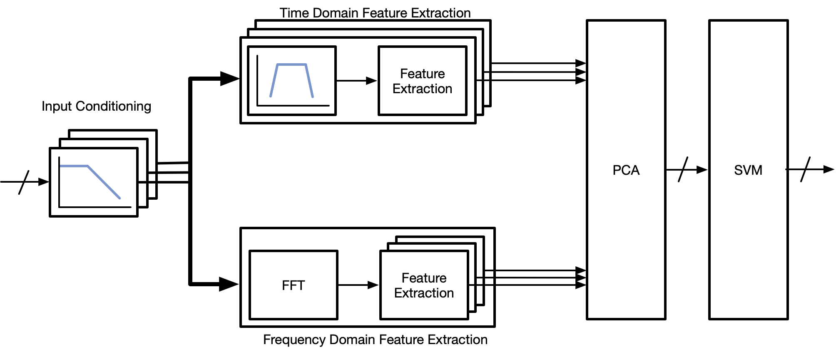
Wellness Monitor - Overview
Ingest different data streams (EEG, ECG, EMG, etc.)
Extract pertinent features
Classify
Neurological states (e.g., seizure detection, sleep)
Bandpower, line length, etc...
Cardiac states (e.g., arrhythmias, bradycardia)
DWT, peak variability, etc...
General health states (e.g., auscultatory sensing of blood clots)
Peak variability, threshold detection, etc...
Notes:
Justin
TODO:
(done) Swap EEG and ECG to be consistent with classification bullet points
Add ECG path to high-level block diagram (this and next slide)

Slide 4
Wellness Monitor - Overview
There can be multiple input channels
Two types of feature extraction:
Time Domain
Frequency Domain
Every feature has a datapath associated with it
Each datapath consists of blocks with similar I/O structures
Notes:
Justin

Slide 5
Module Generators Overview
The following generators were implemented as building blocks:
FIR / IIR filter
Bandpower Extractor
Line Length Extractor
Principal Component Analysis (PCA)
Offline eigendecomposition, online dimensionality reduction
Support Vector Machine (SVM)
Offline training, online classification
Some other supplementary modules (memories, stream-to-parallel converters…)
FFT generator was imported from ucb-art repo
Notes:
Rachel

Slide 6
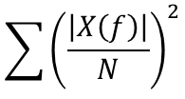
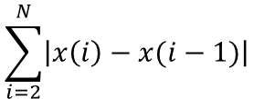
Feature Extractors: Bandpower & Line Length
Bandpower: finds average power in a frequency range
Calculates the following sum, frequency components acquired from FFT block
Configurable frequency bands and number of bins
Line Length: integral of the derivative within a time window
Calculates the following sum
Configurable window size
Notes:
Rachel

Slide 7
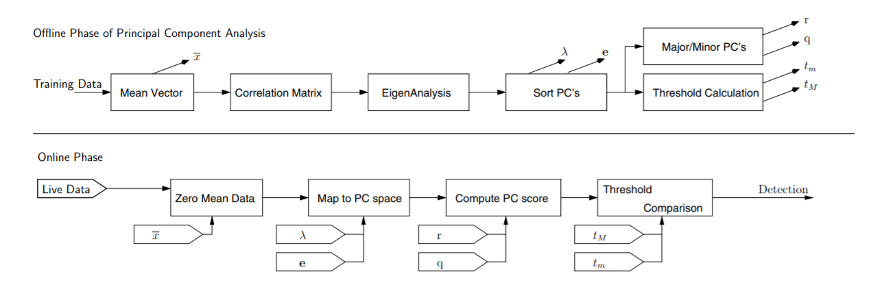
Principal Component Analysis (PCA)
Reduce dimensionality of feature space to minimize classifier complexity
New set of dimensions will be a linear combination of the original features
Transformation matrix is acquired from offline training
Dot product for dimensionality reduction done in hardware
Configurable number of features and output dimensions
Offline
Online
Das, 2008.
Notes:
Adel
Convert a set of observations of possibly correlated variables into a set of values of linearly uncorrelated variables (linearly dependent observations -> linearly independent observations)
TODO:
(done) show a PCA cluster plot
Blow up the block diagram; color code with labels/textboxes
Highlighter point to things we’re doing within the block diagram
Reduce bullet points; other than the first

Slide 8
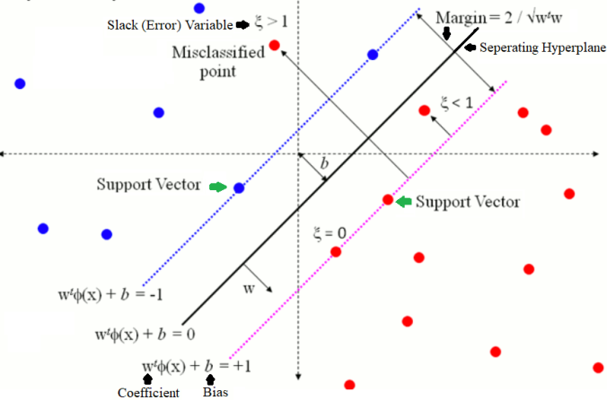
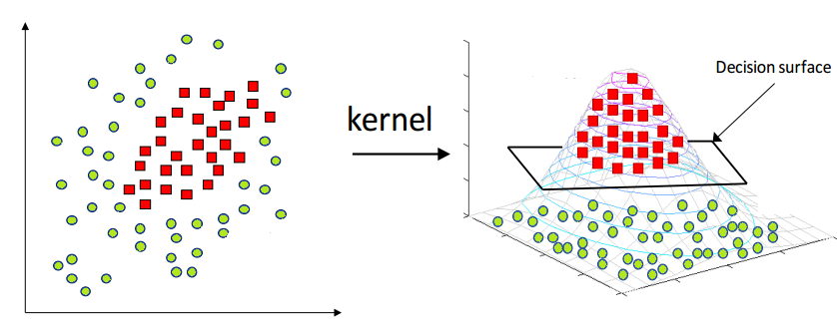
Support Vector Machine (SVM)
Divides positive and negative classes through a separating hyperplane
Support vectors are the points (actual data from training) that define the hyperplane
Can also use ‘kernel trick’ which transforms the data projection into higher dimensional space to curve the separating hyperplane in lower dimensional space
Feature z
Feature 2
Feature x
Feature y
Feature 1
Notes:
Adel

Slide 9

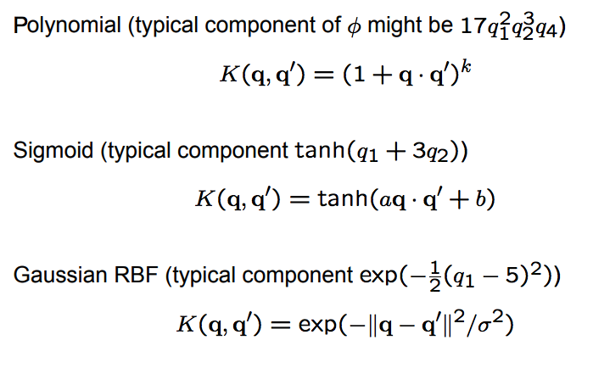
SVM Classifier
Classification is computed using the formula:
Alpha term is the support vector weights
y(i) is the support vector class (1 or -1)
x(i) is the support vector features, x is the input feature set
b is the intercept
K(x(i),x) is kernel / the similarity function between the support vector and input
Some common kernels:
The sign of the resulting answer decides which class the new point belongs to
Polynomial
Gaussian radial basis function (RBF)
More info: https://github.com/ucberkeley-ee290c/fa18-wellness-monitor/blob/master/doc/svm_tutorial.md
Notes:
Adel
SVM fully combinational - not optimized or time-multiplexed
Not benchmarkable until we implement an accelerator

Slide 10
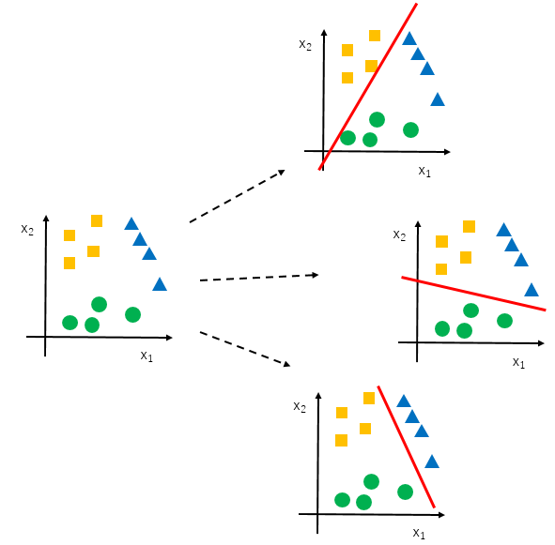
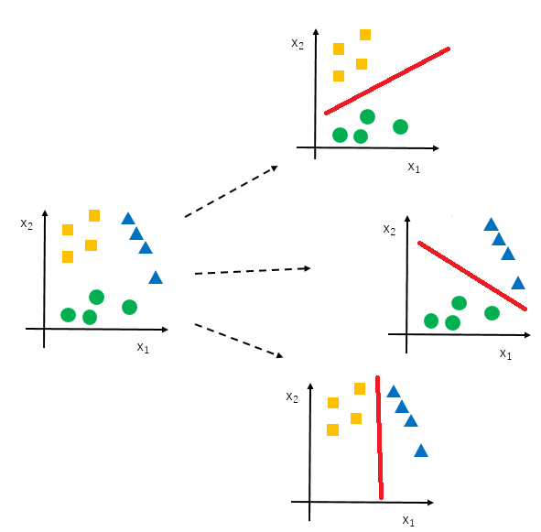
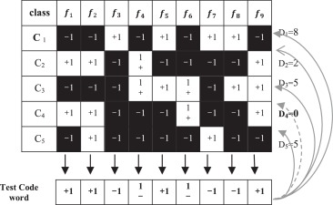
SVM Classifier
Classification can also be extended to multiple classes
Involves creating more than one classifier which vote for the final class
One vs Rest classification:
One vs One classification:
Error-Correcting Output Codes
n classes, n classifiers
n classes, nC2 classifiers
n classes, m classifiers, m>n
Hamming distance for classification
More info: https://github.com/ucberkeley-ee290c/fa18-wellness-monitor/blob/master/doc/svm_tutorial.md
Notes:
Adel

Slide 11
Wellness Generator Overview
Takes specific features and generates a wellness monitor in hardware
Currently the generator:
Creates collection of desired features
Decide on the “datapath” that computes the feature
Organizes datapaths in human readable data-structure
Generates modules
Automatically wires everything and connects monitor to a RISC-V core
FIR
FFT
Delta Bandpower
PCA
SVM
FIR
FFT
Alpha Bandpower
ADC
FIR
Autocorrelation
FIR
Line Length
Rocket
Notes:
Ryan

Slide 12
Wellness Generator Next Steps
Generator should not duplicate blocks - it should reuse them
Organize datapaths into a tree structure to reuse blocks
Generate the modules (as nodes in tree)
Connect the nodes
Finish ‘wrapper’ app that parses user input
Integrate into automated design flow
FIR
FFT
Delta Bandpower
FIR
FFT
Alpha Bandpower
FIR
Autocorrelation
FIR
Line Length
Delta Bandpower
FFT
Alpha Bandpower
Ch0
FIR
Autocorrelation
Line Length
Notes:
Ryan
Future project for MEng students / side project for grad students?:
Add additional features to hardware library
Architectural design with an accelerator optimization
Classifier / neural net
Continue as part of Rikky’s class project next semester (EE290P)

Slide 13
Testing
Two main golden models:
ScalaTest
Python
ScalaTest:
Unit tests
Generatable integration test
Python
Functionally equivalent python model for a specific design
Used to confirm seizure detector could actually detect seizures
Notes:
Cem

Slide 14
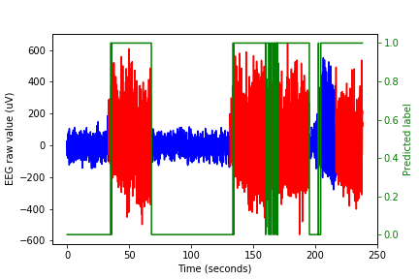
Application-Specific Training-Testing Setup
Test framework for application-specific testing from raw data
Starts from SVM training to C tests in a simulated RISC-V environment
Python script creates SVM model given the data, writes out all configuration matrices and input vectors to CSV files
Scala tester reads CSV to get parameters, uses it to test Chisel datapath, writes out a C header file (.h) containing config matrices and I/O vectors
Header file is used by the C program to test the accelerator connected to the RISC-V core
* All generator parameters are set in the Python script, no need to change parameters in the Scala or C code
Trying out the framework on seizure data
Seizure
No seizure
Notes:
Cem

Slide 15
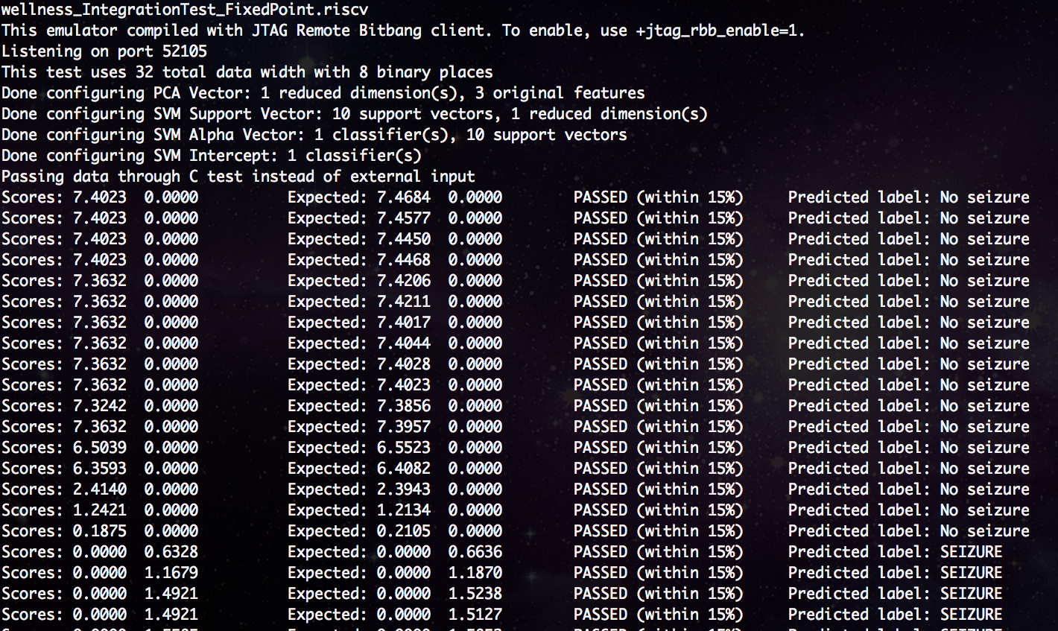
Sample Execution (Seizure Detection)
No seizure
Seizure
Chisel HW Output
Golden Tester Output
Notes:
Cim

Slide 16
Conclusion and Next Steps
Flexible and scalable wellness monitor generator implemented in Chisel
Seizure detector functionality confirmed through comparisons with Python model
Block optimizations/modularity (SVM and PCA)
Optimize datapath generation
Include new health feature extractors
GUI for painless design space exploration
Notes:
Cem/Ryan

Slide 17
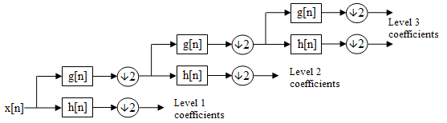
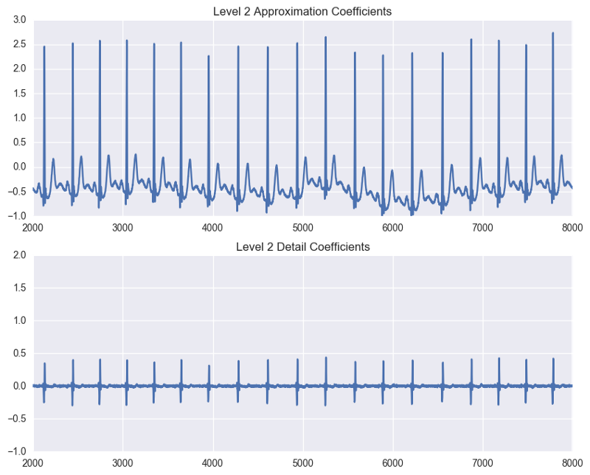
DWT Generator
Capture both frequency and temporal information about the signal
Pass signal through lowpass & highpass filters
Downsample
Configurable number of levels, filter coefficients and length
Feature Extractor:
DWT used to detect QRS waveform
Tachycardia, bradycardia
https://medium.com/@andrewtan_36013/electrocardiograms-qrs-detection-using-wavelet-analysis-a1070505efee
Notes:
Rachel
Decomposes the signal into several levels of coefficients which correspond to various scale sizes. Each level has a pair of approximation and detail coefficients.

