Slide 1

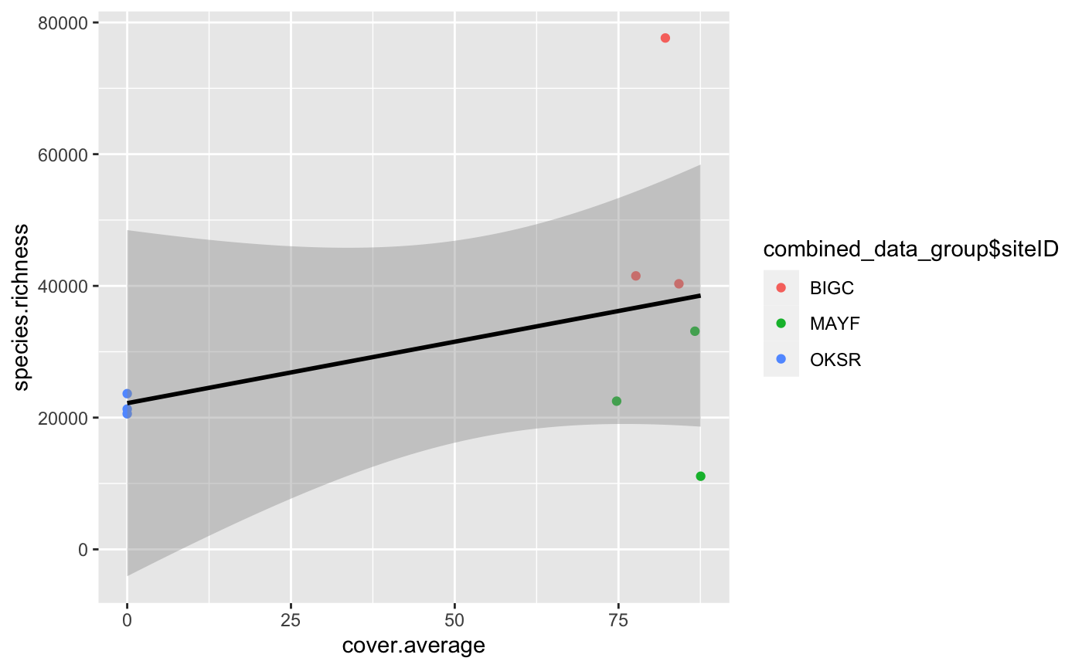
Riparian Buffer Percent Coverage Effect On Aquatic Macroinvertebrates Richness
Chelsey Burks, Jonathan Ray, Callie Wallace
Site 1
Site 2
Site 3
Introduction/Background
Figure 1
Results
Discussion
Research Question & Hypothesis/Prediction
Figure 1
Methods
Next Steps/Future Directions
References & Acknowledgements

