Slide 1
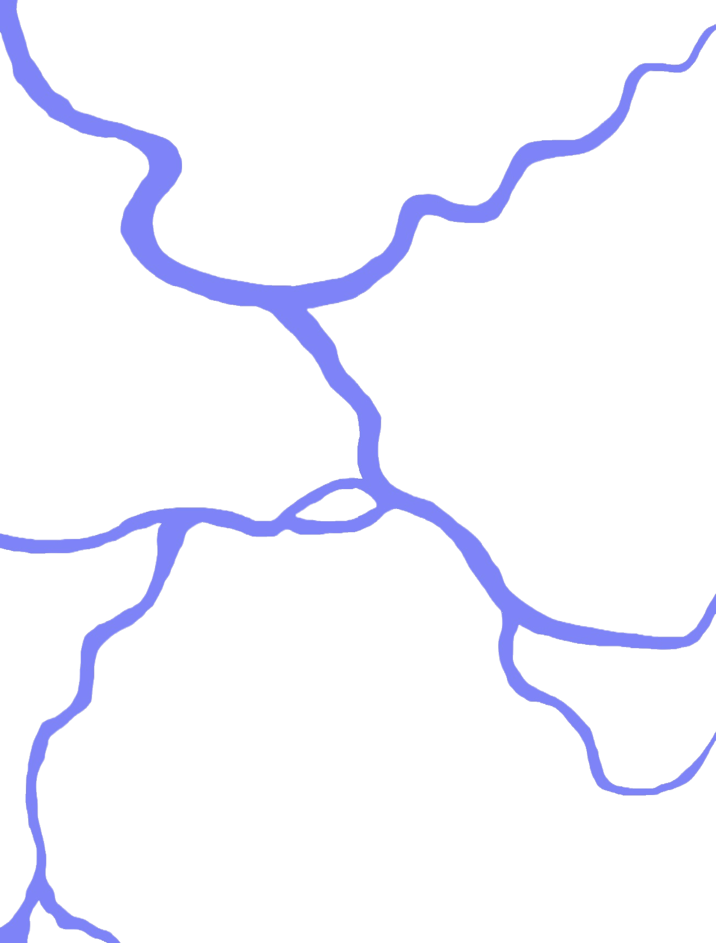

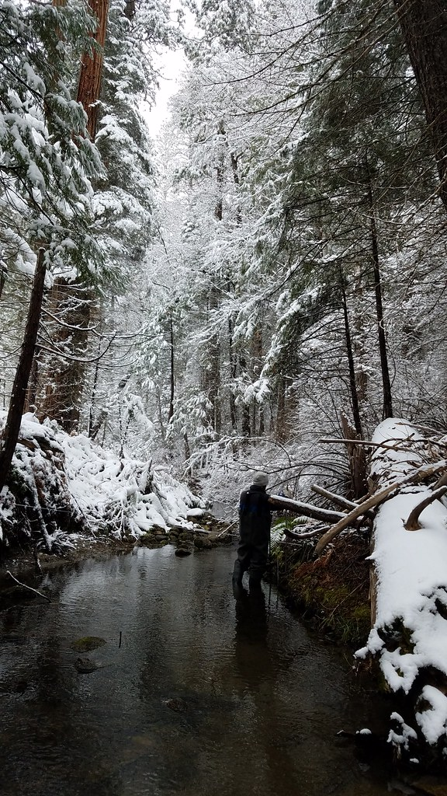
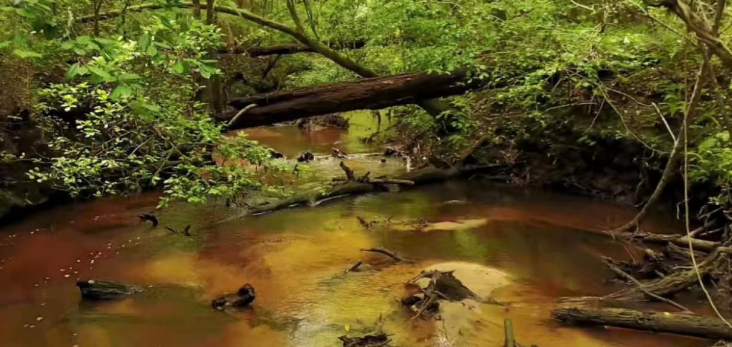
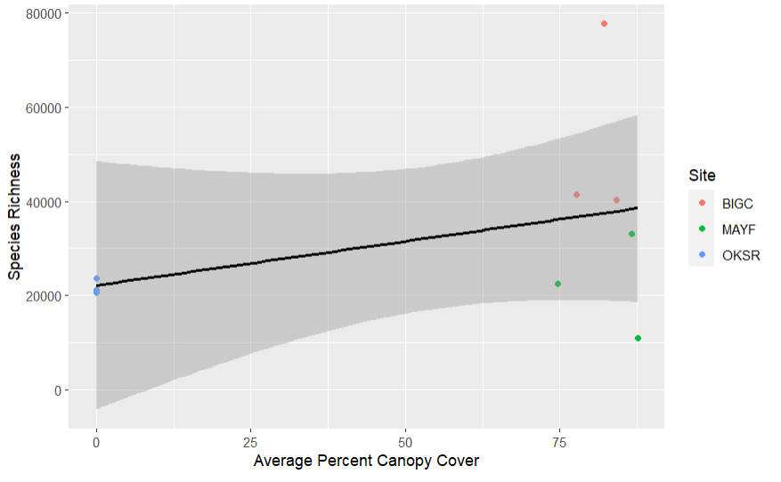
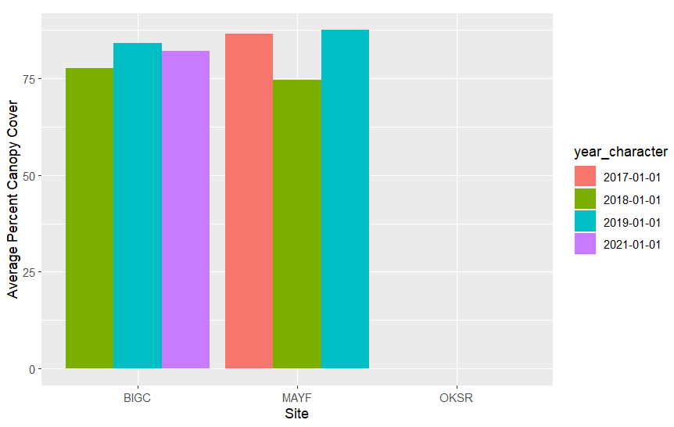
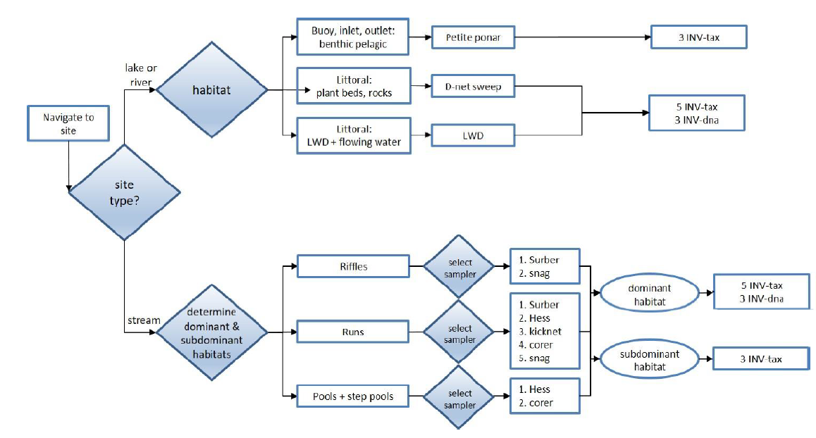
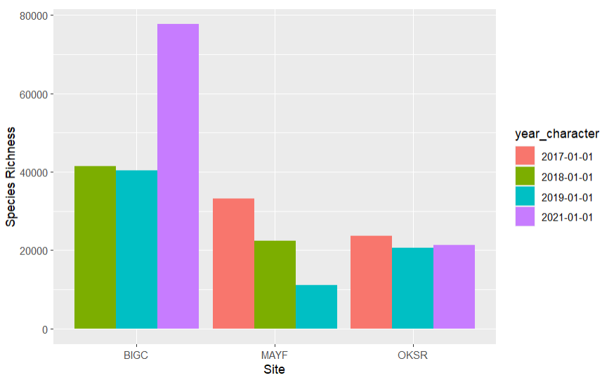


Riparian Buffer Percent Coverage Effect On Aquatic Macroinvertebrates Richness
Chelsey Burks, Jonathan Ray, Callie Wallace
Site Name: Upper Big Creek, California
Oksrukuyik Creek, Alaska
Mayfield Creek, Alabama
Location:
Central California in the Sierra National Forest
Wadeable stream in the Sierra Nevada Mountains
Climate:
Mediterranean with warm, dry summers and mild/moderate wet winters
Soil Composition:
Low horizonation, clay content, and weak structure
Primary Vegetation:
Mixture of mature cottonwood trees, short grasses, and shrubs
Hydrology:
Flow regime is typical of snow melt dominated mountainous streams
Location:
Talladega National Forest in west-central Alabama
Climate:
Subtropical climate; hot, humid temperatures
Year-round precipitation
Soil Composition:
Sandy banks with clay and mudstone soil surrounding
Primary Vegetation:
Surrounded by dense forest
Shrubs, grasses, and various tree species.
Hydrology:
A diverse stream with many turns, straights, and pools which is suitable for various fishes and macroinvertebrates
Introduction/Background
Figures
Figure 1: This visualization shows a comparison of species richness (y-axis) and canopy coverage (x-axis). The three sites shown, in differing colors, compare the coverage and the species richness by year. The pattern shows that those sites with more canopy cover have a higher richness in aquatic macro-invertebrates ($R^{2}=0.15, t=1.13, p=0.3$).
Results
No correlation was found between riparian cover and species richness of aquatic macroinvertebrates ($R^{2}=0.15, t=1.13, p=0.3$)
Average canopy cover was fairly consistent across all years at each site (Figure 2)
Species richness varied widely in Mayfield Creek and Upper Big Creek, but were fairly consistent in Oksrukuyik Creek (Figure 3)
Discussion
There may be a potential relationship between riparian cover and aquatic macroinvertebrate communities that our test could not capture with only nine data points
Sites varied in altitude and latitude which drastically impacted average temperature. Temperature is a limiting factor for insect diversity.
Our study only examined relationships between riparian cover and macroinvertebrates in unimpaired streams to establish a baseline relationship
Research Question & Hypothesis/Prediction
Figure 2: A bar graph of average canopy cover (y-axis) grouped by site (x-axis) and year (bar color). Higher bars represent large amounts of average canopy cover where the Alaska site (OKSR) had very little to no tree cover. Not all sites had a 2017 or a 2021 recording, but all three sites had similar average percent canopy cover across all three years.
Figure 3: On the x-axis of this figure, three sites are labeled and colored by year, and the y-axis is aquatic macroinvertebrate richness. Each color signifies the year the data was collected. The pattern shows that in Upper Big Creek (BIGC) there was an increase in richness, Mayfield Creek had a decrease in richness, and Oksrukuyik Creek had no change in richness.
Methods
Data Collection:
NEON data portal collected data of aquatic macroinvertebrate richness and canopy coverage percentage from all three sites
Collected using remote sensing, meteorological measurements, and phenocameras
Data Analysis:
Used Rstudio to create linear regression statistical analysis
Bar Chart: Compared species richness (dependent variable) across the three sites canopy coverage percentage (independent variable)
Next Steps/Future Directions
More Data
In the future, more NEON data will be available to strengthen the test results
Geography
Future studies, researchers should use sites in close proximity to decrease confounding variables
Varying Stream Type
Future studies should compare unimpaired and impaired stream vegetation and community composition to inform policy makers
Study Design:
Collected data from three sites: Upper Big Creek, California; Mayfield Creek, Alabama; Oksrukuyik Creek, Alaska
Data was collected from summer months of (July-August) between 2017-2019
Upper Big Creek: Urbanized
Mayfield Creek: Agricultural
Oksrukuyia Creek: Rural
References & Acknowledgements

