Slide 1

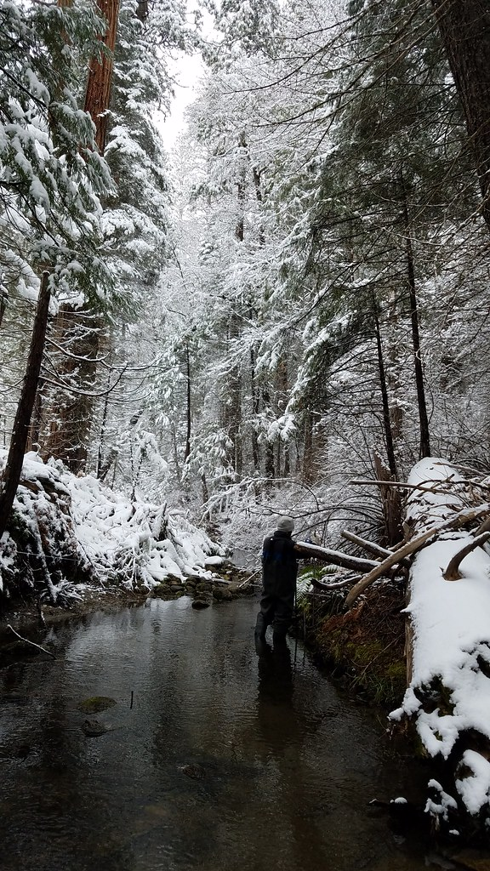
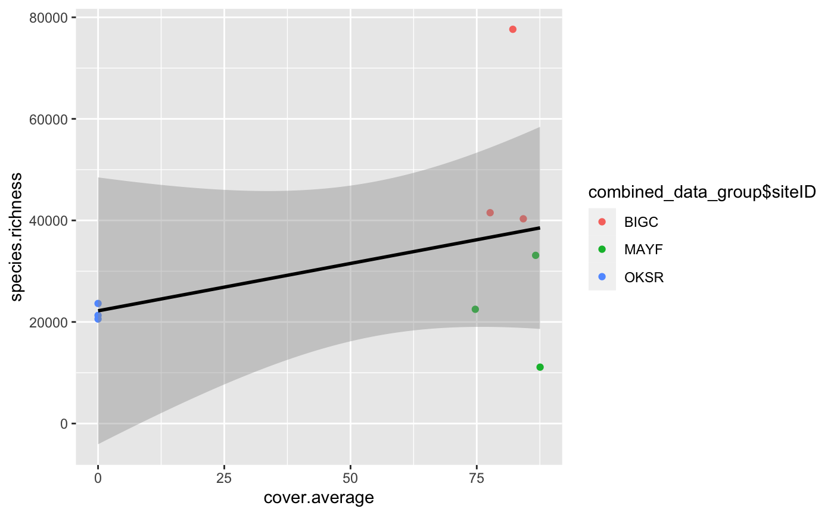
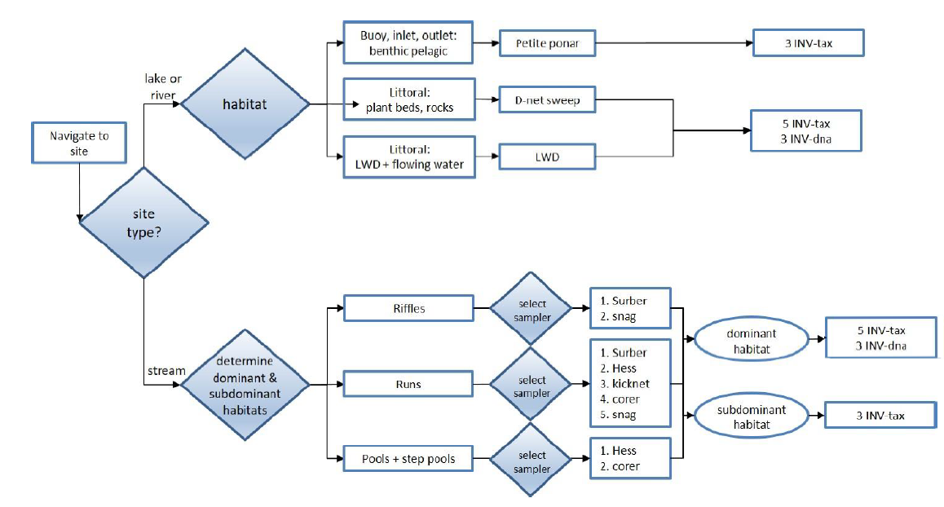
Riparian Buffer Percent Coverage Effect On Aquatic Macroinvertebrates Richness
Chelsey Burks, Jonathan Ray, Callie Wallace
Site Name: Upper Big Creek, California
Site 2: Mayfield Creek, Alabama
hi
Site 3: Oksrukuyik Creek
Location:
Central California in the Sierra National Forest
Wadeable stream in the Sierra Nevada Mountains
Climate:
Mediterranean with warm, dry summers and mild/moderate wet winters
Soil Composition:
Low horizonation, clay content, and weak structure
Primary Vegetation:
Mixture of mature cottonwood trees, short grasses, and shrubs
Hydrology:
Flow regime is typical of snow melt dominated mountainous streams
Introduction/Background
Figure 1
Results
Discussion
Research Question & Hypothesis/Prediction
Figure 1
Methods
Data Collection:
NEON data portal collected data of aquatic macroinvertebrate richness and canopy coverage percentage from all three sites
Collected using remote sensing, meteorological measurements, and phenocameras
Data Analysis:
Used Rstudio to create linear regression statistical analysis
Bar Chart: Compared species richness (dependent variable) across the three sites canopy coverage percentage (independent variable)
Study Design:
Collected data from three sites: Upper Big Creek, California; Mayfield Creek, Alabama; Oksrukuyik Creek, Alaska
Data was collected from summer months of (July-August) between 2017-2019
Upper Big Creek: Urbanized
Mayfield Creek: Agricultural
Oksrukuyia Creek: Rural
Next Steps/Future Directions
References & Acknowledgements

