Slide 1

Health Visitor und soziale Phobie
Task 2: Domain Model and Sequence Diagram
S. Gfeller, O. Jemal, P. Kyburz, J. Meier, M. Petitat, M. Ziegler
BFH | Medizininformatik | Software engineering & design

Slide 2
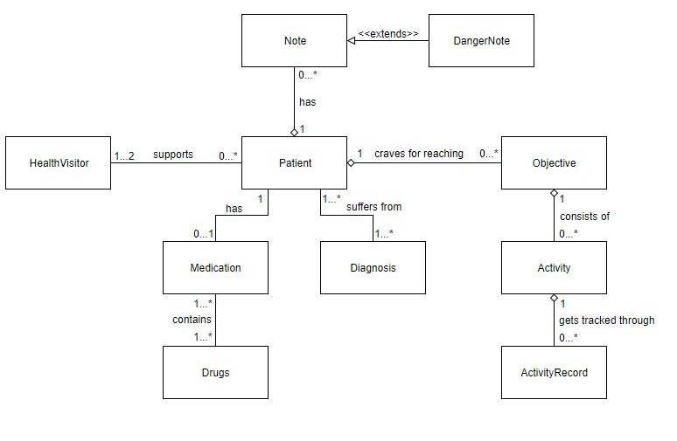
Domain Model

Slide 3
CRC Card - ActivityRecord
Class Name: ActivityRecord
Purpose: Represent an overview of the activity record
Responsibilities: shows the date of the exposition training the description of the activity record for the exposition training can be described detailed can add image documents of the exposition training the progress of the expositions training of this day can be adjusted manually shows the progress of the exposition training of this day | Collaborators: the class activity takes the date of the activity record and its progress

Slide 4
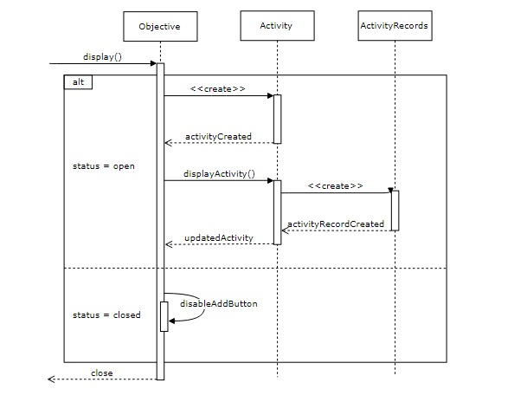
Sequence Diagram – Add ActivityRecord

Slide 5
CRC Card - DangerNote
Class Name: DangerNote
Purpose: A particular note containing text data to describe a dangerous fact related to a patient.
Responsibilities: contains a title (title), text (text) which is attached to specific patient (patientId). indicates a fact about / correlated to a patient which is or could be dangerous | Collaborators: belongs to a patient extends a normal note

Slide 6
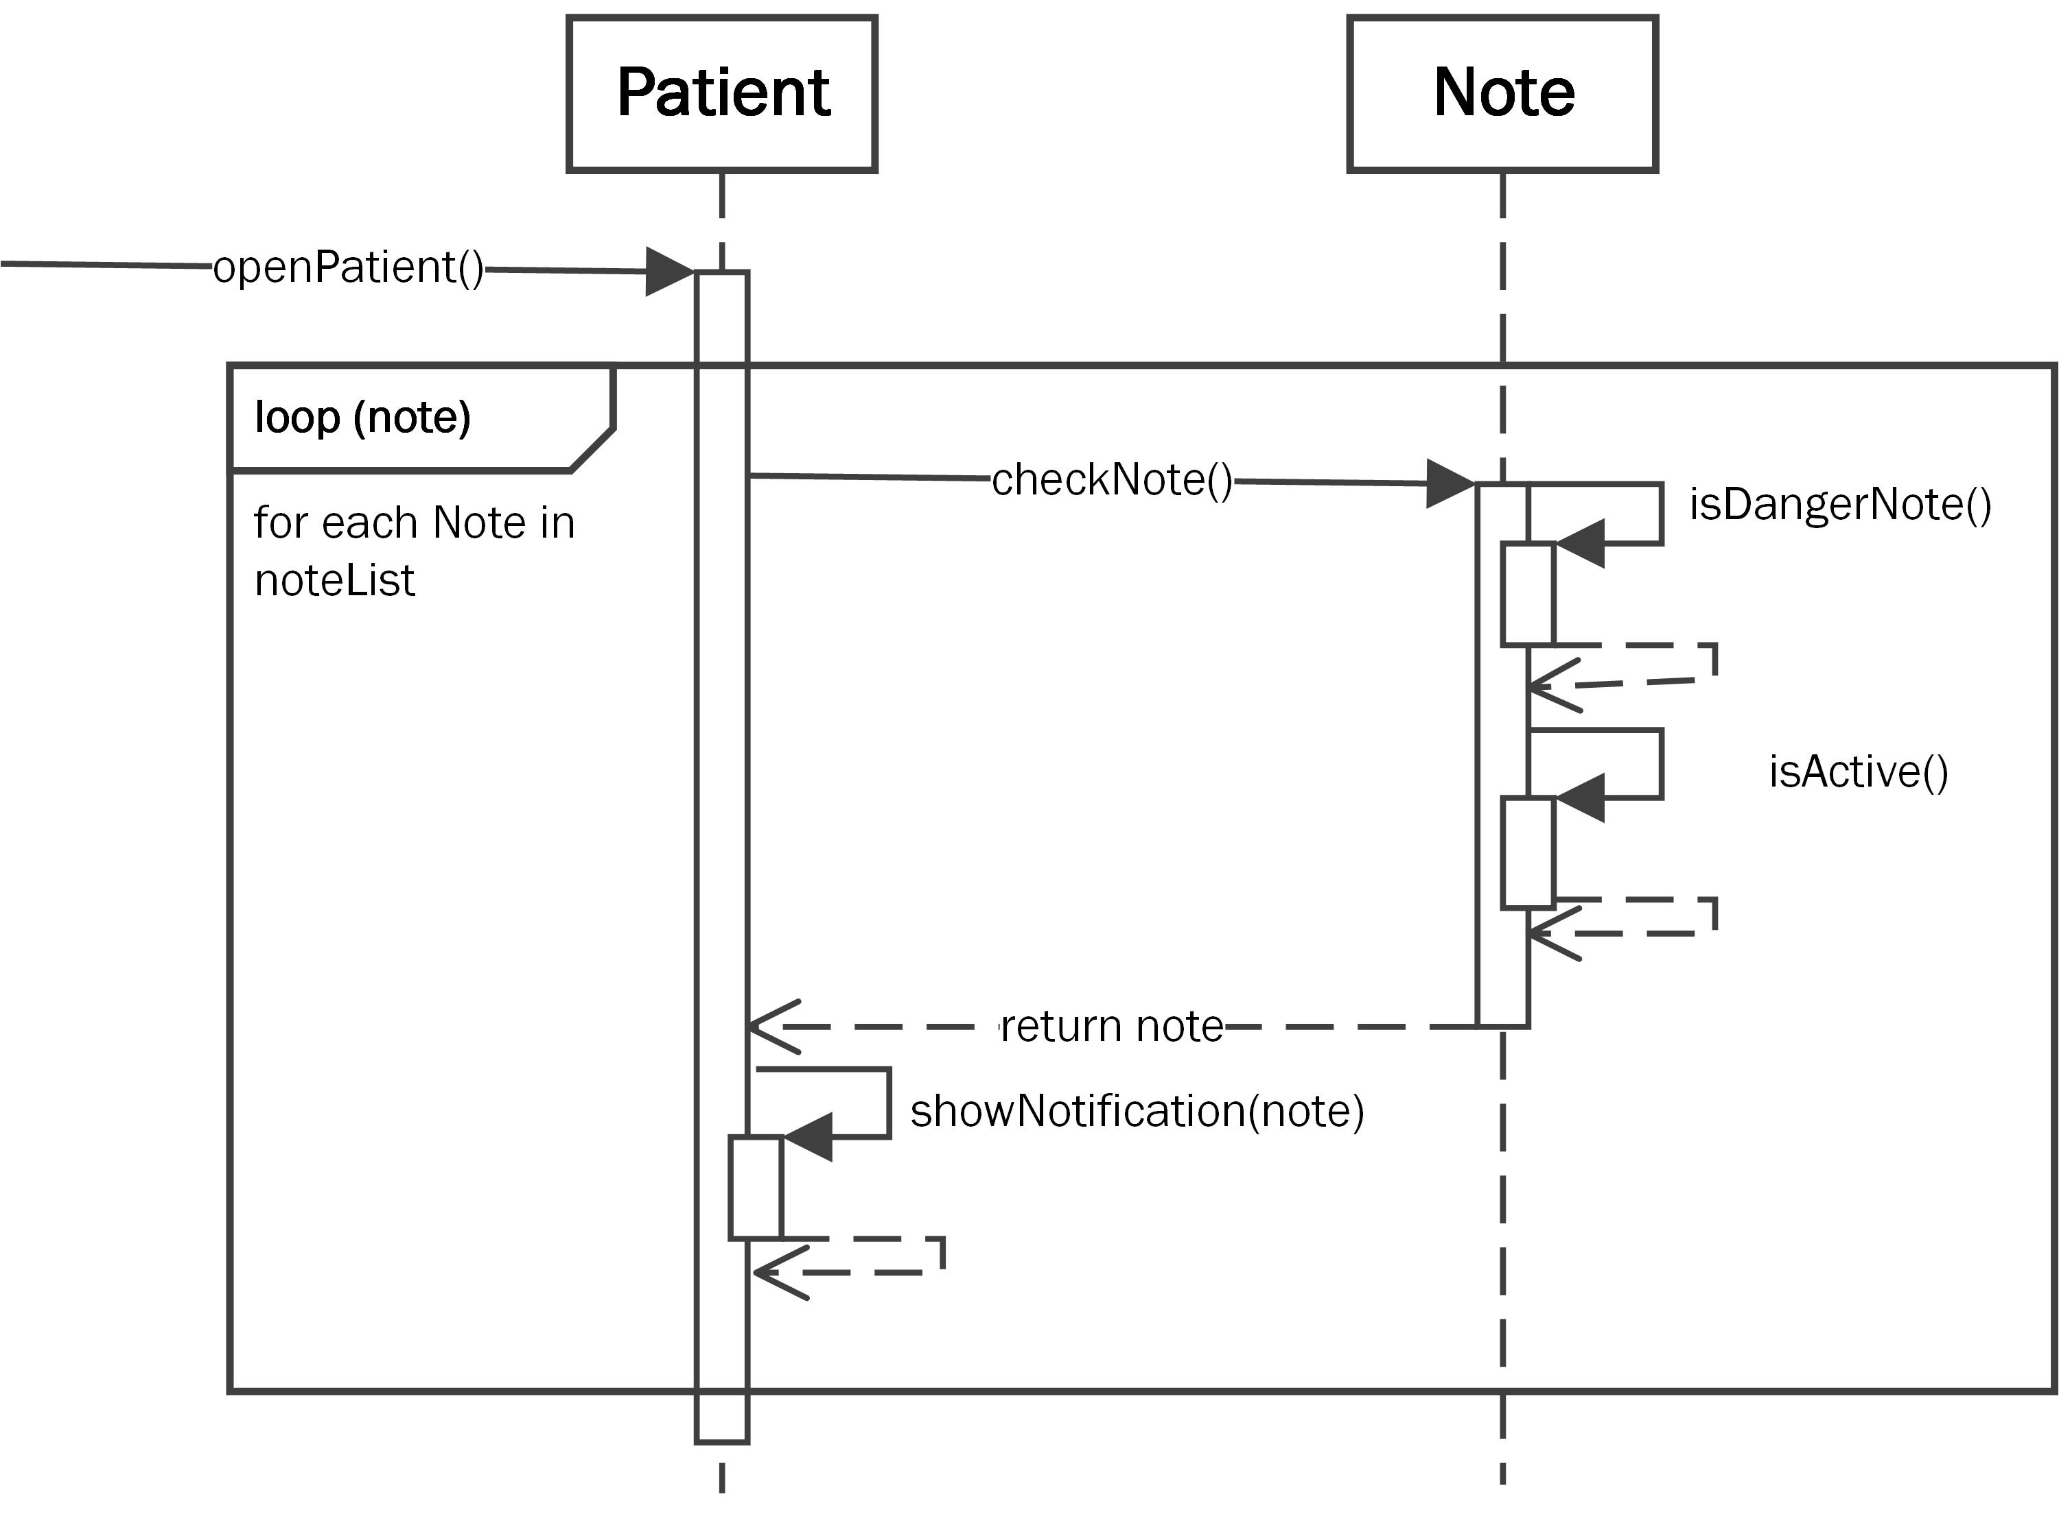
Sequence Diagram – Alert Danger Notes

Slide 7
Fazit
Zeitmanagement verbessern
Haben nun mehr Klarheit, wo wir hinwollen

Slide 8
Fragen / Anmerkungen?

