Slide 1

Health Visitor und soziale Phobie
Task 2: Domain Model and Sequence Diagram
S. Gfeller, O. Jemal, P. Kyburz, J. Meier, M. Petitat, M. Ziegler
BFH | Medizininformatik | Software engineering & design

Slide 2
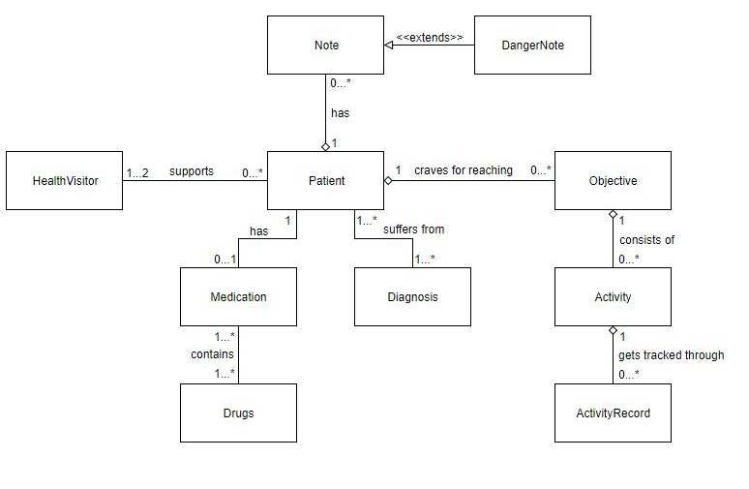
Domain Model

Slide 3
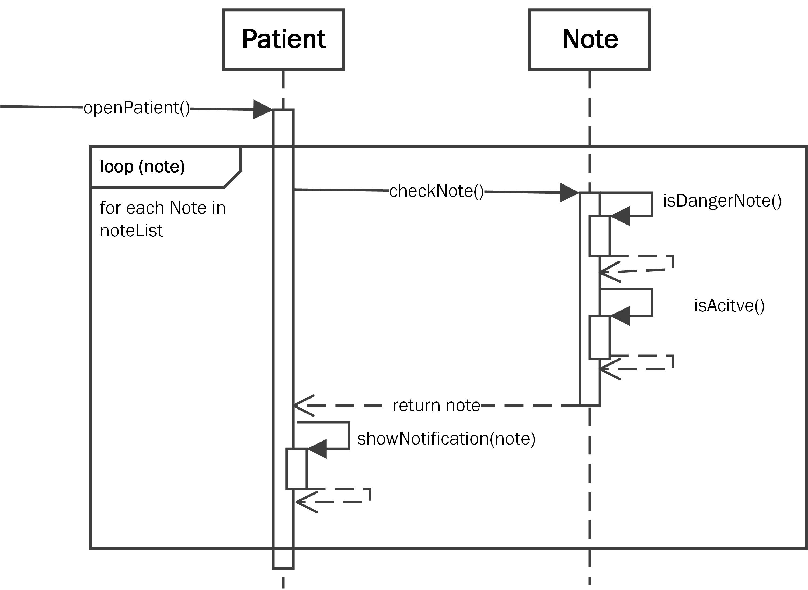
Sequence Diagram – Alert Danger Notes

Slide 4
Sequence Diagram – Add ActivityRecord

Slide 5
CRC Card - DangerNote
Class Name: DangerNote
Purpose: A particular note containing text data to describe a dangerous fact related to a patient.
Responsibilities: - Contains a title (title), text (text) which is attached to specific patient (patientId). - Indicates a fact about / correlated to a patient which is or could be dangerous | Collaborators: - belongs to a patient - extends a normal note

Slide 6
CRC Card
Class Name:
Purpose:
Responsibilities: | Collaborators:

