Slide 1

Health Visitor und soziale Phobie
Task 2: Domain Model and Sequence Diagram
S. Gfeller, O. Jemal, P. Kyburz, J. Meier, M. Petitat, M. Ziegler
BFH | Medizininformatik | Software engineering & design

Slide 2
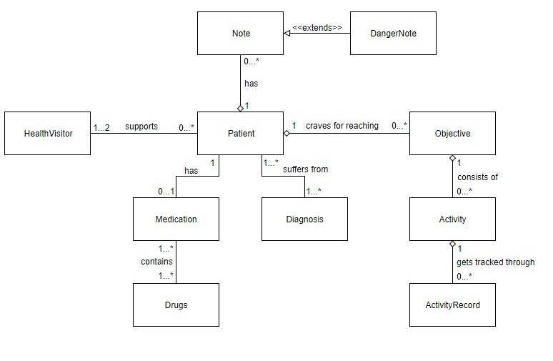
Domain Model

Slide 3
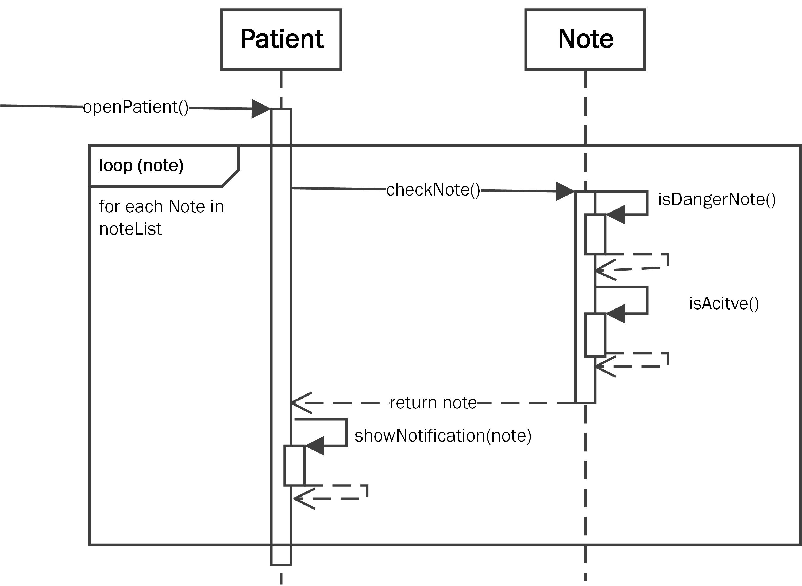
Sequence Diagram – Alert Danger Notes

Slide 4
Sequence Diagram – Add ActivityRecord

Slide 5
CRC Card
Class Name:
Purpose:
Responsibilities: | Collaborators:

Slide 6
CRC Card
Class Name:
Purpose:
Responsibilities: | Collaborators:

