Slide 1
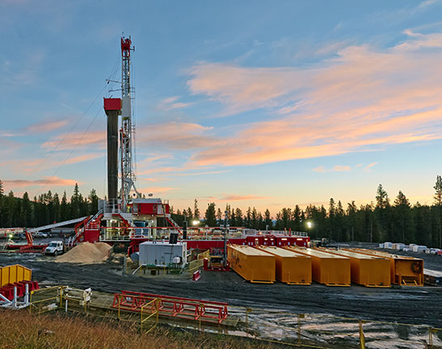
Applied Analytics on Surface Drilling and Geomechanical Data
Ngoc Tran, Deepankar Dangwal
Final Project DSA 5103
December 11th 2019

Slide 2
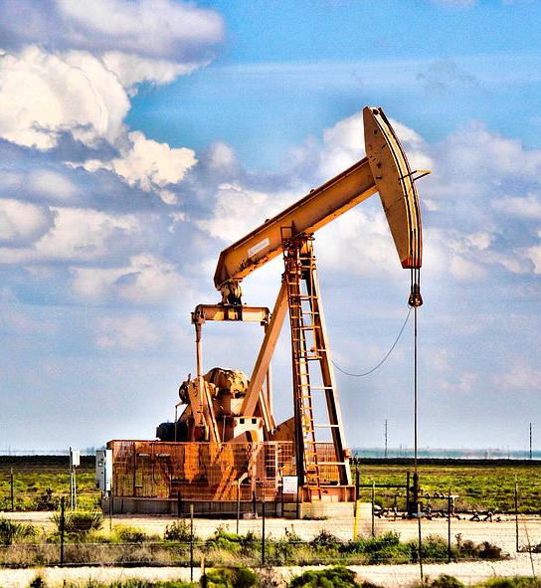
Overview
Introduction to the Problem
Data Description
Data Understanding
Modeling Approach
Results and Discussions
Conclusion

Slide 3

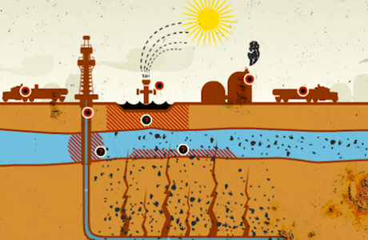
Introduction to the Problems
Can we use Drilling measurements (MWD data) to interpret “fracking” ability from rock?
More than 14000 horizontal wells fracked in targeted shale plays
However, a few shale plays have multiple target zone.
Real-time logging applications: remain in-zone or steer towards a target
Knowledge of petrophysical/ rock geomechanical properties surrounding drilling bit
Conventional logging (LWD) -> information with considerable addition costs
Machine Learning Techniques to predict geomechanical properties by using MWD data

Slide 4
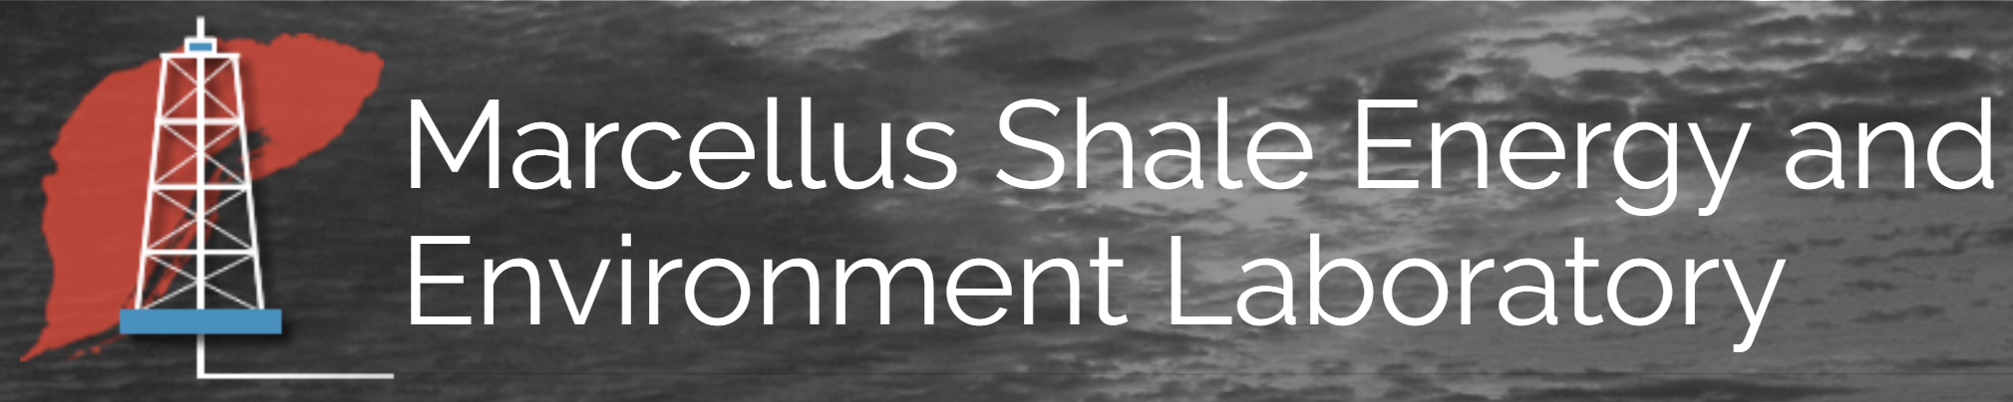
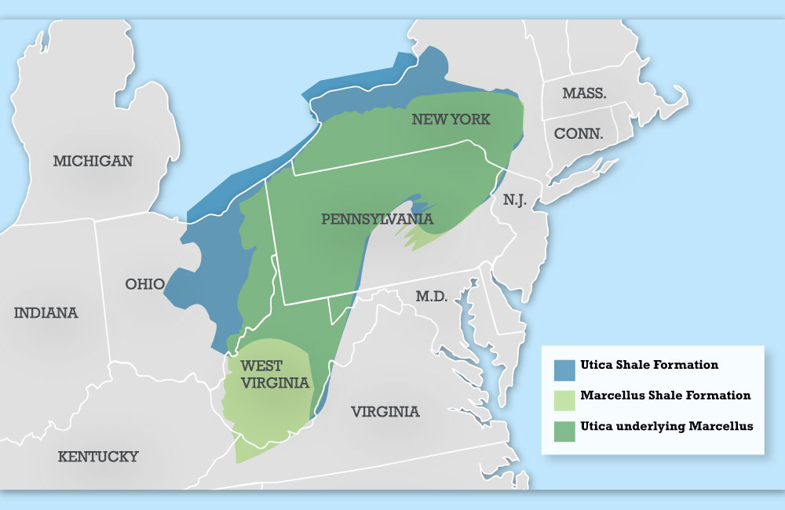
Data Acquisition
Dataset released by Marcellus Shale Energy and Environment Laboratory and taken from Marcellus Shale Fields, West Virginia
LWD and MWD logs from horizontal wells
LWD Log: Gamma Ray (GR), Young’s Modulus (YME), Poisson’s ratio (PR), Rock Density log (RHOB), Neutron Porosity (NPHI), Sonic slowness (DTCO)
MWD Log: contains 26 attributes - surface rotations per minute (RPM), weight on bit (WOB), Torque, rate of penetration (ROP), Downhole Pressure, Mud Pump Flow Rate, Mechanic Specific Energy , etc.
(Marcellus Shale Fields)

Slide 5
Modeling Schematic
Log Data – Sonic (DTCO), Gamma Ray (GR), Young Modulus (YME), Poisson ratio (PR), MWD
Exploratory Data Analysis (EDA)
Missingness
Feature Engineering – Brittleness Index variable
Identify Brittleness/Frackability Clusters on YME, PR, Brittleness Index
K-means and SOM
Identify Brittleness/Frackability significance
Predict Brittleness/Frackability clusters using MWD
Sample split data into Train/ Test sets (65-35%), Centering and Scaling
K Nearest Neighbors , Gradient Boosted Random Forest, Multi Layer Perceptron

Slide 6
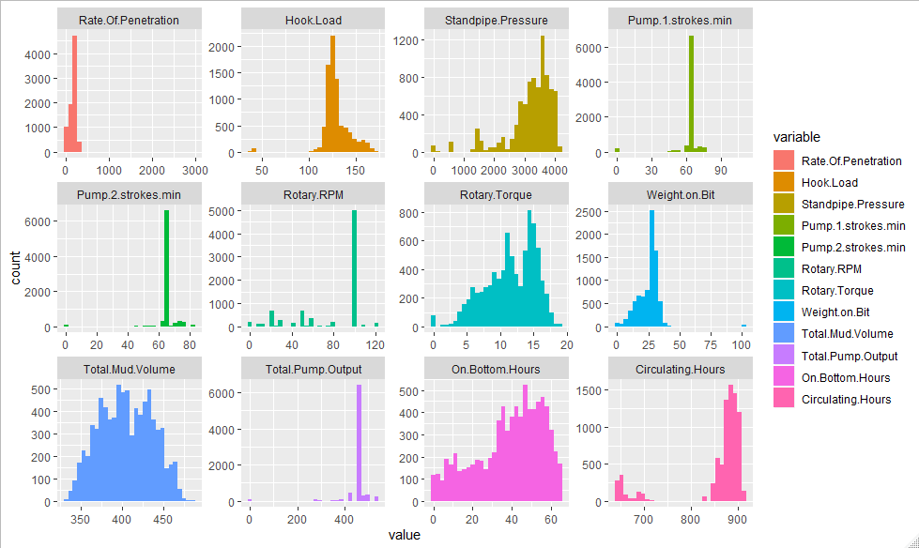
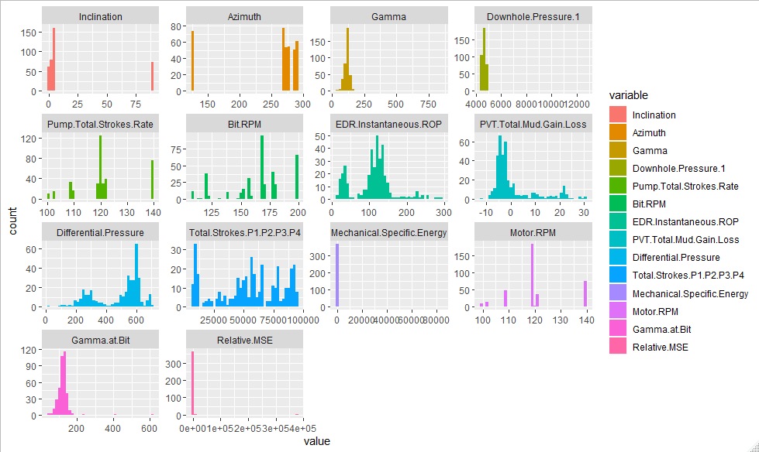
EDA- Data Visualization for Drilling Data (Histogram)
Total mud Volume is normally distributed
Rate of Penetration, Hook Load, Standpipe Pressure, Rotary Torque, Weight on Bit, On Bottom Hours, and PVT Total Mud Gain/Loss, Gamma at Bit show the highly left/ right skewness
District distributions of Rotary RPM, Pump Total Strokes rate, Motor RPM

Slide 7
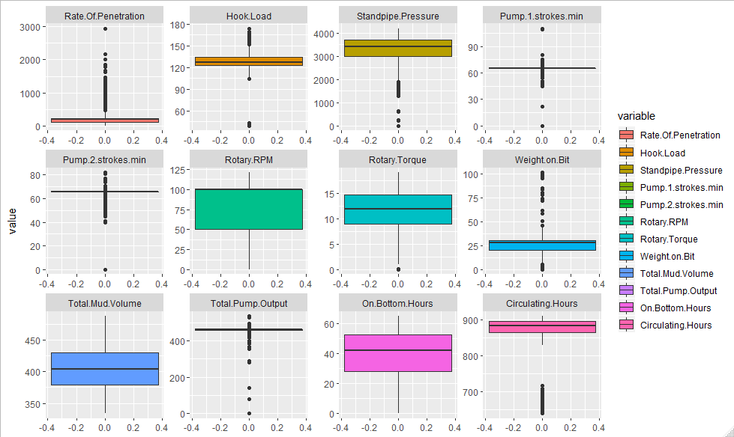
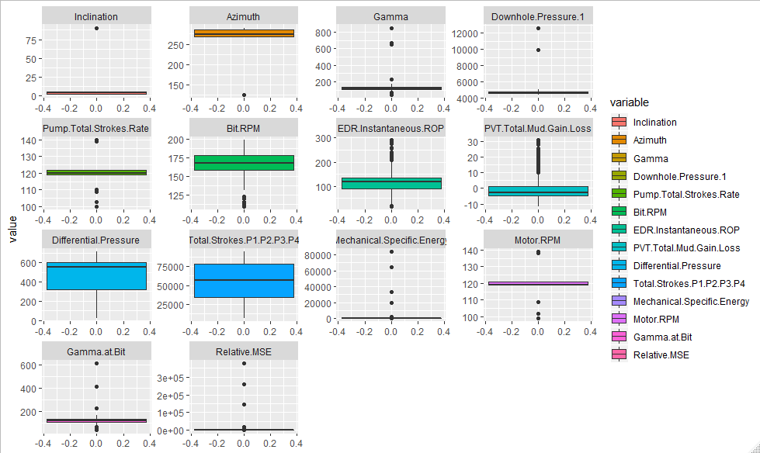
EDA- Data Visualization for Drilling Data (Boxplots)
Boxplots reveal max, min and quartiles
It also shows outliers

Slide 8
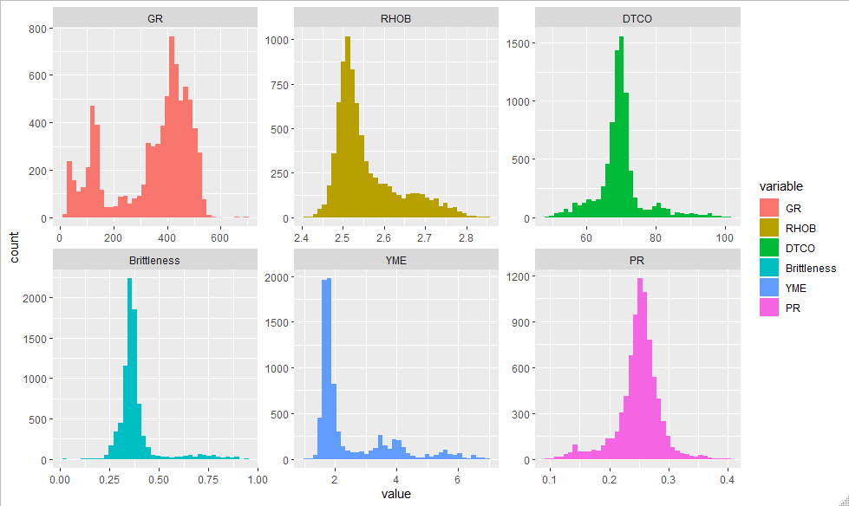
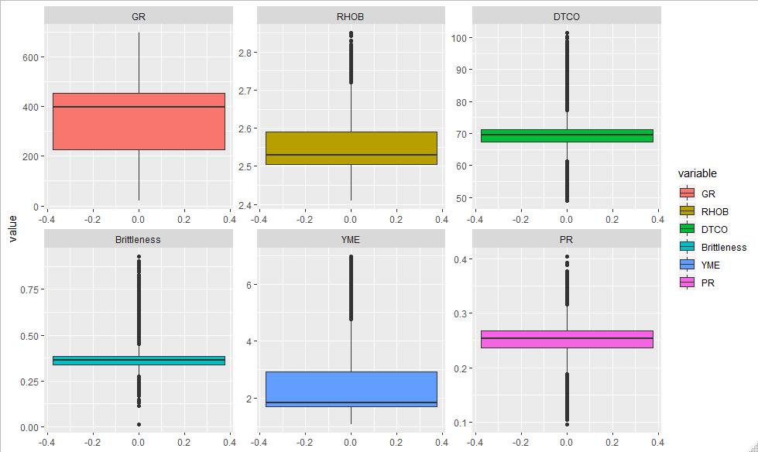
Visualization for Geomechanical Parameters
Histograms for Geomechanical Data
Boxplots for Geomechanical Data
DTCO, Brittleness and Poisson’s ratio are normally distributed
RHOB and YME, show the highly left/ right skewness
Outliers on the boxplots for these variables suggest the classification technique to group these points

Slide 9
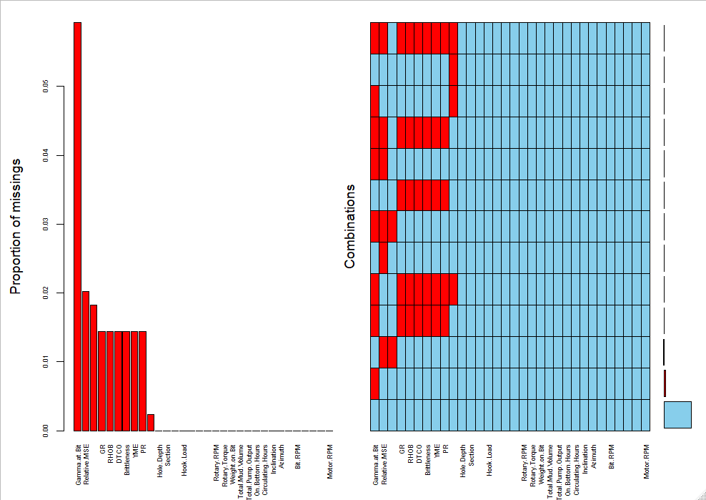
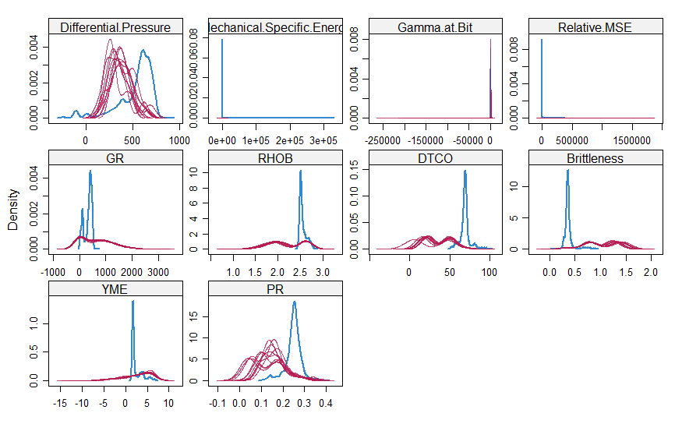
Missingness Discussion
Available data
Imputed data
GR has the most missing variables
Probability distributions of imputed data (norm method) does not match distribution for the available data.
We proceed by removing all the incomplete cases
Removing all incomplete cases

Slide 10
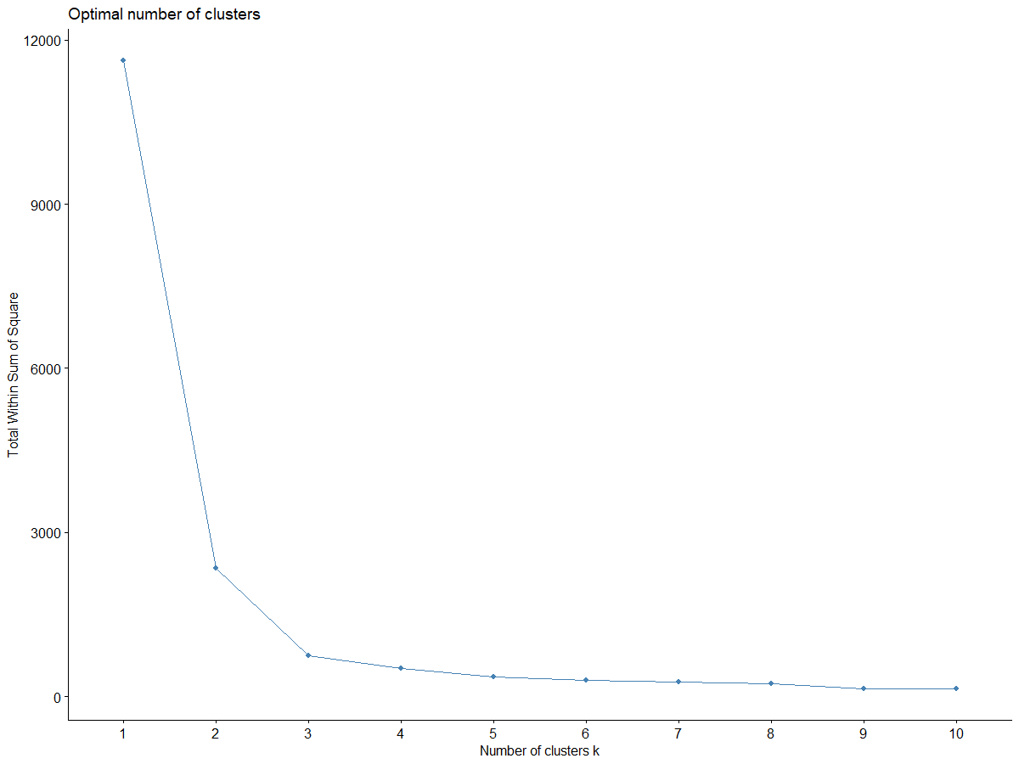
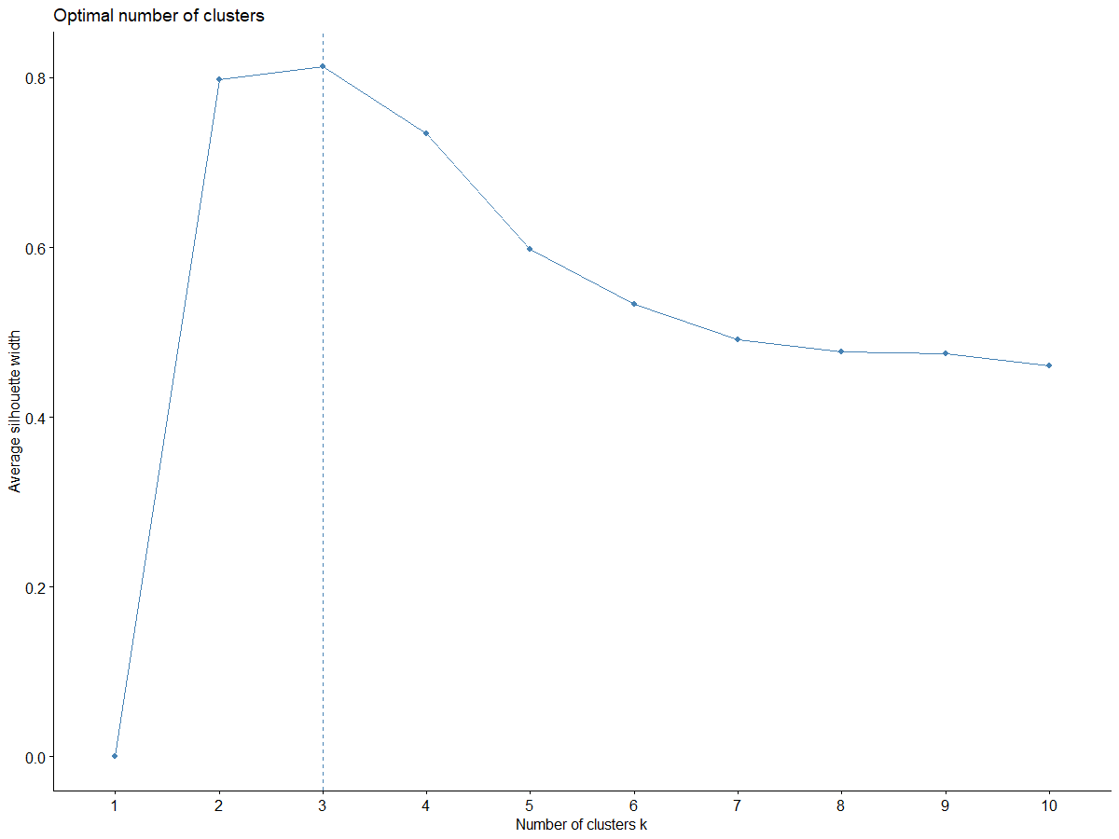
K-Means Optimal Numbers of Clusters
Within cluster sum of squares
Silhouette
The optimal number of clusters should be 3

Slide 11
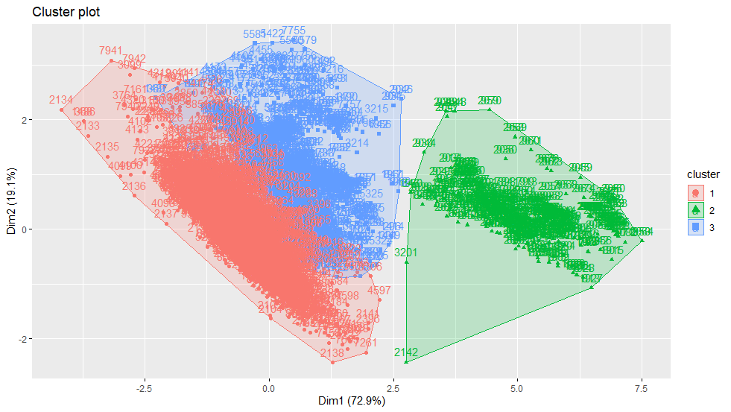
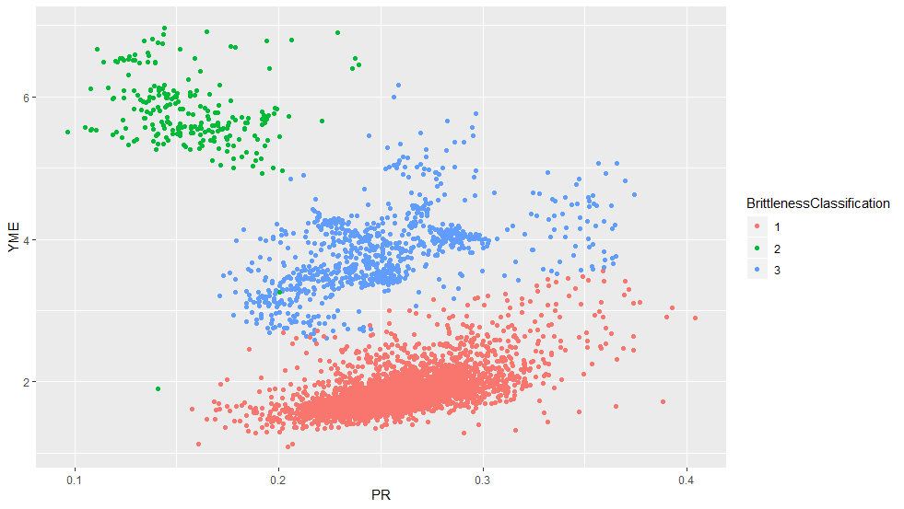
K-Means Clustering Results
3. moderate brittleness and ductile, moderate frackability
2. high brittleness, low frackability
1. low brittleness and high ductile, high frackability
The predicted clusters plotted on principal component 1,2 plane
The predicted clusters plotted on Young’s modulus, Poisson’s ratio plane.

Slide 12
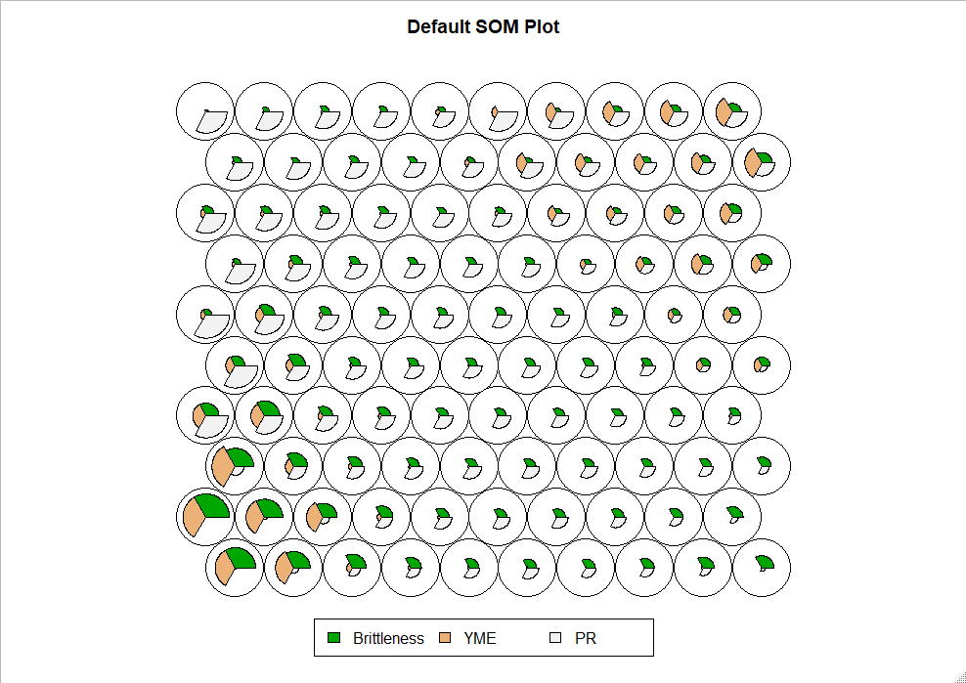
Self-Organizing Map SOM
The left corner:
high brittleness and higher young’s modulus
The middle section
lower brittleness/ higher ductile with lower young’s modulus and higher poisson’s ratio
The right corner
moderate brittleness and ductile, thus moderate frackability.
Overall, SOM validates 3 clusters predicted from K-Means
Facies 3
Facies 1
Facies 2
Notes:
Facies – a body of rock characterized by a particular combination of lithology physical and biological structures that bestow an aspect that is different from the surrounding rocks.
Walker (1992); geological usage introduced by Gressly (1838)

Slide 13
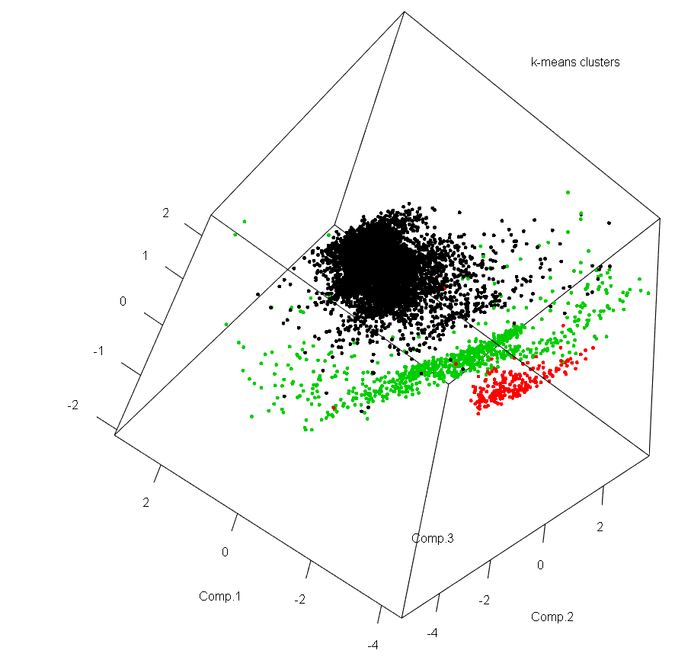
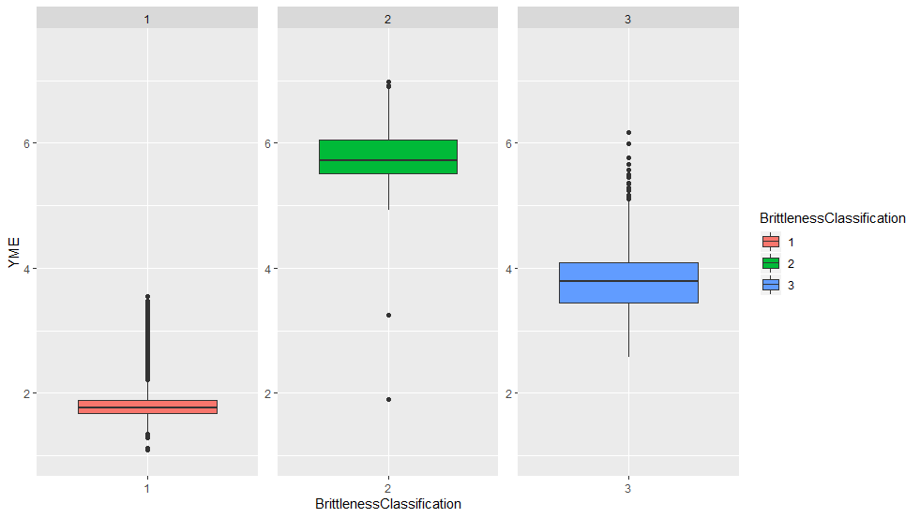
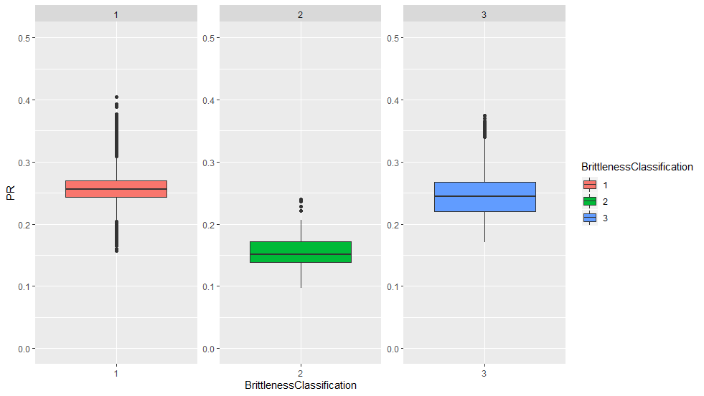
Petrophysical and Geomechanical Significance from 3 clusters
3 Principle Components of Gamma Ray, Density of Rocks and Sonic Slowness
Boxplots of Young’s Modulus (YME) and Poisson ratio (PR) for 3 clusters.

Slide 14
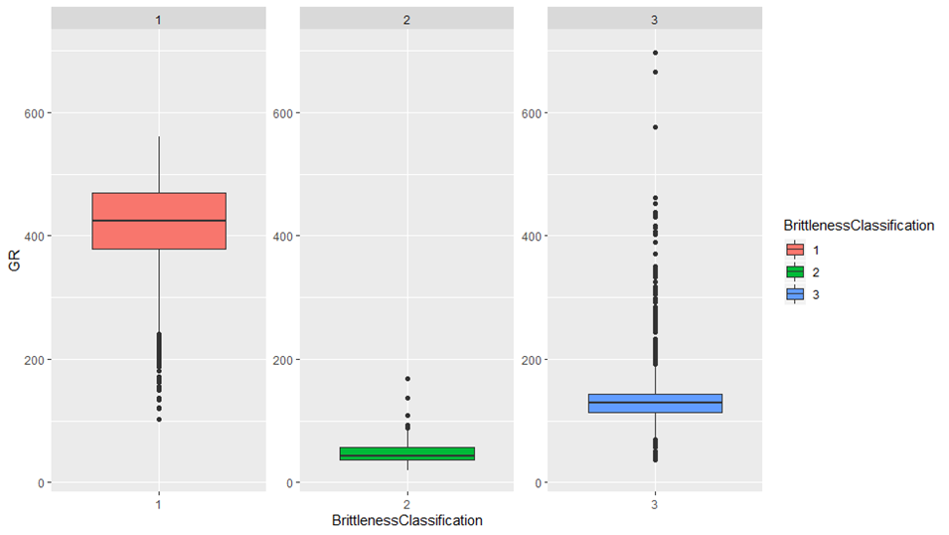
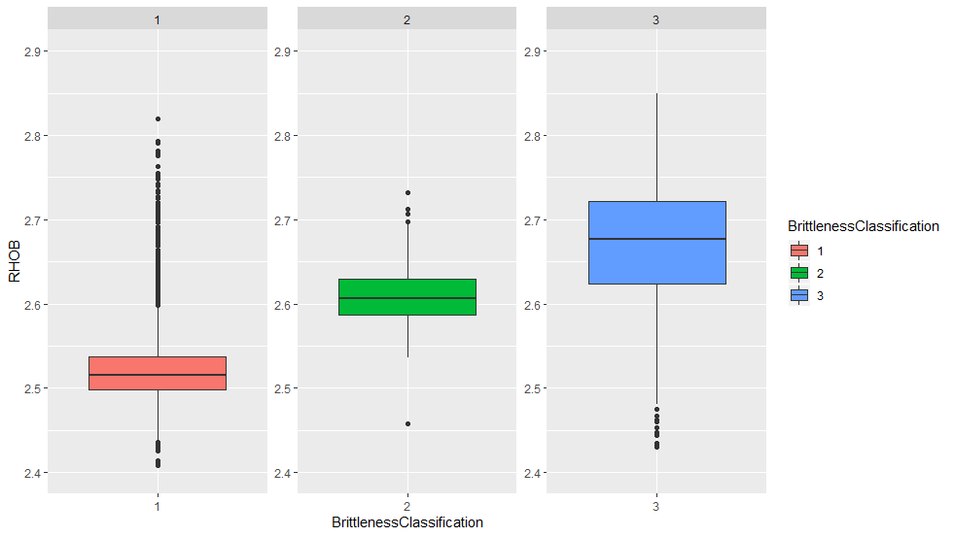
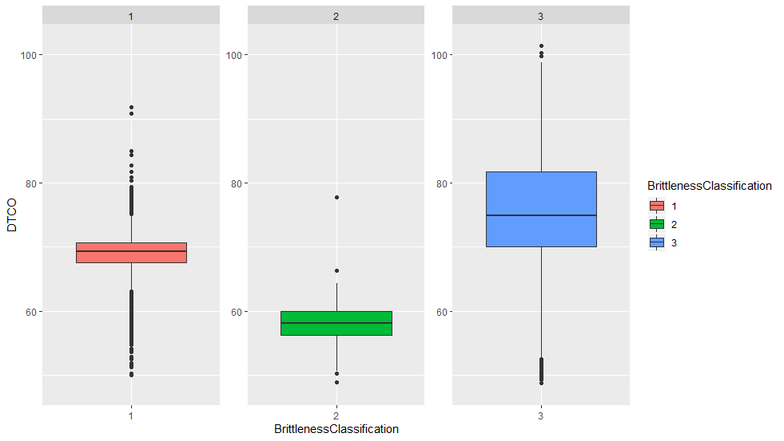


Slide 15
Classifications with Geomechanical Properties
Facies | Properties
1 | Low brittleness, high ductile, thus high frackability
2 | High brittleness, thus low frackability
3 | Moderate brittleness and ductile, thus moderate frackability

Slide 16
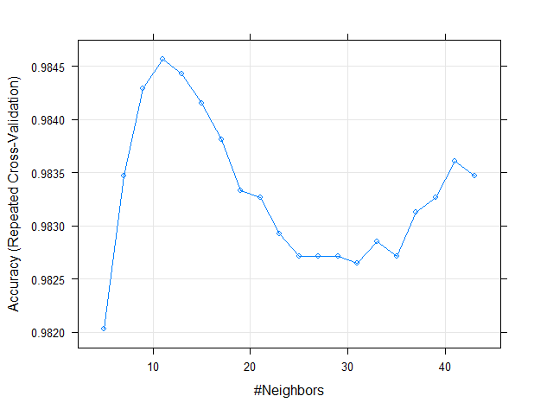
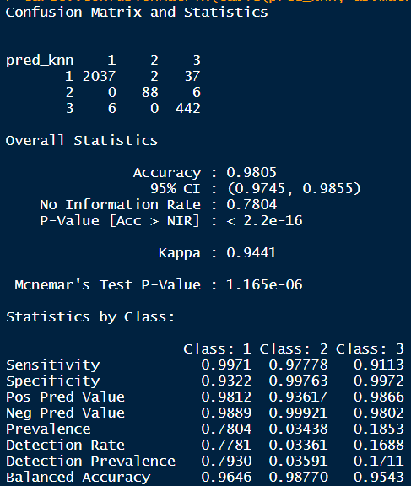
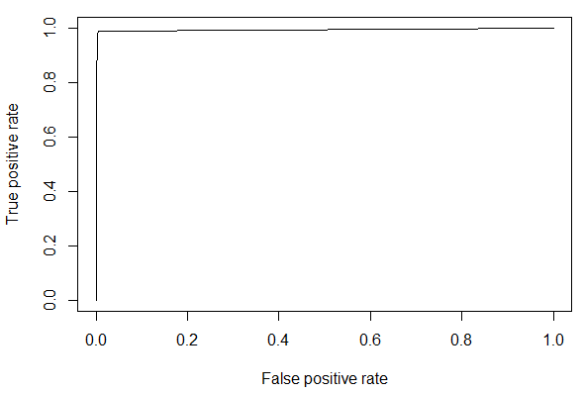
Supervised KNN
This technique predicts facies cluster based on MWD
Features: MWD Data
Target: Geomechanical Facies
Using random split
Train set: 65% Dataset & Test set: 35 % Dataset
Hyperparameter Optimization by determining optimal numbers of neighbors -> n=11
Accuracy: 0.9805
Kappa: 0.9441
ROC Curve

Slide 17
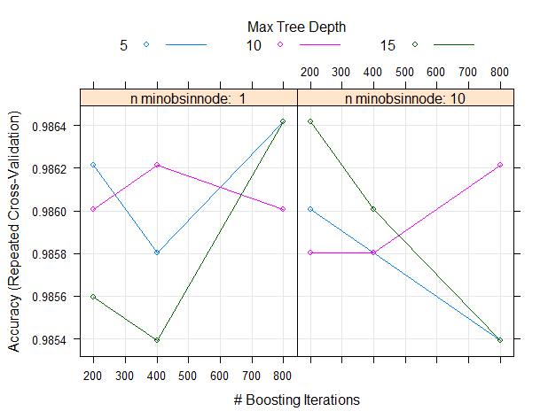
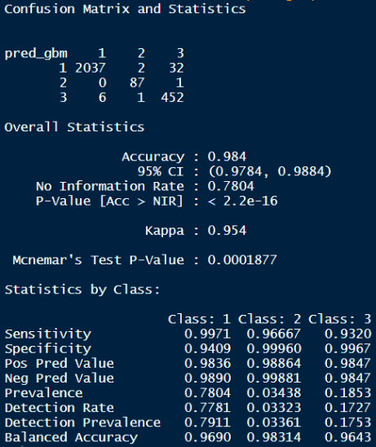
Supervised Techniques- Gradient Boosted Random Forest
Features: MWD Data
Target: Geomechanical Facies
Hyperparameters include:
Number of trees (Boosting iterations) => Number of trees = 800
Interaction depth (Max tree depth) => Max tree depth = 5
Minimum number of nodes in last level of a tree (n.minobsinmode) => n.minobsinmode =1
Accuracy: 0.984
Kappa: 0.9454

Slide 18
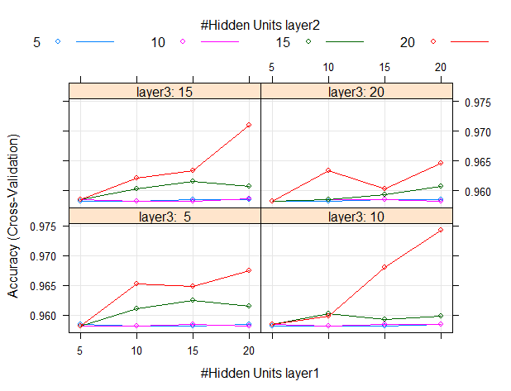
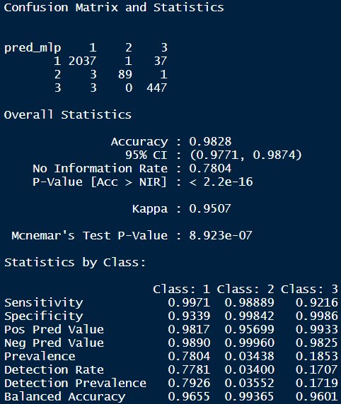
Supervised Techniques- Neural Networks multi-layer perceptron
Features: MWD Data
Target: Geomechanical Facies
Hyper-parameters include:
Number of nodes in layer 1 = 20
Number of nodes in layer 2 = 20
Number of nodes in layer 3 = 20
Accuracy = 0.9828
Kappa = 0.9507
This technique predicts most numbers of Facies #3 (moderately good zone for fracking)

Slide 19
3 Supervised Techniques Sum Up
FACIES/ CLUSTERS KNN |  | Predicted
 |  | 1 | 2 | 3
Actual | 1 | 2037 | 2 | 37
 | 2 | 0 | 88 | 6
 | 3 | 6 | 0 | 442
3 methods give consistent accuracy of 0.98 and kappa of 0.95
3 methods predict similar numbers of Facies 1 with 2037 datapoints
MLP Neural Networks predicts most numbers of Facies 2 and 3 with 89 and 447 datapoints
Need more data obtained from same/ different basin to generate full-field scale model
FACIES/ CLUSTERS GBM Random Forest |  | Predicted
 |  | 1 | 2 | 3
Actual | 1 | 2037 | 2 | 32
 | 2 | 0 | 87 | 1
 | 3 | 6 | 1 | 452
FACIES/CLUSTERS MLP Neural Networks |  | Predicted
 |  | 1 | 2 | 3
Actual | 1 | 2037 | 1 | 37
 | 2 | 3 | 89 | 1
 | 3 | 3 | 0 | 447

Slide 20
Conclusions
Feature engineering, Exploratory Data Analysis and Missingness Handling, offer insights to the combined set of more than 263000 records
The unsupervised and supervised techniques demonstrate the great promise.
Unsupervised methods allow the predictions of 3 facies
KNN gives 98% accuracy in cluster prediction on test dataset
Gradient Boosting gives 98% accuracy in cluster prediction on test dataset
Neural Networks gives 98% accuracy in cluster prediction on test dataset, forecasts the most numbers of moderate-good facies for fracking
The application to drilling automation and advisory systems to prevent out-of-zone drilling, minimize rig-time and equipment and allow cost saving

Slide 21
THANK YOU

Slide 22
References
Marcellus Shale Energy and Environment Laboratory. http://mseel.org/

Slide 23
Clusters
3. moderate brittleness and ductile, moderate frackability
2. high brittleness, low frackability
1. low brittleness and high ductile, high frackability

Slide 24
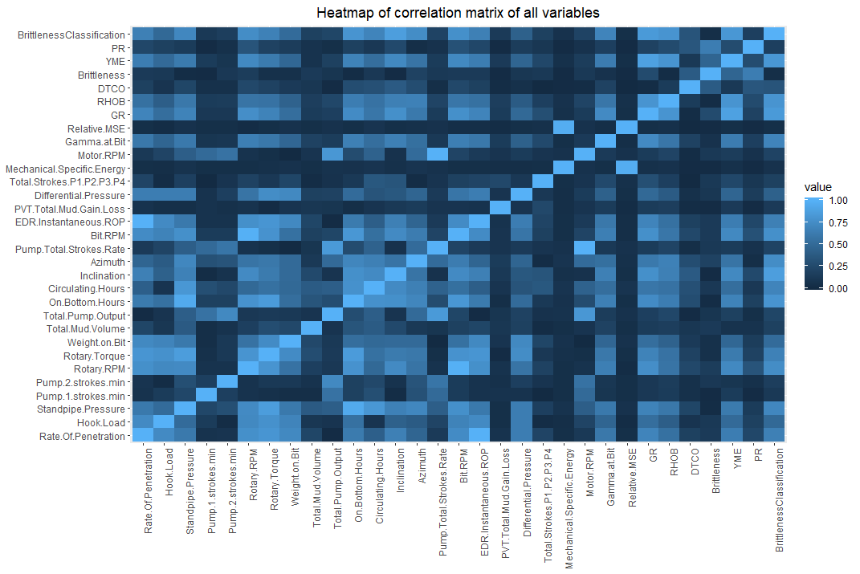

Slide 25
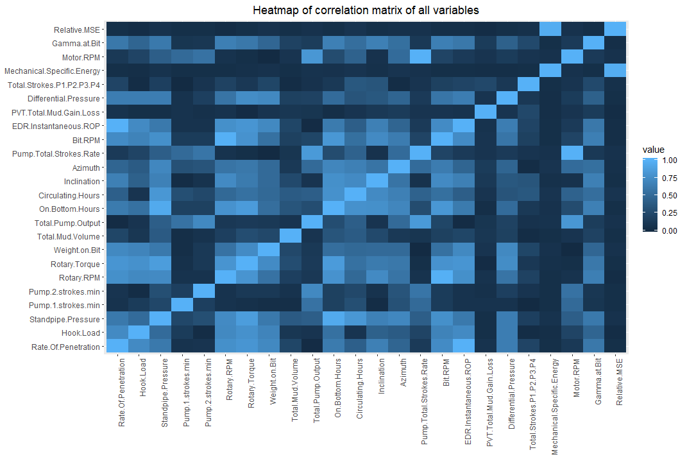

Slide 26
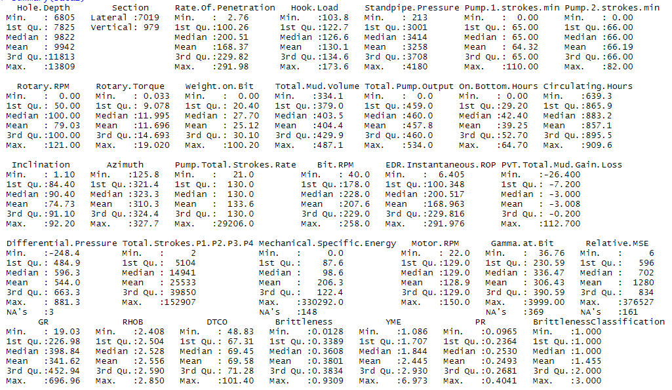
Summary Dataset

Slide 27
Workflow
Log Data – Sonic (DTCO), Gamma Ray (GR), Young Modulus (YME), Poisson ratio (PR), MWD
Exploratory Data Analysis
Missingness
Feature Engineering
Identify Brittleness/Frackability Clusters on DT, GR and RHOB
K-means and SOM
Identify Brittleness/Frackability significance
Predict Brittleness/Frackability clusters using MWD
Sample split data into Train/ Test sets, Centering and Scaling
KNN, Gradient Boosting, Random Forest
Petrophysical Significance of Lithology clusters
Identify cluster properties using core data (3 wells)

