Slide 1


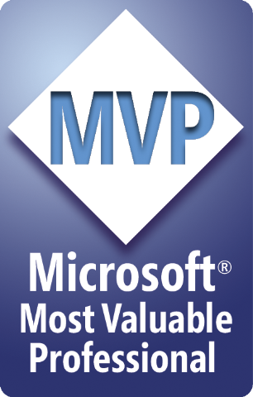


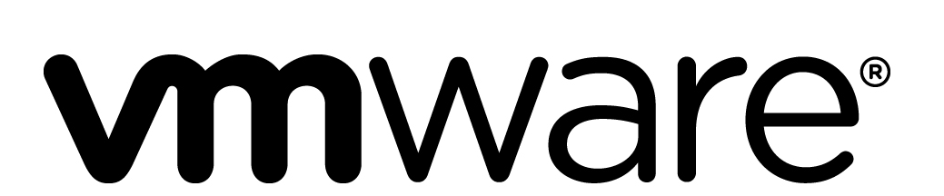
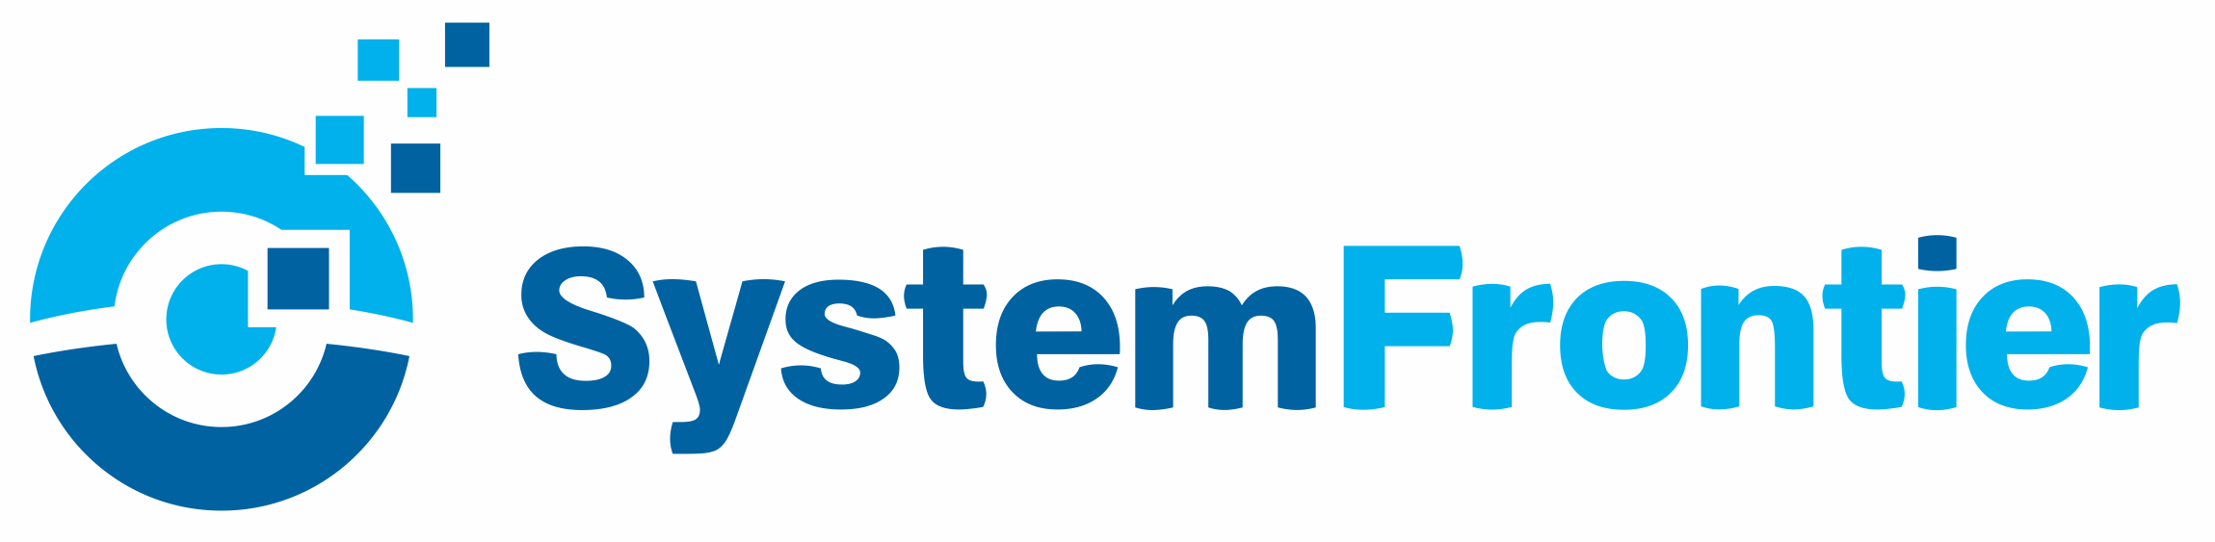




Building Better Bricks: Module design and development best practices.
PowerShell Conference Asia

Slide 2



Powershell quick starts, tutorials, API reference, and code examples!
Advance your career with hands-on training at docs.microsoft
Check it out here:

Slide 3

We really do!
Show some love and join the conversation by tweeting
@MicrosoftTech

Slide 4

Chris Gardner
DevOps and ALM consultant at Black Marble
4+ Years PowerShell experience
Spent the last 2 years+ automating software builds and writing DSC
Contribute to various DSC resources and maintain 2.5 of my own
Usually found on Slack (PSUGUK and PowerShell)
https://www.github.com/ChrisLGardner
PowerShell Conference
Singapore 2018

Slide 5
Agenda
Why?
Function Design
Module Structure options
Folder Structure
Build Scripts
Testing
Documentation
PowerShell Conference
Singapore 2018

Slide 6
Why?
We’re developers technologists
Easier for other people to contribute
Easier for people to use
PowerShell Conference
Singapore 2018
Notes:
https://github.com/PoshCode/PowerShellPracticeAndStyle
A dev in my opinion is anyone who has written and saved a PowerShell script. Copy/Pasting from Google or StackOverflow doesn’t quite count. That doesn’t mean everyone is suddenly a good developer. You can be a developer no matter what your actual job title is.
To be a good developer you need to implement more of the practices that “traditional” developers use, like source control, unit testing, CI, etc. Not all developers do this, I’ve got a number of horror stories about people who claim to be developers not doing some of these things (or all of them in the case of one team) but just because your job title is developer doesn’t mean you’re a good developer. The reverse is also true, just because your title is sysadmin doesn’t mean you aren’t a good developer.

Slide 7

PowerShell Conference Asia
Function Design

Slide 8
Function Design
Always include an output type for functions which output an object
Always write-output/$var your objects
Always add CmdletBinding to enable advanced functions
Accept pipeline input on Set-*/Update-*/etc functions
PowerShell Conference
Singapore 2018
Notes:
PSSA will complain if you don’t have an output type, but it also makes the code more readable and understandable for anyone looking at it.
Some people would argue you shouldn’t use Write-Output and instead just use $var. Either works and the balance you have to decide on is the trade off between readability from using Write-Output with the confusion it can cause when people use it for more than just actual output when they should be using Write-Verbose or Write-Information instead.
Always use Approved Verbs, always use sensible singular nouns. Etc
Cmdletbinding or [parameter()] will enable advanced functions but it’s often best to be explicit about this and not everyone is aware of the [parameter()] attribute enabling it.
Get-* and similar can also accept pipeline input when it makes sense.

Slide 9
Function Design
Consider including a PSTypeName for custom objects
Descriptive variable and function names
Common names for parameters, e.g. ComputerName
PowerShell Conference
Singapore 2018
Notes:
https://stackoverflow.com/a/66693/7612001
https://poshoholic.com/2008/07/05/essential-powershell-define-default-properties-for-custom-objects/
https://poshoholic.com/2008/07/03/essential-powershell-name-your-custom-object-types/
Classes are another option instead of PSTypeName, especially when you’ve got a variety of constructors that let you cast common types into basic versions of your class. They should only be used when you know your module will be running on PSv5+ since earlier versions don’t support them.
You can do some nifty tricks to work around your users not passing in the write pstypename object. See the demo of Get-UserData and Set-UserData
Parameter aliases are a good option when you want to allow users to use ComputerName as well as other things like Server, Target, Endpoint or anything else that makes sense in your environment.

Slide 10

PowerShell Conference Asia
Demo

Slide 11

PowerShell Conference Asia
Module Structure

Slide 12
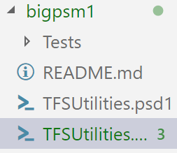
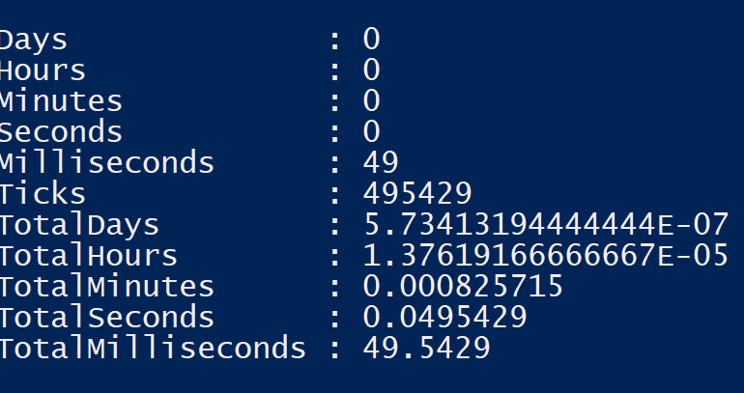
Module Structure – Big psm1
Pros
Quick to load
Easy to distribute
Cons
Difficult to maintain
Can become very long
PowerShell Conference
Singapore 2018
Notes:
In the example module there are 3700+ lines of code in the psm1. Trying to resolve merge conflicts on that size file gets pretty difficult and just generally reviewing the changes on such a file isn’t easy.
PowerShellGet was original 16k lines in a single file.

Slide 13
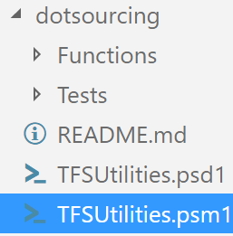
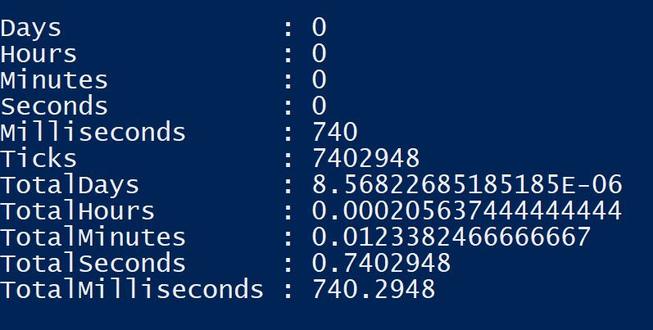
Module Structure – Dot sourced ps1
Pros
Easy to maintain
Short PSM1
Easy to add more functions
Cons
Slow to load
Potential security issues
Slow command discovery
PowerShell Conference
Singapore 2018
Notes:
When doing code signing you have to sign every single file in the module, the numbers shown here don’t include that but get considerably worse when you have to check the signing on every single file.
PowerShellGet had a dot sourced version after someone refactored the code and the load time was 12s
DbaTools has a dot sourced version for dev users, with it’s 506 public commands, loads in 17s (previously I’d seen it load in 40s on the same machine)

Slide 14
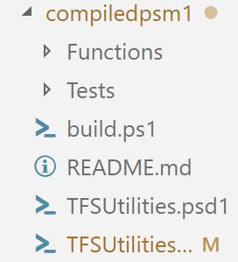
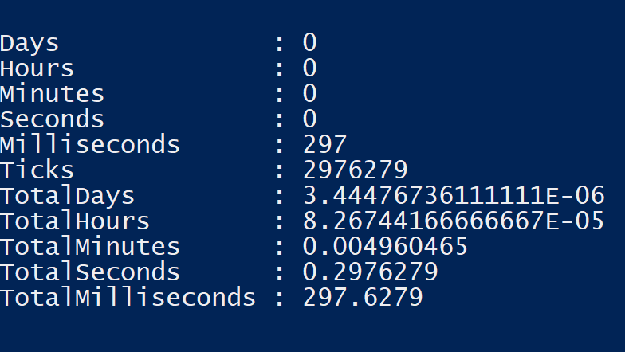
Module Structure – Compiled psm1
Pros
Easy to maintain
Quick to load
Easy to distribute
Easy to add more functions
Cons
Extra learning required to use
Automation needed
PowerShell Conference
Singapore 2018
Notes:
You should only ship the pd1 and psm1.
PowerShellGet moved to compiling their module again and dropped the load time down to about 2s
DbaTools public version is a compiled psm1 and load time is dropped to about 6s

Slide 15

PowerShell Conference Asia
Folder Structure

Slide 16
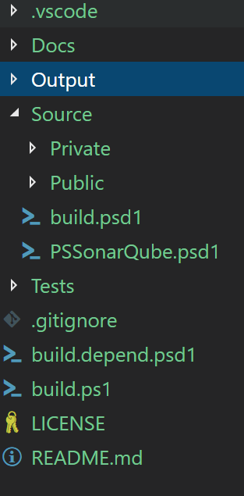
Folder Structure
Git Ignore file set to ignore the output directory
VS Code folder to enforce some coding styles and use build script for debugging
Source split into public and private folders with 1 function per ps1 file.
PowerShell Conference
Singapore 2018
Notes:
If you’ve got PowerShell classes then they can go into a Classes folder under source. There are some difficulties with ensuring they load in the correct order if you’ve got classes depending on each other, there aren’t any good solutions to this yet beyond naming them 01.Class.ps1, 02.Class.ps1
Tests can be broken down into unit, integration or other categories. Personally I have a Unit folder for true unit tests and then later will create an Integration folder for integration testing, all using Pester with Tags to differentiate between the types.
Build.depend.ps1 is for PSDepend and handles any dependencies I have for building the module, like Pester, PlatyPS and more. In some other modules I have it download some of those dependencies to the Output folder so that I can ship them with the module for systems that don’t have Internet access.
LICENSE isn’t really necessary for modules that will only be used internally but for public projects please include one, ideally MIT or another very open license.
Other optional files include appveyor.yml or similar task runner files.
Contributing, code of conduct and similar helpful docs for anyone coming along to work on this. These are more needed for open source but a guide to contributing, either in a dedicated file or in the readme, would be very useful regardless of where the module is stored or used.

Slide 17

PowerShell Conference Asia
Demo

Slide 18

PowerShell Conference Asia

Slide 19
General Good Practice
Version stamp your module-
Major increases on breaking changes
Minor changes with new non-breaking changes, bug fixes etc
Revision however many times the module was built before releasing this version
Don’t create functions with the same name as core functions.
Create an alias pointing at your suitably named version
PowerShell Conference
Singapore 2018

Slide 20
Build Scripts
Invoke-Build and PSake for pure PS build automation
Azure Pipelines, AppVeyor, Gitlab etc
Three key steps needed:
Build psm1 from all your ps1 files
Test your built psm1
ScriptAnalyser your psm1
PowerShell Conference
Singapore 2018
Notes:
The crucial thing here is that you should be testing/PSSA’ing the compiled PSM1. If you don’t then you’re not testing the same thing that you’re shipping.
Automating all of this with InvokeBuild or PSake is a great step too, we’re writing PowerShell to automate the boring things, why wouldn’t we then use PowerShell to automate the building of that automation.
Platforms like Azure Pipelines (part of Azure DevOps) etc are usually free or cheap (depending on users and where your code sits), they make it much easier to implement this sort of build automation and store your code. The larger tools like Azure Pipelines and Gitlab come with even more tools, Azure DevOps in particular also comes with work item management that can be leveraged to let you track the next few features you want to add in your code, or any bugs that have been found. Both platforms give you a range of tracability options too, you can get pretty build output to see how your tests ran and fail builds if the tests fail.

Slide 21
Testing
Pester is your friend
Test against the compiled psm1
If a bug is found, write a test for it and then fix it
PowerShell Conference
Singapore 2018
Notes:
There are a lot of videos and blog posts on writing tests, plus the Pester Book on LeanPub. Glenn Sarti and Brian Bunke have great sessions from PSH Summit talking about writing pester tests. Jakob Jares has some interesting talks from PSConfEU about pester internals and common mistakes in writing tests.
Write tests for how the function should work, expected input and expected output, not for how it currently works (though those sort of tests are pretty useful when refactoring).
You’ll never write perfect code so there will be bugs, when a bug is found you should write a test for it to make sure you can replicate it (maybe more than 1 test) and then fix the code so the test passes. This way you can be more sure that the bug won’t reappear because your test will hopefully fail if it does reappear.

Slide 22
Documentation
Write it
Consider PlatyPS to generate external help
Teach/Remind users about Get-Help
About pages are your friend for complex details
PowerShell Conference
Singapore 2018
Notes:
Michael T Lombardi has a great talk from PSH Summit about the various types of documentation.
Don’t try writing MAML yourself, it’s awful and PlatyPS makes everything easier for that and CBH.
You can test your documentation (and should), Vors has a good demo on github for how to do that, https://github.com/vors/docs-pedantic-ci-demo, DSC Resources repos has a bunch of tests for their docs too, checking things like line length and endings etc.

Slide 23
Contact Details
@halbaradkenafin
Chrislgardner.github.io
github.com/chrislgardner
PowerShell Conference
Singapore 2018

Slide 24
Don’t Forget!
Fill in your survey – it’s how we do better!
Don’t lose you badge! You need it for the Social Events
Grab the Speakers for a chat – they all have time for you!
Let everyone know what they are missing on Social Media
#PowerShell
#PSConfAsia
@Psconf.Asia
Photos of Marina Bay Credit: Sebastian Szumigalski
PowerShell Conference
Singapore 2018

