Slide 2
slicetiming
motion
distortion
normalization
regression
- Motion
- slelected covs
Smoothing
extraction motion
params
extraction covs.
- WM, GM, CSF
- compcorr
- selected volumes

Slide 3
FMRIPREP
Paula
THE SCRIPT
slicetiming
motion
distortion
normalization
regression
- Motion
- slelected covs
Smoothing
extraction motion
params
extraction covs.
- WM, GM, CSF
- compcorr
- selected volumes

Slide 4
FMRIPREP + AROMA Option
slicetiming
motion
distortion
normalization
AROMA
ICA demix
mark ‘motion’
re-mix
(it also smooths!)
regression
- Motion
- slelected covs
extraction motion
params
extraction covs.
- WM, GM, CSF
- compcorr
- selected volumes

Slide 5
Standard fMRIPREP Preprocessing check:
Carpet-Plots!
If Carpet plot = good, we are happy.

Slide 6
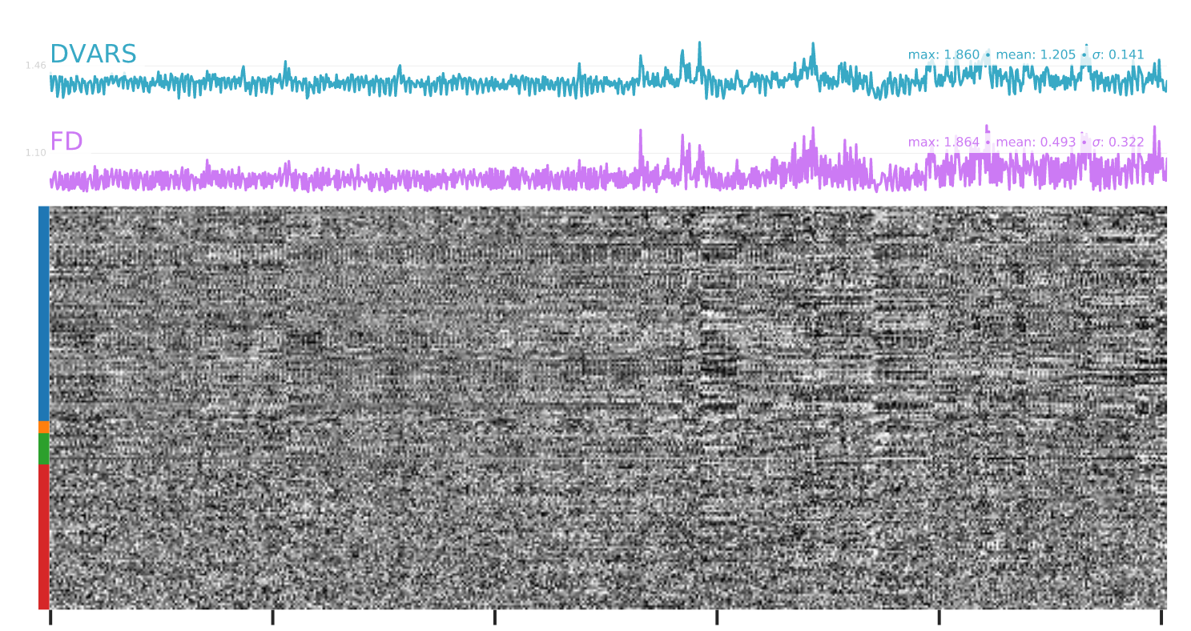
Horrible – un-usable data.

Slide 7
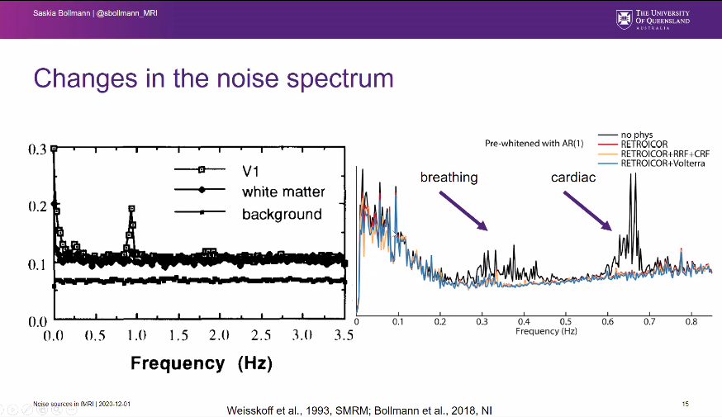
Our Cut-off Frequency
This effect might impair estimation of FD too

Slide 8
FMRIPREP
FMRIPREP
ICA-FIX
slicetiming
motion
distortion
ICA de-mix
mark BAD/GOOD
re-mix
normalization
Smooth/DONE
covs =
components
extraction motion
params
extraction covs.
- WM, GM, CSF
- compcorr
- selected volumes

Slide 9
HCP Pipeline
Scripts
FMRIPREP
ICA-FIX
slicetiming
motion
distortion
ICA de-mix
mark BAD/GOOD
re-mix
normalization
Smooth/DONE
covs =
components
extraction motion
params
extraction covs.
- WM, GM, CSF
- compcorr
- selected volumes
This is:
CONVOLUTED
According to ICA-FIX Expert (and other reports):
- ICA-FIX better after HPC Pipeline
? What’s the difference

Slide 10
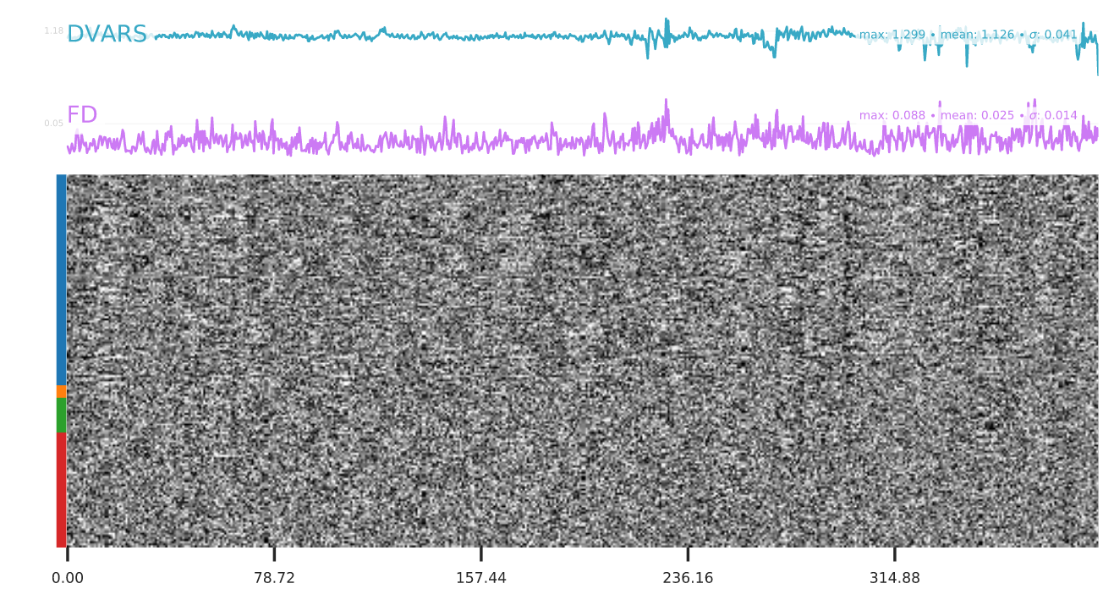
Can’t look at FD; WHY?
After ICA-FIX:

Slide 11
FMRIPREP
FMRIPREP
ICA-FIX
slicetiming
motion
distortion
ICA de-mix
mark BAD/GOOD
re-mix
normalization
extraction motion
params
extraction covs.
- WM, GM, CSF
- compcorr
- selected volumes
Need:
THE SCRIPT
OUTPUT SPACE:
BOLD
Need Script?
SKIP:
slicetime, distortion
ignore motion

Slide 12
THE SCRIPT
https://github.com/jnvandermeer/Prepare_FIX

Slide 13
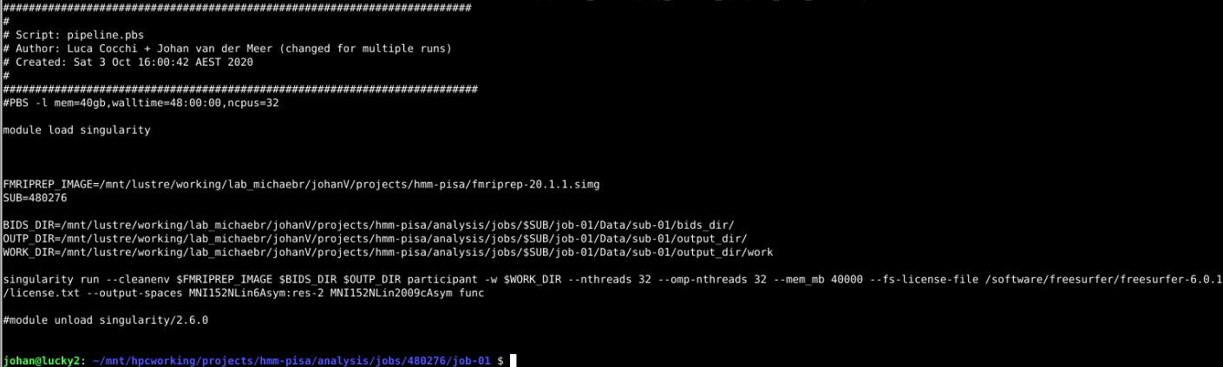
First fMRIPREP RUN:

Slide 14
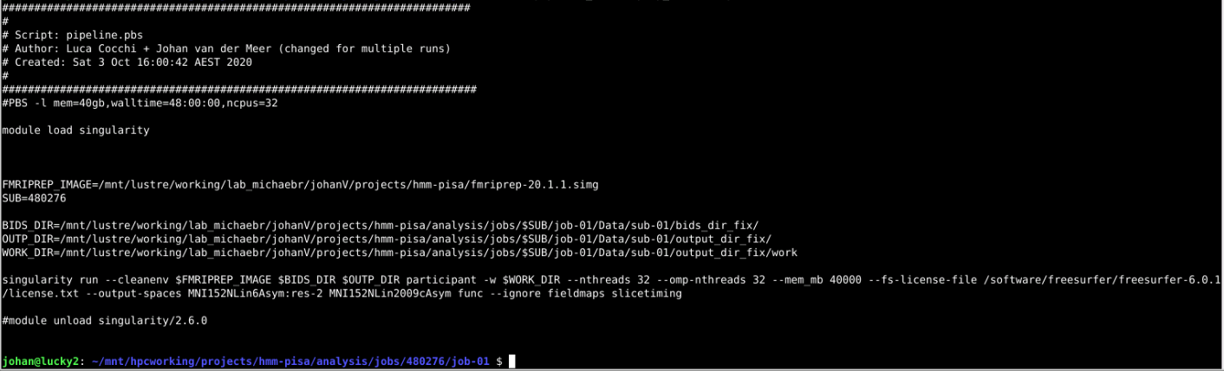
SECOND fMRIPREP RUN:

Slide 15
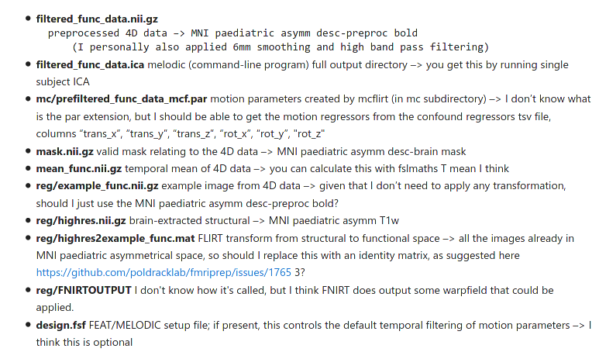
Ipython Notebook
Re-format from BIDS data into .FEAT Data structure, change file names
Then run a ‘design.fsf’ file with FEAT, using ICA Data Exploration

Slide 16
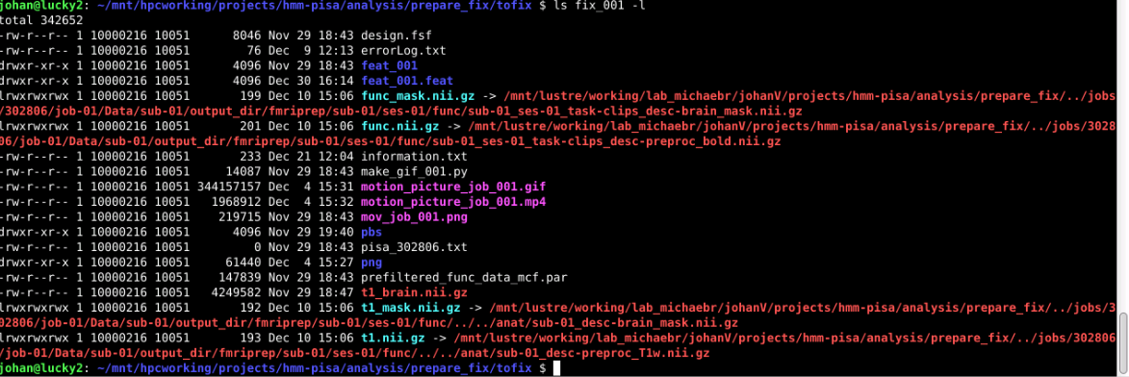

Slide 17
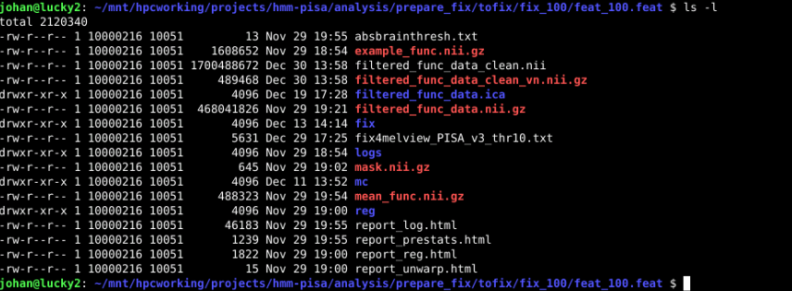

Slide 18
FSLEYES
Connectome
Workbench?
(never tried this one)

Slide 19
https://fsl.fmrib.ox.ac.uk/fsl/fslwiki/FIX/UserGuide
- de-mix
- Mark Good / Bad (30 subjects; ~5000 components)
- Train Classifier
- Use Classifier to auto-mark ‘good’, ‘bad’ all the rest (including hand-marked!)
- ditch the bad ones
- re-mix == CLEAN data

Slide 20
# 1. grab out the features (all 219 subjects) - each IC component has 184 properties == features
fix -f feat_001.feat
fix -f feat_002.feat
....
fix -f feat_219.feat
# 2. annotate ~ 20 people, each IC Component = Good or Bad, so we can use that for Training of the Classifier.
# naming the files johan_v1.txt or caro_v1.txt or something else.
# manual marking of Signal, Unknown (GOOD), or Motion/Resp/Cardiac/etc (BAD)
fsleyes feat_001.feat/filtered_func_data.ica
fsleyes feat_002.feat/filtered_func_data.ica
...
fsleyes feat_020.feat/filtered_func_data.ica

Slide 21
# 3. train the Classifier
# Rename/Copy the johan/caro.txt files into: hand_labels_noise.txt in the <fix_0XX.feat> folders (one level up)
# Then train it:
fix -t PISA_v3 -l <fix_001.feat> <fix_002.feat> ... <fix_020.feat>
# This will generate the PISA_v3.RData file.
# This will also generate the PISA_v3_LOO_results file
# show the file:
#4. Once the classifier is trained you can use it to mark other components into 'good' or 'bad':
fix -c feat_001.feat PISA_v3.RData 10
fix -c feat_002.feat PISA_v3.RData 10
...
fix -c feat_219.feat PISA_v3.RData 10
# this will make new .txt files (like ours) claiming whether compo netns are good or bad.
# now we have the Classifiers verdict on each IC component if it's to be kept or to be binned.
# this file is called: fix4melview_PISA_v3_thr10.txt
# 5. We bin the bad components:
fix -a feat_001.feat/fix4melview_PISA_v3_thr10.txt -m
fix -a feat_002.feat/fix4melview_PISA_v3_thr10.txt -m
...
fix -a feat_219.feat/fix4melview_PISA_v3_thr10.txt -m
# this will make the filtered_func_data_clean.nii.gz, in each feat_XXX.feat folder.
# additionally it will also remove stuff that co-varies with the motion parameters.

Slide 22
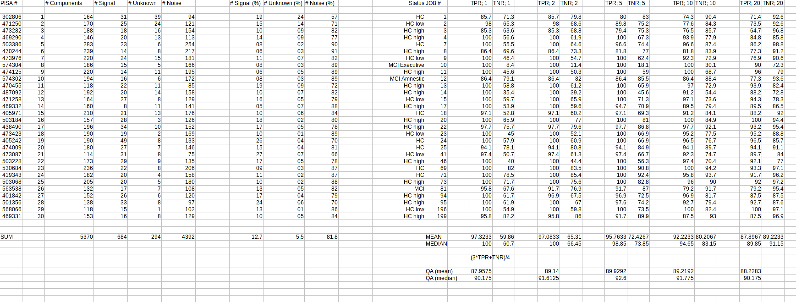
- check our performance:

