Slide 1

Indian Institute of Information Technology Allahabad
Prayagraj (UP) India
3D CHESS GAME Using openGL
Group Members:
Shubham Kumar (IIT2020007) Rahul Mahto (IIT2020022)
Supervised By :
Prof. Anupam Aggarwal

Slide 2
Introduction
The current level of development in computer chess programming is fairly complicated, yet interesting as well.
In this project, we were supposed to develop a chess-playing program.
The program was supposed to play chess at a good level and have an adaptive property.

Slide 3
Purpose of the Project
The purpose of this document is to provide a
detailed requirements overview for the Chess application.
It will also explain the purpose and features. Chess shall provide the user with a reliable, well designed chess game.
The version of this product is 1.0 and this SRS shall cover the full scope of Chess.

Slide 4
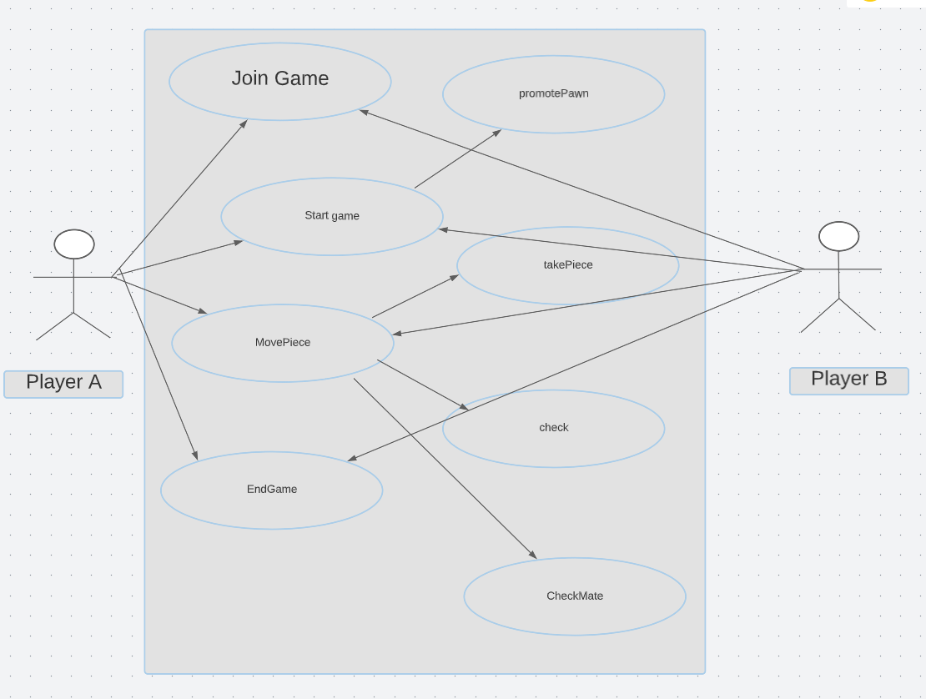
Use Cases Diagram(Proposed)+ UML Design

Slide 5
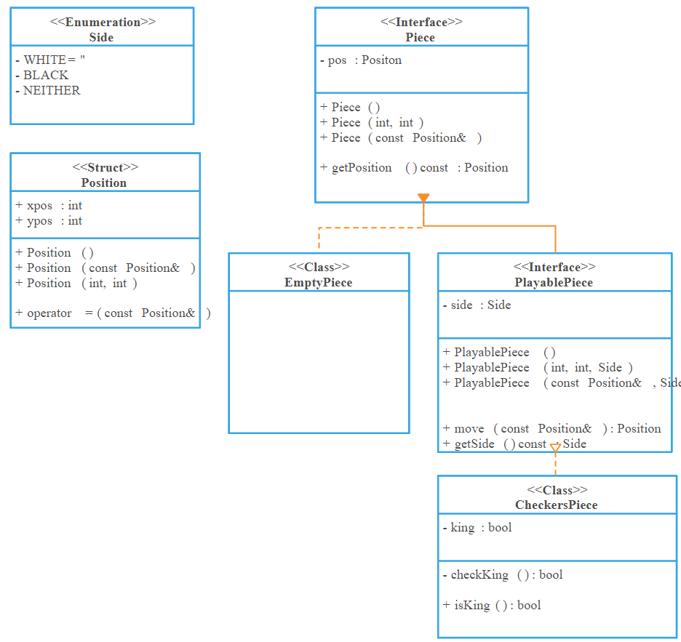
Class Diagram

Slide 6
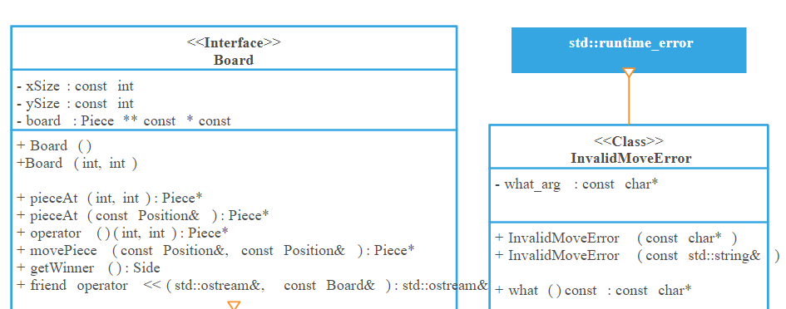
Class Diagram

Slide 7
Function Requirements
For defining the requirement in terms of system’s perspective I divide the players into three categories, which are given below:
Player 1
Player 2
That describe functional requirement of all user as given in next slides.

Slide 8
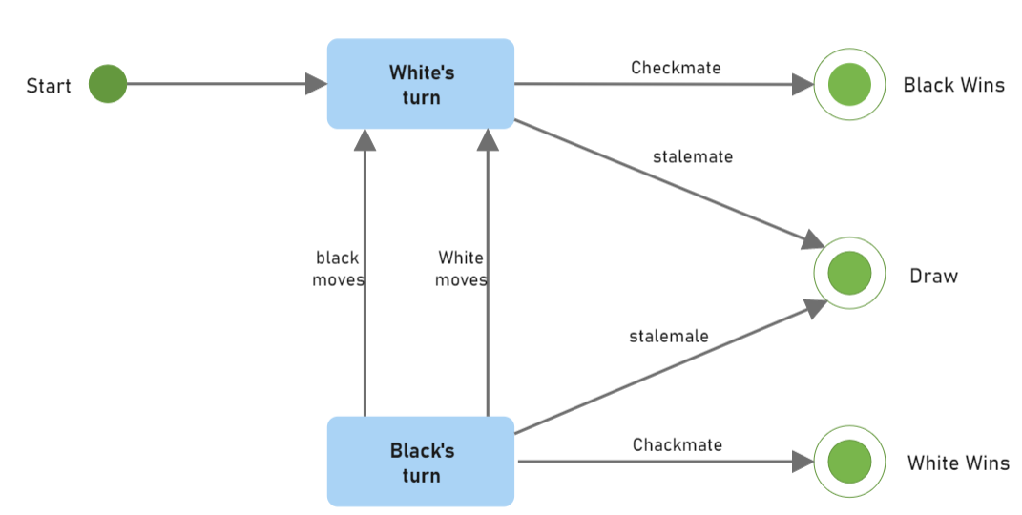
State Diagram

Slide 9
Functional and non Functional Requirements
Functional requirement define the software functionality of product from the system’s perspective that the developer must build to enable the users to accomplish their task stated in the user requirement.
Non-functional requirement describe services provide by system along with constraints under which the system operate.

Slide 10
LITERATURE REVIEW
1. Chess Gaming and Graphics using Open-Source Tools,Tong Lai Yu, California State University, Department of Computer Science and Engineering, San Bernardino, CA 92407 Paper Link
2. Design, Development and Evaluation of a Chess Game in a Ubiquitous Environment, Vasileios Georgitzikis, University of Patras Paper Link
3. An Interactive Augmented Reality Chess Game using Bare-Hand Pinch Gestures, Marios Bikos, Yuta Itoh and Gudrun Klinker, Konstantinos Moustakas Paper Link

Slide 11
Movement Legality
A move shall be deemed illegal if it does not follow the above rules or would cause the moving player's king to become in check

Slide 12
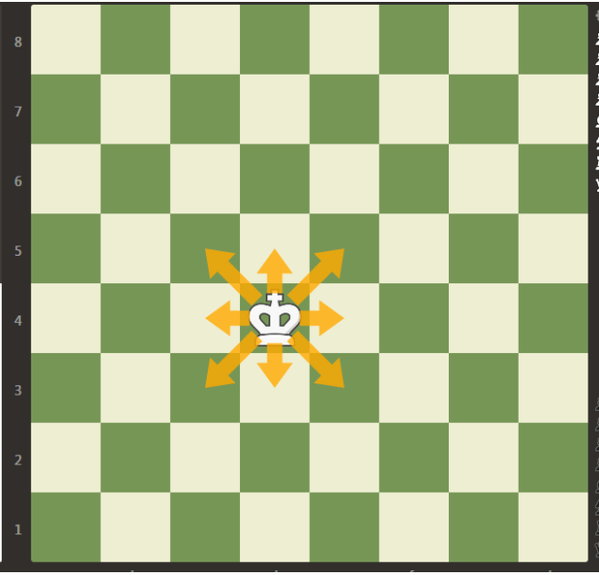
Movements
The King
The King is the most important piece. When it is trapped so it cannot move without being captured, then the game is lost. This trap is called checkmate.
The King can move one square in any direction. A King can
never move into check, or onto a square where it can be captured by an opponent's piece. If a King is not in check, and no other legal move is possible, then the position is said to be in stalemate. A stalemated game is a draw, or a tie.

Slide 13
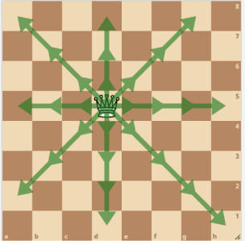
The QUEEN
The Queen is the most powerful piece.
The Queen can move to any square in any direction as long as
her path is not blocked. Her range and the ability to attack many pieces at once are the source of her power.

Slide 14
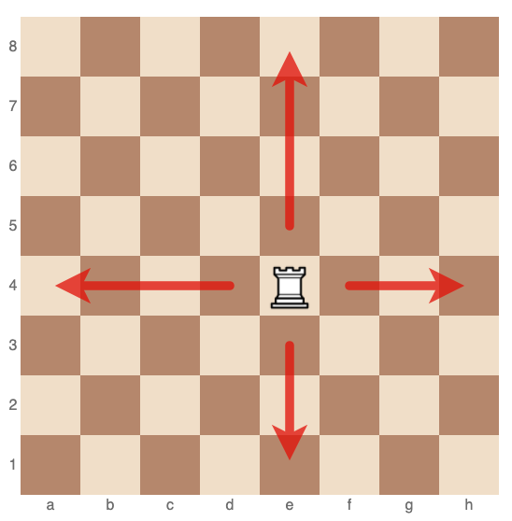
The ROOK
The Rook is the next very powerful piece after Queen.The Rook moves vertically or horizontally, making it a very powerful piece that can control large sections of the board. Its range is the source of its power

Slide 15
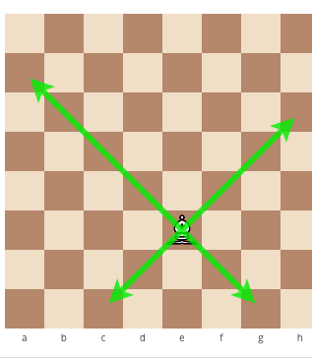
The BISHOP
The Bishop comes next to Rook in terms of power. The Bishop can move to any square along its diagonals as long as its path is not blocked. Its range is the source of its power

Slide 16
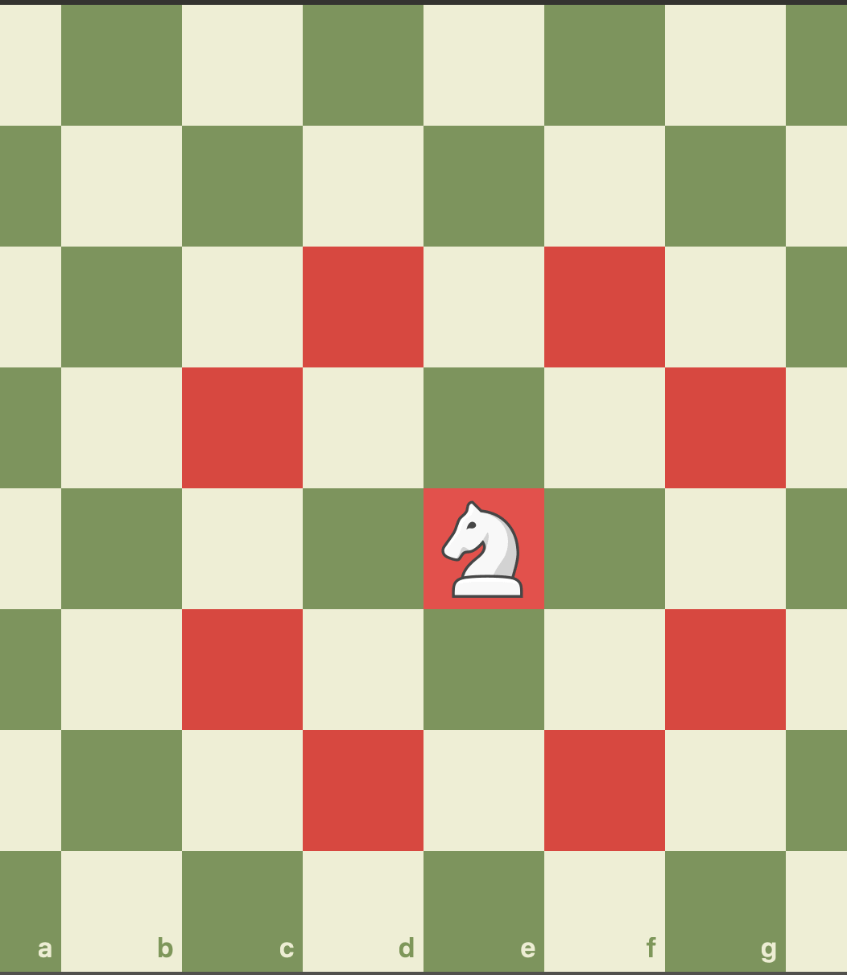
The KNIGHT
The Knight is nearly as powerful as the Bishop. The Knight is the only piece that can hop over other pieces in an L-shaped path. This ability makes it particularly powerful in the early stage of a game when the board is crowded with pieces

Slide 17
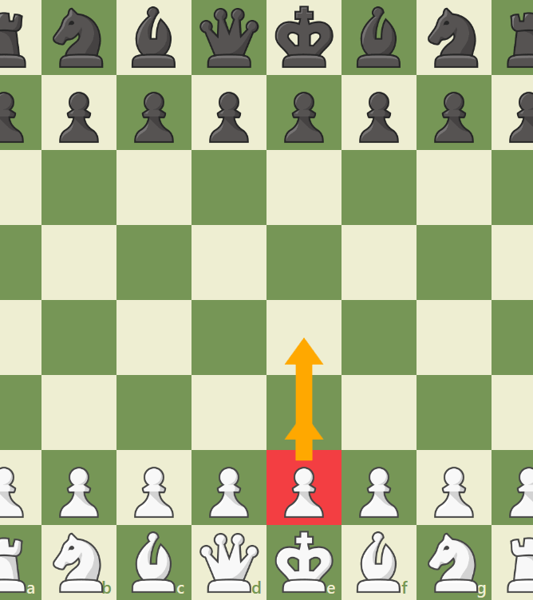
The PAWN
The Pawn is the least powerful piece because of its poor mobility. The Pawn may move only one square forward if its path is not blocked. However, it may move as an option one or two squares forward on its first move only. It may capture only one square diagonally

Slide 18
Non-functional requirements
Usability: The game should be easy to learn and play, with clear and intuitive controls.
Performance: The game should run smoothly on a wide range of hardware configurations, without significant lag or crashes.
Compatibility: The game should be compatible with different operating systems and devices, including desktop computers, laptops, and mobile devices.
Sound: The game should have high-quality sound effects and music, that enhance the player's experience.

Slide 19
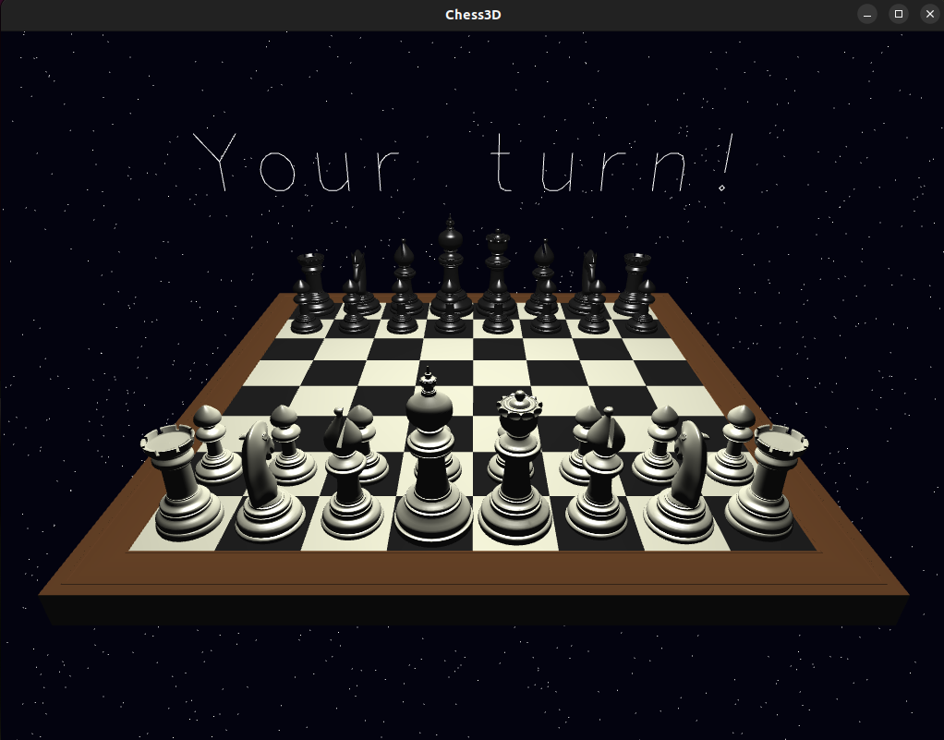
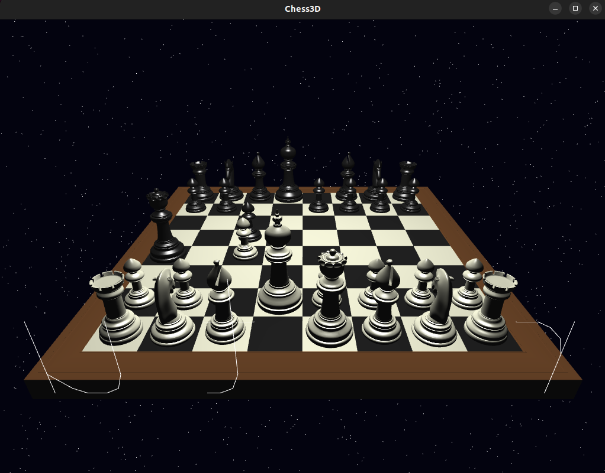
Screenshot
When we have start the game
When we have playing the game

Slide 20
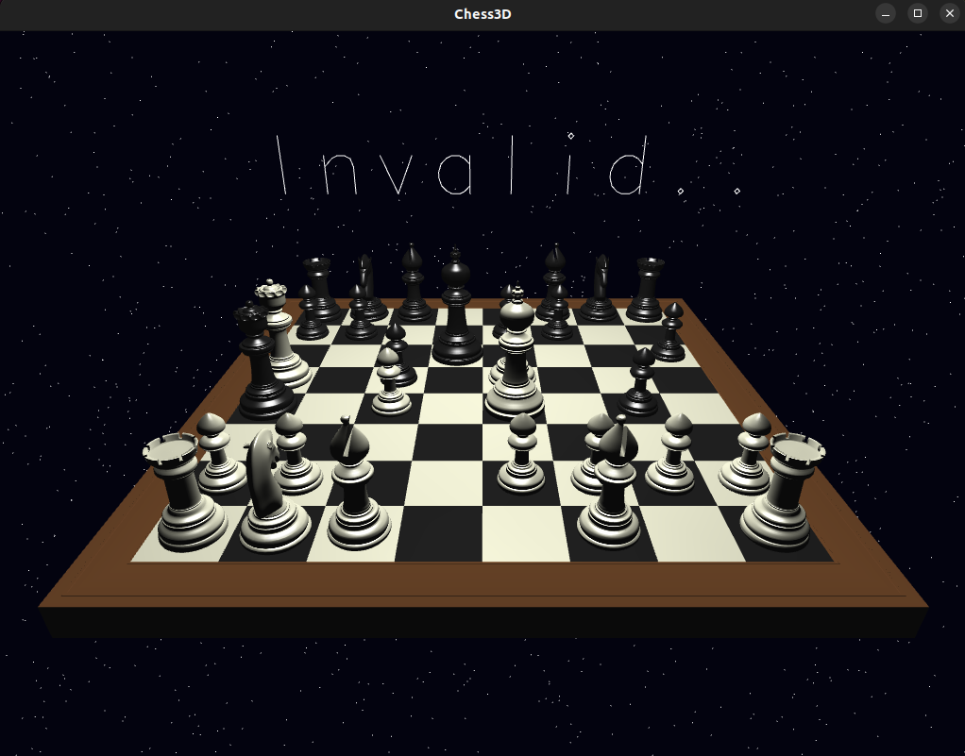
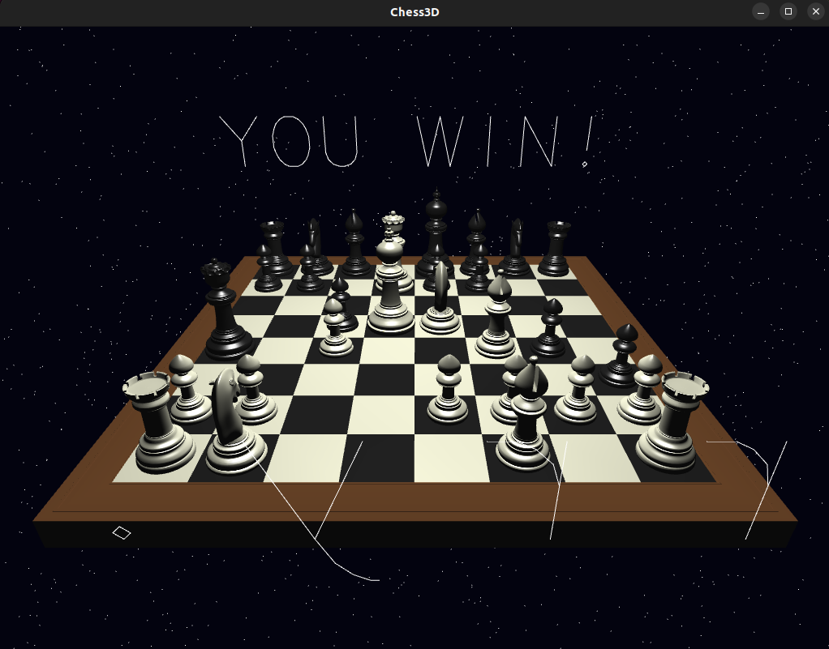
Screenshot
When we have taken wrong step
When we have win the match

Slide 21
Scope of Project:
Chess is a two-player game which is played on a chessboard. Chess comprises on 64 squares arranged by eight rows and eight columns. It is very popular games played internationally by millions of people. This document explains all features, functions, and constraints of this program

Slide 22
Conclusion
The conclusion of a 3D chess game, like any chess game, is determined by the outcome of the play. The game ends when one player's king is checkmated, meaning that the king is in a position to be captured (in check)
and there is no way to move the king out of capture (mate). A player may also resign, forfeit the game, or the game may end in a draw if neither player has a chance of winning.
In the case of a draw, this can occur when neither player has enough pieces to checkmate the other, when a stalemate occurs (where a player cannot make a legal move), or if the same position is repeated three times.

Slide 23
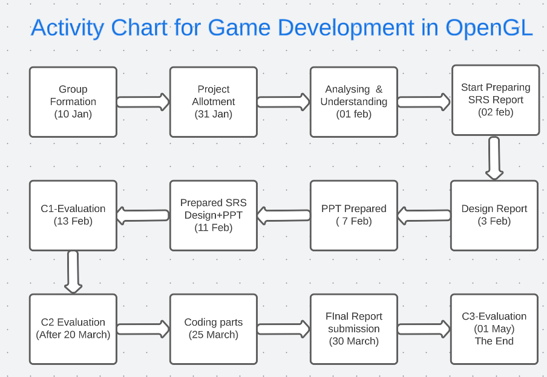
Work Scheduler

Slide 24
References
[1] Chess Gaming and Graphics Using Open-Source Tools
https://ieeexplore.ieee.org/document/5328146
[2] geekforgeeks
https://www.geeksforgeeks.org/draw-a-chess-board-using-graphics-programming-in-c/
[3] Chess Gaming and Graphic
https://citeseerx.ist.psu.edu/document?repid=rep1&type=pdf&doi=bddeb8c213b6078880621977cdca95cd7f18b940
[4] Chess cum Chat Application
file:///C:/Users/Rahul%20Mahto/Desktop/Chess_major_project.pdf.pdf

