Slide 1
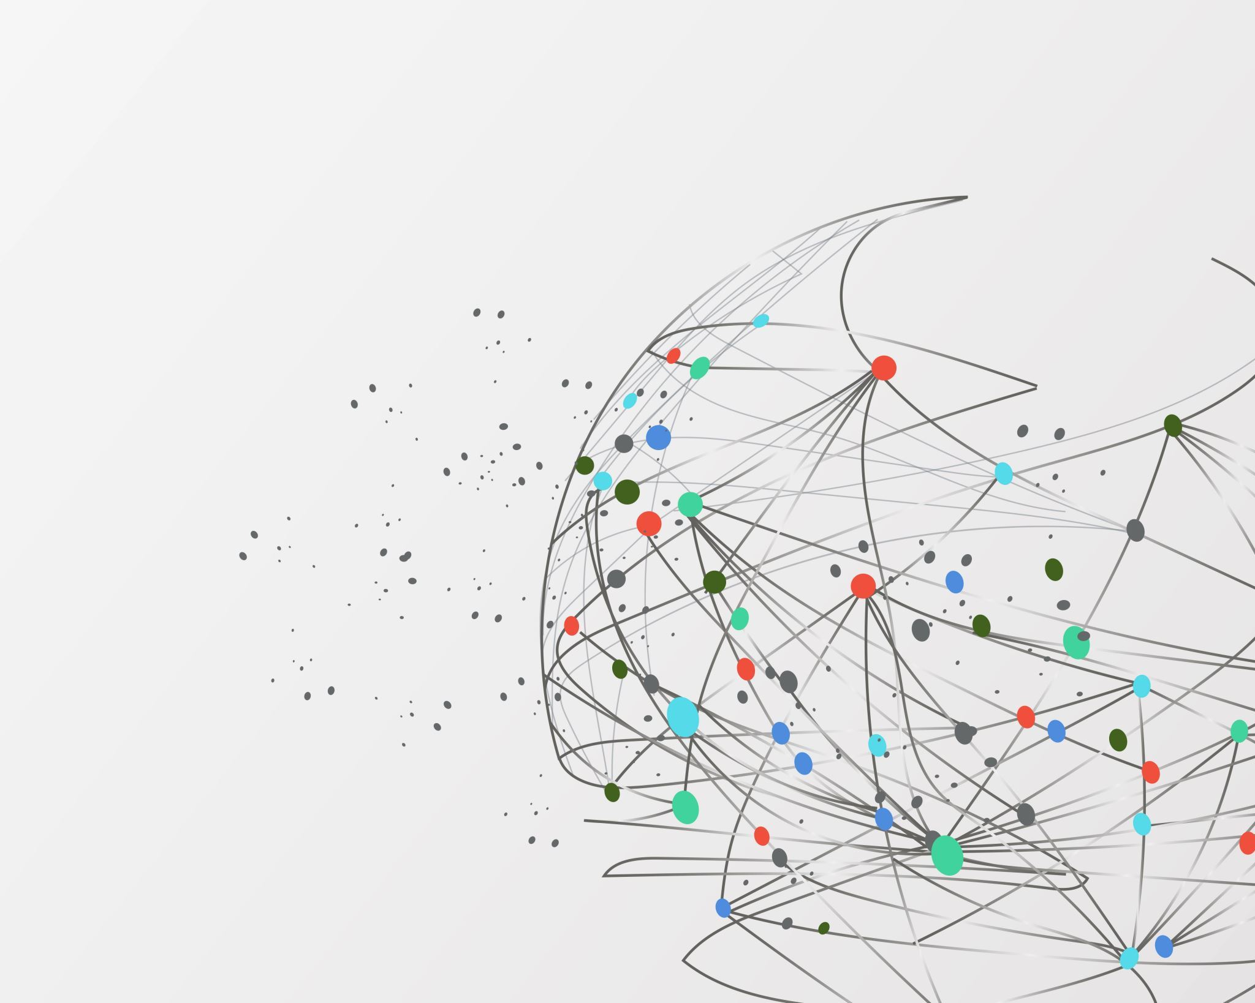
Extracting Event Information from News Articles
Name – Shubham Kumar Bhokta
Roll No - IIT2020007

Slide 2

Abstract
Extracting event information from news articles is an important task in natural language processing and information extraction
The goal of this project is to identify and extract the key event information, such as the event type, event location, time, and participants, from news articles
We propose a pipeline that consists of several stages, including text preprocessing, named entity recognition, relation extraction, and event extraction

Slide 3

Introduction
Extracting event information from news articles involves identifying the key events and their associated attributes, such as the location, time, and participants involved.
This can be a challenging task, as news articles can be written in different styles and may contain a variety of information that is not directly related to the event.
NLP techniques can be used to process large amounts of textual data and extract the relevant information in a structured format.

Slide 4
Methodology
Data Collection
Collect the news articles from various sources and store them in a suitable format. The news articles can be collected using a csv file.

Slide 5
Methodology
Pre-processing
The collected data needs to be pre-processed to remove any irrelevant information or noise. This can be done using techniques like stop-word removal, tokenization.

Slide 6
Methodology
Named Entity Recognition (NER)
Perform Named Entity Recognition on the pre-processed data to identify and extract relevant entities like people, organizations, and locations mentioned in the news articles. This can be done using NLP libraries like spaCy or NLTK.

Slide 7
Methodology
Event Extraction
Use the information obtained from NER to identify the key events or actions mentioned in the news articles. This can be done using techniques like rule-based extraction.

Slide 8
Methodology
Event Clustering
Group similar events based on their semantic similarity, time, and location. This step helps in summarizing the events and identifying the key events. Using dbscan we have done event clustering.

Slide 9
Methodology
Event Classification
Classify the extracted events into different categories based on their type and relevance to the news article. This can be done using supervised or unsupervised machine learning algorithms.

Slide 10
Conclusions
Extracting event information from news articles can be a challenging task due to the complexity of natural language and the variety of ways in which events can be described. However, with the help of advanced computational techniques and natural language processing (NLP) tools, it is possible to automatically extract relevant information from news articles and identify key events.

Slide 11
Github Link
Link - https://github.com/jnvshubham7/NLP_Project

Slide 12
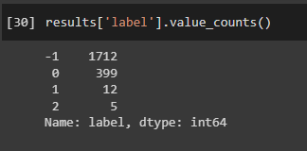
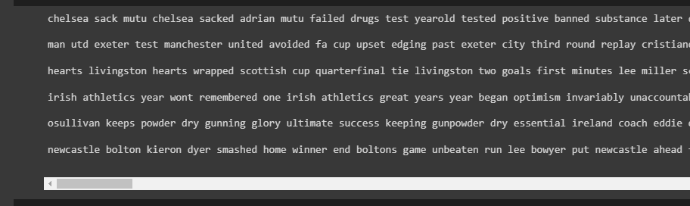
Results

Slide 13
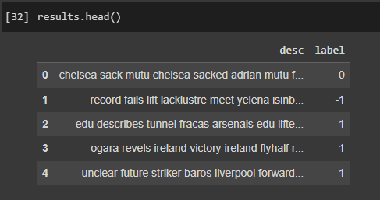
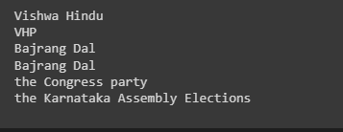
Results

Slide 14
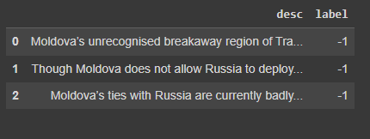
Results

