Slide 1

Indian Institute of Information Technology Allahabad
Prayagraj (UP) India
Identification of Artificially Generated Images
Group Members:
Rohit Choudhury (IIT2020043)
Mohit Kumar (IIT2020220)
Shashikant Thakur (IIT2020024)
Shubham Kumar (IIT2020007) Rahul Mahto (IIT2020022)
Supervised By :
Prof. Shiv Ram Dubey

Slide 2
Introduction
The rise of AI in image processing and computer vision has given rise to convincingly deceptive synthetic images.
These artificial images, which are frequently created using deep learning models, present a serious threat to the reliability and authenticity of visual content.
So we present a comprehensive approach to recognize artificially generated image using a ResNet-based framework.

Slide 3
LITERATURE REVIEW
[1] Exposing computer generated images by using deep convolutional neural networks
This paper uses a deep architecture based on a convolutional neural network (CNN) to classify each image from the dataset. The raw RGB pixels are used as dataset. The deep CNN architecture is based on the ResNet-50 model and the method uses transfer learning techniques.
[2] Distinguish computer generated digital images: A CNN solution - Ming He
The research utilises a Convolutional Neural Network (CNN) model that incorporates VGG19 and ResNet50 architectures. To tackle the challenge posed by limited training data, the study introduces the concept of transfer learning. The chosen loss function is Softmax, and Training Settings including data augmentation are discussed.
[3] CIFAKE: Image Classification and Explainable Identification of AI-Generated Synthetic Images - Jordan J. Bird, Ahmad Lotfi
The study compares AI-generated images using synthetic data that looks like CIFAR-10. With a 92.98% accuracy rate, a Convolutional Neural Network (CNN) classifies images as real or artificial intelligence (AI) generated.

Slide 4
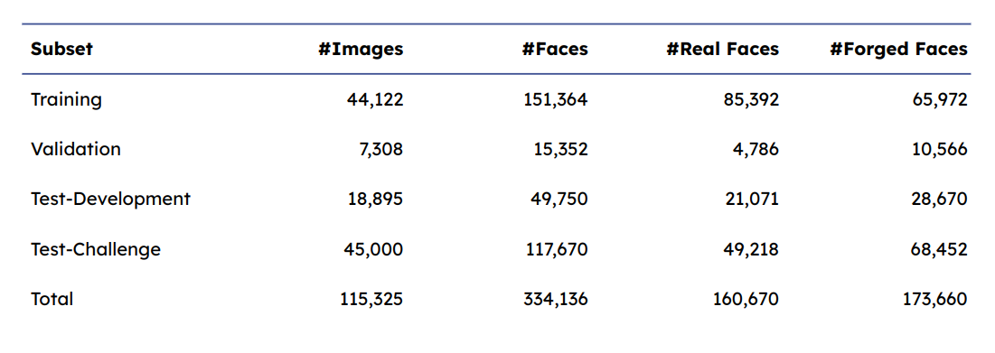
Dataset Description
Our dataset comprises both manipulated and authentic images, with the former depicting artificially generated faces through various methods.
The dataset was sourced from https://zenodo.org/record/5528418#.YpdlS2hBzDd
and was further processed to maximize the utility of these images.
Each image in the dataset is a 256 x 256 jpg representation of a human face, presenting either a genuine or fabricated portrayal.

Slide 5
ResNet(Residual Neural Network)
1) Residual Block: Introduces a building block that enables the learning of residual functions, addressing the vanishing gradient problem in deep neural networks.
2) Skip Connections: Connects input and output across layers, facilitating the flow of information and mitigating degradation issues in the training of deep networks.
3) Identity Mapping: Aims to learn an identity function within residual blocks, enhancing model convergence and enabling the training of deeper networks.
4) Bottleneck Architecture: Utilizes a three-layer structure in residual blocks, reducing computational complexity and enhancing the efficiency of deep neural networks.
5) Architecture Depth: ResNet achieves remarkable depth, enabling the training of very deep networks with hundreds or even thousands of layers.
6) Batch Normalization: Normalizes intermediate layer inputs, reducing internal covariate shift and accelerating training convergence in deep neural networks.

Slide 6
Experimental Settings
In our settings, we configured the notebook options as follows:
- Accelerator: GPU T4*2
- Language: Python

Slide 7
Methodology
[1] Data Collection:
Real images - Gather the relevant real images for testing
Artificially Generated images - using some method like Dall-E or GAN
[2] Data Preprocessing:
Resize all images to a 256 x 256 jpg size.
Normalize pixel values to a common scale (e.g., [0, 1] or [-1, 1]).
[3] Model Architecture:
We opted for pre-trained ResNet50 and CNNs as our models.
[4] Data Partitioning:
The dataset is divided into test (18k images) , validation(7k Images ), training sets(44k Images).
[5] Model Training:
Train the model on the real and generated images
Using binary cross-entropy loss since it is a binary classification task.
[6] Evaluation of Model:
We tested the model on separated test dataset for evaluation refer the below sides for performance metric

Slide 8
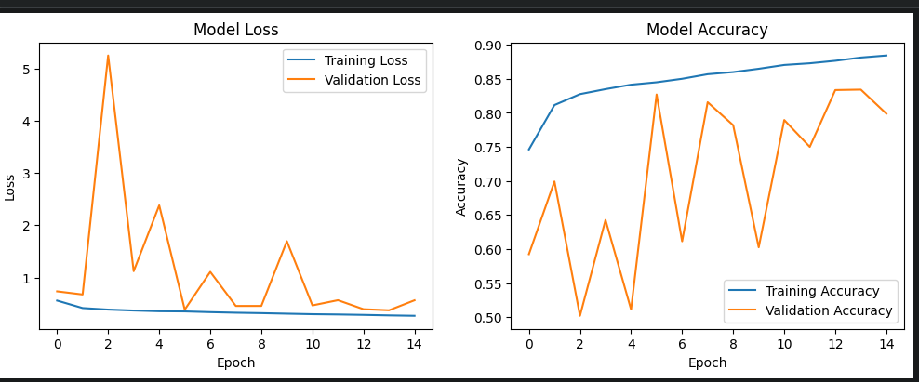
Results and Analysis

Slide 9
Results and Analysis
The accuracy of our model stands at a noteworthy 77%, showcasing its proficiency in predictions.
With a precision of 86%, our model excels in correctly identifying positive instances with accuracy.
The F1-score, a balanced metric at 0.71, underscores our model's effectiveness in minimizing false predictions.

Slide 10
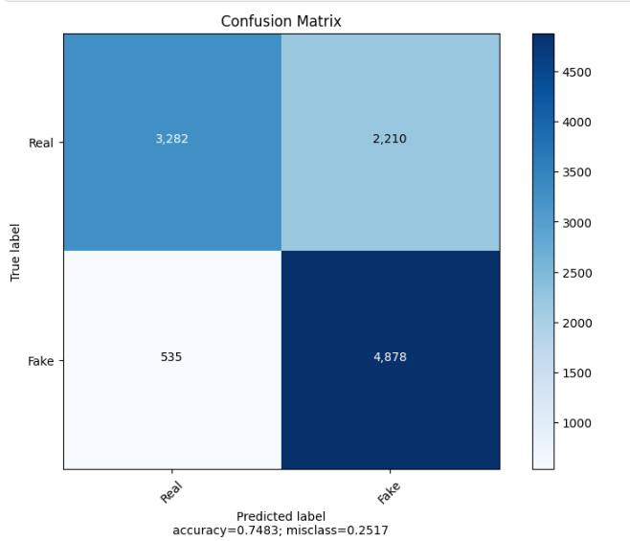
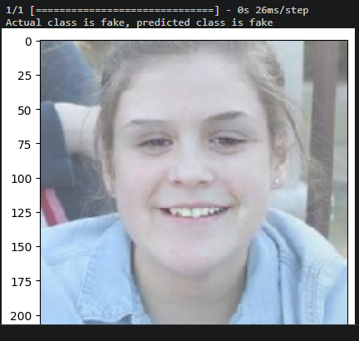
Results and Analysis

Slide 11
Conclusion
Because AI and deep learning are developing so quickly in the digital age, it is more important than ever to identify artificially generated images.
These technologies enable the creation of extremely lifelike counterfeit images, opening the door to potential abuse.
To tackle this obstacle, a variety of inventive methods—from conventional forensics to state-of-the-art deep learning are needed.
And our method serves as an efficient way to identify Artificially Generated Images.

Slide 12
References
[2303.14126] CIFAKE: Image Classification and Explainable Identification of AI-Generated Synthetic Images
https://www.sciencedirect.com/science/article/pii/S0923596518303205
https://onlinelibrary.wiley.com/doi/full/10.1002/cpe.4788

Slide 13
Thank You

