Slide 1
中国开始沦为半殖民地半殖民社会
Report By LubsWang feat. Icb

Slide 2
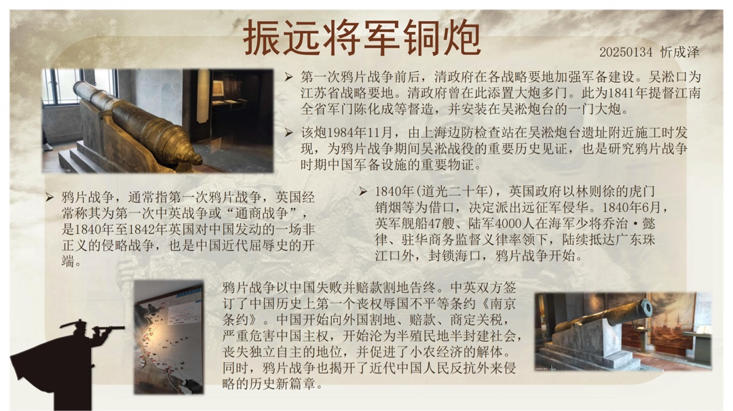



Slide 3
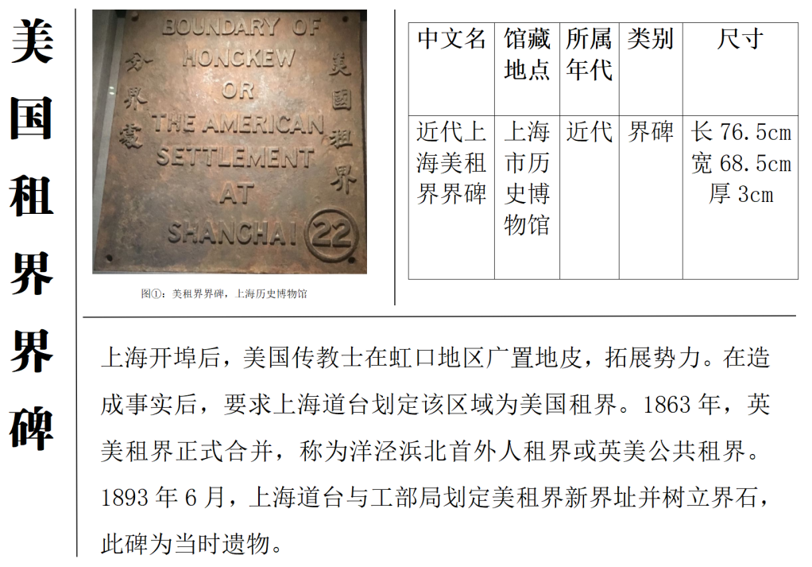

Slide 4
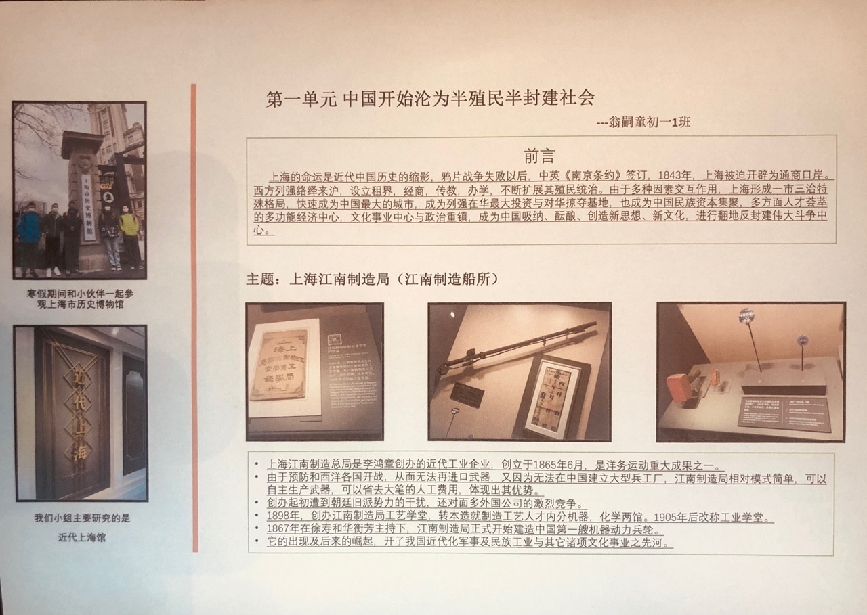

Slide 5
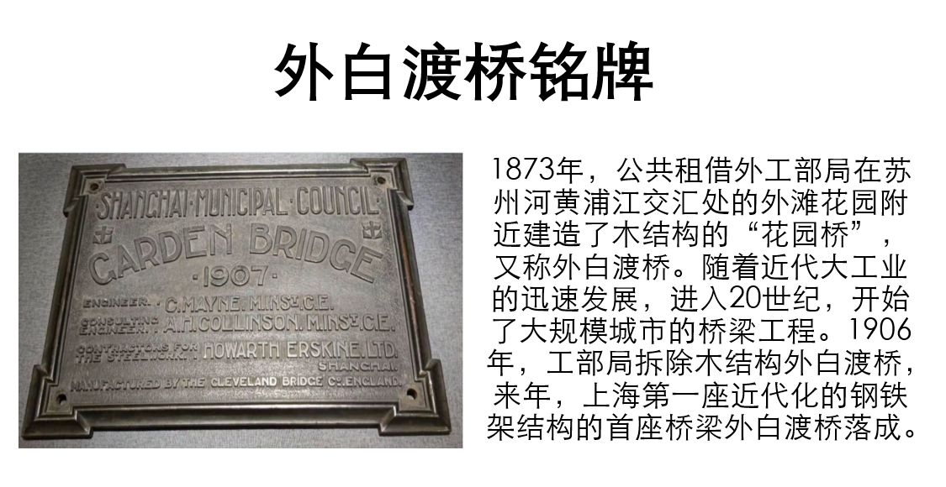

Slide 6
Thanks For Watching
Made By LubsWang Feat. Icb

