Slide 1
Environment Protection Portal Development Project
2020 K-MOVE Java Web Project
Team GRÜNWELT
JONGNAM WON, HYEYOUNG SIM,
GEON JO, DAMBI YU, JAEHYEONG GIL

Slide 2
Team Members
Project Overview
Project Development Environment
Structure of Web Page
ERD
Features & Demonstration

Slide 3
1. Team Members
JONGNAM WON
Project planning, Research, Main Developer, Main DB Designer
HYEYOUNG SIM
Research, Main Developer, Main Web Designer
GEON JO
Research, Sub Developer
DAMBI YU
Research, Sub Developer
JAEHYEONG GIL
Research, Main Developer

Slide 4
2. Project Overview
Collects/edits data of environmental themes from various countries and provides users those information
Provides features for group gathering, who want to discuss of common interesting themes

Slide 5
3. Project Development Env.
Back-end : Java (Model2 structured)
Front-end : JSP / Jquery / Bootstrap
Data communication : Ajax / Curl REST API
Database : MySQL
Server : Amazon EC2 / Tomcat 9
IDE : Eclipse
Version control : Github
Project management : Redmine
(http://54.180.97.42/projects/k-move)

Slide 6
4. Structures
Source
Web site
MySQL
MVC structured
REST API
/Web Crawling
JDBC
View
(JSP / JS)
Controller
(Java Servlet)
Model
(Java Class)
Ajax
/Legacy

Slide 7
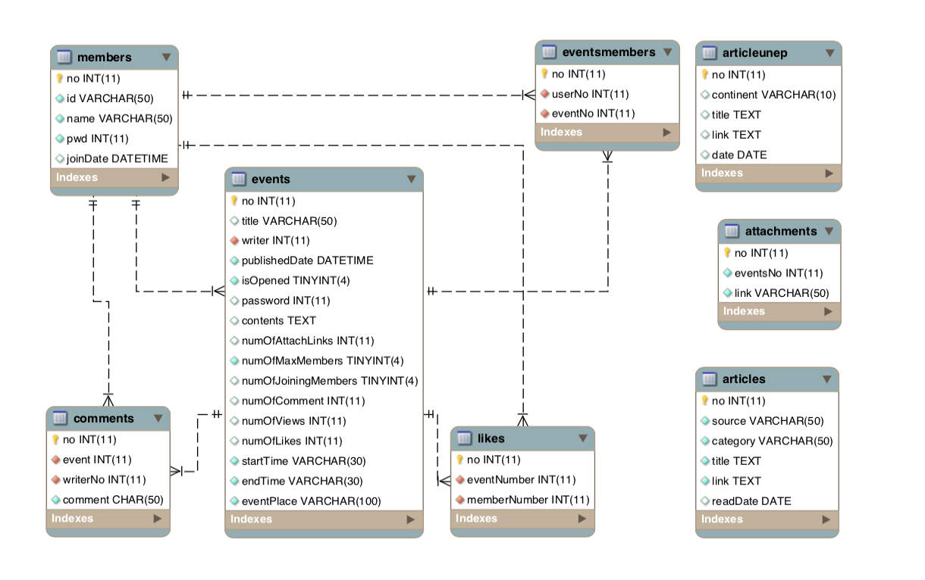
5. ERD

Slide 8
6. Features
http://54.180.92.20:8080/gruenwelt/main.um
Main page
News search : SIM
Articles
European Environment Agency : JO
US Environmental Protection Agency : YU
UN Environment Programme : GIL
Events brief & Map data : WON
Implementation
Outer API : SIM(News), WON(Map data)
Article links crawling : GIL & WON
Database querying : JO, YU, GIL, WON

Slide 9
6. Features(cont.)
Article board : SIM
Outer API Implementation : SIM(News)
Community board : SIM
Events listing
Event register
Event viewer
Implementation
Database querying : SIM
Database design : WON
Login / Join : WON

Slide 10
Furthermore..

