Slide 1


Slide 2
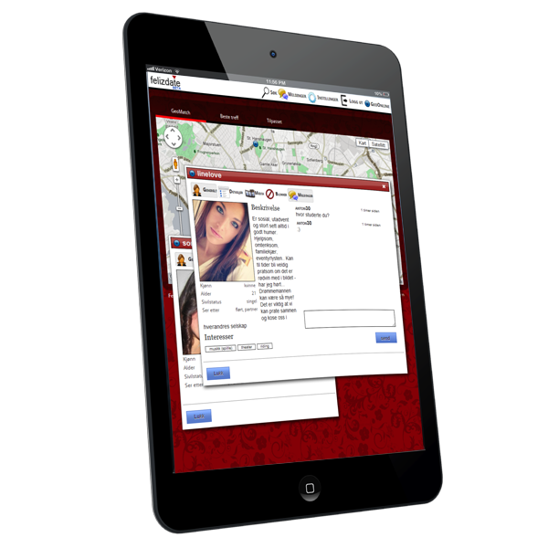
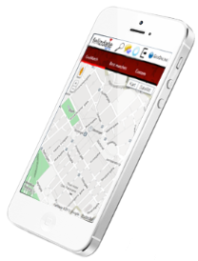
Overview clientside
Mobile phone app
Apache Cordova
Provides JavaScript API to mobilefunctions like vibration, gyro etc.
www.felizdate.com
Refers to
Amazon CloudFront
Codebase clientside app/static content (JS/CSS/images etc.)

Slide 3
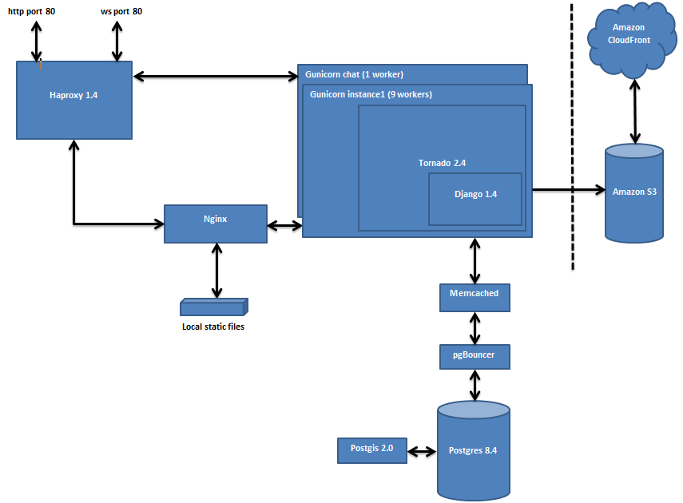
Server environment
www.felizdate.com

Slide 4
Architecture
Uses third party content delivery networks (CDN) for static content
Optional Facebook auth registration process (for faster profile registration)
ONE clientside codebase
Advantages
Let CDN providers do what they are best at, and get stable high speed access to static resources
Ease registration process for customers
One codebase = less to update/maintain
Result
Improved UI response and less hassle for customer
Effort is moved from updating/maintaining many codebases to quality imprivement and innovation OR improved delivery times

Slide 5
Clientside application (simplified)
ObservableModel
notifyObservers(eventtype, parameters)
addObserver(observer)
removeObserver(observer)
View
handleModelEvent(eventtype, parameters)
setLoginState(state)
processMessage(message)
showProfileDialog(profileId)
showDialog(dialogtype, message)
closeAllDialogs()
handleMenuOption(option)
render()
1 1
App (singleton)
Start()
1 1
1
1
Platform specific libs
cordova.js
android_websocket.js
(loaded if needed)
Controller
performAction(request)
handleSuccessResponse(response)
handleErrorResponse(response)
handlePushResponse(response)
Static app utilities

Slide 6
Clientside
Uses Mootools & jQuery as DOM bridgEach view object is rendered as DOM element with class-name set as CSS class
DOM is accessed in a transactional manner and ONLY used for event API & view rendering
Advantages
Cross browser issues are much outsourced to DOM handler providers. Developers can focus on business logic.
Makes life easier for an unorganized designer (structured styling basis is provided)
Result
Improved delivery times and UI response = higher customer satisfaction!

Slide 7
Serverside application (simplified)
URL mapped actions
Login(…)
setStatus(…)
Logout(…)
getUserSession(…)
setPosition(…)
getOptions(…)
getProfile(…)
sendMessage(…)
...
Django models
Worker
City
Country
Occupation
EducationalDegree
Political
Religion
Hairtype
Eyecolor
Bodytype
Category
Interest
UserProfile
Media
PendingProfileImages
Message
Membership
CustomUser
Django persistence layer
handlerUtils.py
Generic JSON converters, response types etc.

Slide 8
Serverside
Facilitates existing functionality in Tornado/Django framework to handle wsgi transactions (HTTP & WebSocket) and data-layer/DB. Use existing developed functionality in framework
Uses generic JSON/result typecoverters
Uses Django driven tests db for integration tests on from action/request handler level and down
Advantages
Developers can focus on business logic & its less to do when customer changes his mind. This means more time to improve tests/coverage which gives higher teqhnical quality.
Result
Improved delivery times/less bugs = higher customer satisfaction!

