Slide 1
Classifying Cancer Cells Using Local Binary Patterns
Hugo Harlin and Joe Gay
Supervisors: Joakim Lindblad, Natasa Sladjoe
Centre for Image Analysis, Department of Information Technology, Uppsala University

Slide 2
Project Goal
Classify images of cancer cells using Local Binary Patterns
Compare three LBP inspired CNN models
- Juefei-Xu et al. [1]
- Li et al. [2]
- Marcos et al. [3]
LBP’s: What are they?
[1] Felix Juefei-Xu, Vishnu Naresh Boddeti, and Marios Savvides. Local binary convolutional neural networks. In Computer Vision and Pattern Recognition (CVPR), 2017 IEEE Conference on , volume 1. IEEE, 2017
[2] Lei Li, Xiaoyi Feng, Zhaoqiang Xia, Xiaoyue Jiang, and Abdenour Hadid. Face spoofing detection with local binary pattern network. Journal of Visual Communication and Image Representation, 54:182–192, 2018.
[3] Diego Marcos, Michele Volpi, Nikos Komodakis, and Devis Tuia. Rotation equivariant vector field networks. In ICCV, pages 5058–5067, 2017.

Slide 3

Local Binary Patterns
Concieved by Ojala et al in 1996 and extended in 2002. [1]
Rotational invariant thresholding filters
P uniformly spaced points
Center pixel – threshold
Generates binary string
Encoding:
${LBP}_{P,R}= \sum_{p=0}^{P−1}{ s(g_{p}−g_{c})2^{p}}$
P = Number of points
R= Radius
s = binary thresholding function
$g_{p }, g_{c}$ = intensity values
P = 8, R = 2
[1] Timo Ojala, Matti Pietikainen, and Topi Maenpaa. Multiresolution gray-scale and rotation invariant texture classification with local binary patterns. IEEE Transactions on pattern analysis and machine
intelligence, 24(7):971–987, 2002.

Slide 4








Data
10274 80x80 images (75% healthy)
Cells sampled from patients mouth
Three healthy patients, three with cancer
Ground truth on patient level, not cell level
Healthy Cells
Cancer Cells

Slide 5
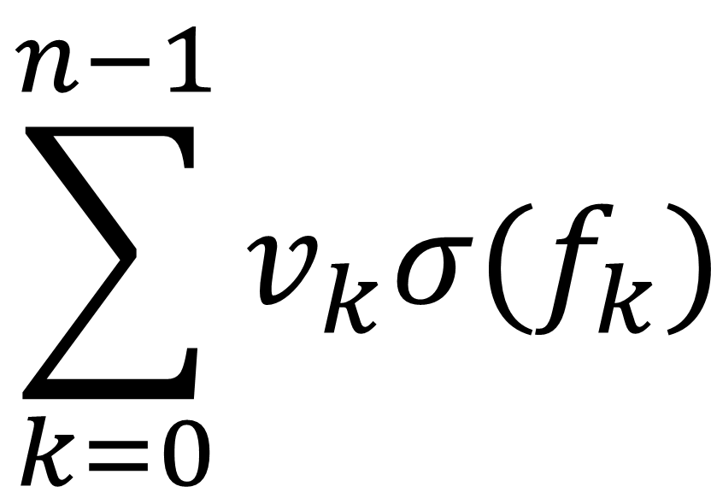



Model 1: Juefei-Xu et al.
Idea: Fixed LBP-inspired convolutional layers
LBCCN Module
3x3 filters with randomly arranged values of 1 and -1
Sigmoid activation to smooth noise
Multiply each output by learnable constant $v$
1 | 0 | 0
0 | -1 | 0
0 | 0 | 0
1 | 1 | 0
0 | 0 | 0
0 | 0 | 0
$$\sum_{k=0}^{n−1}{v_{k}σ(f_{k})}$$
0 | 1 | 0
0 | 0 | 1
0 | -1 | 0
$$…$$
Apply 𝑛 fixed convolutional filters
to image, giving outputs $f$
Calculate weighted sum of
outputs for each pixel
These form a feature map
which can be used in
further layers

Slide 6
Model 2: Li et al.
Network comprised of four sequentially coupled modules
- Convolutional Module
- LBP Module
- Gate Layer Module
- Standard dense NN module

Slide 7
Model 2: Convolutional Module
1 | 0 | 0
0 | -1 | 0
0 | 0 | 0
Convolutional Layer
Sigmoid
Values in range [0,1]
BN
0 | 1 | 0
0 | -1 | 0
0 | 0 | 0
Sum Layers
BN
.
.
.
0 | 0 | 0
1 | -1 | 0
0 | 0 | 0
BN

Slide 8
Model 2: Gate Layer Module
Average Pooling
concatenate
2
Size: [1x1]
0
0.5
1
.
.
2
.
1
1.5
2
.
.
.
.
.
.
.
.
2
.
7
7.5
8
.
.
.

Slide 9
Model 3: Marcos et al.
Not based on LBPs
Rotationally invariant groups of filters
Each group consists of R filters
Only the first is trainable
The rest are rotations
Input is passed to each filter in parallel
The output of the group is combined into a vector field

Slide 10



Convolutional Module
Filter 1
Filter 2
Filter 8
1 | 0 | 0
0 | -1 | 0
0 | 0 | 0
0 | 1 | 0
0 | -1 | 0
0 | 0 | 0
0 | 0 | 0
1 | -1 | 0
0 | 0 | 0
. . .
$$2^{0}$$
$$2^{1}$$
$$2^{7}$$

