Slide 1
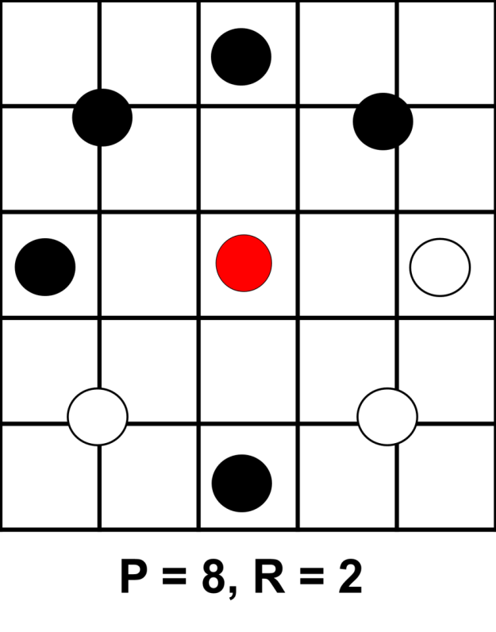









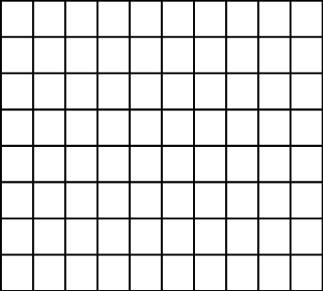

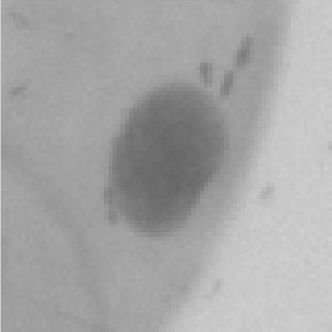
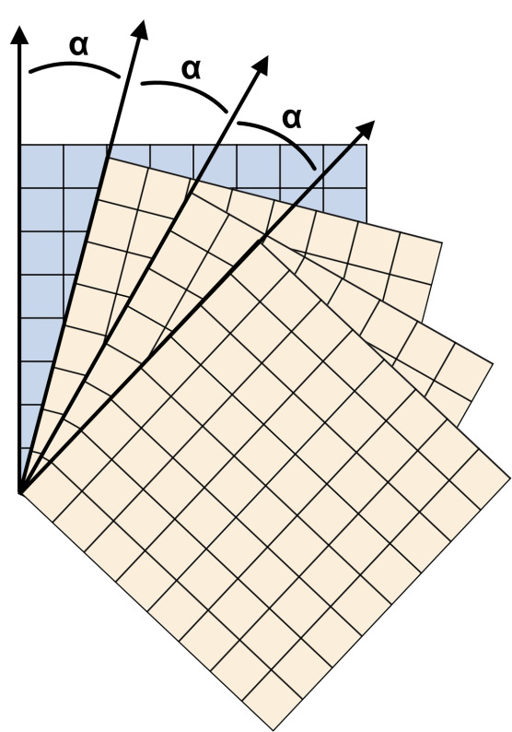
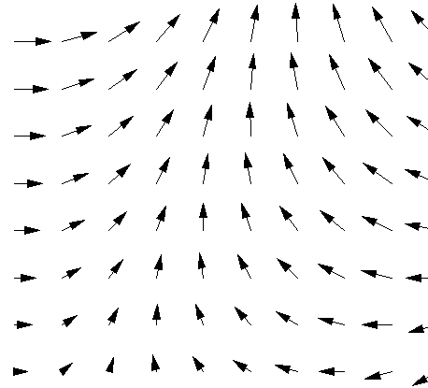
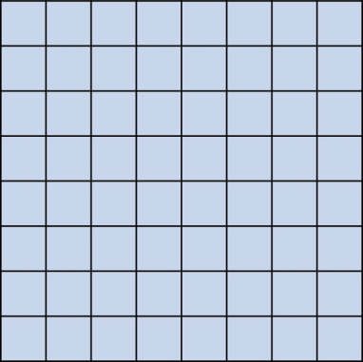


Detecting Cancer using Texture Classification
Project Goals
Local Binary Patterns
Data
Compare ability of methods to classify cell images as healthy or cancerous
Evaluate power of texture descriptors, in particular LBPs, to improve on performance of purely CNN-based approaches
Implement and compare three recently published models
Juefei-Xu et al. [3]
Li et al. [4]
Marcos et al. [5]
Compare with previous work using VGG and ResNet [1]
LBPs [2] are powerful texture classifiers
Use intensity level of central pixel to threshold intensity values of P points surrounding it at radius R
Binary string gives pattern index
Rotational equivalents may be combined
6 patients, 3 with cancer and 3 healthy
10274 cell images, size 80x80
Individual cells have been identified in samples from the patients’ mouths [1]
Only patient diagnosis known, not individual cell classification
Jo Gay
Hugo Harlin
Project in Computational Science, January 2019
Supervisors:
Joakim Lindblad Nataša Sladoje
Centre for Image Analysis,
Department of Information Technology
11101001
=
00111101
Healthy Cells
Cancer Cells
Three CNN Models
Results
…
1 | 1 | 0
0 | 1 | 0
-1 | -1 | 0
Model 1, Juefei-Xu et al.:
Fixed random ±1 filters
Weighted linear sum to create feature map
0 | 0 | 1
-1 | 0 | 1
1 | -1 | 0
$$\sum_{k=0}^{n−1}{v_{k}σ(f_{k})}$$
0 | 1 | 0
0 | 0 | 1
0 | -1 | 0
Input image
Output feature map
Model 2, Li et al.:
8 fixed difference filters
Sum of sigmoid activations
8 Gating functions applied to sum
Histogram of results
…
0 | 0 | 0
1 | -1 | 0
0 | 0 | 0
0 | 1 | 0
0 | 0 | 0
0 | -1 | 0
1 | 0 | 0
0 | -1 | 0
0 | 0 | 0
$$∑$$
Input image
Model | Accuracy | F₁-Score
Juefei-Xu [3] | 81.03 | 84.85
Li [4] | 78.57 | 83.02
Marcos [5] | 55.91 | 66.80
ResNet | 78.34 | 75.51
VGG | 80.66 | 77.68
Model 3, Marcos et al.:
Stack of rotated filters, adapted for vector field input.
The output angle is given by the rotation of the filter with highest activation
Activation magnitude & direction forms 2D vector field output
Input image
Trainable filter
Output vector map
fixed rotated copies
[1] H Wieslander, G Forslid, E Bengtsson, C Wählby, J Hirsch, C Runow Stark, S Kecheril Sadanandan. Deep convolutional neural networks for detecting cellular changes due to malignancy. In CVPR, pages 82–89, 2017
[2] T Ojala, M Pietikainen, T Maenpaa. Multiresolution gray-scale and rotation invariant texture classification with local binary patterns. IEEE Transactions on PAMI, 24(7):971–987, 2002.
[3] F Juefei-Xu, V Boddeti, M Savvides. Local binary convolutional neural networks. In CVPR, volume 1, 2017.
[4] L Li, X Feng, Z Xia, X Jiang, A Hadid. Face spoofing detection with local binary pattern network. Journal of Visual Communication and Image Representation, 54:182–192, 2018.
[5] D Marcos, M Volpi, N Komodakis, D Tuia. Rotation equivariant vector field networks. In ICCV , pages 5058–5067, 2017.

Slide 2
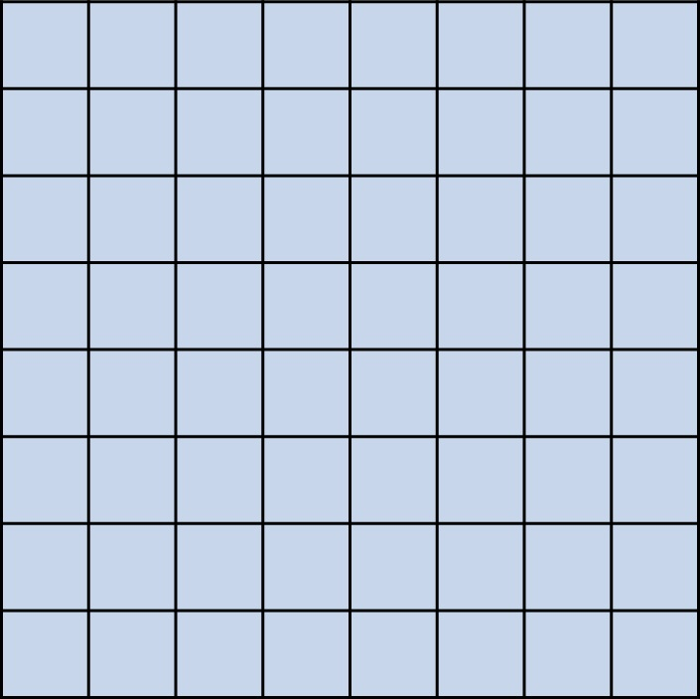
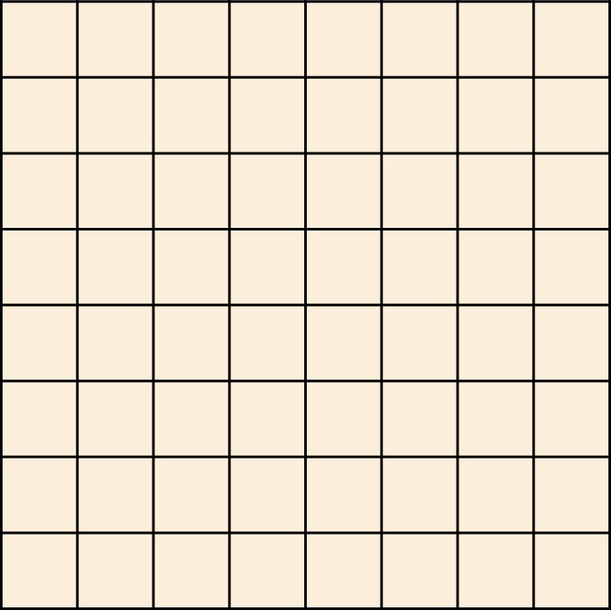
α
α
α

