Slide 1
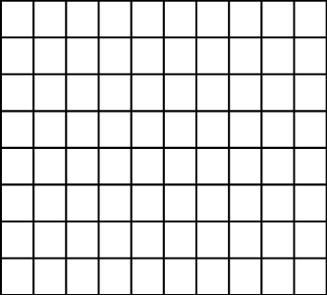
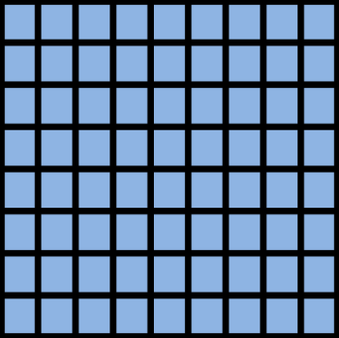
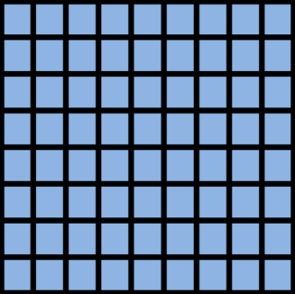
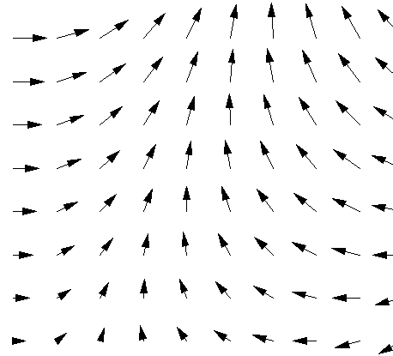
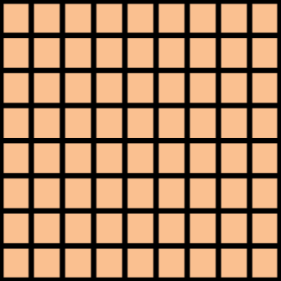




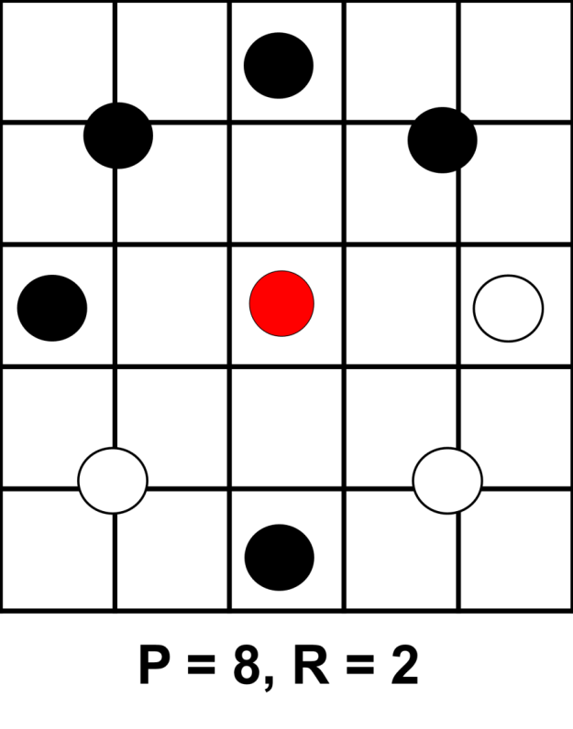





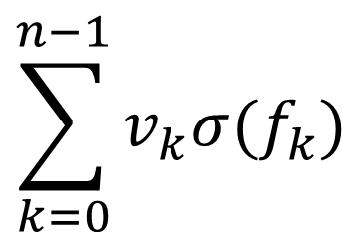
Detecting Cancer using Texture Classification
Project Goals
Three CNN Models
Compare ability of methods to classify cell images as healthy or cancerous
Evaluate power of texture descriptors, in particular LBPs, to improve on the performance of purely CNN-based approaches
Implement and compare three recently published models
Juefei-Xu et al. [3]
Li et al. [4]
Marcos et al. [5]
Compare with previous work using VGG and ResNet [1]
…
1 | 1 | 0
0 | 1 | 0
-1 | -1 | 0
$$\sum_{k=0}^{n−1}{v_{k}σ(f_{k})}$$
Model 1, Juefei-Xu et al.:
Fixed random ±1 filters
Weighted linear sum to create feature map
0 | 0 | 1
-1 | 0 | 1
1 | -1 | 0
0 | 1 | 0
0 | 0 | 1
0 | -1 | 0
Output feature map
…
0 | 0 | 0
1 | -1 | 0
0 | 0 | 0
Model 2, Li et al.:
8 fixed difference filters
Sum of sigmoid activations
8 Gating functions applied to sum
Histogram of results
Jo Gay
Hugo Harlin
Project in Computational Science, January 2019
Supervisors:
Joakim Lindblad Nataša Sladoje
Centre for Image Analysis,
Department of Information Technology
0 | 1 | 0
0 | 0 | 0
0 | -1 | 0
1 | 0 | 0
0 | -1 | 0
0 | 0 | 0
$$∑$$
Model 3, Marcos et al.:
CNN filters modified for vector input, plus rotational copies
Activation magnitude & direction forms 2D vector field output
Output vector map
Local Binary Patterns
Data
Results
LBPs [2] are powerful texture classifiers
Use intensity level of central pixel to threshold intensity values of P points surrounding it at radius R
Binary string gives pattern index
Rotational equivalents may be combined
6 patients, 3 with cancer and 3 healthy
10274 cell images, size 80x80
Individual cells have been identified in samples from the patients’ mouths [1]
Only patient diagnosis known, not individual cell classification
Model | Accuracy | F₁-Score
Juefei-Xu [3] | 81.03 | 84.85
Li [4] | 78.57 | 83.02
Marcos [5] | 55.91 | 66.80
ResNet | 78.34 | 75.51
VGG | 80.66 | 77.68
11101001
=
00111101
Healthy Cells
Cancer Cells
[1] H Wieslander, G Forslid, E Bengtsson, C Wählby, J Hirsch, C Runow Stark, S Kecheril Sadanandan. Deep convolutional neural networks for detecting cellular changes due to malignancy. In CVPR, pages 82–89, 2017
[2] T Ojala, M Pietikainen, T Maenpaa. Multiresolution gray-scale and rotation invariant texture classification with local binary patterns. IEEE Transactions on PAMI, 24(7):971–987, 2002.
[3] F Juefei-Xu, V Boddeti, M Savvides. Local binary convolutional neural networks. In CVPR, volume 1, 2017.
[4] L Li, X Feng, Z Xia, X Jiang, A Hadid. Face spoofing detection with local binary pattern network. Journal of Visual Communication and Image Representation, 54:182–192, 2018.
[5] D Marcos, M Volpi, N Komodakis, D Tuia. Rotation equivariant vector field networks. In ICCV , pages 5058–5067, 2017.

Slide 2
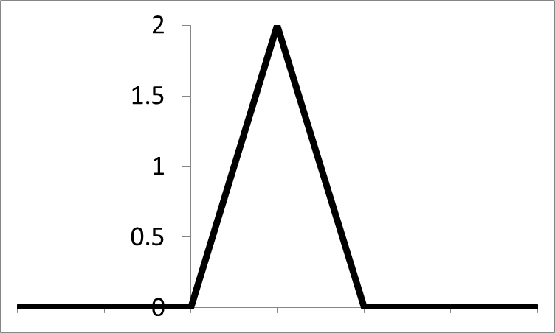

0
0
0
0
1
1
1
0
P = 8, R = 2
P = 8, R = 2

Slide 3
Old Background text:
Early detection of cancer plays a major role in reducing cancer mortality. With deep convolutional neural networks, it is becoming possible to automatically classify cell images as either healthy or cancerous, a task previously done manually by highly trained professionals.
Local binary patterns are very good at identifying textures, which has been hypothesized to be of importance in cell classification. In this project three recent LBP based networks are tuned and compared to conventional network architectures.
Removed text re LBPs
Group patterns which are rotationally similar
Translate binary string to pattern index
Distribution of patterns can be used to classify textures
Removed text re models
Three recently published LBP based architectures were implemented in this project, where the first two use LBPs directly in some form whereas the third model uses slightly different filters that share many properties with LBPs. [3] [4] [5]
Two conventional CNNs were used for benchmarking, Resnet and VGG.

