Slide 1
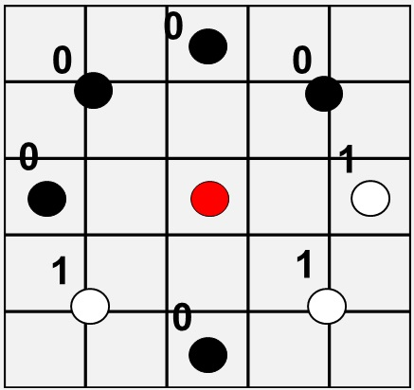








Detecting Cancer with Texture
Background
Local Binary Patterns
Models
Early detection of cancer plays a major role in reducing cancer mortality. With deep convolutional neural networks, it is becoming possible to automatically classify cell images as either healthy or cancerous, a task previously done manually by highly trained professionals.
Local binary patterns are very good at identifying textures, which has been hypothesized to be of importance in cell classification. In this project three recent LBP based networks are tuned and compared to conventional network architechtures.
Conceived by Ojala et al in 1996 and extended in 2002, and have been found to be powerfull classifiers of texture. [1]
LBPs compare P surrounding points at radius R, with the center pixel (red), and record either a 1 or a 0 depending which value is greater.
The resulting strings of 1 and 0’s are unique patterns, and are grouped such that it doesn’t matter where one starts recording the pattern. This encorporates rotation invariance into the filter.
Plotted in a histrogram, the LBPs can be used to classify texture.
Several improvements and adaptions of LBPs have been made since their advent in 1996, such as adapting the binary comparison of a center pivot element to surrounding pixels in conventional convolutional layers.
Three novel LBP based architechtures where implemented in this project, where the first two use LBPs directly in some form whereas the third model uses slightly different filters that share many properties with LBPs. [2] [3] [4]
Two conventional CNNs where used for benchmarking, Resnet and VGG.
Jo Gay
Hugo Harlin
Project in Computational Science, January 2019
Supervisors:
Joakim Lindblad Nataša Sladjoe
Centre for Image Analysis,
Department of Information Technology
00110100
=
Results
00001101
Data
R = 2, P = 8
Model | Accuracy | F-Score
Juefei [2] | 81.03 | 84.85
Li [3] | 78.57 | 83.02
Marcos [4] | 55.91 | 66.80
Resnet | 78.34 | 75.51
VGG | 80.66 | 77.68
The data set consisted of 10274 80x80 images of cells from six patients, three with cancer and three without. Cells were sampled from the mouth of the patient and placed on a glass and photographed.
Juefei, Li, and Marcos where the three LBP architechtures used in this project. Resnet and VGG are benchmark conventional networks.
Healthy Cells
Cancer Cells
[1] Timo Ojala, Matti Pietikainen, and Topi Maenpaa. Multiresolution gray-scale and rotation invariant texture classification with local binary patterns. IEEE Transactions on pattern analysis and machine intelligence, 24(7):971–987, 2002.
[2] Felix Juefei-Xu, Vishnu Naresh Boddeti, and Marios Savvides. Local binary convolutional neural networks. In Computer Vision and Pattern Recognition (CVPR), 2017 IEEE Conference on , volume 1. IEEE, 2017.
[3] Lei Li, Xiaoyi Feng, Zhaoqiang Xia, Xiaoyue Jiang, and Abdenour Hadid. Face spoofing detection with local binary pattern network. Journal of Visual Communication and Image Representation, 54:182–192, 2018.
[4] Diego Marcos, Michele Volpi, Nikos Komodakis, and Devis Tuia. Rotation equivariant vector field networks. In ICCV, pages 5058–5067, 2017

Slide 2
0
0
0
0
1
1
1
0
P = 8, R = 2

