Slide 1
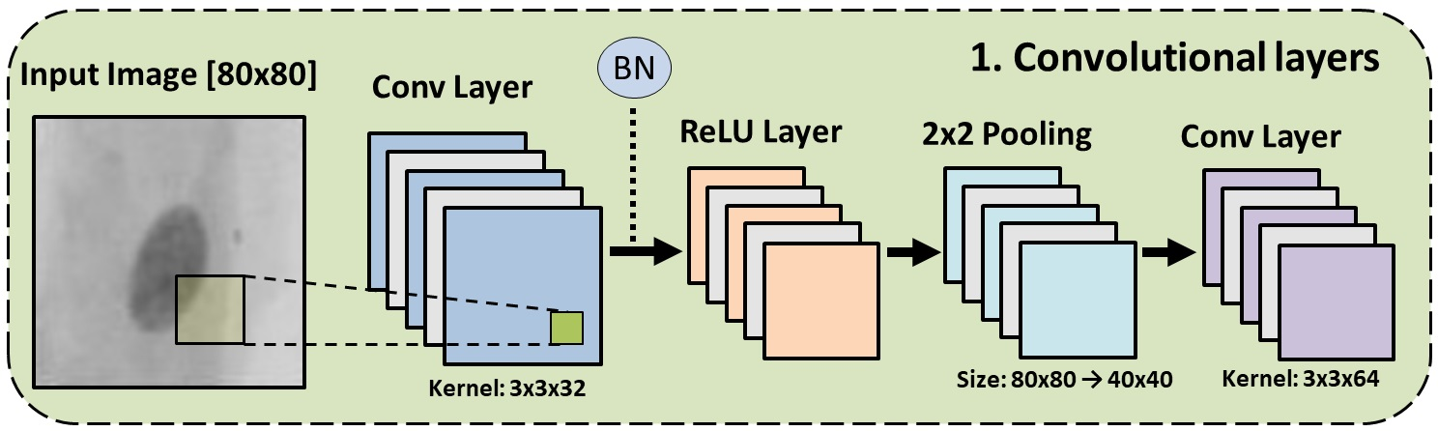
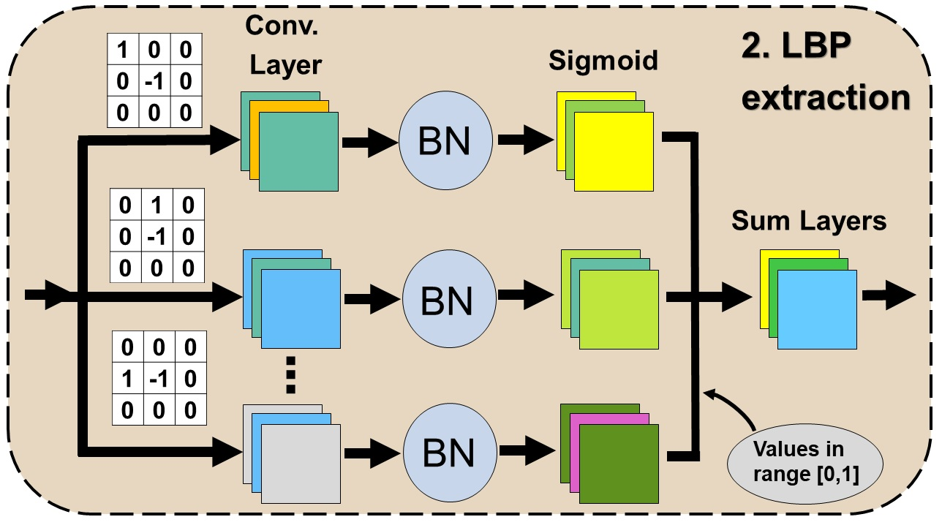
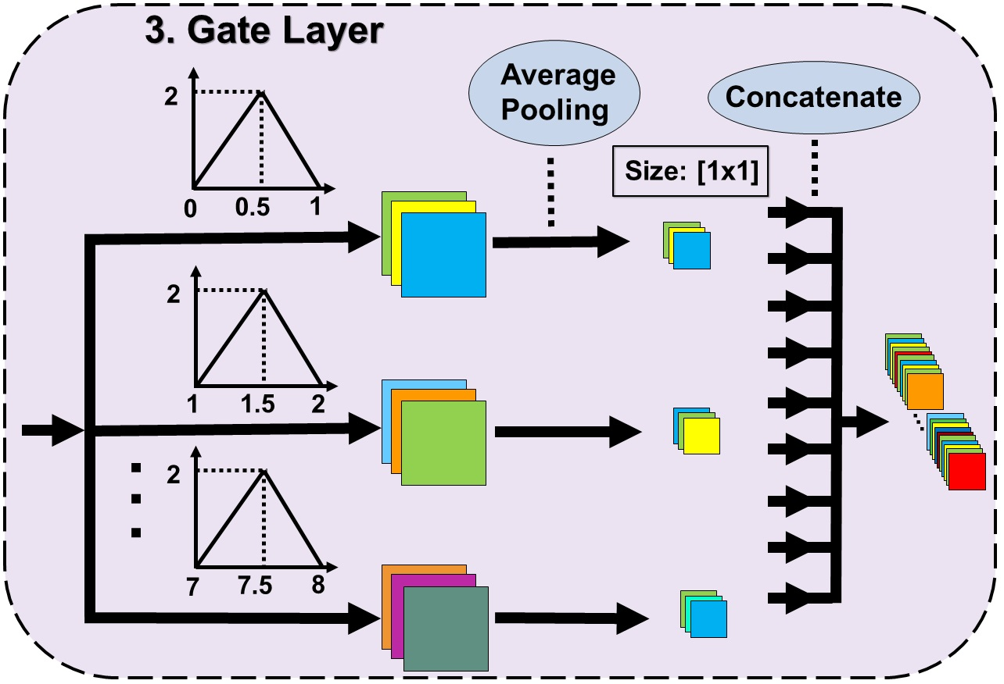
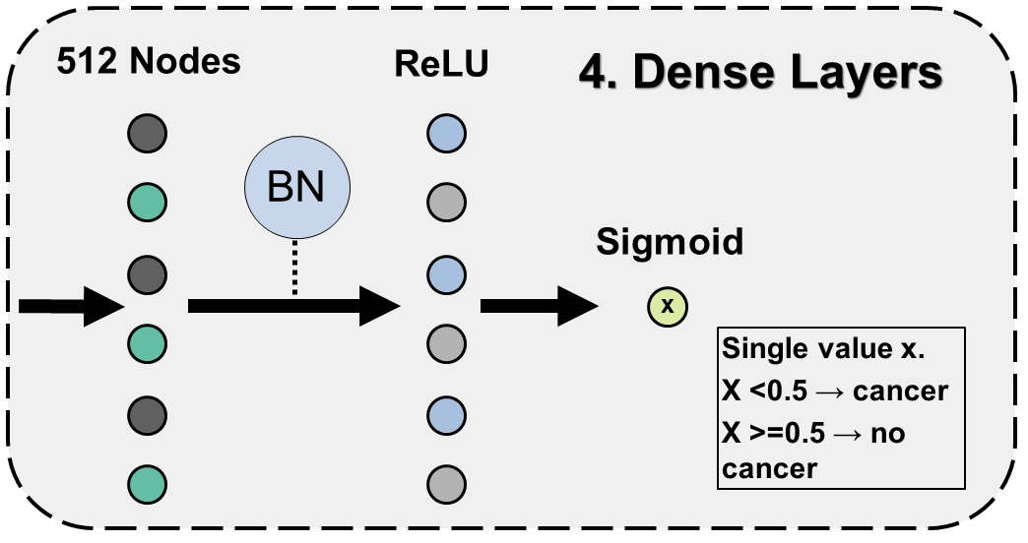

Slide 2

BN
1. Convolutional layers
Input Image [80x80]
Conv Layer
ReLU Layer
2x2 Pooling
Conv Layer
Kernel: 3x3x32
Size: 80x80 → 40x40
Kernel: 3x3x64

Slide 3
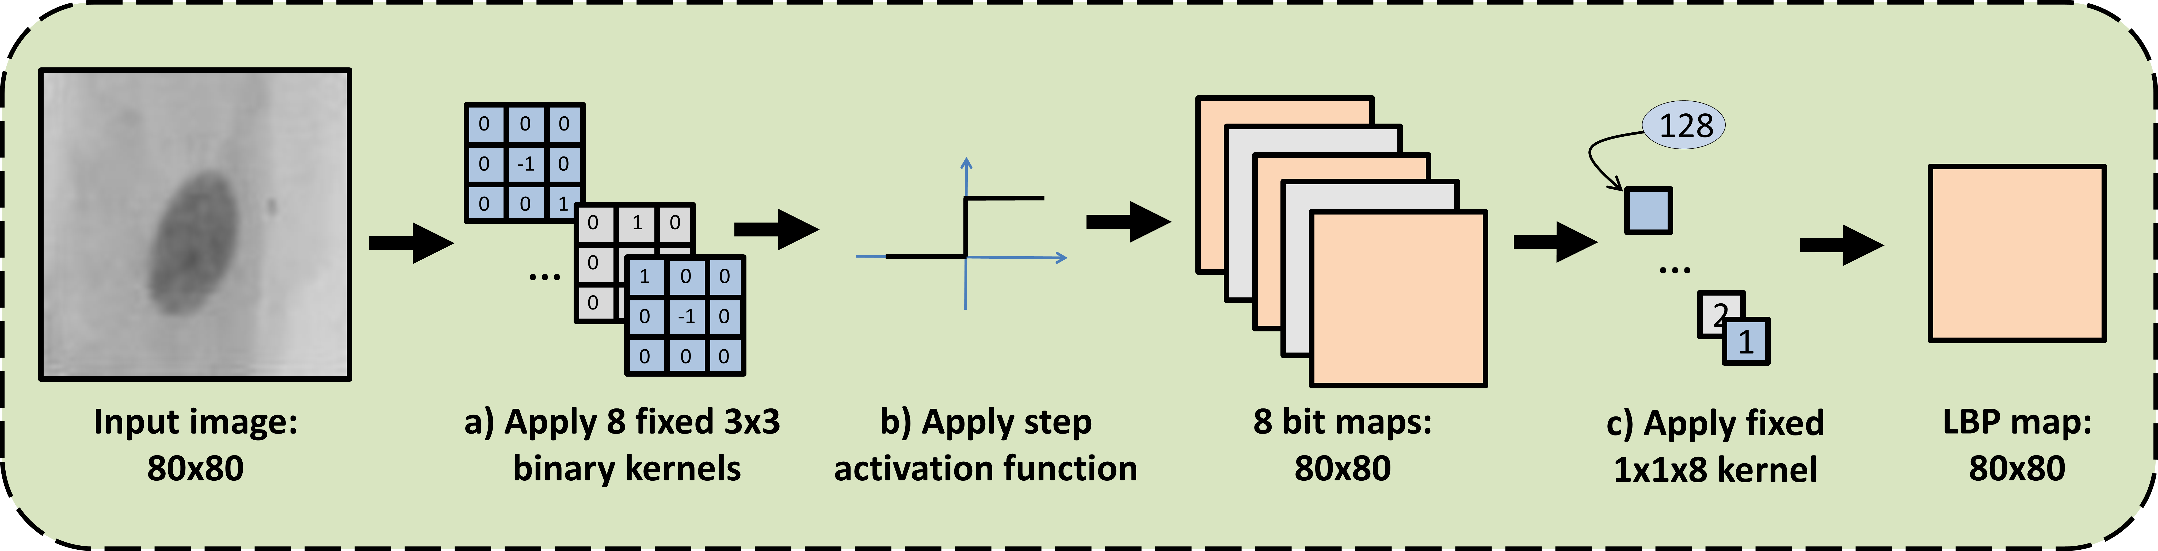
-1
128
0 0 0
0 -1 0
0 0 1
0 1 0
0 -1 0
0 0 0
…
-1
…
-1
1 0 0
0 -1 0
0 0 0
2
1
Input image: 80x80
a) Apply 8 fixed 3x3
binary kernels
b) Apply step activation function
8 bit maps: 80x80
c) Apply fixed 1x1x8 kernel
LBP map:
80x80

Slide 4
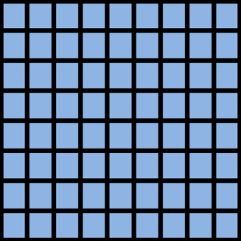
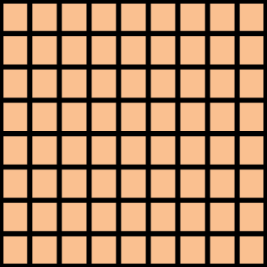
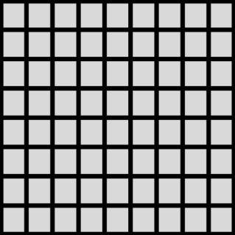
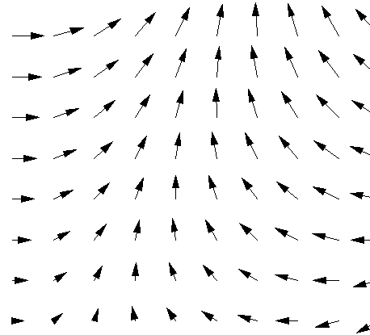
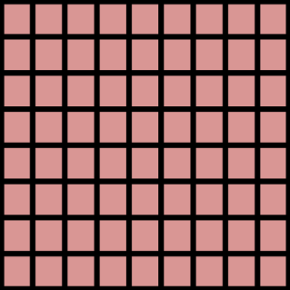
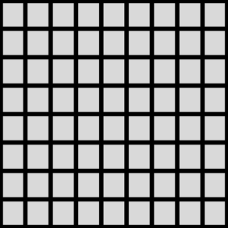
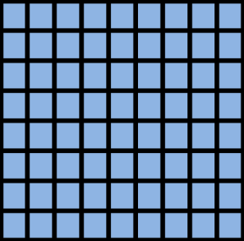
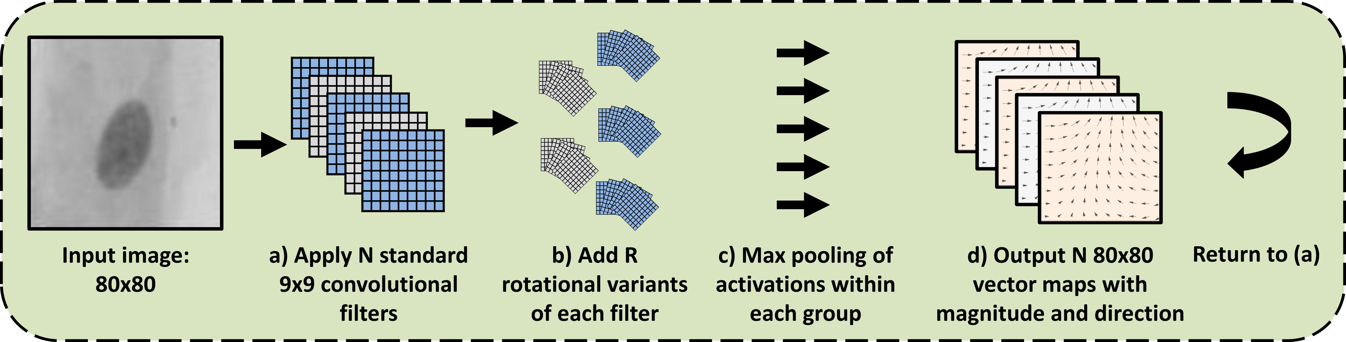
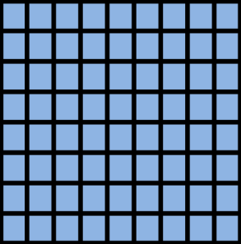
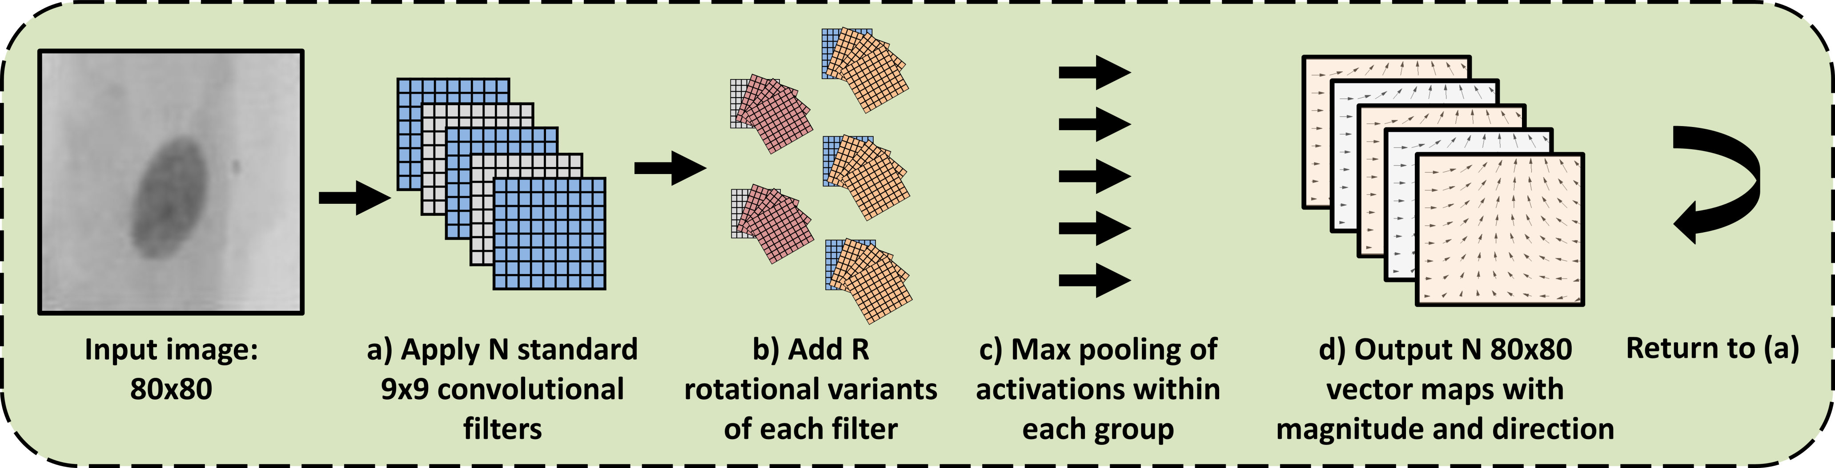
Input image: 80x80
a) Apply N standard 9x9 convolutional filters
b) Add R rotational variants of each filter
c) Max pooling of activations within each group
d) Output N 80x80 vector maps with magnitude and direction
Return to (a)

