Slide 1
Classifying Cancer Cells Using Local Binary Patterns
Jo Gay
Hugo Harlin
Project in Computational Science, January 2019
Supervisors:
Joakim Lindblad Nataša Sladoje
Centre for Image Analysis,
Department of Information Technology
Hugo Harlin and Jo Gay
Supervisors: Joakim Lindblad, Nataša Sladoje
Centre for Image Analysis, Department of Information Technology, Uppsala University

Slide 2
Project Goals
Compare ability of methods to classify cell images as healthy or cancerous
Evaluate power of texture descriptors, in particular LBPs, to improve the performance of purely CNN-based approaches
Implement and compare three recently published models
- Juefei-Xu et al. [1]
- Li et al. [2]
- Marcos et al. [3]
Compare with previous work using VGG and ResNet [4]
Jo Gay
Hugo Harlin
Project in Computational Science, January 2019
Supervisors:
Joakim Lindblad Nataša Sladoje
Centre for Image Analysis,
Department of Information Technology
[1] Felix Juefei-Xu, Vishnu Naresh Boddeti, and Marios Savvides. Local binary convolutional neural networks. In Computer Vision and Pattern Recognition (CVPR), volume 1. IEEE, 2017
[2] Lei Li, Xiaoyi Feng, Zhaoqiang Xia, Xiaoyue Jiang, and Abdenour Hadid. Face spoofing detection with local binary pattern network. Journal of Visual Communication and Image Representation, 54:182–192, 2018.
[3] Diego Marcos, Michele Volpi, Nikos Komodakis, and Devis Tuia. Rotation equivariant vector field networks. In ICCV, pages 5058–5067, 2017.
[4] Wieslander, H., Forslid, G., Bengtsson, E., Wählby, C., Hirsch, J.M., Stark, C.R. and Sadanandan, S.K., 2017, July. Deep convolutional neural networks for detecting cellular changes due to malignancy. In Proceedings of the IEEE Conference on Computer Vision and Pattern Recognition (pp. 82-89).

Slide 3








Data
10274 80x80 images (75% healthy)
Individual cells isolated within samples taken from patients mouth
Three healthy patients, three with cancer
Ground truth on patient level, not cell level
Jo Gay
Hugo Harlin
Project in Computational Science, January 2019
Supervisors:
Joakim Lindblad Nataša Sladoje
Centre for Image Analysis,
Department of Information Technology
Healthy Cells
Cancer Cells

Slide 4

Local Binary Patterns
Conceived by Ojala et al in 1996 and extended in 2002. [1]
Rotationally invariant thresholding filters
Jo Gay
Hugo Harlin
Project in Computational Science, January 2019
Supervisors:
Joakim Lindblad Nataša Sladoje
Centre for Image Analysis,
Department of Information Technology
P uniformly spaced points
Center pixel – threshold
Generates binary string
Encoding:
${LBP}_{P,R}= \sum_{p=0}^{P−1}{ s(g_{p}−g_{c})2^{p}}$
P = Number of points
R= Radius
s = binary thresholding function
$g_{p }, g_{c}$ = intensity values
P = 8, R = 2
[1] Timo Ojala, Matti Pietikainen, and Topi Maenpaa. Multiresolution gray-scale and rotation invariant texture classification with local binary patterns. IEEE Transactions on pattern analysis and machine
intelligence, 24(7):971–987, 2002.
Notes:
Expand on black/white board. Show binary string representation (dec 203, rot 151) and rotational invariance. Our experiments show R=10, P=6 has highest predictive power. Histograms used as input features to neural network. Loss of positional information.

Slide 5
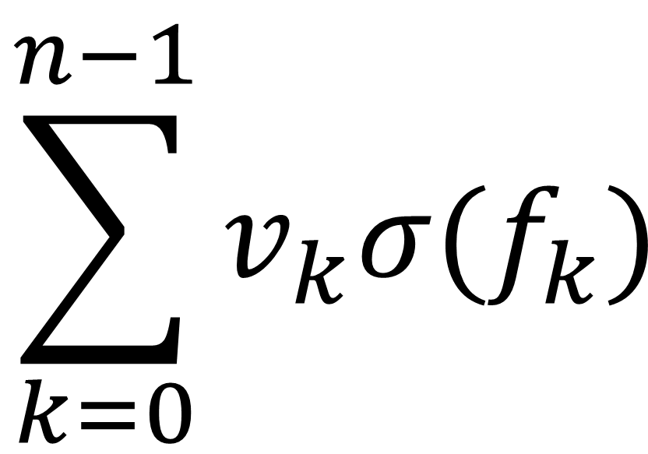
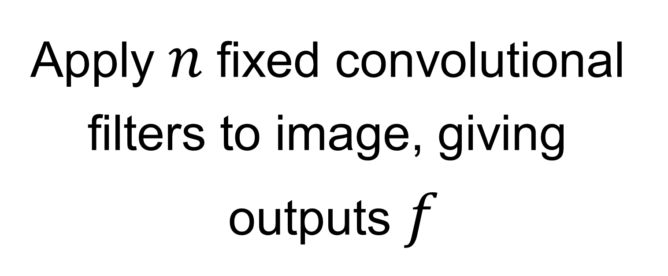

Model 1: Juefei-Xu et al.
Idea: Fixed LBP-inspired convolutional layers
LBCNN Module
Jo Gay
Hugo Harlin
Project in Computational Science, January 2019
Supervisors:
Joakim Lindblad Nataša Sladoje
Centre for Image Analysis,
Department of Information Technology
3x3 filters with randomly arranged values of 1 and -1
Multiply each output by learnable constant $v$
Repeat
1 | 0 | 0
0 | -1 | 0
0 | 0 | 0
1 | 1 | 0
0 | 0 | 0
0 | 0 | 0
$$\sum_{k=0}^{n−1}{v_{k}σ(f_{k})}$$
0 | 1 | 0
0 | 0 | 1
0 | -1 | 0
$$…$$
Apply 𝑛 fixed convolutional
filters to image, giving
outputs $f$
Calculate weighted sum of
outputs for each pixel
These form a feature map
which can be used in
further layers

Slide 6
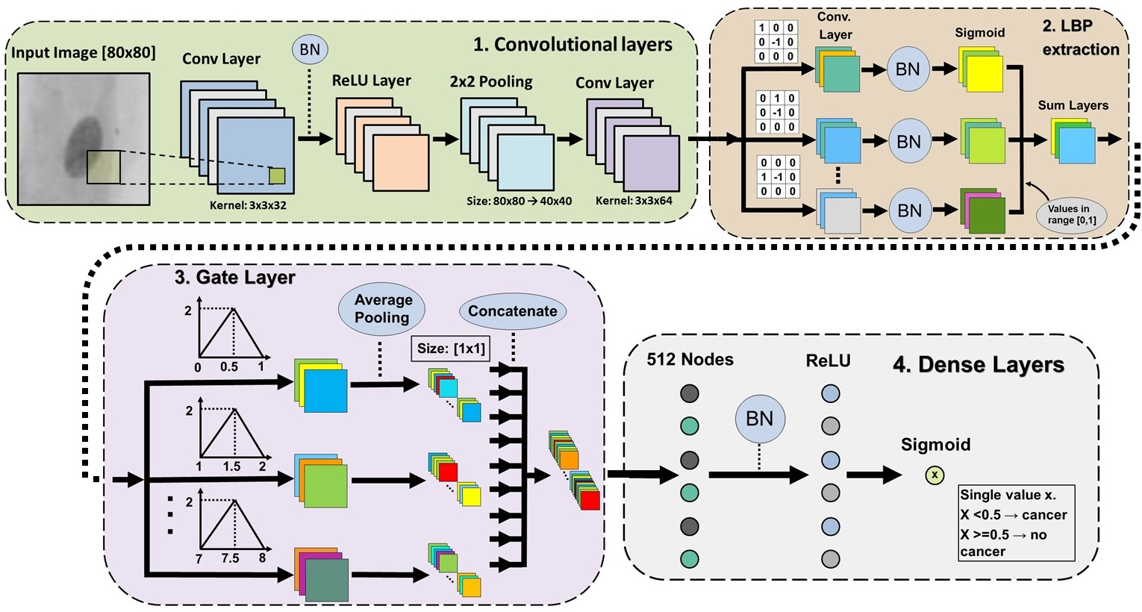
Model 2: Li et al.
Network comprised of four sequentially coupled modules
Jo Gay
Hugo Harlin
Project in Computational Science, January 2019
Supervisors:
Joakim Lindblad Nataša Sladoje
Centre for Image Analysis,
Department of Information Technology

Slide 7
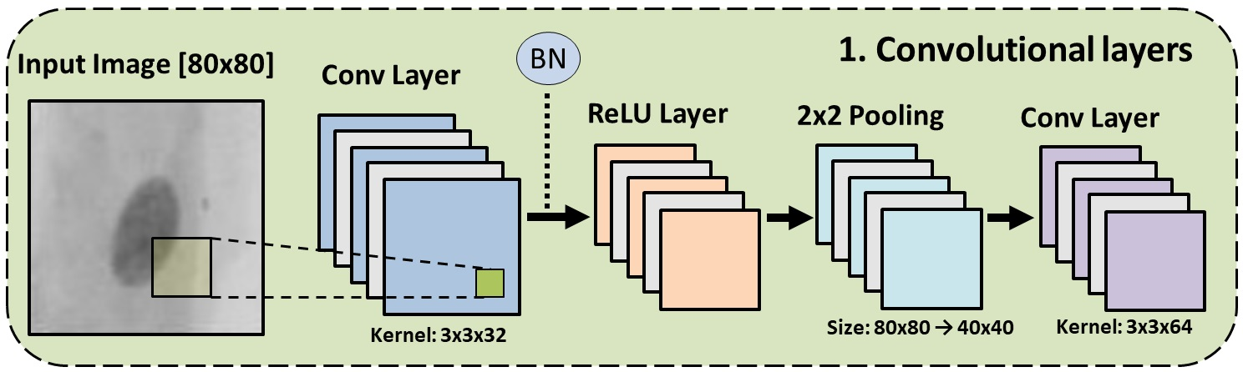
Model 2: Convolutional Layers
Output: 40x40x64 tensor

Slide 8
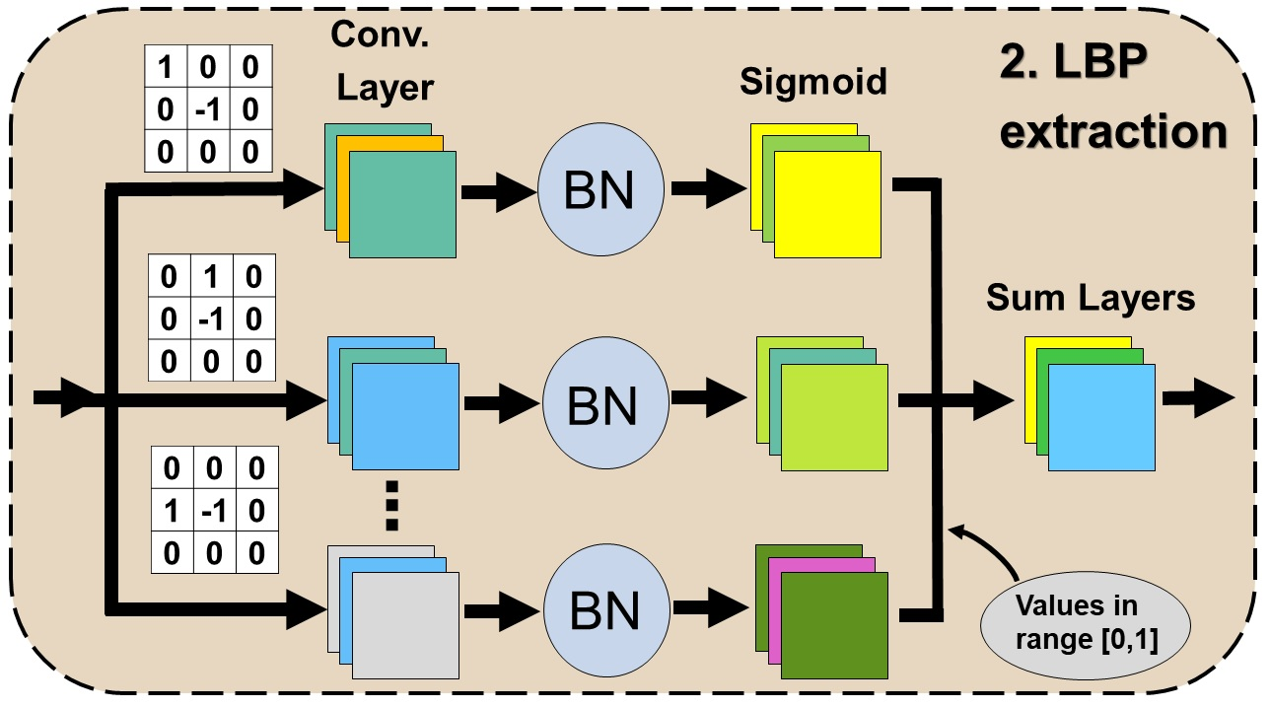
Model 2: Convolutional Module
Jo Gay
Hugo Harlin
Project in Computational Science, January 2019
Supervisors:
Joakim Lindblad Nataša Sladoje
Centre for Image Analysis,
Department of Information Technology
Input: 40x40x64 tensor
Output: 40x40x64 tensor

Slide 9
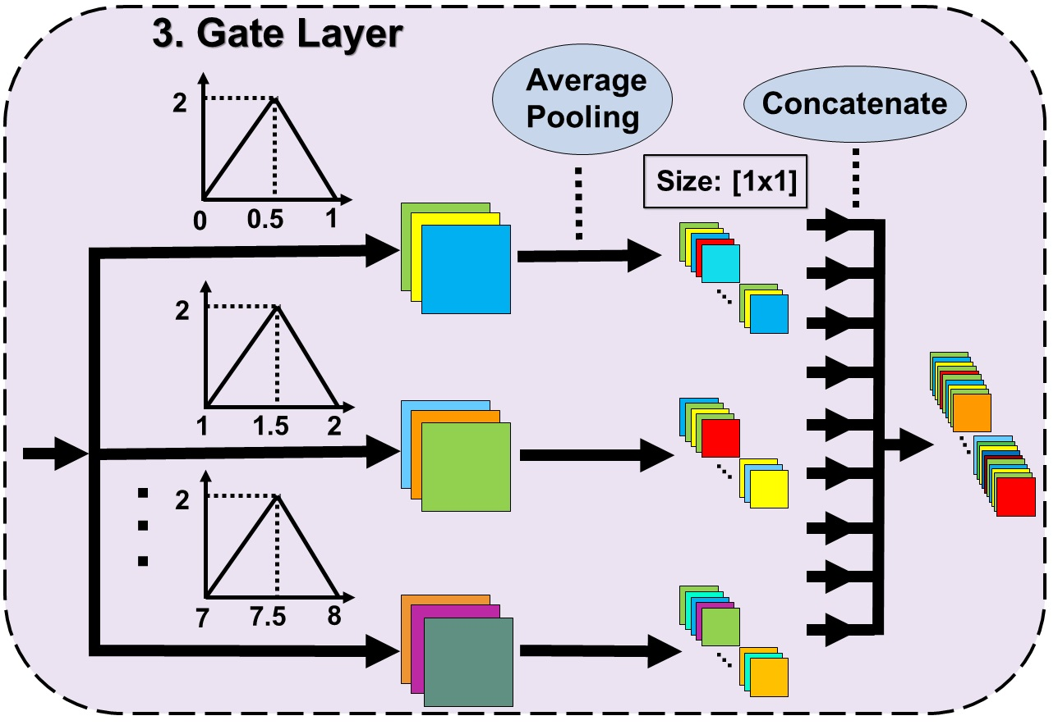
Model 2: Gate layer
Input: 40x40x64 tensor
Output: 512 element vector

Slide 10
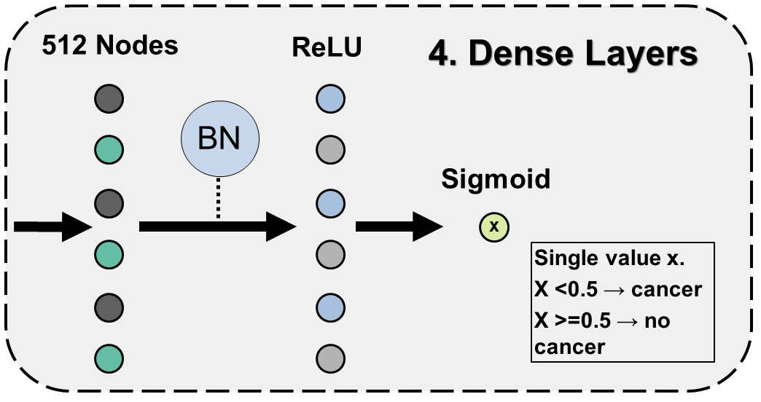
Model 2: Dense Layers
Input: 512 element vector
Output: Single value

Slide 11
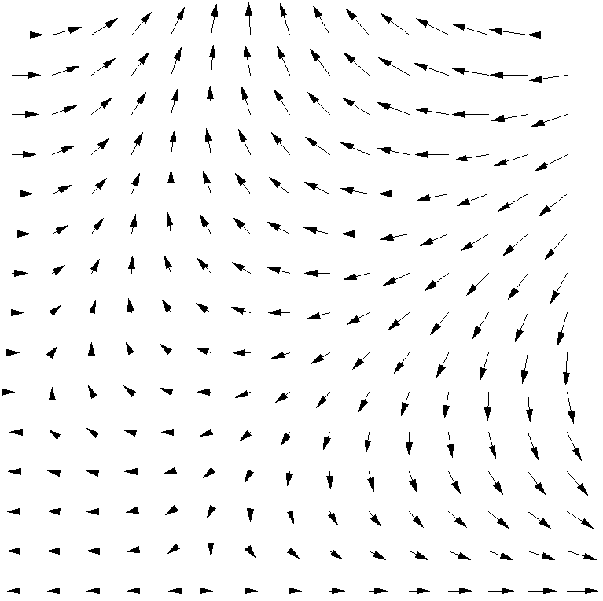
Model 3: Marcos et al.
Developed rotationally invariant filters with vector field outputs
Filters are organised in groups consisting of R filters
Only the first is trainable
The rest are rotations
Jo Gay
Hugo Harlin
Project in Computational Science, January 2019
Supervisors:
Joakim Lindblad Nataša Sladoje
Centre for Image Analysis,
Department of Information Technology
The result contains the magnitude and direction of the maximum activation of any filter in the group
This is passed on to the next layer
4 RotEqNet layers are used in our model

Slide 12
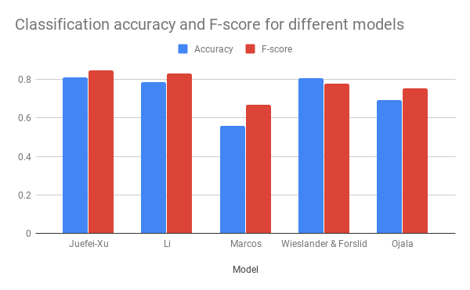
Preliminary Results
Jo Gay
Hugo Harlin
Project in Computational Science, January 2019
Supervisors:
Joakim Lindblad Nataša Sladoje
Centre for Image Analysis,
Department of Information Technology

Slide 13
Thanks for Listening!
Jo Gay
Hugo Harlin
Project in Computational Science, January 2019
Supervisors:
Joakim Lindblad Nataša Sladoje
Centre for Image Analysis,
Department of Information Technology
Questions?

