Slide 1
Classifying Cancer Cells Using Local Binary Patterns
Hugo Harlin and Jo Gay
Supervisors: Joakim Lindblad, Nataša Sladjoe
Centre for Image Analysis, Department of Information Technology, Uppsala University

Slide 2
Project Goals
Evaluate ability of methods to classify cell images as healthy or cancerous
Implement and compare three LBP inspired CNN models
- Juefei-Xu et al. [1]
- Li et al. [2]
- Marcos et al. [3]
Compare against results from state-of-the-art CNNs: VGG and ResNet
[1] Felix Juefei-Xu, Vishnu Naresh Boddeti, and Marios Savvides. Local binary convolutional neural networks. In Computer Vision and Pattern Recognition (CVPR), volume 1. IEEE, 2017
[2] Lei Li, Xiaoyi Feng, Zhaoqiang Xia, Xiaoyue Jiang, and Abdenour Hadid. Face spoofing detection with local binary pattern network. Journal of Visual Communication and Image Representation, 54:182–192, 2018.
[3] Diego Marcos, Michele Volpi, Nikos Komodakis, and Devis Tuia. Rotation equivariant vector field networks. In ICCV, pages 5058–5067, 2017.

Slide 3

Local Binary Patterns
Conceived by Ojala et al in 1996 and extended in 2002. [1]
Rotationally invariant thresholding filters
P uniformly spaced points
Center pixel – threshold
Generates binary string
Encoding:
${LBP}_{P,R}= \sum_{p=0}^{P−1}{ s(g_{p}−g_{c})2^{p}}$
P = Number of points
R= Radius
s = binary thresholding function
$g_{p }, g_{c}$ = intensity values
P = 8, R = 2
[1] Timo Ojala, Matti Pietikainen, and Topi Maenpaa. Multiresolution gray-scale and rotation invariant texture classification with local binary patterns. IEEE Transactions on pattern analysis and machine
intelligence, 24(7):971–987, 2002.
Notes:
Expand on black/white board. Show binary string representation and rotational invariance. Our experiments show R=10, P=6 has highest predictive power. Histograms used as input features to neural network. Loss of positional information.

Slide 4








Data
10274 80x80 images (75% healthy)
Cells sampled from patients mouth
Three healthy patients, three with cancer
Ground truth on patient level, not cell level
Healthy Cells
Cancer Cells

Slide 5
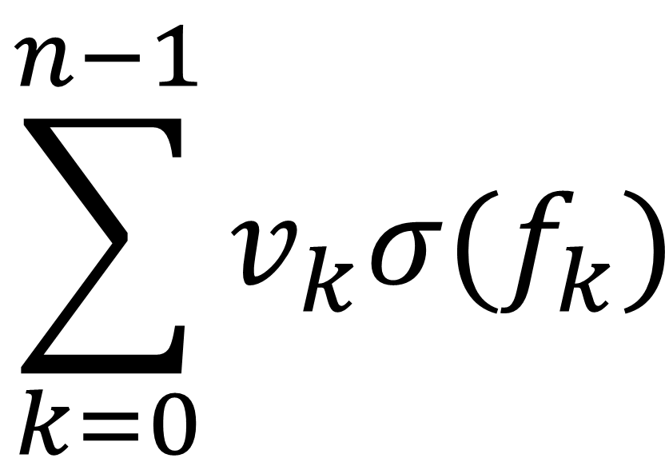



Model 1: Juefei-Xu et al.
Idea: Fixed LBP-inspired convolutional layers
LBCCN Module
3x3 filters with randomly arranged values of 1 and -1
Sigmoid activation to smooth noise
Multiply each output by learnable constant $v$
1 | 0 | 0
0 | -1 | 0
0 | 0 | 0
1 | 1 | 0
0 | 0 | 0
0 | 0 | 0
$$\sum_{k=0}^{n−1}{v_{k}σ(f_{k})}$$
0 | 1 | 0
0 | 0 | 1
0 | -1 | 0
$$…$$
Apply 𝑛 fixed convolutional filters
to image, giving outputs $f$
Calculate weighted sum of
outputs for each pixel
These form a feature map
which can be used in
further layers

Slide 6
Model 2: Li et al.
Network comprised of four sequentially coupled modules
- Convolutional Module
- LBP Module
- Gate Layer Module
- Standard dense NN module

Slide 7
Model 2: Convolutional Module
1 | 0 | 0
0 | -1 | 0
0 | 0 | 0
Convolutional Layer
Sigmoid
Values in range [0,1]
BN
0 | 1 | 0
0 | -1 | 0
0 | 0 | 0
Sum Layers
BN
.
.
.
0 | 0 | 0
1 | -1 | 0
0 | 0 | 0
BN

Slide 8
Model 2: Gate Layer Module
Average Pooling
concatenate
2
Size: [1x1]
0
0.5
1
.
.
2
.
1
1.5
2
.
.
.
.
.
.
.
.
2
.
7
7.5
8
.
.
.

Slide 9
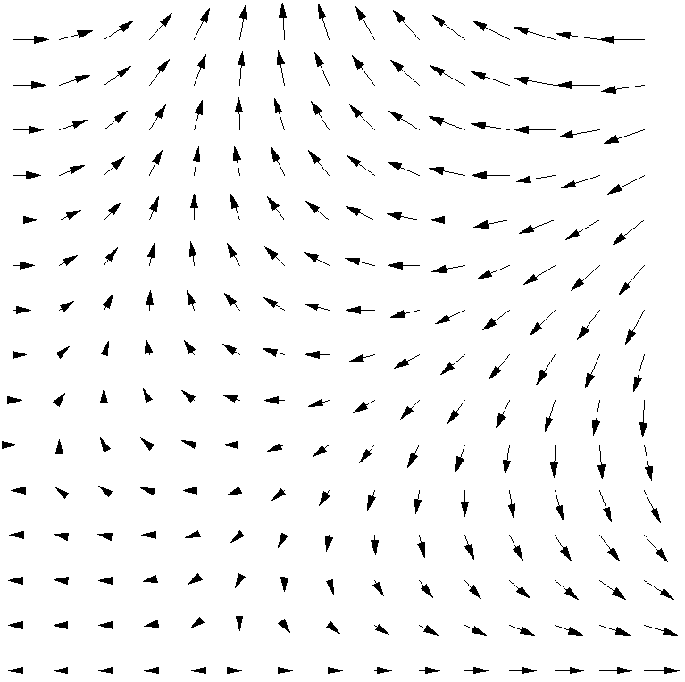
Model 3: Marcos et al.
Developed rotationally invariant filters with vector field outputs
Filters are organised in groups consisting of R filters
Only the first is trainable
The rest are rotations
The result contains the magnitude and direction of the maximum activation of any filter in the group
This is passed on to the next layer
4 RotEqNet layers are used in our model

Slide 10
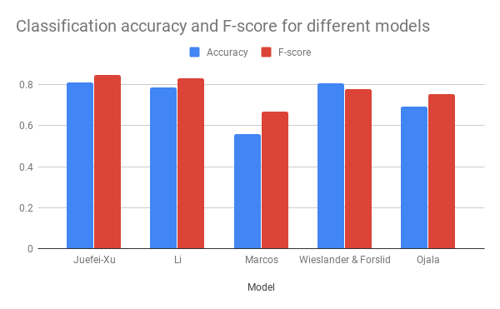
Preliminary Results

Slide 11



Convolutional Module
Filter 1
Filter 2
Filter 8
1 | 0 | 0
0 | -1 | 0
0 | 0 | 0
0 | 1 | 0
0 | -1 | 0
0 | 0 | 0
0 | 0 | 0
1 | -1 | 0
0 | 0 | 0
. . .
$$2^{0}$$
$$2^{1}$$
$$2^{7}$$

