Slide 1
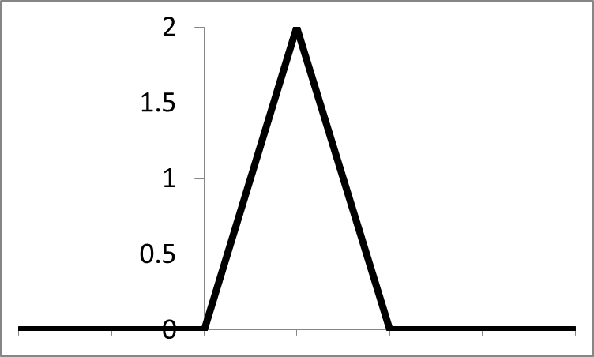
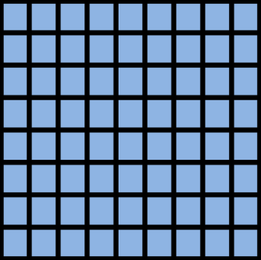
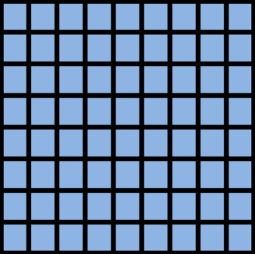
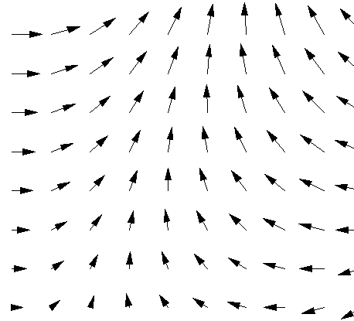
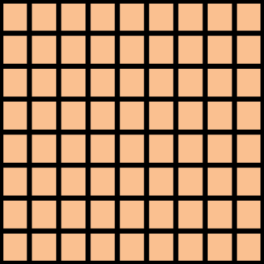
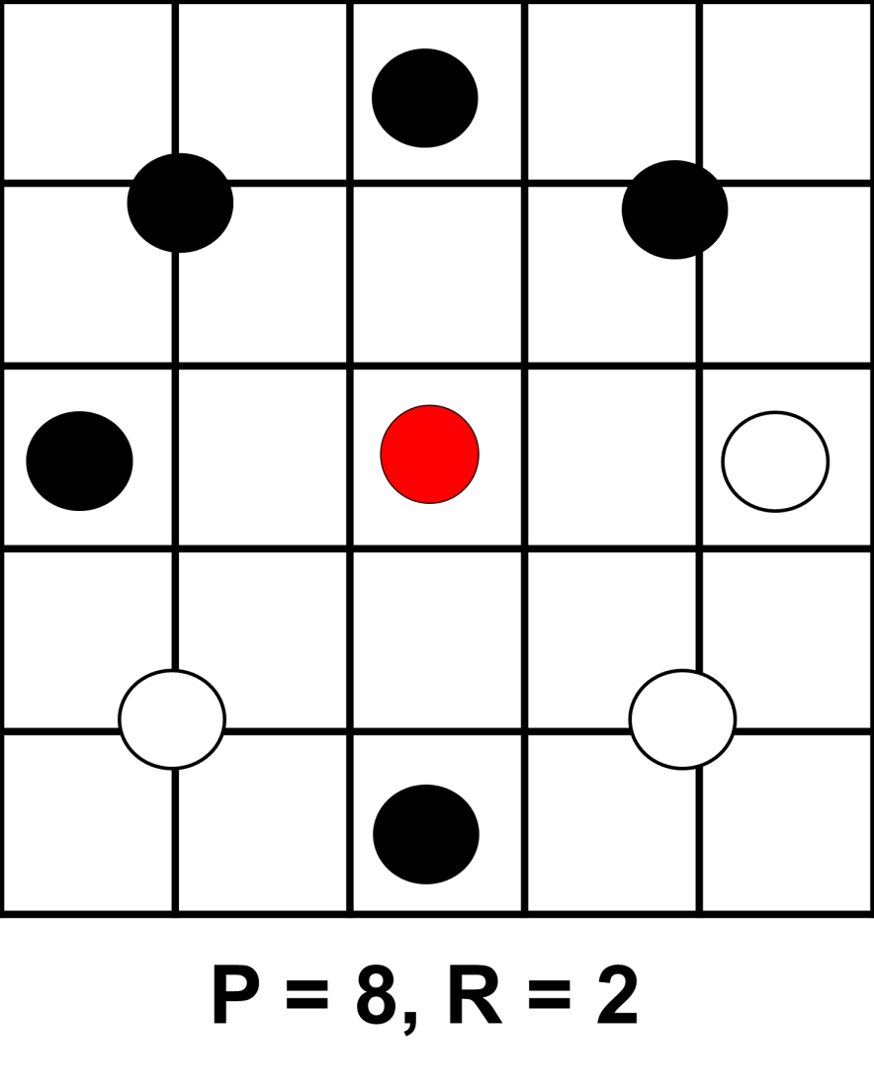








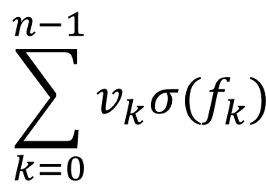
Detecting Cancer with Texture
Overview
Models
Compare ability of methods to classify cell images as healthy or cancerous
Evaluate power of texture descriptors, in particular LBPs, to improve on the performance of purely CNN-based approaches
Implement and compare three recently published models
Juefei-Xu et al. [3]
Li et al. [4]
Marcos et al. [5]
Compare with previous work using VGG and ResNet [1]
1 | 1 | 0
0 | 1 | 0
-1 | -1 | 0
Model 1, Juefei-Xu et al.:
Randomly initialized fixed ±1 filters
Linear sum to create feature map
0 | 0 | 1
-1 | 0 | 1
1 | -1 | 0
$$\sum_{k=0}^{n−1}{v_{k}σ(f_{k})}$$
0 | 1 | 0
0 | 0 | 1
0 | -1 | 0
0 | 0 | 0
1 | -1 | 0
0 | 0 | 0
Model 2, Li et al.:
8 fixed difference filters
Sigmoid activation
Histogram of gated sum
0 | 1 | 0
0 | 0 | 1
0 | -1 | 0
Jo Gay
Hugo Harlin
Project in Computational Science, January 2019
Supervisors:
Joakim Lindblad Nataša Sladoje
Centre for Image Analysis,
Department of Information Technology
1 | 0 | 0
0 | -1 | 0
0 | 0 | 0
Model 3, Marcos et al.:
Rotational groups of filters
2D vector field outputs
Local Binary Patterns
Data
Results
LBPs [2] are powerful texture classifiers
Compare intensities of P points surrounding center pixel at radius R
Record either a 1 or a 0 depending which value is greater
6 patients, 3 with cancer and 3 healthy
10274 cell images, size 80x80
Individual cells have been identified in samples from the patients’ mouths [1]
Only patient diagnosis known, not individual cell classification
Model | Accuracy | F-Score
Juefei-Xu [3] | 81.03 | 84.85
Li [4] | 78.57 | 83.02
Marcos [5] | 55.91 | 66.80
ResNet | 78.34 | 75.51
VGG | 80.66 | 77.68
00110100
=
00001101
Healthy Cells
Cancer Cells
[1] Håkan Wieslander, Gustav Forslid, Ewert Bengtsson, Carolina Wählby, Jan-Michael Hirsch, Christina Runow Stark, and Sajith Kecheril Sadanandan. Deep convolutional neural networks for detecting cellular changes due to malignancy. In Proceedings of the IEEE Conference on Computer Vision and Pattern Recognition, pages 82–89, 2017
[2] Timo Ojala, Matti Pietikainen, and Topi Maenpaa. Multiresolution gray-scale and rotation invariant texture classification with local binary patterns. IEEE Transactions on pattern analysis and machine intelligence, 24(7):971–987, 2002.
[3] Felix Juefei-Xu, Vishnu Naresh Boddeti, and Marios Savvides. Local binary convolutional neural networks. In Computer Vision and Pattern Recognition (CVPR), 2017 IEEE Conference on, volume 1. IEEE, 2017.
[4] Lei Li, Xiaoyi Feng, Zhaoqiang Xia, Xiaoyue Jiang, and Abdenour Hadid. Face spoofing detection with local binary pattern network. Journal of Visual Communication and Image Representation, 54:182–192, 2018.
[5] Diego Marcos, Michele Volpi, Nikos Komodakis, and Devis Tuia. Rotation equivariant vector field networks. In ICCV , pages 5058–5067, 2017.

Slide 2

0
0
0
0
1
1
1
0
P = 8, R = 2
P = 8, R = 2

Slide 3
Old Background text:
Early detection of cancer plays a major role in reducing cancer mortality. With deep convolutional neural networks, it is becoming possible to automatically classify cell images as either healthy or cancerous, a task previously done manually by highly trained professionals.
Local binary patterns are very good at identifying textures, which has been hypothesized to be of importance in cell classification. In this project three recent LBP based networks are tuned and compared to conventional network architectures.
Removed text re LBPs
Group patterns which are rotationally similar
Translate binary string to pattern index
Distribution of patterns can be used to classify textures
Removed text re models
Three recently published LBP based architectures were implemented in this project, where the first two use LBPs directly in some form whereas the third model uses slightly different filters that share many properties with LBPs. [3] [4] [5]
Two conventional CNNs were used for benchmarking, Resnet and VGG.

