Slide 1
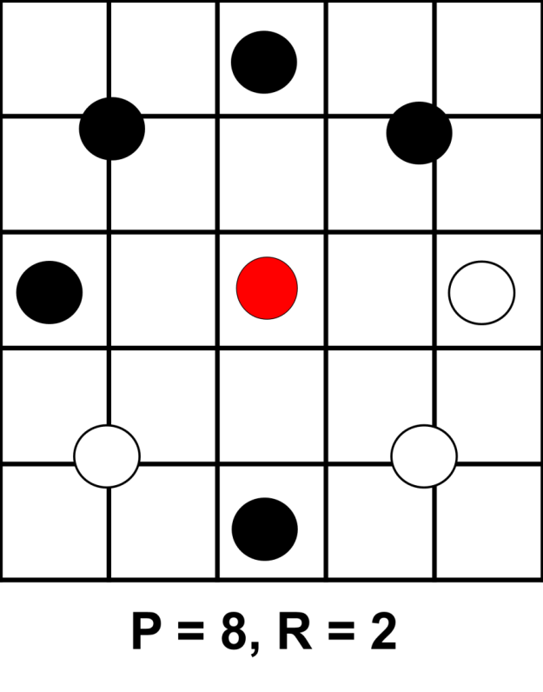









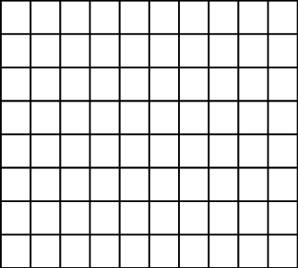


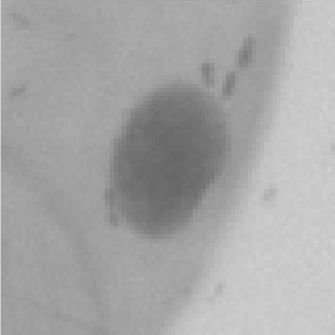
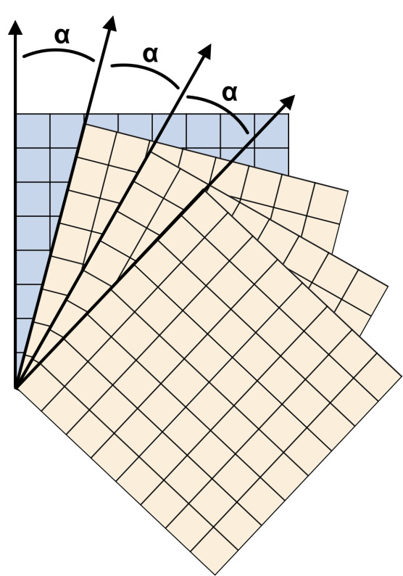
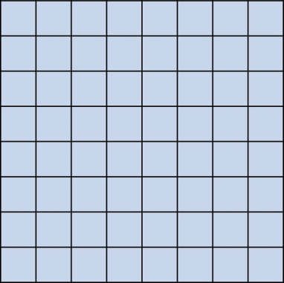
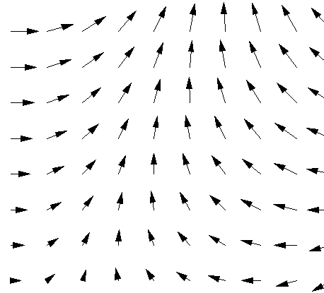
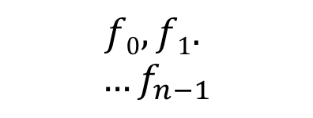
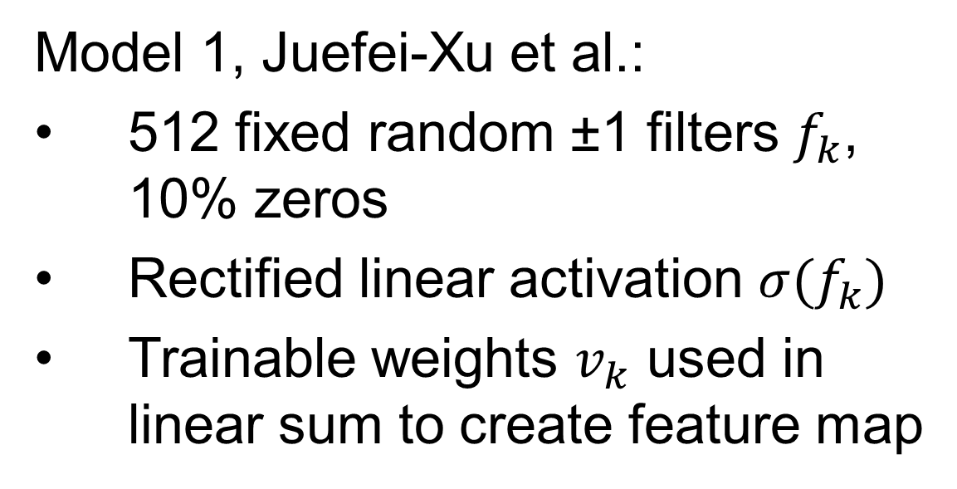


Detecting Cancer using Texture Classification
Project Goals
Local Binary Patterns
Data
Compare ability of methods to classify cell images as healthy or cancerous
Evaluate power of texture descriptors, in particular LBPs, to improve on performance of purely CNN-based approaches
Implement and compare three recently published models
Juefei-Xu et al. [3]
Li et al. [4]
Marcos et al. [5]
Compare with previous work using VGG and ResNet [1]
LBPs [2] are powerful texture classifiers
Use intensity level of central pixel to threshold values of P points surrounding it at radius R
Binary string gives pattern index
Rotational equivalents and least common (‘non-uniform’) patterns are usually combined
6 patients, 3 with oral cancer and 3 healthy
10k cell images (80x80) [1]
Only patient diagnosis known, not individual cell classification
Training and test data selected from different patients to avoid data leakage
Histogram of pattern indexes can be used as a feature set in a neural network
Jo Gay
Hugo Harlin
Project in Computational Science, January 2019
Supervisors:
Joakim Lindblad Nataša Sladoje
Centre for Image Analysis,
Department of Information Technology
11101001
=
00111101
Healthy Cells
Cancer Cells
Three CNN Models
Results
…
1 | 1 | -1
0 | 1 | -1
-1 | -1 | 1
Model 1, Juefei-Xu et al.:
512 fixed random ±1 filters $f_{k}$, 10% zeros
Rectified linear activation $σ(f_{k})$
Trainable weights $v_{k}$ used in linear sum to create feature map
-1 | 0 | 1
-1 | 0 | 1
1 | -1 | 0
$$\sum_{k=0}^{n−1}{v_{k}σ(f_{k})}$$
-1 | 1 | 1
1 | -1 | 1
-1 | -1 | 0
$$f0,f1.$$
$$…f_{n−1}$$
Input image
Fixed filters
Weighted sum
Output feature map
…
0 | 0 | 0
1 | -1 | 0
0 | 0 | 0
Model 2, Li et al.:
8 fixed difference filters
Sum of sigmoid activations
8 Gating functions applied to sum
Histogram of results
0 | 1 | 0
0 | 0 | 0
0 | -1 | 0
1 | 0 | 0
0 | -1 | 0
0 | 0 | 0
$$∑$$
Input image
2x CNN layers
Sum of fixed filters
Gating functions
Output histogram
Model | Accuracy (%) | F₁-Score (%)
Juefei-Xu et al. [3] | 81.03 | 84.85
Li et al. [4] | 80.70 | 84.30
Marcos et al. [5] | 68.37 | 74.41
ResNet | 78.34 | 75.51
VGG | 80.66 | 77.68
Model 3, Marcos et al.:
Stack of rotated filters, adapted for vector field input
The output angle is given by the rotation of the filter with highest activation
Activation magnitude & direction forms 2D vector field output
Input image
Trainable filter
Output vector map
Fixed rotated copies
[1] H Wieslander, G Forslid, E Bengtsson, C Wählby, J Hirsch, C Runow Stark, S Kecheril Sadanandan. Deep convolutional neural networks for detecting cellular changes due to malignancy. In CVPR, pages 82–89, 2017
[2] T Ojala, M Pietikainen, T Maenpaa. Multiresolution gray-scale and rotation invariant texture classification with local binary patterns. IEEE Transactions on PAMI, 24(7):971–987, 2002.
[3] F Juefei-Xu, V Boddeti, M Savvides. Local binary convolutional neural networks. In CVPR, volume 1, 2017.
[4] L Li, X Feng, Z Xia, X Jiang, A Hadid. Face spoofing detection with local binary pattern network. Journal of Visual Communication and Image Representation, 54:182–192, 2018.
[5] D Marcos, M Volpi, N Komodakis, D Tuia. Rotation equivariant vector field networks. In ICCV , pages 5058–5067, 2017.

Slide 2
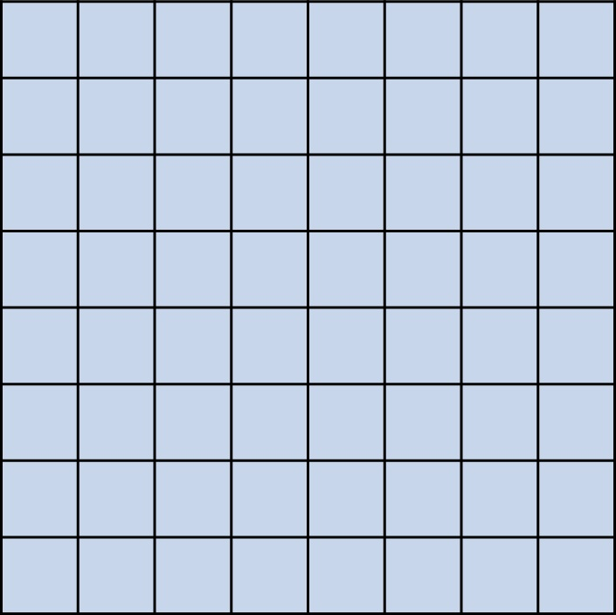
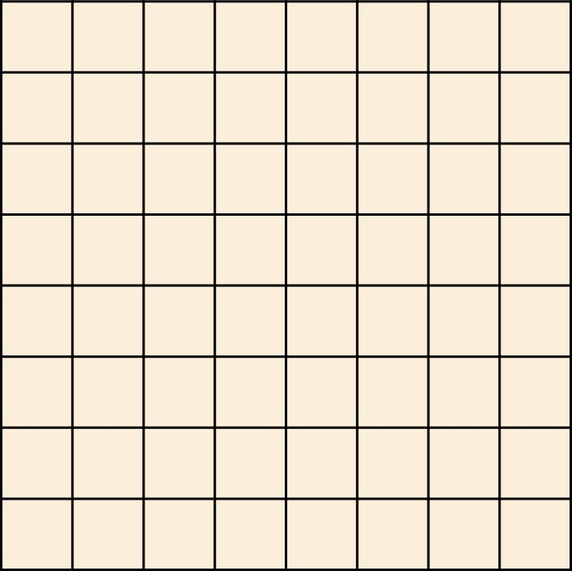
α
α
α

