Slide 1
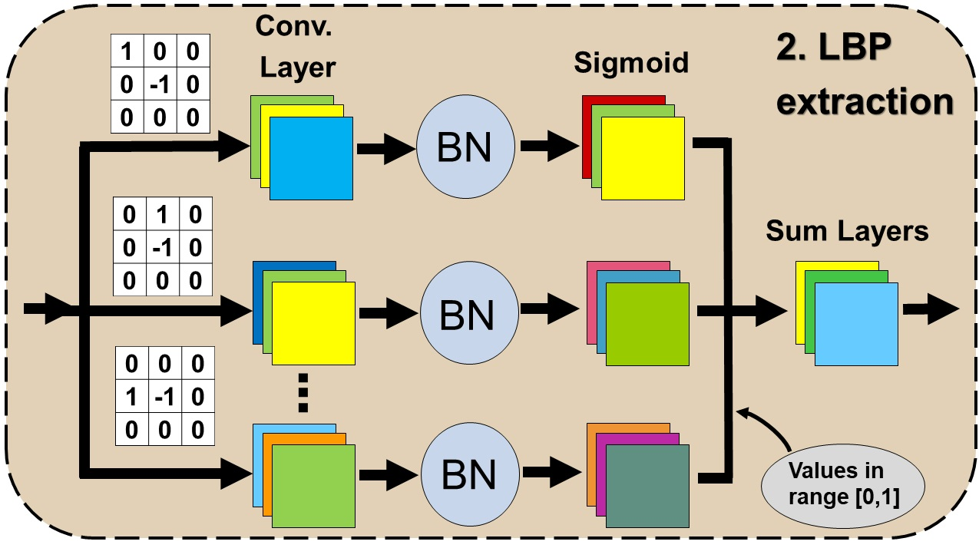
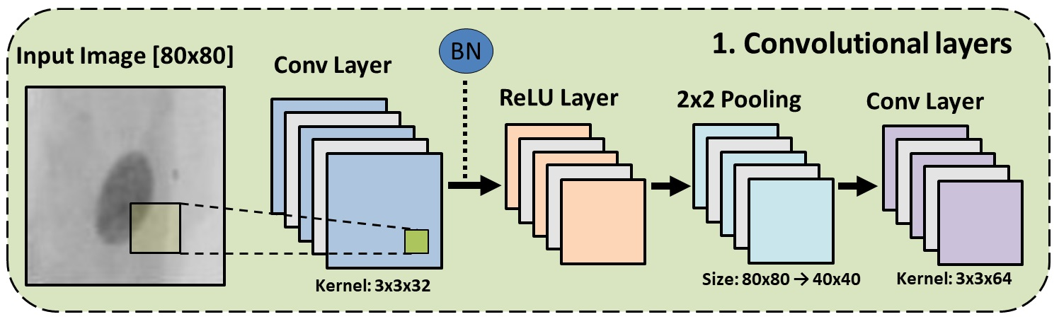
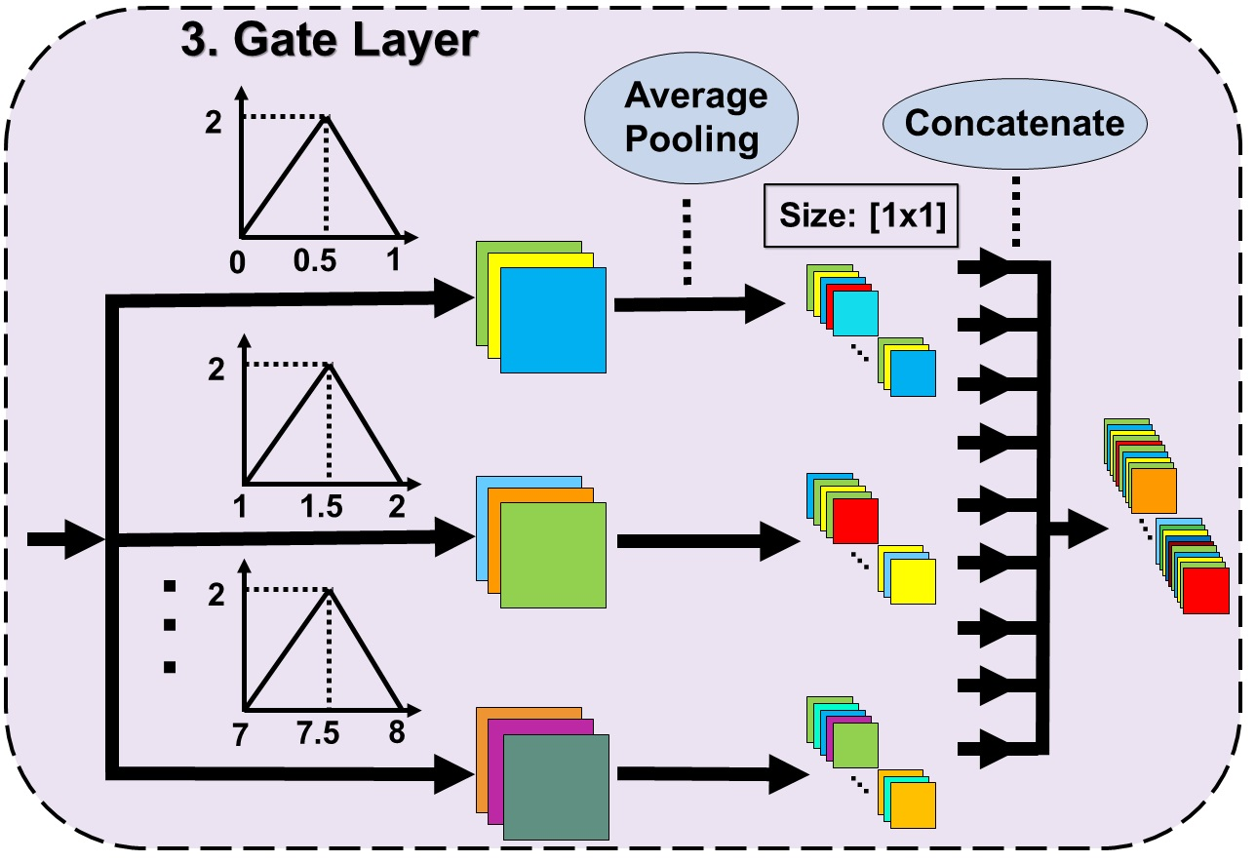

Slide 2

BN
1. Convolutional layers
Input Image [80x80]
Conv Layer
ReLU Layer
2x2 Pooling
Conv Layer
Kernel: 3x3x32
Size: 80x80 → 40x40
Kernel: 3x3x64

