Slide 1

Local Binary Patterns
Conceived by Ojala et al in 1996 and extended in 2002. [1]
Rotationally invariant thresholding filters
P uniformly spaced points
Center pixel – threshold
Generates binary string
Encoding:
${LBP}_{P,R}= \sum_{p=0}^{P−1}{ s(g_{p}−g_{c})2^{p}}$
P = Number of points
R= Radius
s = binary thresholding function
$g_{p }, g_{c}$ = intensity values
P = 8, R = 2
[1] Timo Ojala, Matti Pietikainen, and Topi Maenpaa. Multiresolution gray-scale and rotation invariant texture classification with local binary patterns. IEEE Transactions on pattern analysis and machine
intelligence, 24(7):971–987, 2002.
Notes:
Expand on black/white board. Show binary string representation and rotational invariance. Our experiments show R=10, P=6 has highest predictive power. Histograms used as input features to neural network. Loss of positional information.

Slide 2








Data
10274 80x80 images (75% healthy)
Cells sampled from patients mouth
Three healthy patients, three with cancer
Ground truth on patient level, not cell level
Healthy Cells
Cancer Cells

Slide 3
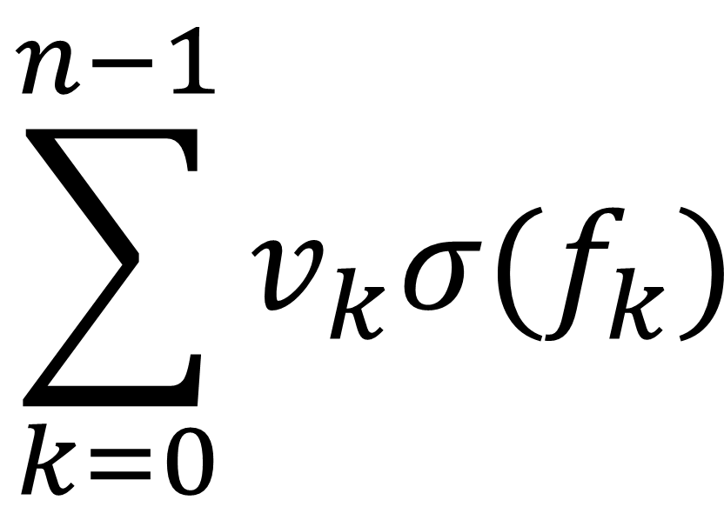



Model 1: Juefei-Xu et al.
Idea: Fixed LBP-inspired convolutional layers
LBCCN Module
3x3 filters with randomly arranged values of 1 and -1
Sigmoid activation to smooth noise
Multiply each output by learnable constant $v$
1 | 0 | 0
0 | -1 | 0
0 | 0 | 0
1 | 1 | 0
0 | 0 | 0
0 | 0 | 0
$$\sum_{k=0}^{n−1}{v_{k}σ(f_{k})}$$
0 | 1 | 0
0 | 0 | 1
0 | -1 | 0
$$…$$
Apply 𝑛 fixed convolutional filters
to image, giving outputs $f$
Calculate weighted sum of
outputs for each pixel
These form a feature map
which can be used in
further layers

Slide 4
Conv.
Layer
2. LBP
extraction
1 | 0 | 0
0 | -1 | 0
0 | 0 | 0
Sigmoid
BN
0 | 1 | 0
0 | -1 | 0
0 | 0 | 0
Sum Layers
BN
.
0 | 0 | 0
1 | -1 | 0
0 | 0 | 0
.
.
BN
Values in range [0,1]

Slide 5
3. Gate Layer
Average Pooling
2
Concatenate
Size: [1x1]
0
0.5
1
.
.
2
.
1
1.5
2
.
.
.
.
.
.
.
.
2
.
7
7.5
8
.
.
.

Slide 6
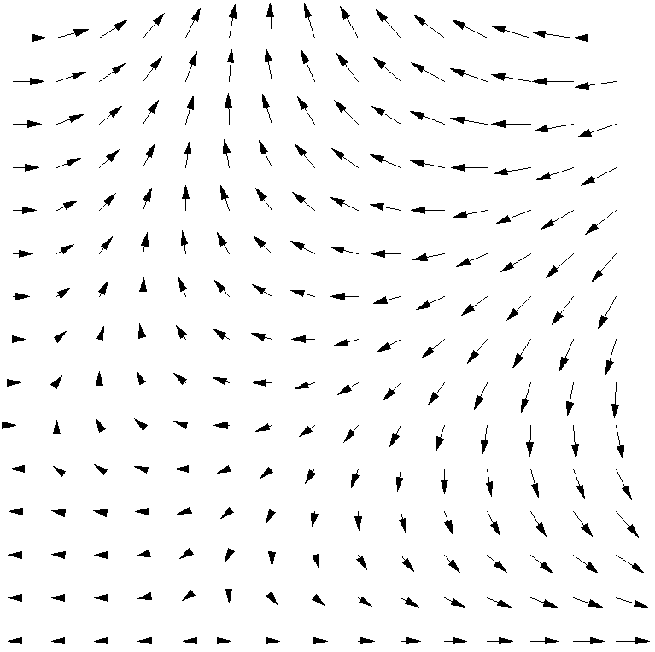
Model 3: Marcos et al.
Developed rotationally invariant filters with vector field outputs
Filters are organised in groups consisting of R filters
Only the first is trainable
The rest are rotations
The result contains the magnitude and direction of the maximum activation of any filter in the group
This is passed on to the next layer
4 RotEqNet layers are used in our model

