Slide 1
Detecting Cancer using Texture Classification
Jo Gay
Hugo Harlin
Project in Computational Science, January 2019
Supervisors:
Joakim Lindblad Nataša Sladoje
Centre for Image Analysis,
Department of Information Technology
Hugo Harlin and Jo Gay
Supervisors: Joakim Lindblad, Nataša Sladoje
Centre for Image Analysis, Department of Information Technology, Uppsala University

Slide 2
Project Goals
Compare ability of methods to classify cell images as healthy or cancerous
Evaluate power of texture descriptors, in particular LBPs, to improve the performance of purely CNN-based approaches
Implement and compare three recently published models
- Juefei-Xu et al. [1]
- Li et al. [2]
- Marcos et al. [3]
Compare with previous work using VGG and ResNet [4]
Jo Gay
Hugo Harlin
Project in Computational Science, January 2019
Supervisors:
Joakim Lindblad Nataša Sladoje
Centre for Image Analysis,
Department of Information Technology
[1] Juefei-Xu, F., Boddeti, V. N., and Savvides, M.. Local binary convolutional neural networks. In CVPR, volume 1. IEEE, 2017.
[2] Li, L., Feng X., Xia, Z., Jiang, X., and Hadid, A.. Face spoofing detection with local binary pattern network. Journal of Visual Communication and Image Representation, 54:182–192, 2018.
[3] Marcos, M., Volpi, M., Komodakis, N., and Tuia, D. Rotation equivariant vector field networks. In ICCV, pages 5058–5067, 2017.
[4] Wieslander, H., Forslid, G., Bengtsson, E., Wählby, C., Hirsch, J.M., Stark, C.R. and Sadanandan, S.K., July. Deep convolutional neural networks for detecting cellular changes due to malignancy. In ICCV, pages 82-89, 2017.

Slide 3








Data
10274 80x80 images (75% healthy)
Three healthy patients, three with cancer
Individual cells isolated within samples taken from patients mouth
Ground truth on patient level, not cell level
Jo Gay
Hugo Harlin
Project in Computational Science, January 2019
Supervisors:
Joakim Lindblad Nataša Sladoje
Centre for Image Analysis,
Department of Information Technology
Healthy Cells
Cancer Cells

Slide 4
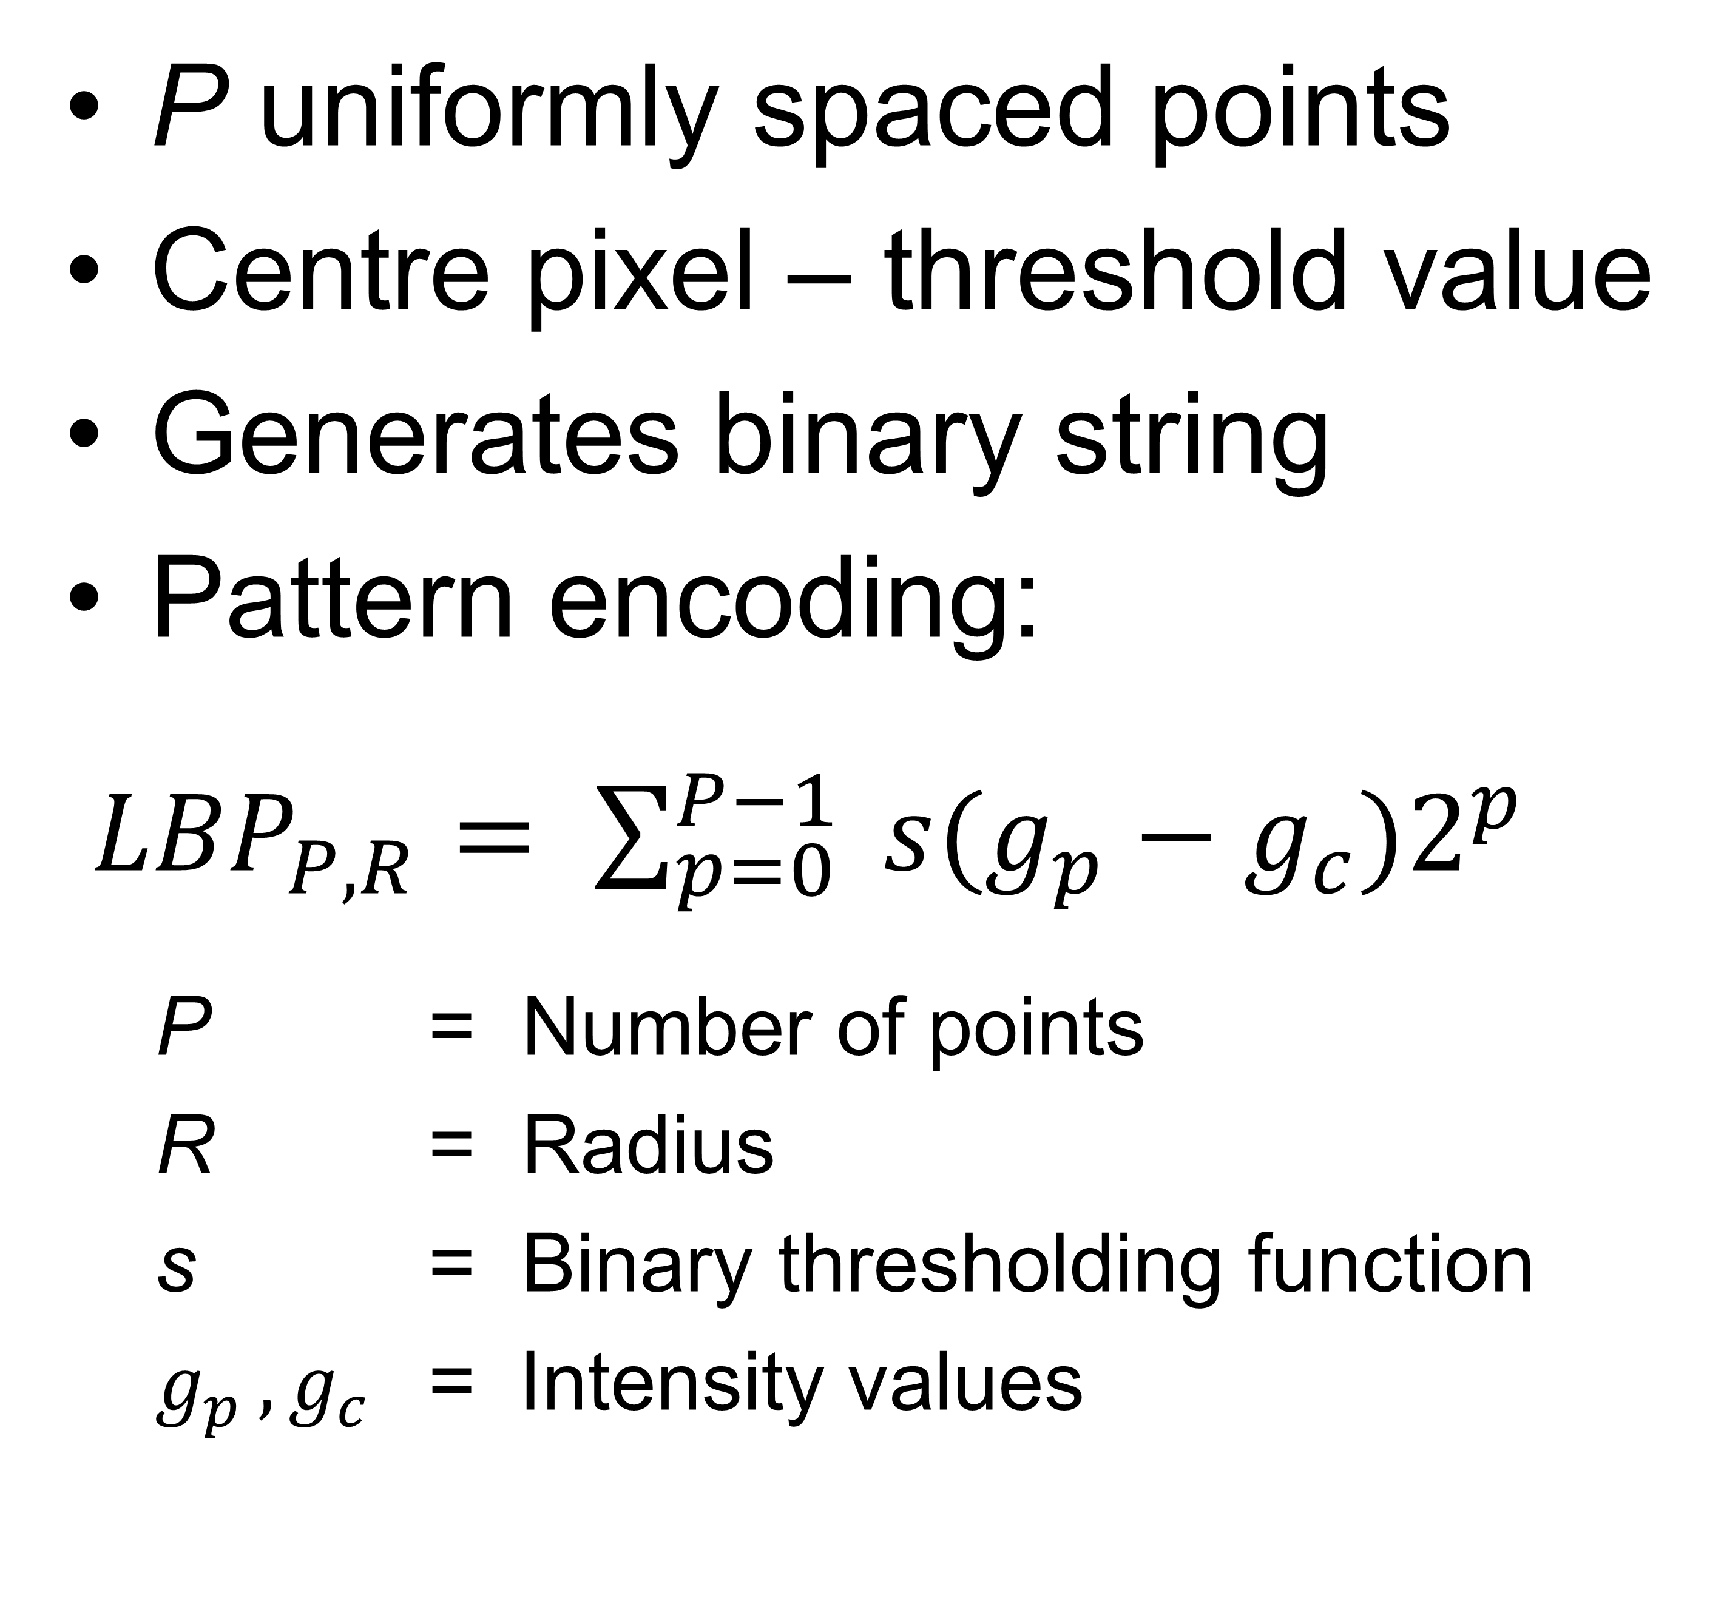
Local Binary Patterns
Conceived by Ojala et al. in 1996 and extended in 2002. [1]
Jo Gay
Hugo Harlin
Project in Computational Science, January 2019
Supervisors:
Joakim Lindblad Nataša Sladoje
Centre for Image Analysis,
Department of Information Technology
P uniformly spaced points
Centre pixel – threshold value
Generates binary string
Pattern encoding:
${LBP}_{P,R}= \sum_{p=0}^{P−1}{ s(g_{p}−g_{c})2^{p}}$
P = Number of points
R = Radius
s = Binary thresholding function
$g_{p }, g_{c}$ = Intensity values
P = 8, R = 2
[1] Ojala, T., Pietikainen, M., and Maenpaa, T. Multiresolution gray-scale and rotation invariant texture classification with local binary patterns. IEEE Transactions on pattern analysis and machine intelligence, 24(7):971–987, 2002.
Notes:
Expand on black/white board. Show binary string representation (dec 203, rot 151) and rotational invariance. Our experiments show R=10, P=6 has highest predictive power. Histograms used as input features to neural network. Loss of positional information.

Slide 5

Local Binary Patterns
Use histogram of pattern indices to train a neural network
LBPs can be made rotationally invariant
Important for cell images because orientation of cells is arbitrary
Jo Gay
Hugo Harlin
Project in Computational Science, January 2019
Supervisors:
Joakim Lindblad Nataša Sladoje
Centre for Image Analysis,
Department of Information Technology
Notes:
Expand on black/white board. Show binary string representation (dec 203, rot 151) and rotational invariance. Our experiments show R=10, P=6 has highest predictive power. Histograms used as input features to neural network. Loss of positional information.

Slide 6
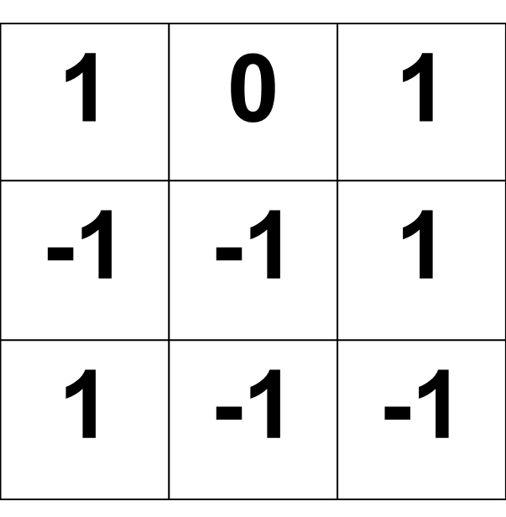
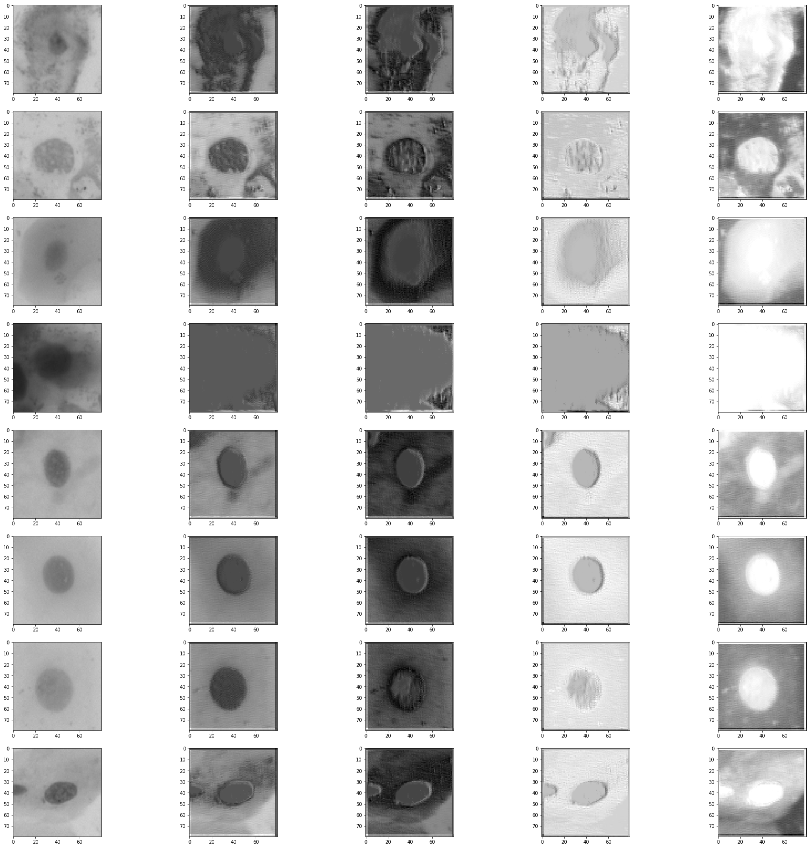
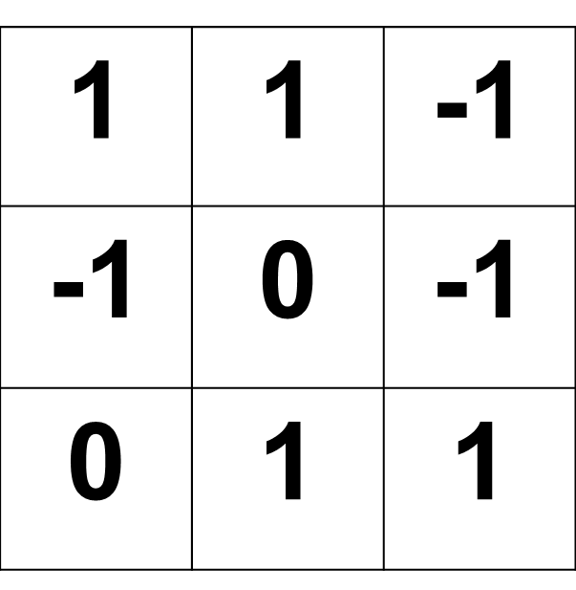
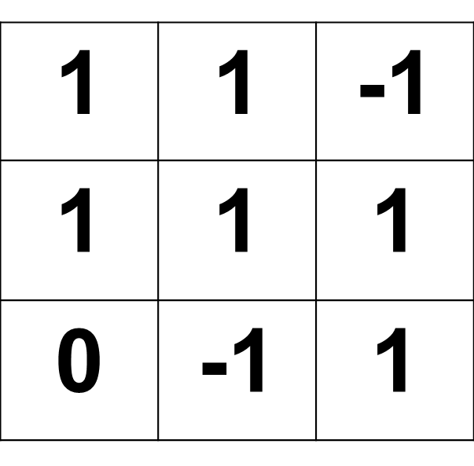
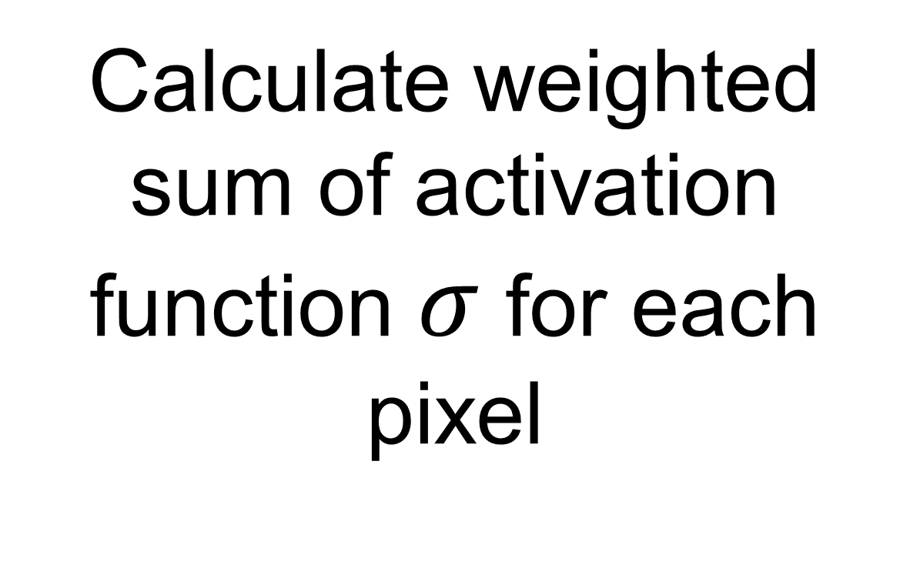
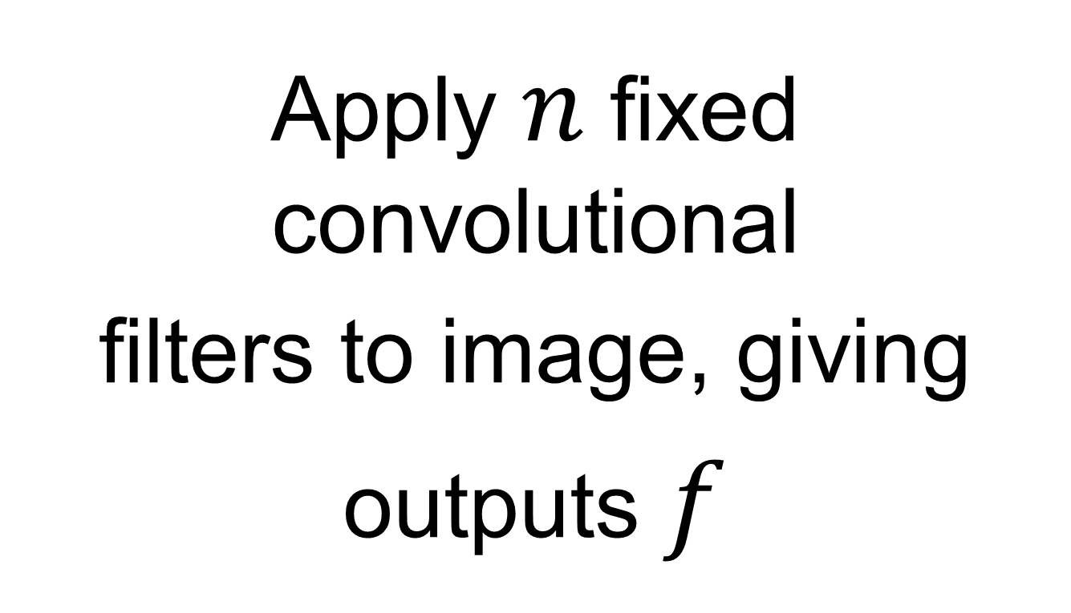

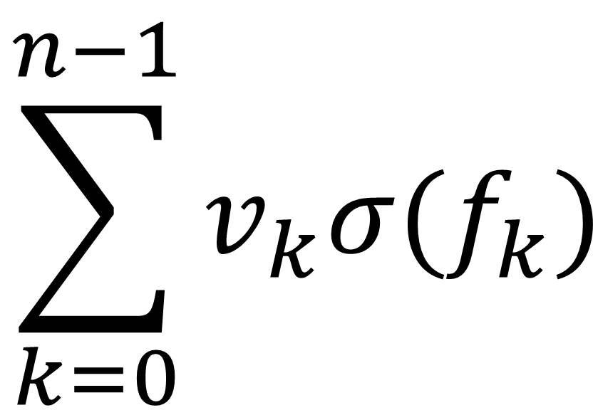
Model 1: Juefei-Xu et al.
Idea: Fixed LBP-inspired convolutional layers
LBCNN Module
Jo Gay
Hugo Harlin
Project in Computational Science, January 2019
Supervisors:
Joakim Lindblad Nataša Sladoje
Centre for Image Analysis,
Department of Information Technology
3x3 filters with randomly arranged values of 1 and -1
Multiply each output by learnable constant $v$ and sum
Use resulting feature map as input for next layer
$$\sum_{k=0}^{n−1}{v_{k}σ(f_{k})}$$
$$…$$
Input image
Apply 𝑛 fixed convolutional
filters to image, giving
outputs $f$
Calculate weighted sum of activation function $σ$ for each pixel
These form a feature map
which can be used in
further layers

Slide 7
Model 1: Juefei-Xu et al.
Pros:
Efficient to run, easy to implement
Translates idea of LBPs to a form that can be used in a CNN
Drop-in layer suitable for any CNN architecture
Cons:
Not rotationally invariant
Filters randomly initialized so not utilizing LBPs as designed

Slide 8
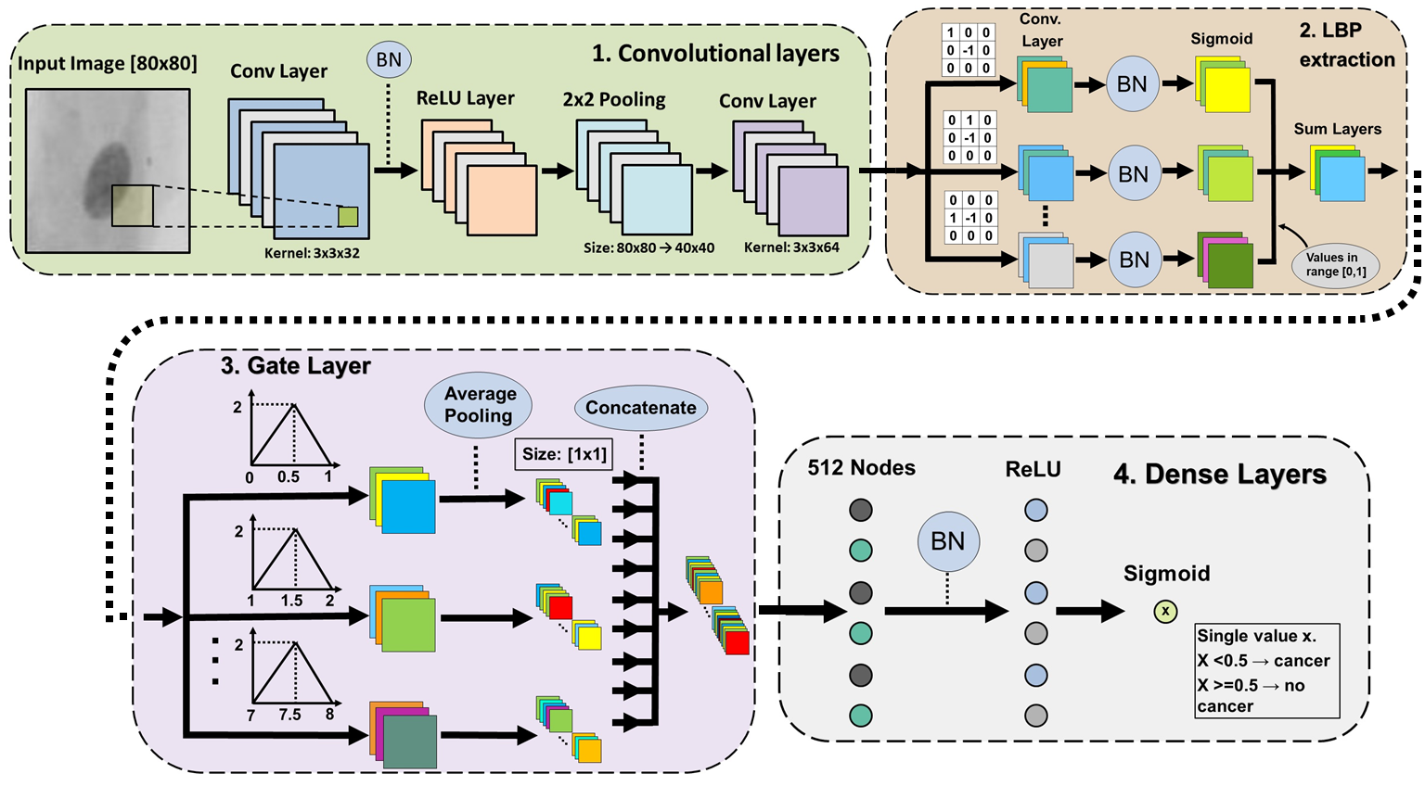
Model 2: Li et al.
Network comprised of four sequentially coupled modules
Jo Gay
Hugo Harlin
Project in Computational Science, January 2019
Supervisors:
Joakim Lindblad Nataša Sladoje
Centre for Image Analysis,
Department of Information Technology

Slide 9
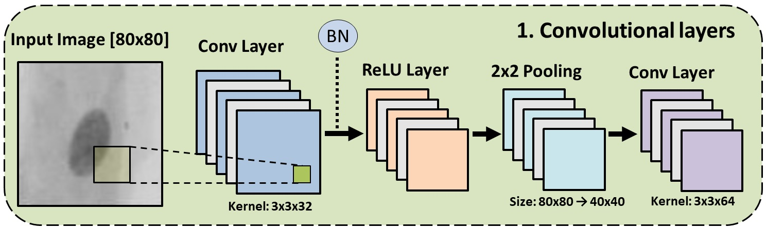
Model 2: Convolutional Layers
Output: 40x40x64 tensor

Slide 10
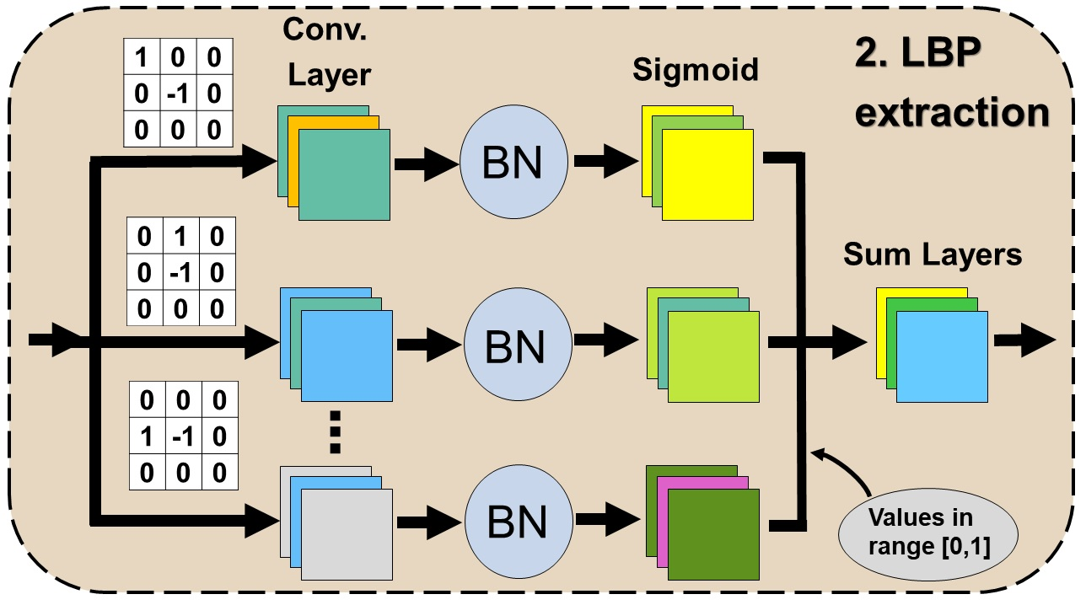
Model 2: Convolutional Module
Jo Gay
Hugo Harlin
Project in Computational Science, January 2019
Supervisors:
Joakim Lindblad Nataša Sladoje
Centre for Image Analysis,
Department of Information Technology
Input: 40x40x64 tensor
Output: 40x40x64 tensor

Slide 11
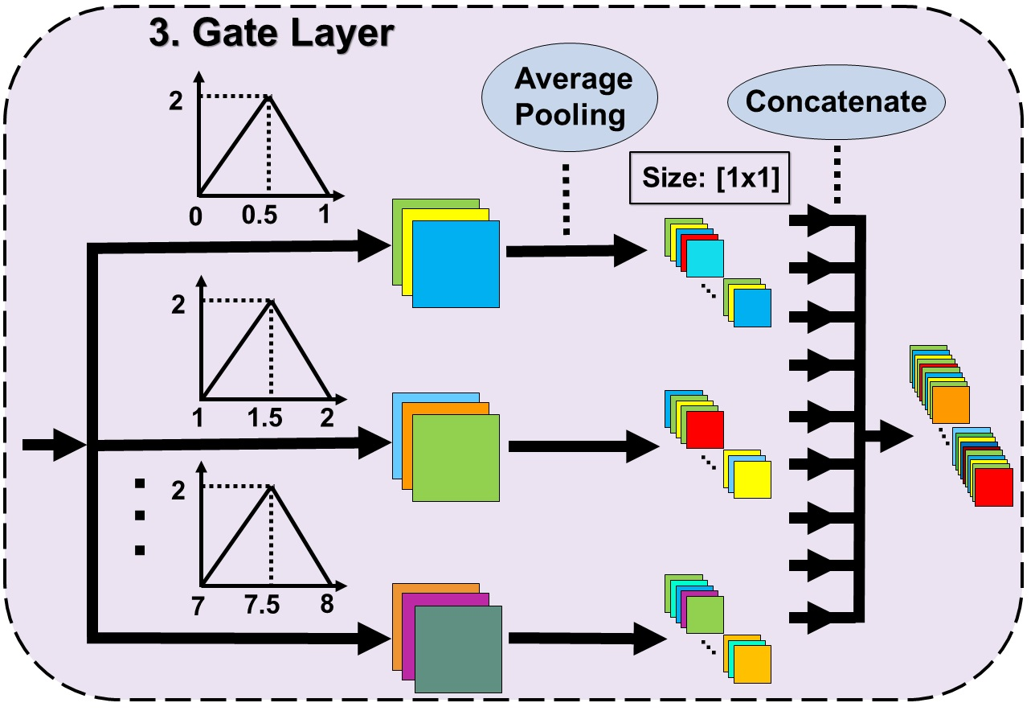
Model 2: Gate layer
Input: 40x40x64 tensor
Output: 512 element vector

Slide 12
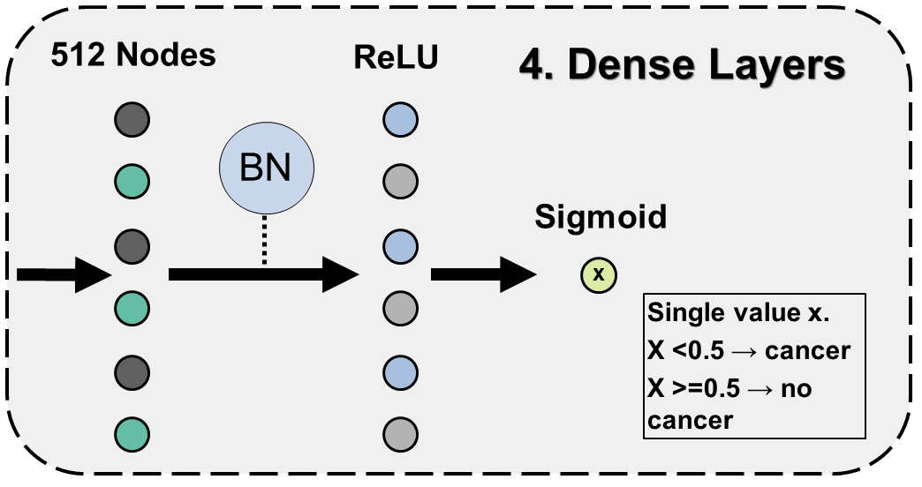
Model 2: Dense Layers
Input: 512 element vector
Output: Single value

Slide 13
Model 2: Li et al.
Pros:
Closely linked to LBP theory
Relatively shallow network saves computational time
Cons:
Classification based on histograms, discarding spatial information

Slide 14
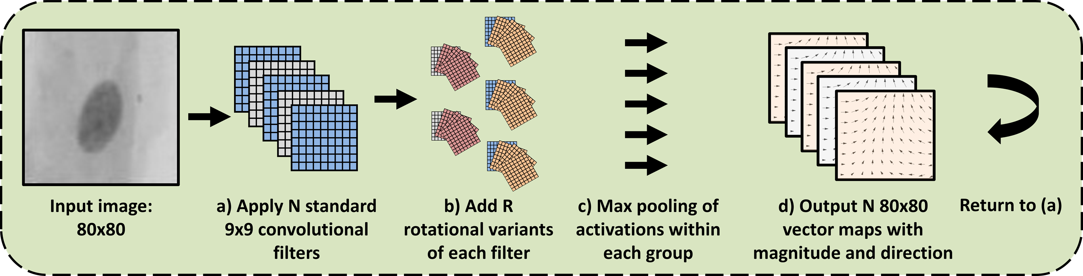
Model 3: Marcos et al.
Jo Gay
Hugo Harlin
Project in Computational Science, January 2019
Supervisors:
Joakim Lindblad Nataša Sladoje
Centre for Image Analysis,
Department of Information Technology
Rotationally equivariant filters with vector field outputs
Filters are organised in groups consisting of R filters
Only the first is trainable, the rest are rotations
The result contains the magnitude and direction of the maximum activation of any filter in the group
This is passed on to the next layer
4 RotEqNet layers are used in our model

Slide 15
Model 3: Marcos et al.
Pros:
Rotationally equivariant
RotEqNet modules are modular, can be used in any CNN architecture
Fewer trainable paramaters compared to conventional CNN of the same size
Cons:
Requires custom back-propagation, challenging to implement
Prone to overfitting on our data
Jo Gay
Hugo Harlin
Project in Computational Science, January 2019
Supervisors:
Joakim Lindblad Nataša Sladoje
Centre for Image Analysis,
Department of Information Technology

Slide 16
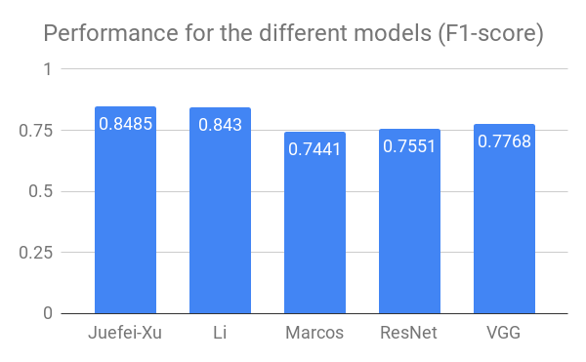
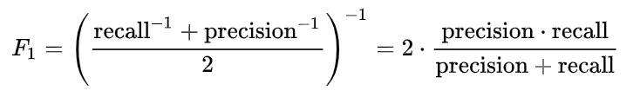
Results
Jo Gay
Hugo Harlin
Project in Computational Science, January 2019
Supervisors:
Joakim Lindblad Nataša Sladoje
Centre for Image Analysis,
Department of Information Technology

Slide 17
Thanks for Listening!
Jo Gay
Hugo Harlin
Project in Computational Science, January 2019
Supervisors:
Joakim Lindblad Nataša Sladoje
Centre for Image Analysis,
Department of Information Technology
Questions?

