Slide 1
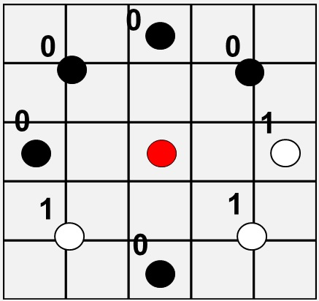








Fighting Cancer with Texture
Background
Local Binary Patterns
Models
Early detection of cancer plays a major role in reducing cancer mortality. With deep convolutional neural networks, it is becoming possible to automatically classify cell images as either healthy or cancerous, a task previously done manually by highly trained professionals.
Local binary patterns are very good at identifying textures, which has been hypothesized to be of importance in cell classification. In this project three recent LBP based networks are tuned and compared to conventional network architechtures.
Conceived by Ojala et al in 1996 and extended in 2002. [1]
LBPs compare P surrounding points at radius R, with the center pixel (red), and record either a 1 or a 0 depending which value is greater.
The resulting strings of 1 and 0’s are unique patterns, and are grouped such that it doesn’t matter where one starts recording the pattern. This ensures rotation invariance.
plotted in a histrogram they can be used to classify texture.
Jo Gay
Hugo Harlin
Project in Computational Science, January 2019
Supervisors:
Joakim Lindblad Nataša Sladjoe
Centre for Image Analysis,
Department of Information Technology
00110100
=
00001101
R = 2, P = 8
Data
Results
The data set consisted of 10274 80x80 images of cells from six patients, three with cancer and three without. Cells were sampled from the mouth of the patient and placed on a glass and photographed.
Healthy Cells
Cancer Cells
[1] Timo Ojala, Matti Pietikainen, and Topi Maenpaa. Multiresolution gray-scale and rotation invariant texture classification with local binary patterns. IEEE Transactions on pattern analysis and machine intelligence, 24(7):971–987, 2002.

Slide 2
0
0
0
0
1
1
1
0
P = 8, R = 2

