Slide 1
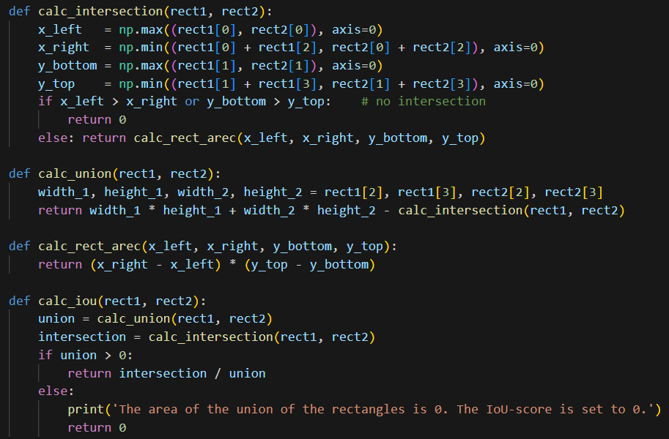
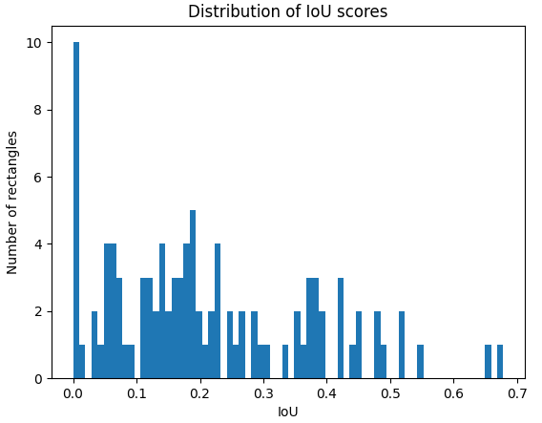
Homework 6
Name: Josephina Imhoff
Matriculation No.: 23464631
IdM: jo17wila

