Slide 1
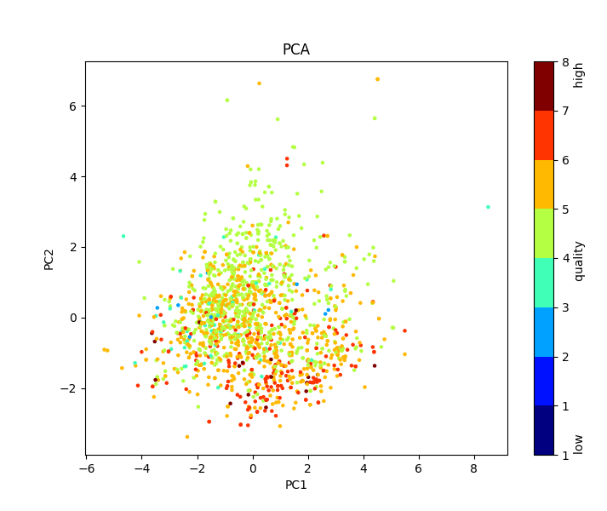
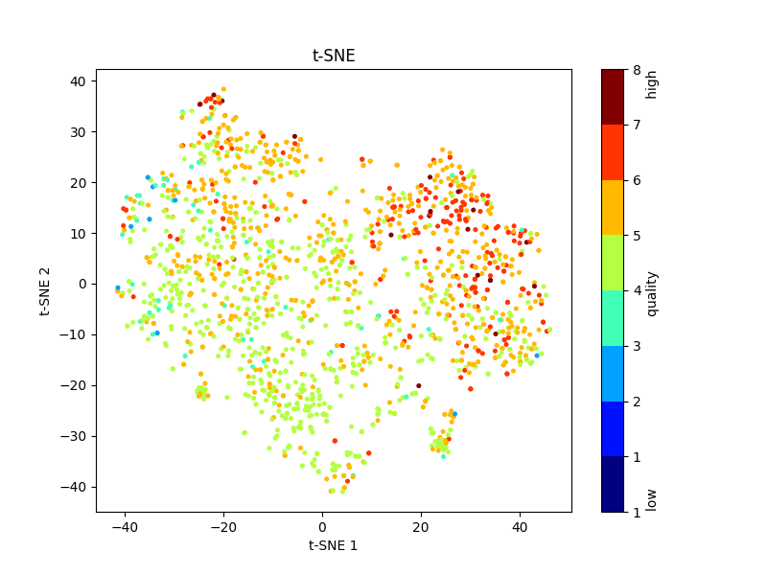
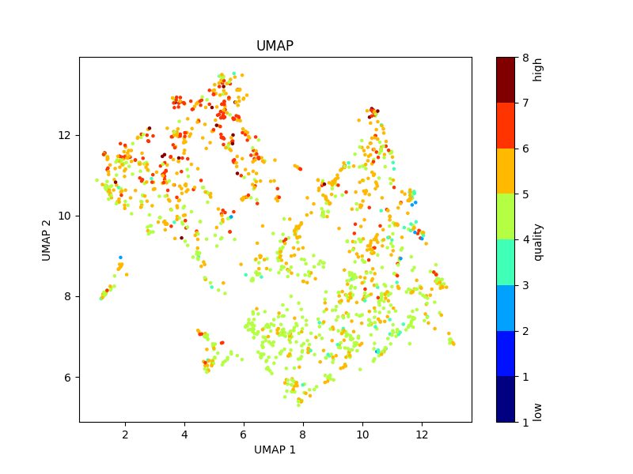
Homework 5 – Wine Quality
H0: The pH-value of the wine does not affect wine quality.
H1: The pH-value of the wine does affect the wine quality.
High quality: quality > median of quality
Low quality: ‘quality’ ≤ median of quality
Why? A t-test was used to check the hypothesis because I wanted to examine the influence of the pH-value on high and low wine quality. It was possible to use the t-test because a QQ-plot showed that the distribution of the pH-values in both groups (high and low wine quality) are normally distributed. Also, by definition, the groups are independent.
p-Value: 0.02198034398691512
Conclusion: Since the p-value is less than 0.05, we reject the null-hypothesis H0 and conclude that H1 is true and the pH-value in fact does affect wine quality.
Name: Josephina Imhoff
Matriculation No.: 23464631
IdM: jo17wila

Slide 2
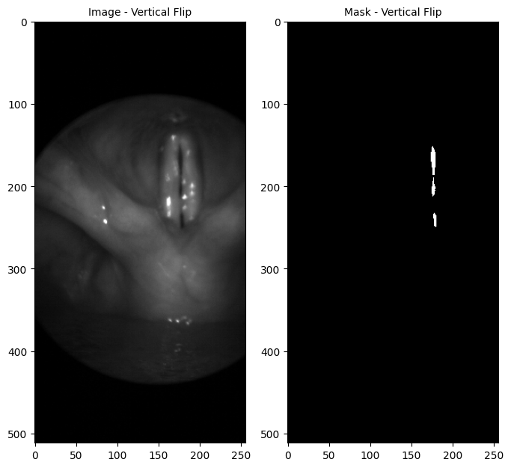
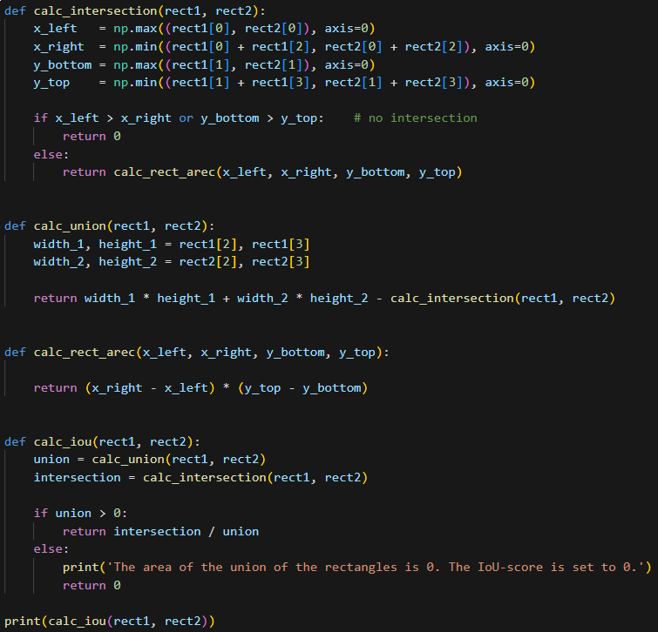
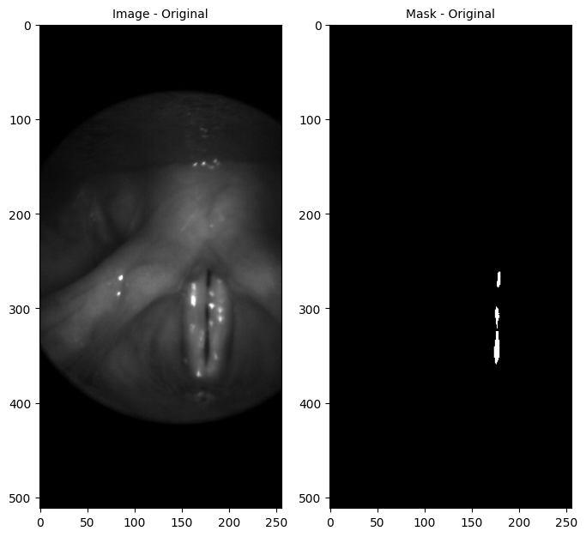
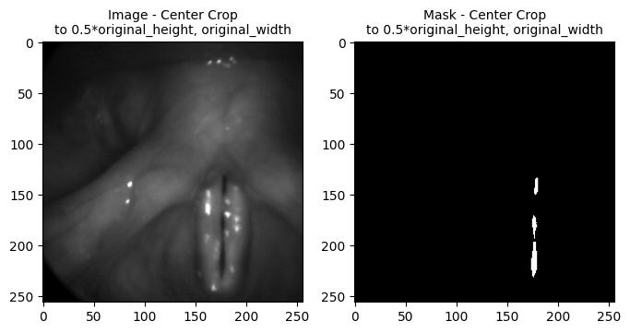
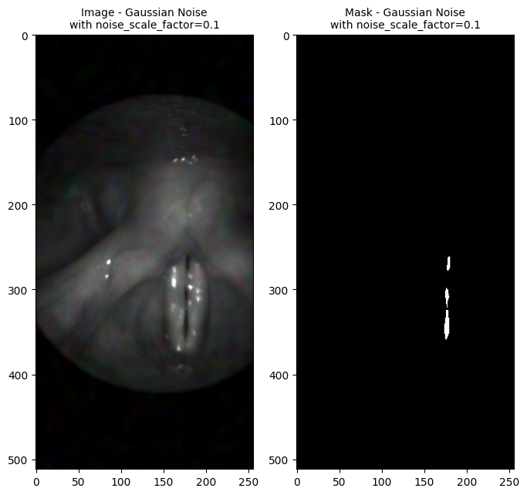
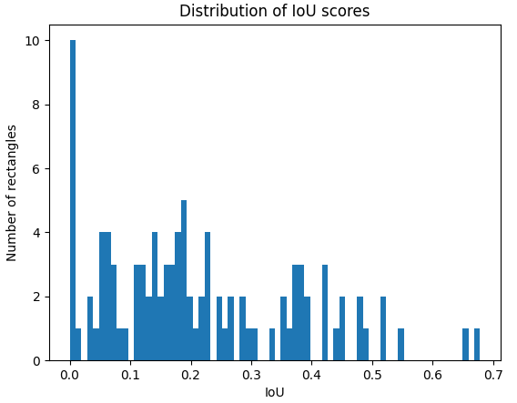
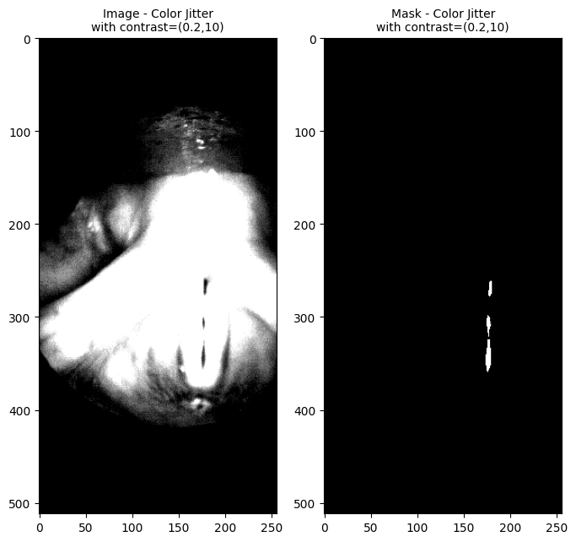
Homework 6
Name: Josephina Imhoff
Matriculation No.: 23464631
IdM: jo17wila

Slide 3
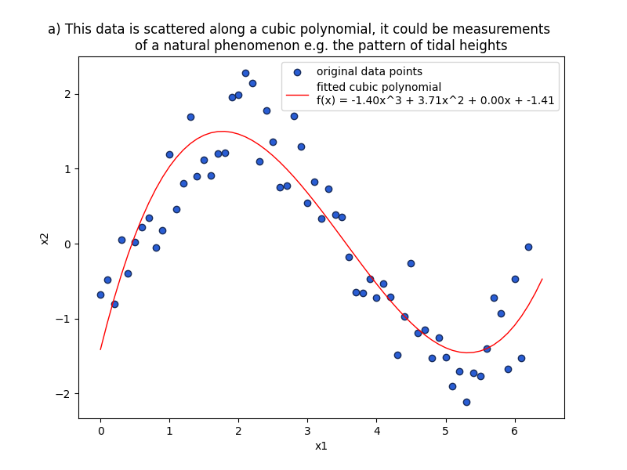
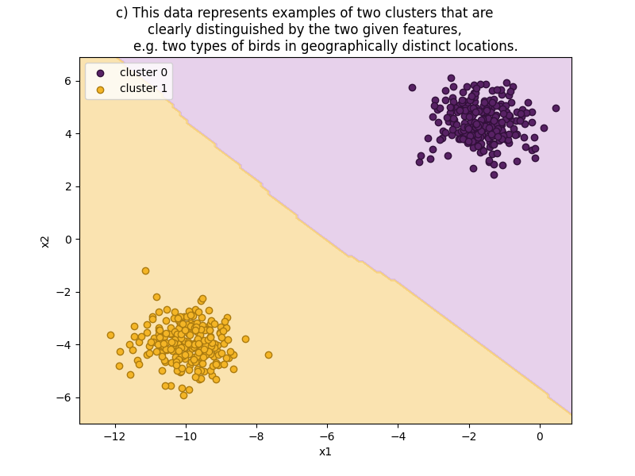
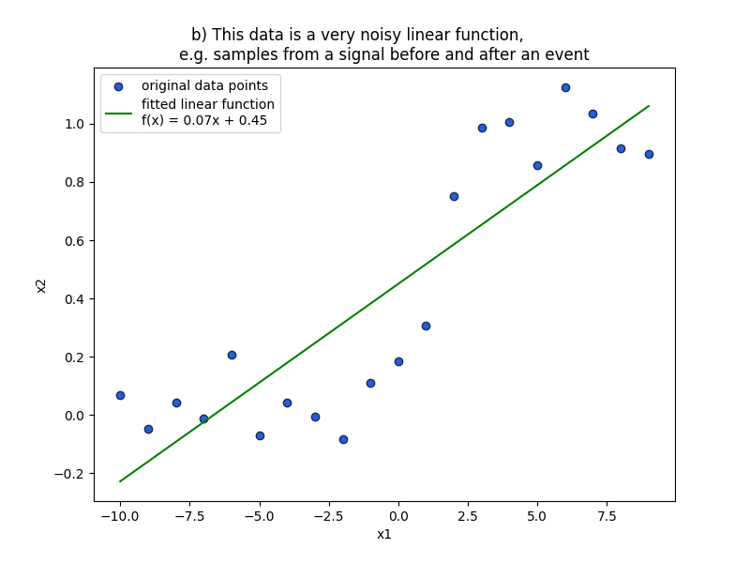
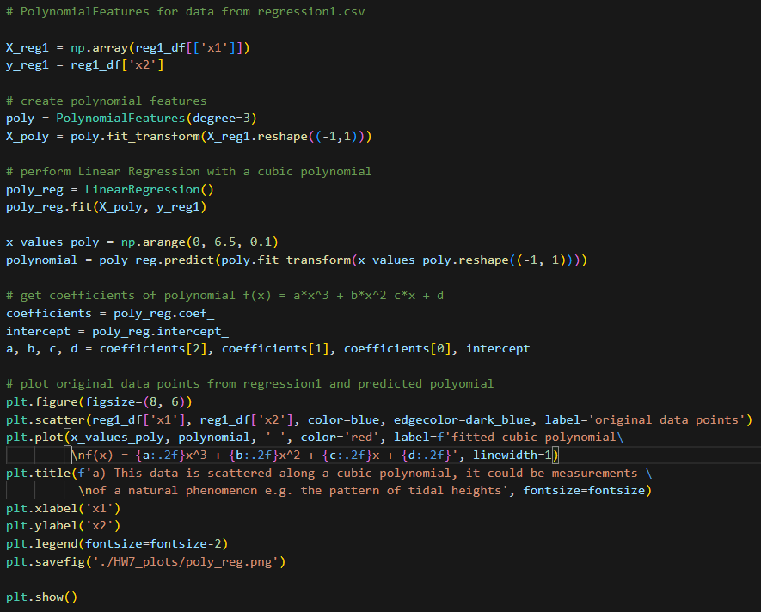
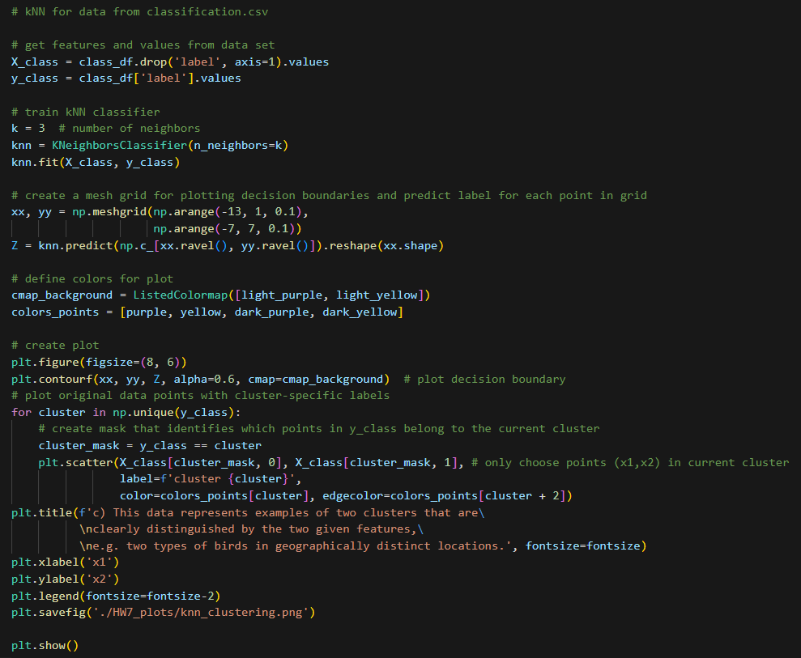
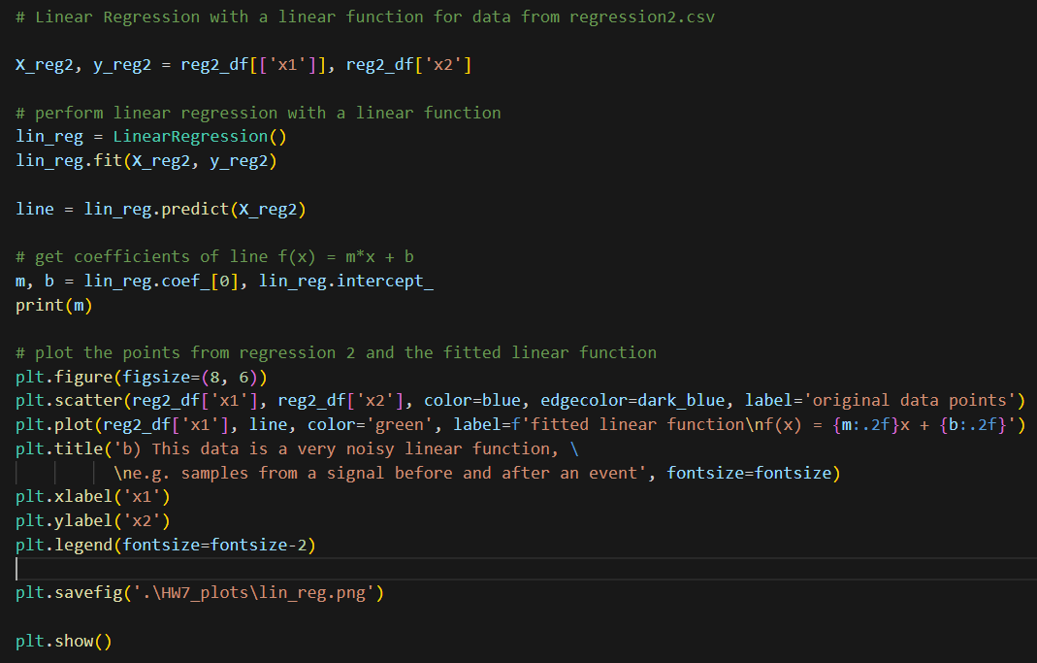
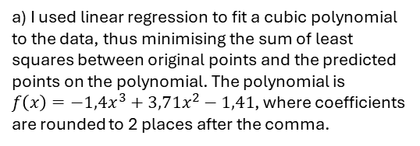
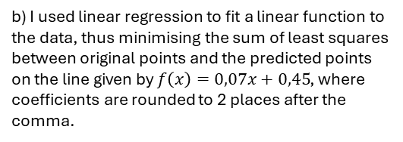
Homework 7
a) I used linear regression to fit a cubic polynomial to the data, thus minimising the sum of least squares between original points and the predicted points on the polynomial. The polynomial is
$f\left(x\right)=−1,4x^{3}+3,71x^{2}−1,41$, where coefficients are rounded to 2 places after the comma.
b) I used linear regression to fit a linear function to the data, thus minimising the sum of least squares between original points and the predicted points on the line given by $f\left(x\right)=0,07x+0,45$, where coefficients are rounded to 2 places after the comma.
c) I used the kNN classifier with k=3 to classify the data points into two clusters. Since the clusters are very clearly separated, we get an almost linear decision boundary.
Name: Josephina Imhoff
Matriculation No.: 23464631
IdM: jo17wila

Slide 4
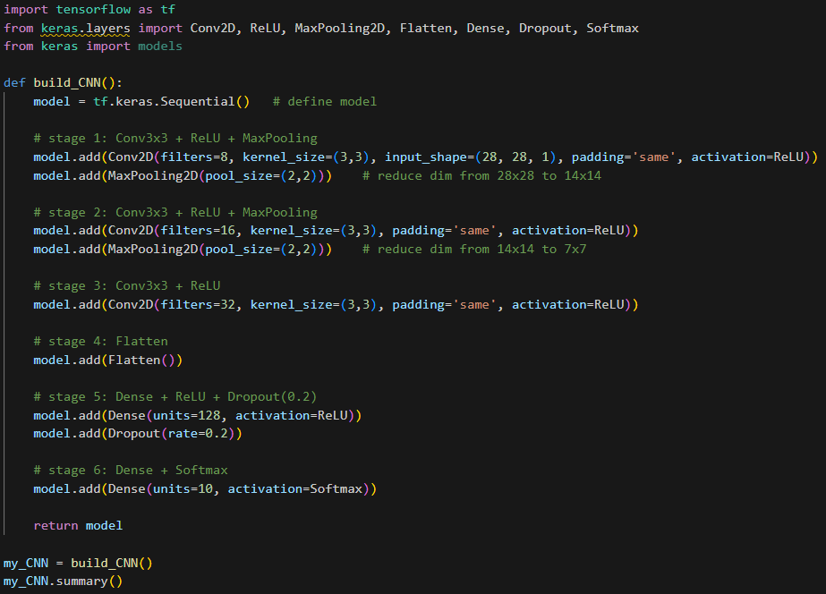
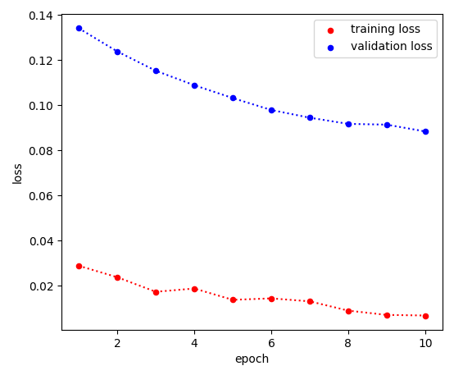

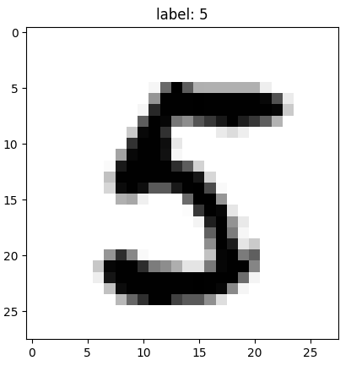
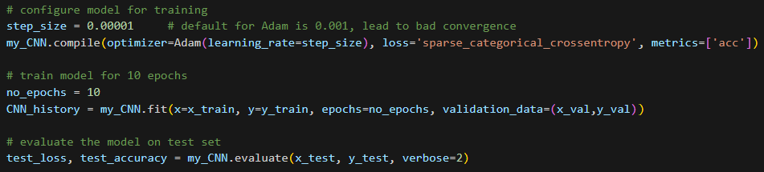
Homework 8
Answers to Questions:
Five Activation Functions:
(Leaky) ReLU
Sigmoid function (or hyperbolic tangent)
Linear function
Step function (signum or unit step)
Piecewise linear function
Adam: Adam is an optimizer based on stochastic gradient descent using adaptive moment estimation, helping the algorithm converge a local minimum faster.
sparse_categorical_crossentropy:
Loss-function for classification tasks with mutually exclusive classes
expects integer labels (not one-hot encoded)
computes the cross-entropy loss
particularly useful for multi-class problems where the target is a single class index
Epoch: An epoch is one complete pass through the whole training set during the training of a ML model.
Build CNN
Compile and evaluate CNN
Name: Josephina Imhoff | Matriculation No.: 23464631 | IdM: jo17wila

Slide 5
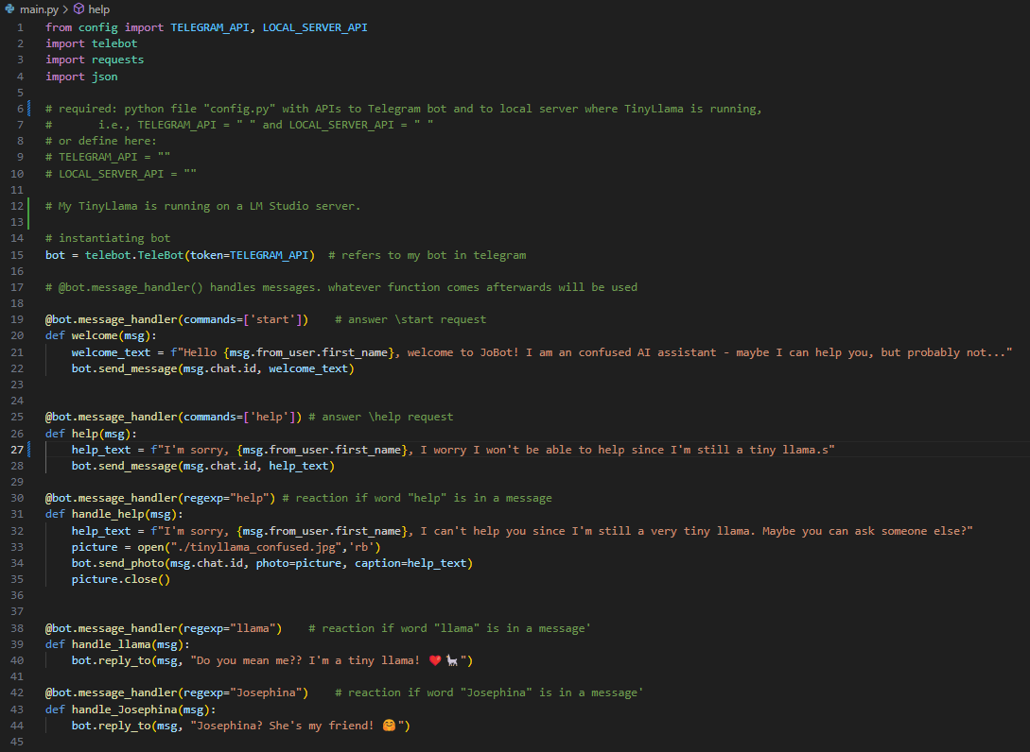
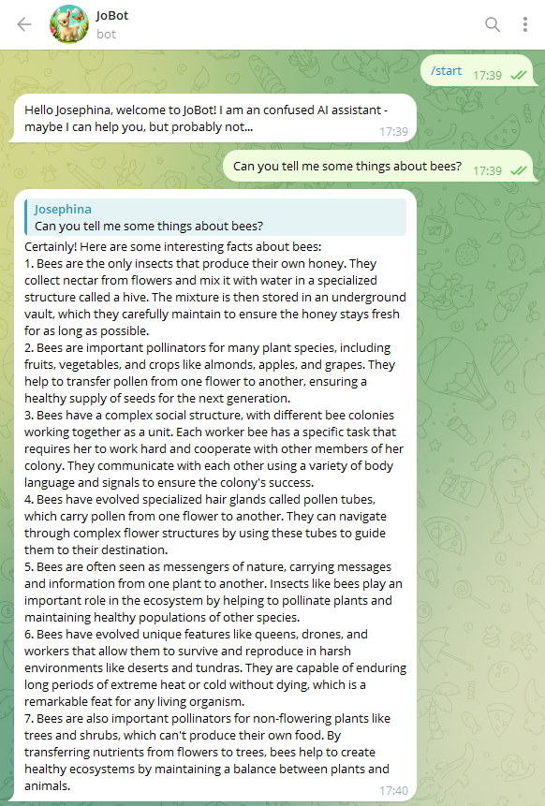
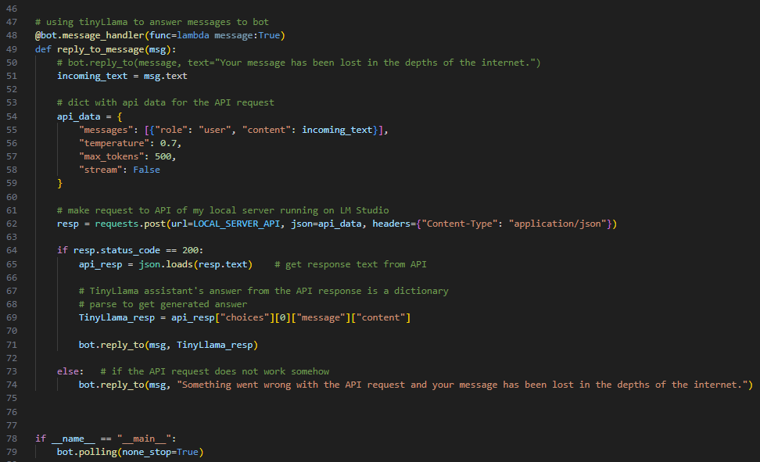
Homework 9
Telegram Bot “JoBot”: https://t.me/josephinas_bot
GitHub repo:
https://github.com/jo-phina/JoBot
Name: Josephina Imhoff
Matriculation No.: 23464631
IdM: jo17wila

Slide 6
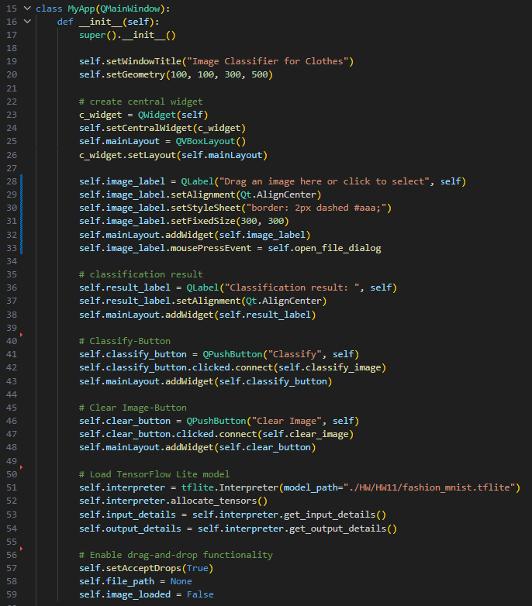
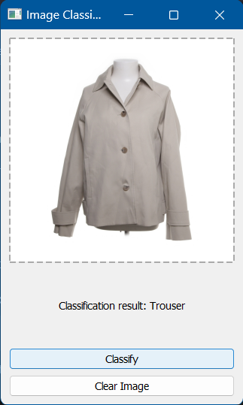
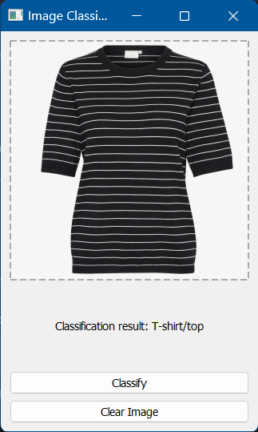

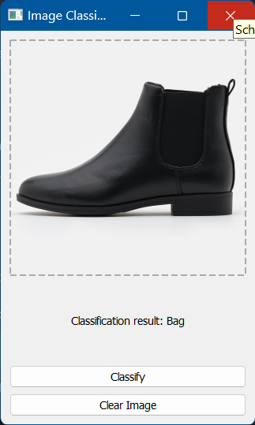
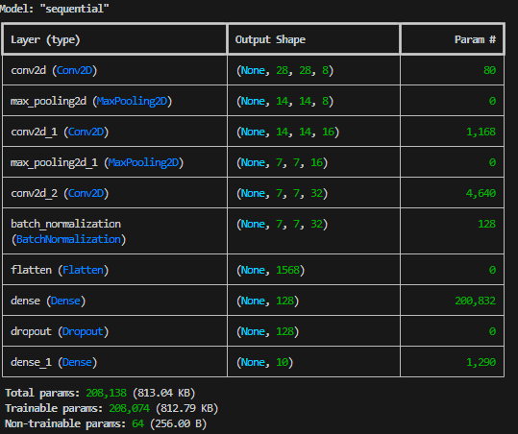
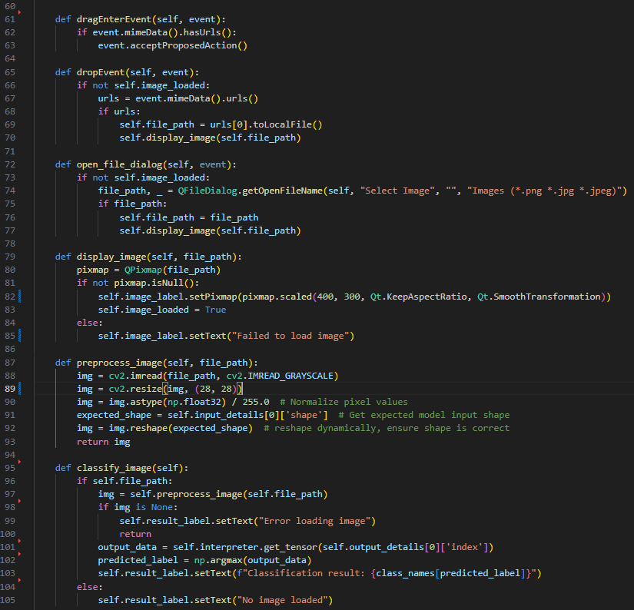
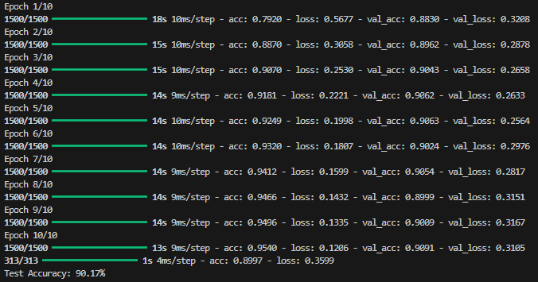
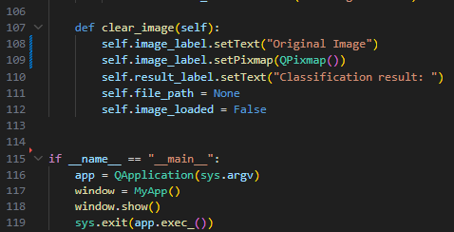
GUI
Homework 11
Model Architecture
Training/Validation Loss & Accuracy
Name: Josephina Imhoff
Matriculation No.: 23464631
IdM: jo17wila

