Slide 1
Homework x
Name: Josephina Imhoff
Matriculation No.: 23464631
IdM: jo17wila

Slide 2
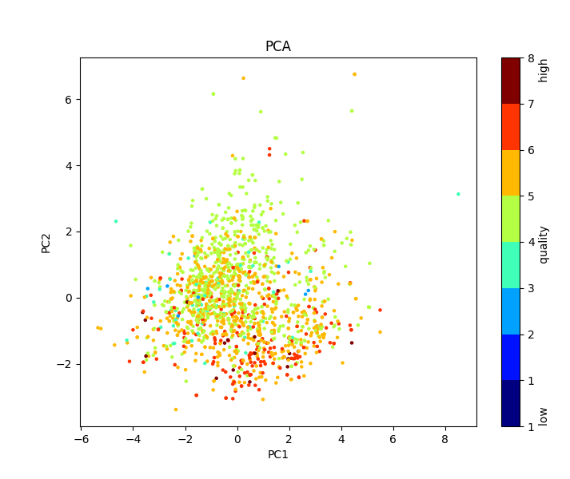
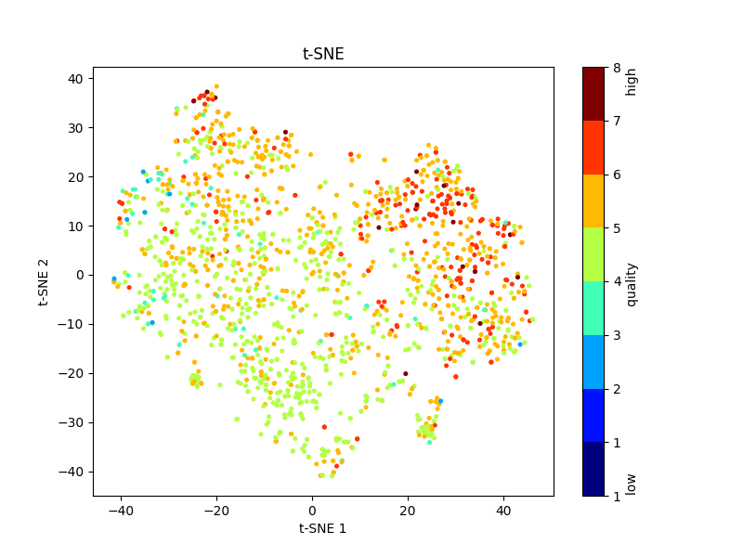
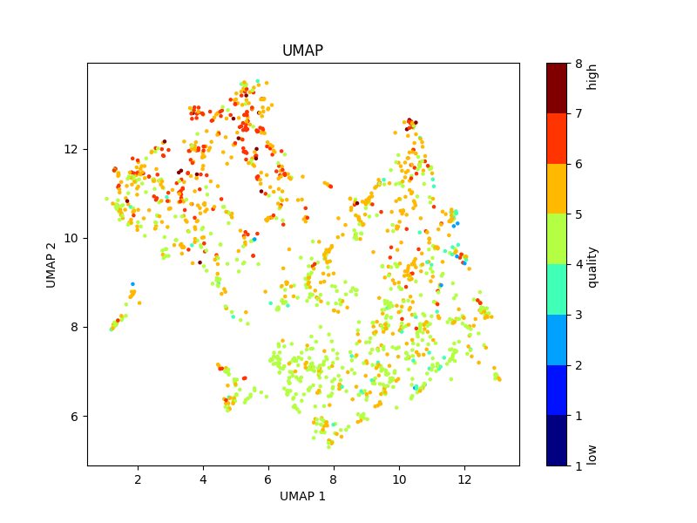
Homework 5 – Wine Quality
H0: The pH-value of the wine does not affect wine quality.
H1: The pH-value of the wine does affect the wine quality.
High quality: quality > median of quality
Low quality: ‘quality’ ≤ median of quality
Why? A t-test was used to check the hypothesis because I wanted to examine the influence of the pH-value on high and low wine quality. It was possible to use the t-test because a QQ-plot showed that the distribution of the pH-values in both groups (high and low wine quality) are normally distributed. Also, by definition, the groups are independent.
p-Value: 0.02198034398691512
Conclusion: Since the p-value is less than 0.05, we reject the null-hypothesis H0 and conclude that H1 is true and the pH-value in fact does affect wine quality.
Name: Josephina Imhoff
Matriculation No.: 23464631
IdM: jo17wila

Slide 3
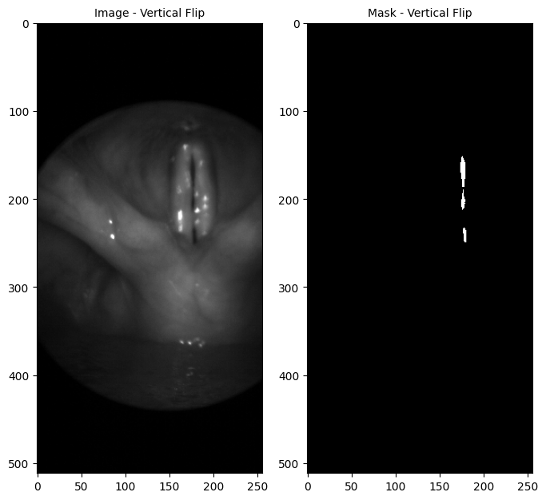
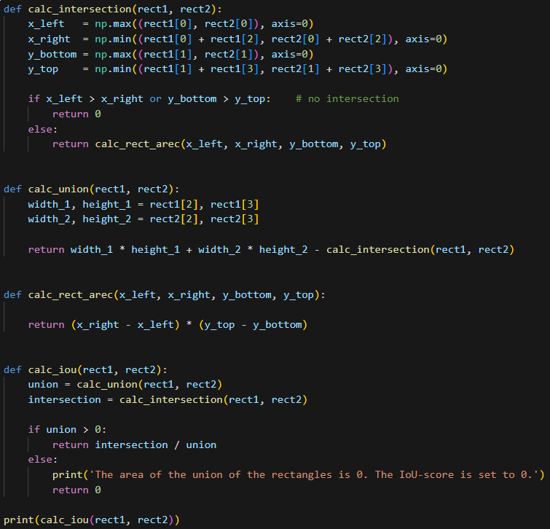
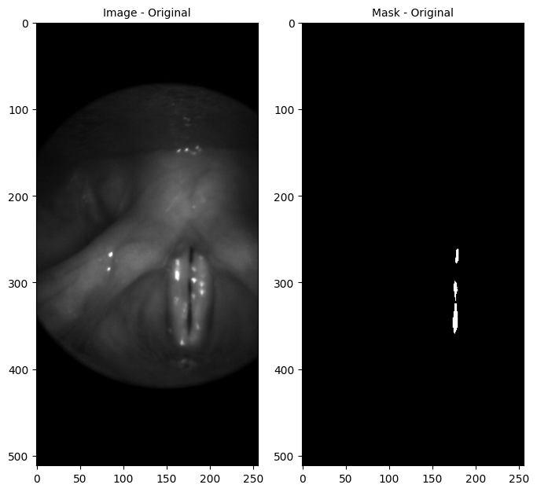
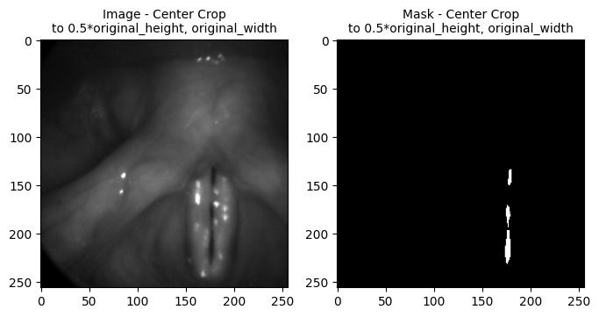
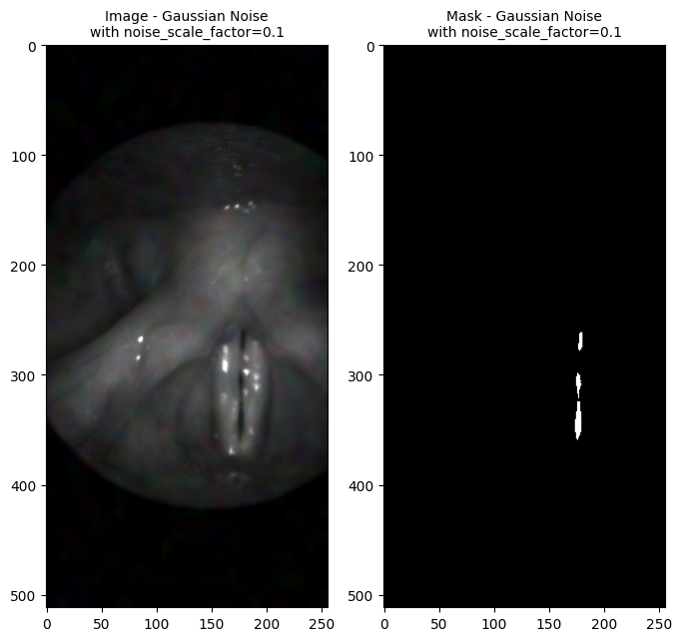
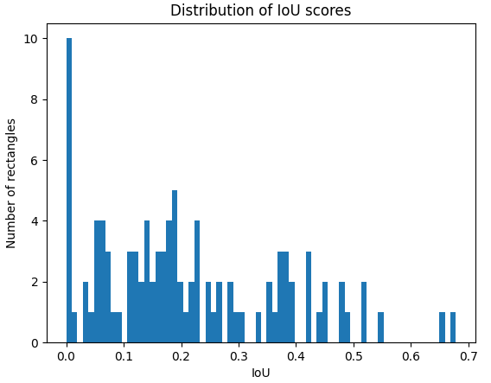
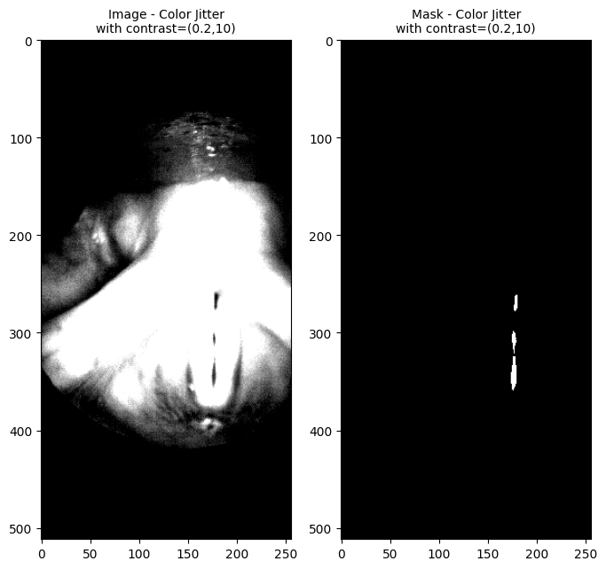
Homework 6
Name: Josephina Imhoff
Matriculation No.: 23464631
IdM: jo17wila

