Slide 1
Cashmere Casa
Login
Store.Cashmerecasa.com

Slide 2

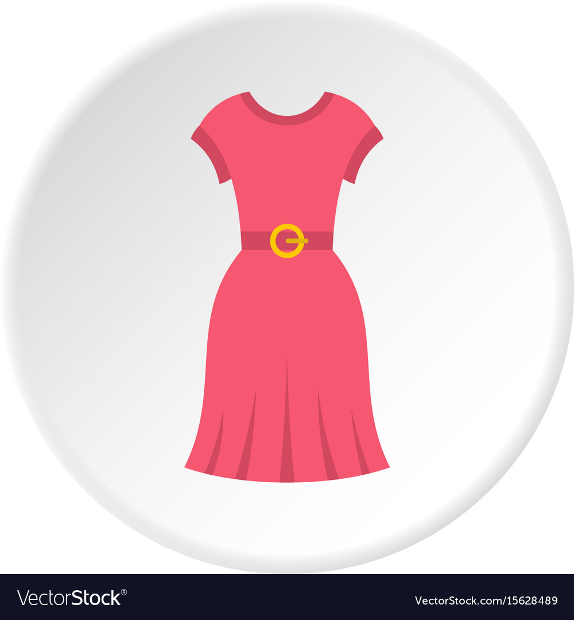
Cashmere Casa
Sales
Refunds
Reports
Taxation
Scan Item
sku
Search item
item
Price
Description
$ 120.00
Add
Size
Often bought together items
Total
Tax
Net
19
$ 50.00
0 Cash 0 CC

Slide 3
Cashmere Casa

Slide 4
Cashmere Casa

