Slide 1

Parky
AI-Enabled Parking Detection

Slide 2
About Parky
Taking the randomness out from city parking.
Real Time.
Low Cost.
Convenient.

Slide 3
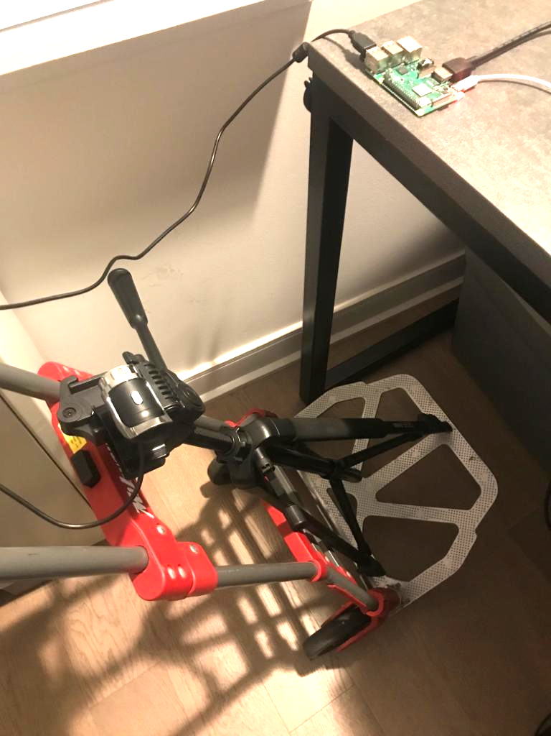
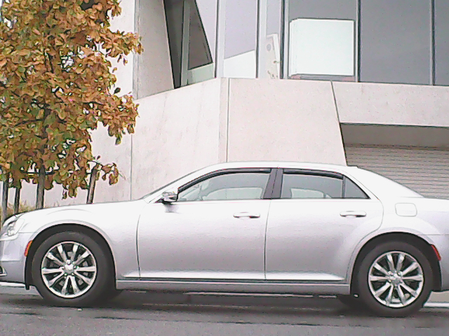

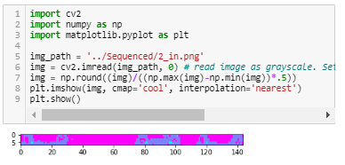
Low Bandwidth Design
99.92% Data Compression
Only relevant from images are preserved.
An elementary Python algorithm is used here to produce a heatmap of the vehicle’s signature.

