Slide 1




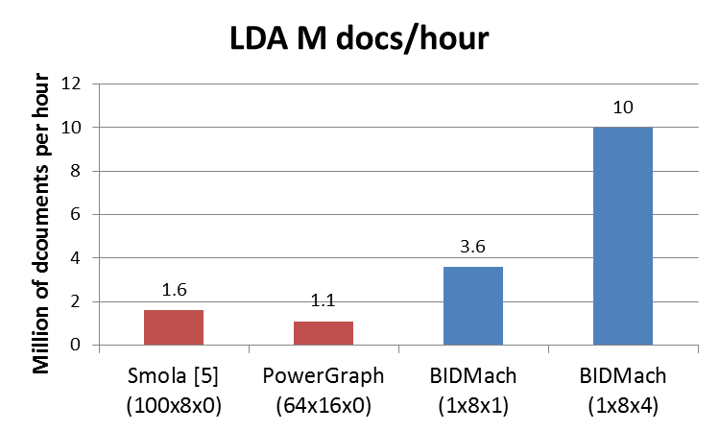
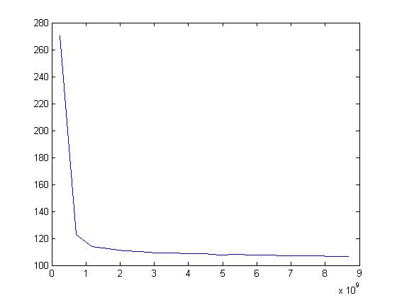
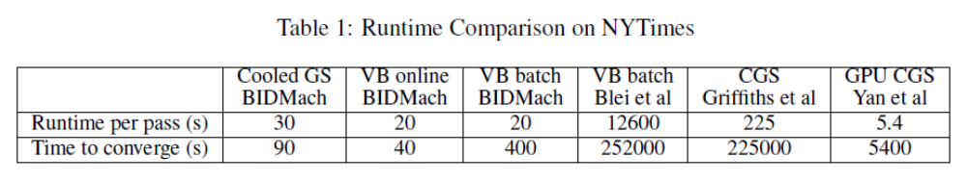
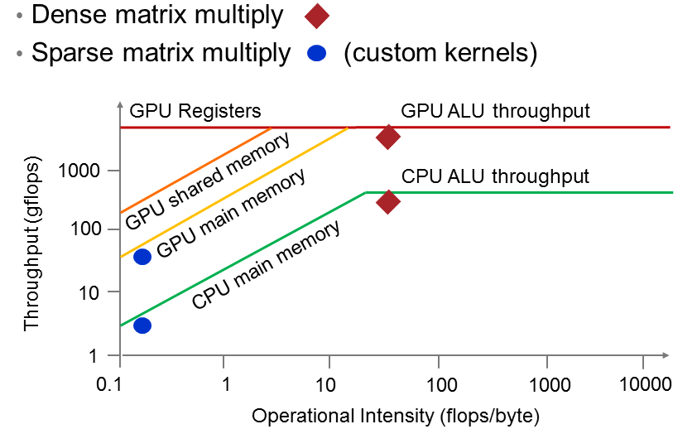
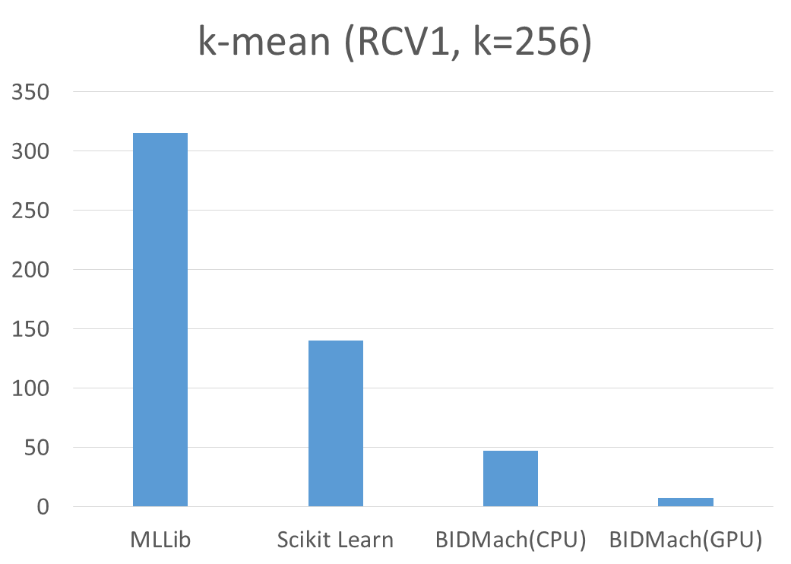
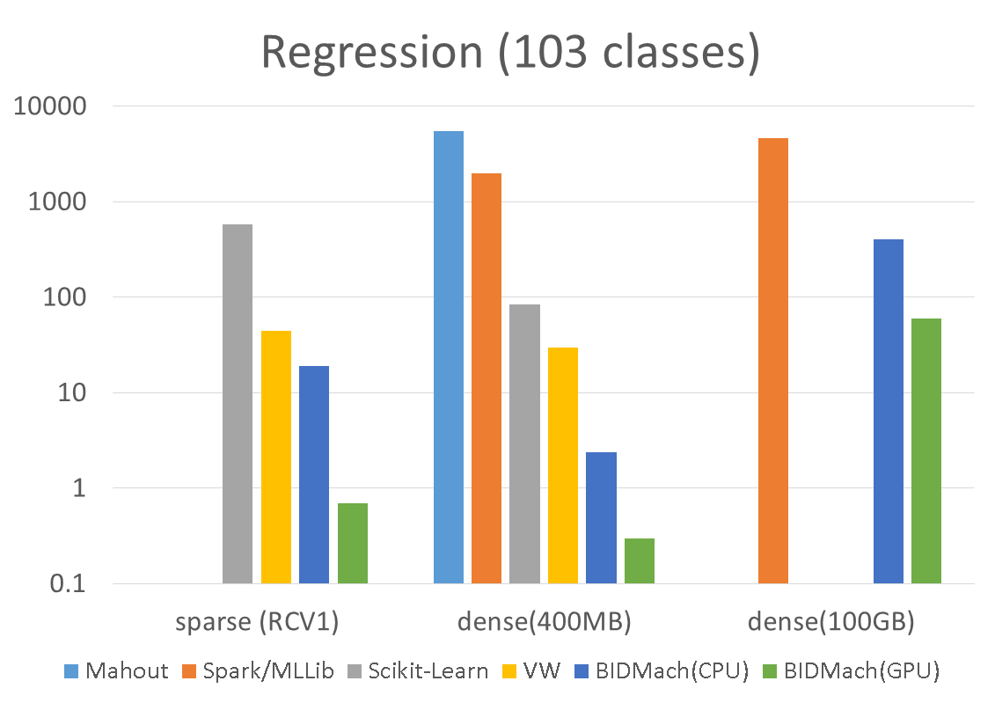
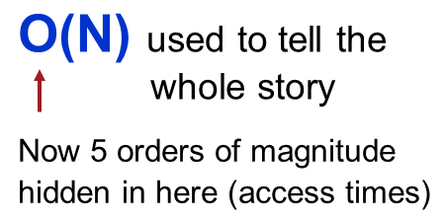
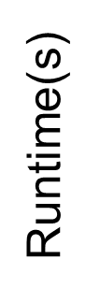
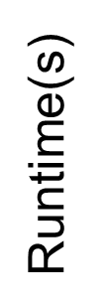
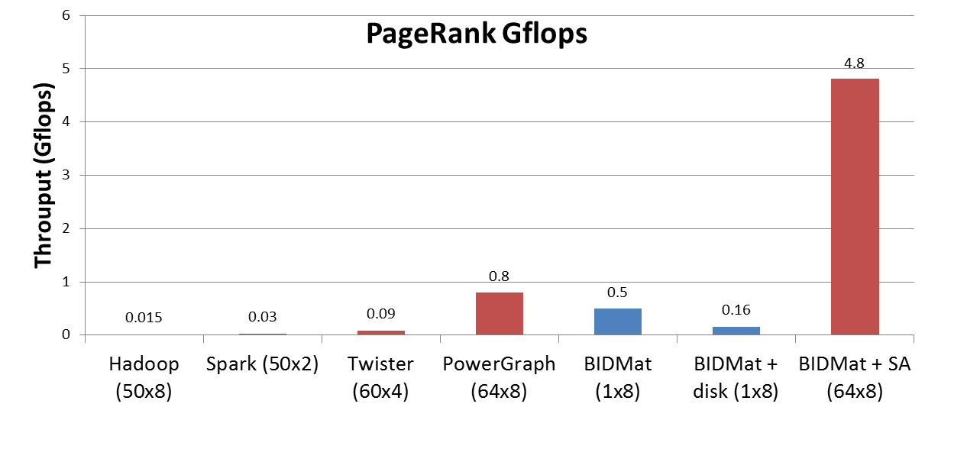
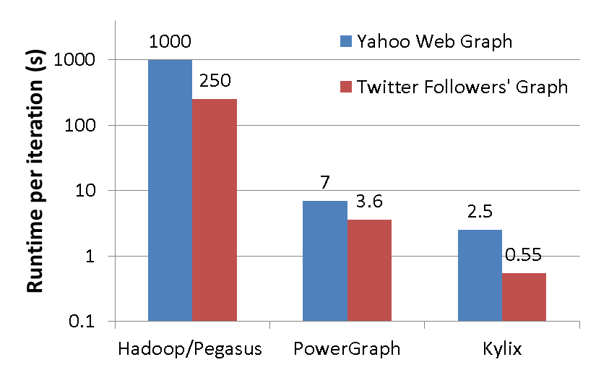
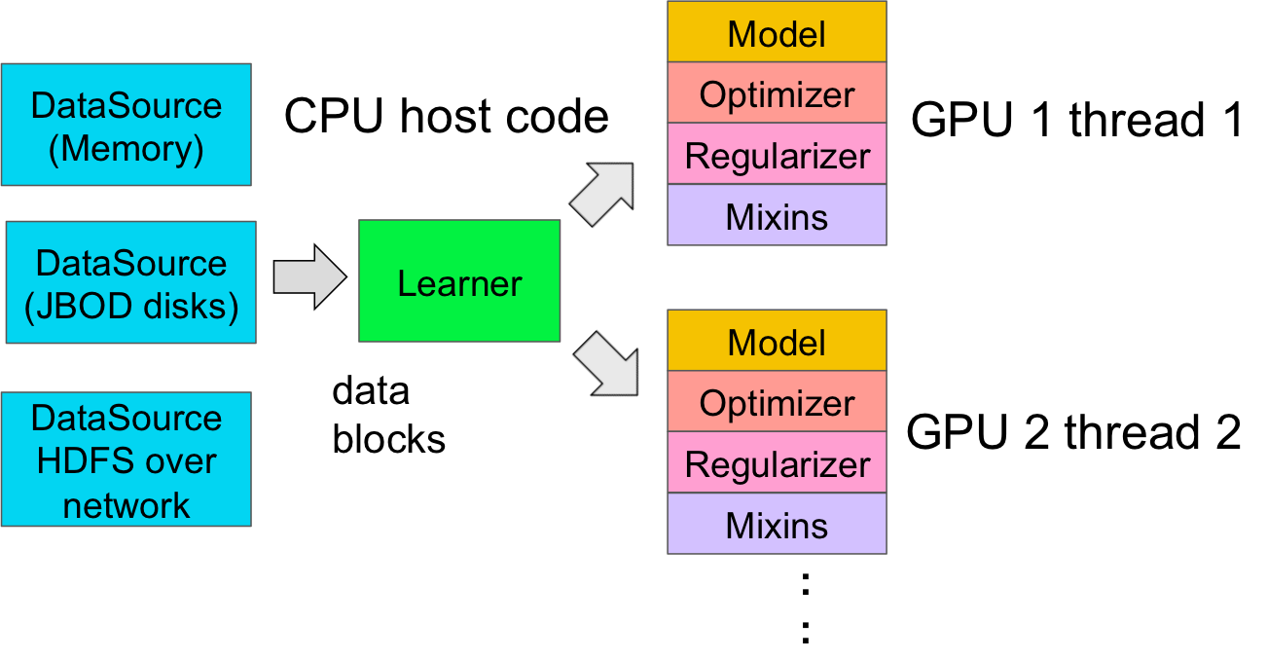
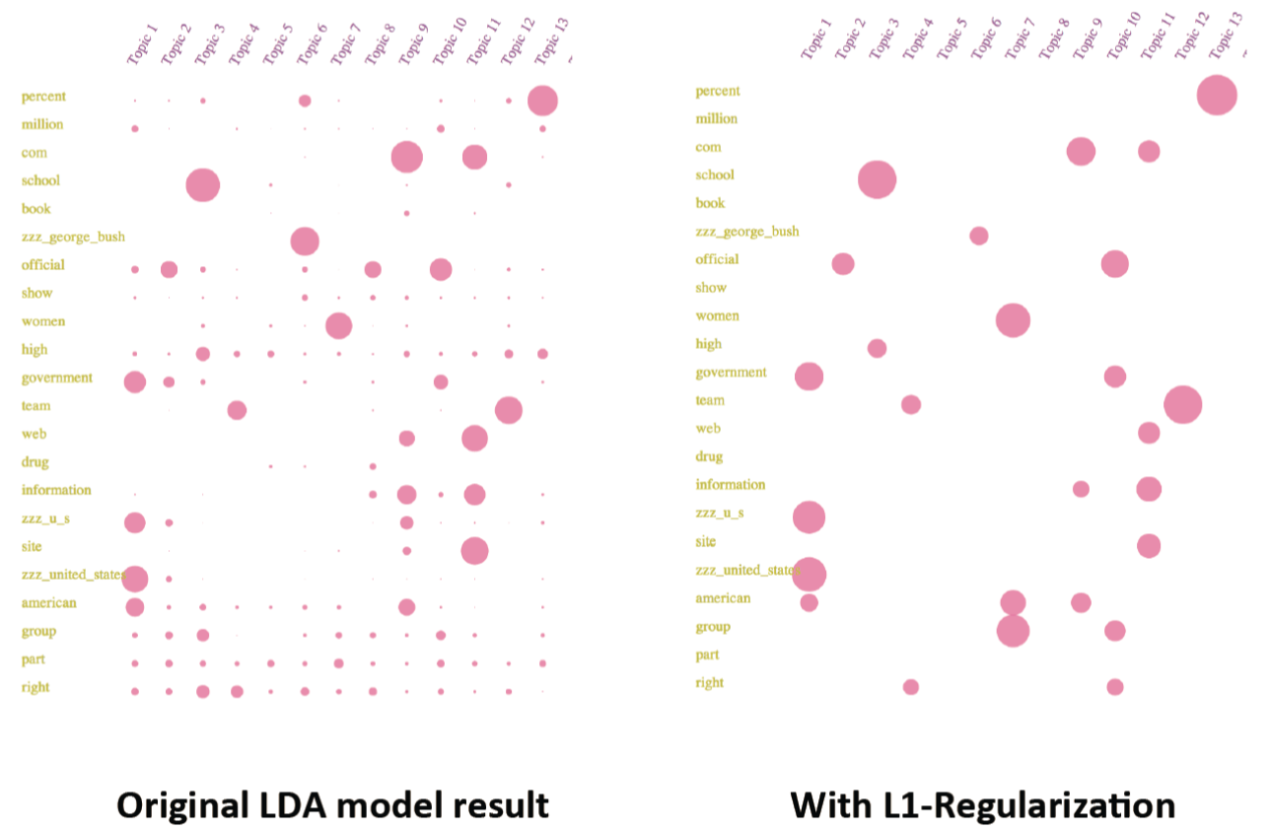
Huasha Zhao, Biye Jiang and John Canny
Computer Science Division
University of California, Berkeley
{hzhao, bjiang, jfc}@cs.berkeley.edu
Berkeley
Institute of Design
Thanks to:
World’s fastest Machine Learning Engine
BIDMach is a new machine learning toolkit that uses full hardware acceleration and roofline design to maximize the performance of machine learning algorithms. Using a recent graphics processor, BIDMach is faster than any other single machine toolkit, and faster than cluster toolkits running on O(100) nodes. Try It! Other unique features:
BIDMach has an open architecture for writing GPU/CPU accelerated, machine learning algorithms. Include s the BIDMat matrix toolkit.
BIDMach supports rich performance criteria through likelihood mixins.
BIDMach supports hyperparameter optimization through concurrent optimization on multiple models.
BIDMach is growing a variety of very efficient MCMC algorithms for
interactive machine learning.
BIDMach code can be compiled, scripted, typed interactively, or run inside an IScala Notebook.
Available Algorithms and Features
Here’s a list of algorithms currently included. All of these will run on CPU/GPU, single or double precision, and most will run with dense or sparse input data.
GLM models: Linear, Logistic, SVM. Single or multiple targets, hyperparameter grids.
Factorization Machines: augments GLM models with a low-dimensional approximation to second-order interaction terms. Typically the most accurate model for power-law data.
Latent Dirichlet Allocation: An implementation of the Online LDA algorithm, and also a SAME-based Gibbs sampler (see below). The latter algorithm on one node is competitive with the custom parallel LDA implementation (Yahoo LDA) running on 1000 nodes.
NMF: Non-Negative Matrix Factorization: Probably the fastest implementation of NMF, gets good leverage from GPU acceleration (throughput is in the teraflop range).
SFA: Sparse Factor Analysis: A faster, equivalent version of ALS (Alternating Least Squares) for collaborate filtering. Our implementation uses a hybrid SGD/CG optimization to efficiently solve for the alternating factors in time linear in the number of latent factors.
K-means: Fast implementation (see benchmarks on right) of batch K-means and a size-balanced K-means.
IPTW: Inverse Probability of Treatment Weighted Causal inference. Built on GLM, but using concurrent estimation of the basic and corrected estimator.
DNN: Deep Neural Networks (non-convolutional, 1-dimenstional). Basic DNN functionality with GLM output layer.
Random Forests: A fully scalable, mini-batch (non-memory bound) RF implementation. Not the fastest (yet), but the smallest memory footprint and largest capacity.
Discrete Graphical Models: Still a WIP, but preliminary results show a 2+ order-of-magnitude speedup up for Gibbs sampling(BUGS-style) on discrete (CPT) graphical models.
Benchmarks
Latent Dirichlet Allocation (LDA). A widely-used topic model, is one of the more computationally-intensive modeling tasks. Our implementations, both online VB and SAME Gibbs Sampling, are currently the fastest (including cluster implementations). The online VB implementation has run a 256-dimensional model on 1 Terabyte of data.
K-means and Logistic Regression
Distributed PageRank. Runtime per iteration on different systems with N_{machines} x N_{cores}. Kylix is used for communication.
LDA on 1 Terabytes of data (6 hours to converge)
Roofline Design (Williams, Waterman, Patterson, 2009)
Is an approach to high-performance software in the post Moore’s-law era (borrowed from hardware design). The roofline limit is set by the hardware and the algorithm, and provides guidance in high-level algorithm design. BIDMach has many custom rooflined CPU and GPU kernels, and higher-level routines are rooflined separately.
Log scale
100 Spark nodes
Research: SAME Gibbs Parameter Estimation
A typical joint probability distribution
P(D,X,Θ)
depends on data D, latent variables X and parameters Θ.
SAME (State Augmentation for Marginal Estimation) is an approach to improving parameter estimates from Gibbs sampling. It replicates states X with shared params Θ, effectively cooling the marginal distribution over Θ by the replication factor k:
P(D, Θ)^{k}
On a GPU, this gives dramatic speedups and also improves the accuracy of inference.
Θ
Architecture
BIDMach is optimized for mini-batch learning on very large datasets. Its architecture supports classes for specific models, secondary likelihoods (mixins), optimization, and a variety of data sources.
P(D,Θ)
P(D,Θ)^{k}
Θ
Parameter cooling
Θ
Research: Interactive Machine Learning
Multiple GPUs on
one machine
Interactive ML allows human trade-offs between primary and secondary optimization criteria with live visualization of models and performance criteria.
It uses SAME GS as the optimizer which supports dynamic performance criteria and provide a temperature control for explore/exploit trade-offs.
Code:
https://github.com/BIDData/BIDMat.git; https://github.com/BIDData/BIDMach.git;
Website:
http://bid2.Berkeley.edu/bid-data-project/overview/.

