Slide 1
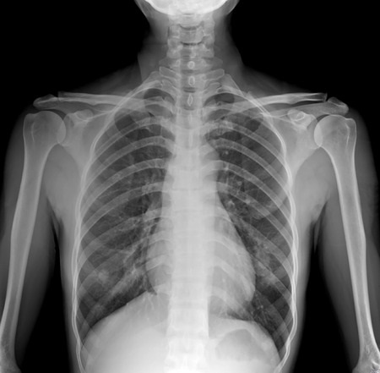
Specific / Intrinsic
Agnostic / Post-Hoc
Node 1
Node 2
Node 3
Leaf 4
Leaf 2
Leaf 3
Leaf 5
Global
Proxy
Node 1
Node 2
Node 3
Leaf 4
Leaf 2
Leaf 3
Leaf 5
Hier nochmal überlegen, welche Methode specifisch und local ist
Black-Box
Model
Prediction
Feature 1
Feature 2
Feature 3
Feature 4
Model
+3
Explanation
+1
Lokal
-1
-3
Interpretation
Bias

