Slide 1
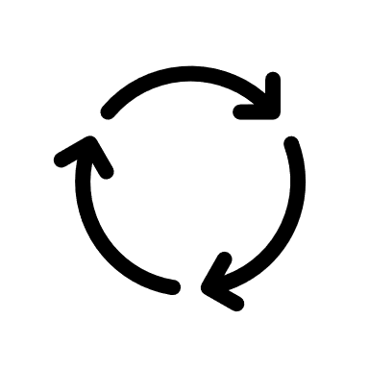

1
All available samples = 100 %
2
Train set, i.e., 80 % of all available samples
Test set, i.e., 20 % of all av. samples
3
Train fold, i.e., 80% of Train set
Development fold, i.e., 20 % of Train set
Use for cross-validation in order to:
estimate robustness by reporting standard deviation of performance between folds
Tune hyperparameters for your model
Use only to report an estimator of your model’s performance when deployed.

Slide 2
100 %
All data
available
80 %
Train
set
80 %
Train
fold
Use for cross-validation
in order to
Estimate robust by calculating the standard deviation of the performance between the folds
Tune hyperparameters of your model
1
2
3
20 %
Validation
fold
20 %
Test
set
Use only to report an estimator of your model’s performance when deployed.

