Slide 1
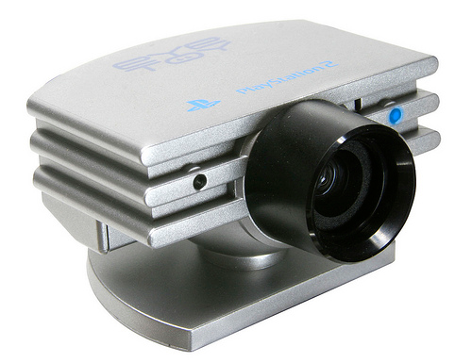
camera_rotor_class.camera_rotor(0,640,75,180,5)
(75%/180degrees) / 5 zones = 8.3% (steps)
CamFocus = zone1,zone2, zone3(middle),zone4,zone5.
ServoBlaster = 0% → 100% (servo movements)
Zone3 = Hold, Zone2 = -8.3 Zone4 = +8.3
Start ( 50% → Zone3 Z3 Middle )
Focus Cam Xcord 450
NextStep (+1 Zone → Zone 4) → Z3
Next(50% + 8.3% = 58.3%)
Focus Cam Xcord 550
NextStep (+2 Zone → Zone 5) → Z3
Next(58.3% + 16.6% = 75%)
Focus Cam Xcord 320
NextStep (0 Zone → Zone 3) → Z3
Next(75% +- 0% = 75%)
Focus Cam Xcord 220
NextStep (-1 Zone → Zone 3) → Z3
Next(75% -8.3% = 66.3%)
Start ( 50% → Zone3 Z3 Middle )
Focus Cam Xcord 450
NextStep (+1 Zone → Zone 4) → Z3
Next(50% + 8.3% = 58.3%)
Focus Cam Xcord 550
NextStep (+2 Zone → Zone 5) → Z3
Next(58.3% + 16.6% = 75%)
Focus Cam Xcord 320
NextStep (0 Zone → Zone 3) → Z3
Next(75% +- 0% = 75%)
Focus Cam Xcord 220
NextStep (-1 Zone → Zone 3) → Z3
Next(75% -8.3% = 66.3%)
Start ( 50% → Zone3 Z3 Middle )
Focus Cam Xcord 450
NextStep (+1 Zone → Zone 4) → Z3
Next(50% + 8.3% = 58.3%)
Focus Cam Xcord 550
NextStep (+2 Zone → Zone 5) → Z3
Next(58.3% + 16.6% = 75%)
Focus Cam Xcord 320
NextStep (0 Zone → Zone 3) → Z3
Next(75% +- 0% = 75%)
Focus Cam Xcord 220
NextStep (-1 Zone → Zone 3) → Z3
Next(75% -8.3% = 66.3%)
25%
41.7%
50%
58.3%
75%
33.4%
66.3%
1
2
3
4
5
Code Example:
testa = test.focus(450)
print (testa)
testa = test.focus(550)
print (testa)
testa = test.focus(320)
print (testa)
testa = test.focus(220)
print (testa)
Camera Options:
Width 0x → 640x (pixels)
Width Zones Ex 5
Ex. 1 zone 8.3% Servo Move
Servomotor : 180 Degrees →
0% → 100% range.
0 → 128
129→ 256
257→ 384
386 →512
512→640

