Slide 1
Optimization of an Ant Colony Simulation
Data layout reorganization, OpenMP parallelization, and MPI parallelization
Objective: reduce total compute time while preserving the simulation model and benchmark fairness.
AMD Ryzen 5 9600X
Windows, g++ 14.2.0
Headless benchmark
SoA
OpenMP
MPI

Slide 2
Context
Problem and Benchmark Setup
Benchmark conditions
Baseline
- Terrain: 513 x 513 fractal grid, with nest and food source.
- Reference workload: 5000 ants, headless execution, identical rules for all methods.
- Dominant phase: ant movement, due to random choices and irregular memory access.
- Correctness fixes before measurement: seed initialization and pheromone buffer refresh.
0.904 ms/iter
Sequential AoS reference
Bottleneck
0.634 ms/iter
Ant movement dominates the runtime
Logic
Change -> code -> result
Same structure for the three methods

Slide 3
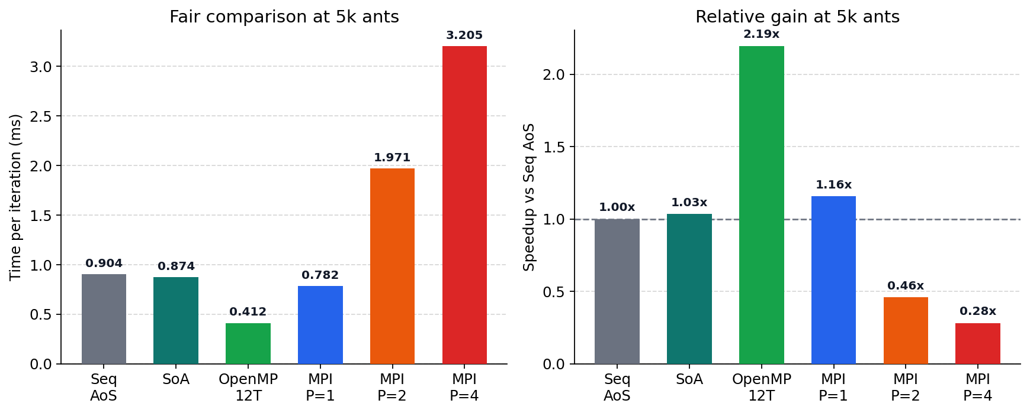
Method 1
Data Layout Reorganization
What changed
Total
Speedup
Reading
- AoS became SoA: position, state, and seed were separated into arrays.
- Movement uses linear indices for terrain and pheromone arrays.
- Touched cells are collected first, then updated once in the buffer.
0.874 ms/iter
1.03x
Useful
vs 0.904 ms/iter
Small but measurable
But not transformative
Interpretation: the layout became cleaner, but the movement kernel remained irregular and only weakly vectorizable.
Representative code
vector<uint32_t> m_land_index, m_pher_index;
vector<uint8_t> m_loaded;
...
for (size_t idx : m_touched_indices)
buffer[idx] = compute_mark(map, idx);

Slide 4
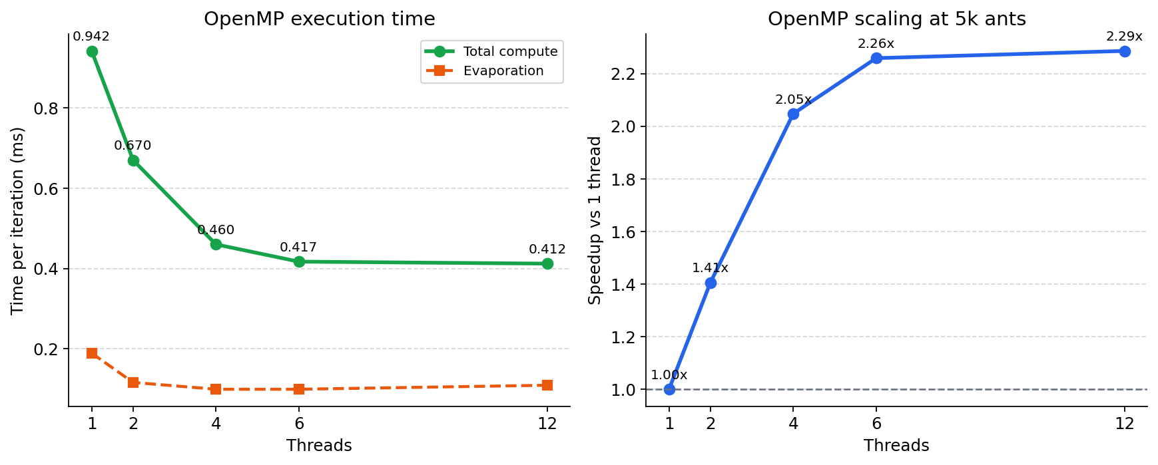
Method 2
OpenMP Parallelization
What changed
- The final version parallelized ant movement, not only evaporation.
- Thread-local mark buffers removed races in the pheromone update.
- The merge step remained deterministic.
Representative code
#pragma omp parallel reduction(+ : food_delta)
{
ants[i].advance_collect(...);
local_marks.values[idx] = phen.compute_mark(pos);
}
merge thread-local marks into the global buffer;
Best result: 0.412 ms/iter, corresponding to about 2.29x speedup.

Slide 5
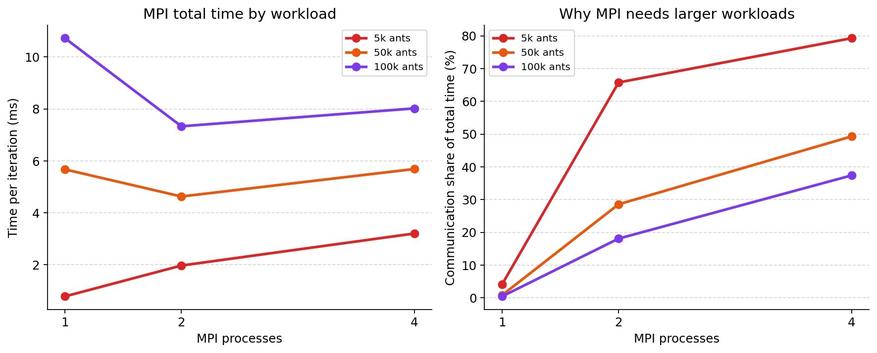
Method 3
MPI Parallelization
What changed
- Each process owns only a subset of ants, but keeps the full map.
- The pheromone buffer is synchronized with MPI_Allreduce.
- Evaporation is distributed by stripes, followed by a second synchronization.
Representative code
for (...) {
for (auto& a : ants) a.advance(...);
MPI_Allreduce(..., MPI_MAX, ...);
phen.do_evaporation_stripe(...);
MPI_Allreduce(..., MPI_MIN, ...);
}
Implemented: MPI approach 1. Approach 2 is discussed as a strategy in the report; the bonus was not pursued.

Slide 6
Comparison
Synthesis in the Common Workload
SoA
1.03x
Small gain
OpenMP
2.29x
Best practical result
MPI
< 1x at 5k
Needs larger workloads
OpenMP is the most effective optimization in the normal regime, while MPI only becomes attractive when the workload is much larger.

Slide 7
Takeaways
Conclusion
Main conclusions
- The first requirement was correctness: seed initialization and pheromone buffer refresh had to be fixed before any serious comparison.
- SoA improved the code organization and produced a small gain, but it did not change the fundamental behavior of the movement kernel.
- OpenMP produced the strongest result because it directly targeted the dominant phase of the simulation.
- MPI approach 1 was implemented and measured. MPI approach 2 was covered as a proposed strategy, which satisfies the non-bonus requirement of the assignment.
OpenMP gave the best balance between implementation effort and performance gain.

