Slide 1
123
123
OK

Slide 2
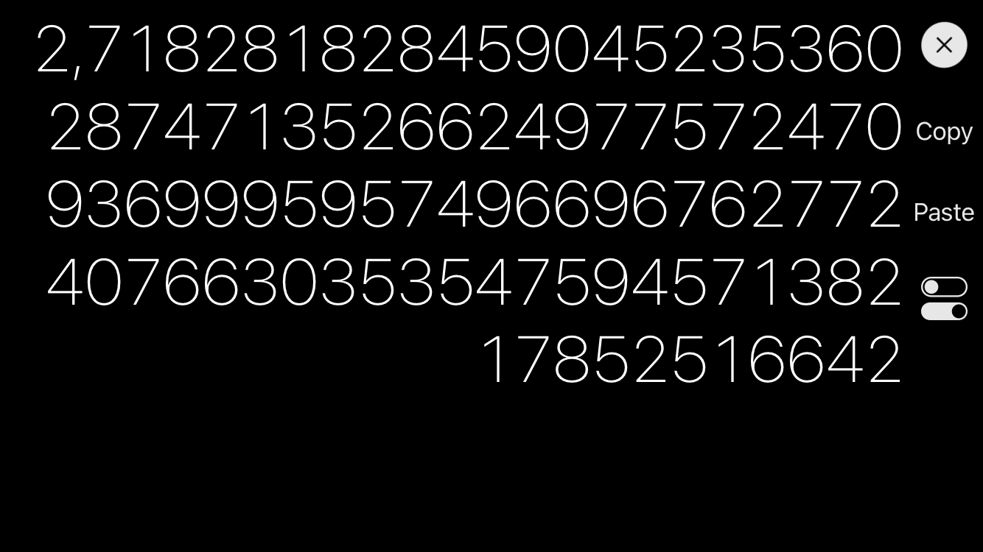

􀁎 100 digits 􀁌 Note: all calculations are executed Internally with 600 bit precision (200 digits) to reduce the effect of error accumulation
Purchase arbitrary precision ($0.99)

Slide 3
􀁎 100 digits 􀁌 Note: all calculations are executed Internally with 600 bit precision (200 digits) to reduce the effect of error accumulation
Arbitrary precision purchased

