Slide 1
twm
m = th*marginFactor
tw
twm = tw + 2*m
thm = th + 2*m
th
thm
b = th*borderWidthFactor

Slide 2
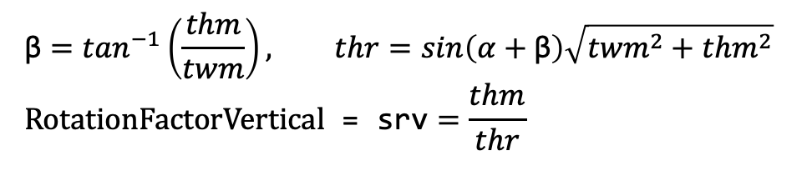

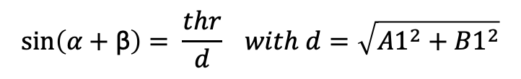

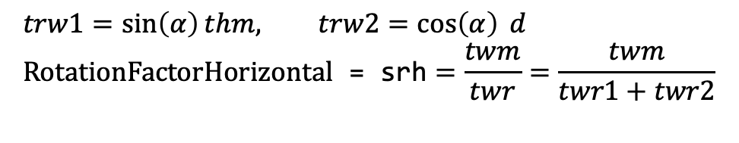

sin$\left(α\right)=\frac{trw1}{thm}$
cos$\left(α\right)=\frac{trw2}{d}$
tan$\left(\text{β}\right)=\frac{thm}{twm}$
$$\sin\left(α+\text{β}\right)= \frac{thr}{d} with d=\sqrt{{{A1}^{2}+B1}^{2}}$$
α
β
thr
twr1
twr2
d
thm
twm
$$trw1=\sin\left(α\right)thm, trw2=\cos\left(α\right) d \\ \text{RotationFactorHorizontal}\text{ = }\text{srh}=\frac{twm}{twr}=\frac{twm}{twr1+twr2}$$
$$\text{β}=\tan^{−1}\left(\frac{thm}{twm}\right), thr=sin\left(α+\text{β}\right)\sqrt{{{twm}^{2}+thm}^{2}} \\ \text{RotationFactor}\text{Vertical}\text{ = }\text{srv}=\frac{thm}{thr}$$

Slide 3
fw
fh
thr
twr
sw = fw / twr
sh= fh / thr
scale=min(sw, sh)

Slide 4
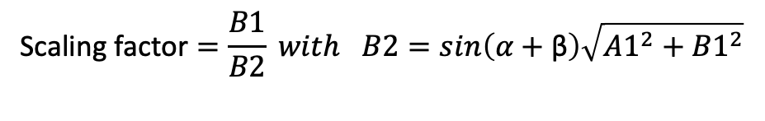
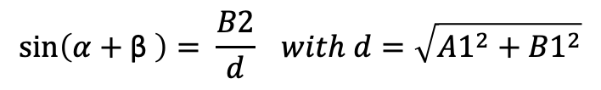

tan$\left(\text{β}\right)=\frac{B1}{A1}$
$$\sin\left(α+\text{β} \right)= \frac{B2}{d} with d=\sqrt{{{A1}^{2}+B1}^{2}}$$
Would stick out at top and bottom
α
β
A2
B2
d
B1
A1
$$\text{Scaling} \text{factor}=\frac{B1}{B2} with B2=sin\left(α+\text{β}\right)\sqrt{{{A1}^{2}+B1}^{2}}$$

Slide 5
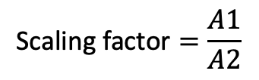

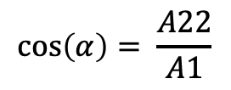

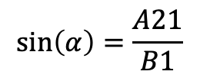

A2
Would stick out at sides
A21
A22
α
$$\sin\left(α\right)=\frac{A21}{B1}$$
$$A21=B1 asin⁡(α)$$
α
$$\cos\left(α\right)= \frac{A22}{A1}$$
$$A22=A1 acos\left(α\right)$$
B2
B1
A$2=A21+A22$
A1
$$\text{Scaling} \text{factor}=\frac{A1}{A2}$$

Slide 6

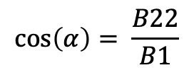
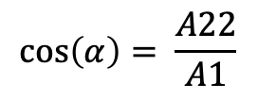




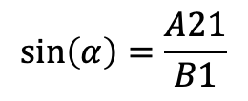
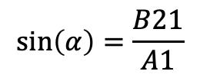
A2
A21
A22
$$\sin\left(α\right)=\frac{A21}{B1}$$
$$A21=B1 sin⁡(α)$$
α
B21
$$\cos\left(α\right)= \frac{A22}{A1}$$
$$A22=A1 cos\left(α\right)$$
α
B2
A$2=A21+A22$
B1
B22
A1
$$\sin\left(α\right)=\frac{B21}{A1}$$
B$21=A1 sin⁡(α)$
$$\cos\left(α\right)= \frac{B22}{B1}$$
B$22=B1 cos\left(α\right)$
B$2=B21+B22$

Slide 7
α
45°- α
45°+ α
offset
α
$\cos\left(\text{45}\text{°}\text{−} \text{α} \right)= \frac{R+\text{offset}}{\sqrt{2 }R} or \text{R}\text{+} \text{offset}=\sqrt{2 }R$ $\cos\left(\text{45}\text{°}\text{−} \text{α}\right) or \text{offset}=\left(\sqrt{2 }\cos\left(\text{45}\text{°}\text{−} \text{α}\right) −1\right) R$

