Slide 1
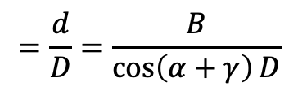
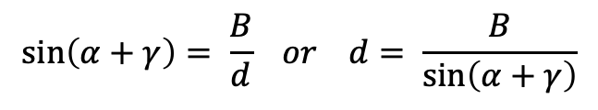
Rotation angle = α
β = 90° - α
Rectangle: γ
δ = 90° - γ
β
γ
α
δ
B
d
D
A
$$\sin\left(α+γ\right)= \frac{B}{d} or d= \frac{B}{sin⁡\left(α+γ\right)}$$
$$=\frac{d}{D}=\frac{B}{\cos\left(α+γ\right)D}$$
Scaling factor

Slide 2
α
45°- α
45°+ α
offset
α
$\cos\left(\text{45}\text{°}\text{-} \text{α} \right)= \frac{R+\text{offset}}{\sqrt{2 }R} or \text{R}\text{+} \text{offset}=\sqrt{2 }R$ $\cos\left(\text{45}\text{°}\text{−} \text{α}\right) or \text{offset}=\left(\sqrt{2 }\cos\left(\text{45}\text{°}\text{−} \text{α}\right) −1\right) R$

Slide 3
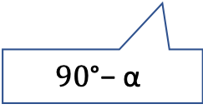
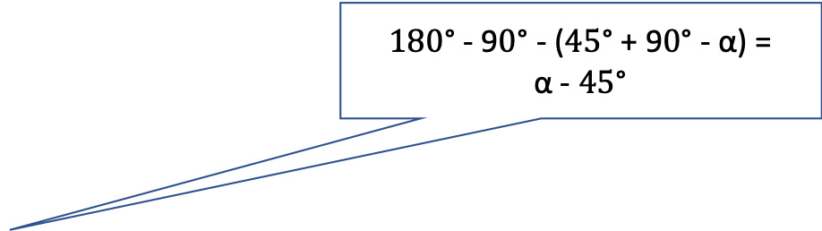
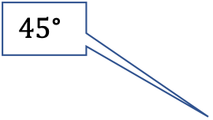
$\text{180}\text{°}\text{ - 9}\text{0}\text{°}\text{ - (}\text{45}\text{°}$ + $\text{9}\text{0}\text{°}$ - $\text{α}$) = $\text{α}$ - $\text{45}\text{°}$
α
$$\text{45}\text{°}$$
α
offset
$$\text{90}\text{°}\text{−} \text{α}$$
$\cos\left(\text{α}\text{ - }\text{45}\text{°}\right)= \frac{R+\text{offset}}{\sqrt{2 }R} or \text{R}\text{+} \text{offset}=\sqrt{2 }R$ $\cos\left(\text{α}\text{ − 45}\text{°}\right) or \text{offset}=\left(\sqrt{2 }\cos\left(\text{α}\text{ − 45}\text{°}\right) −1\right) R$

