Slide 1
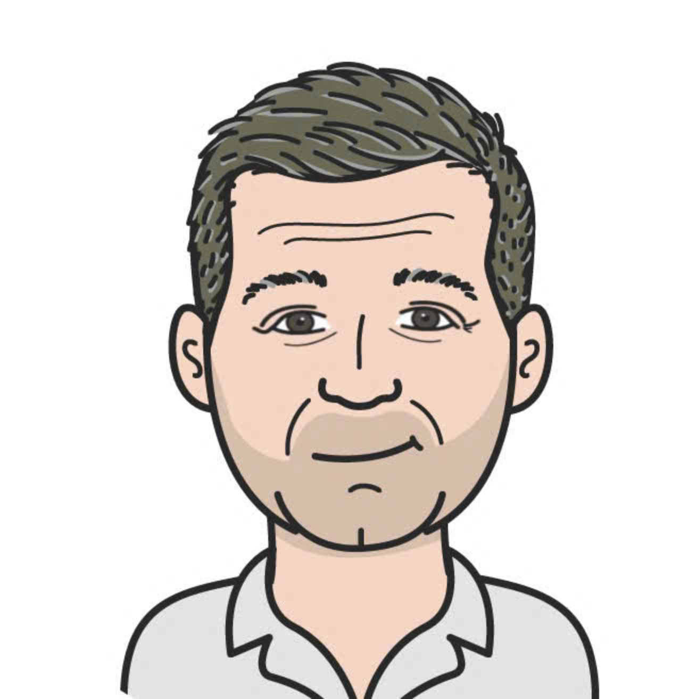

Joachim Neumann
VN
Van Nguyen
✅ Passport
☑️ Passport
Primary Contact
Traveler
TN
Toan Nguyen
+
☑️ Passport
Traveler

Slide 2


