Slide 1
Circular Statistics
Yousef Mohammadi
University College London
February 1, 2024

Slide 2
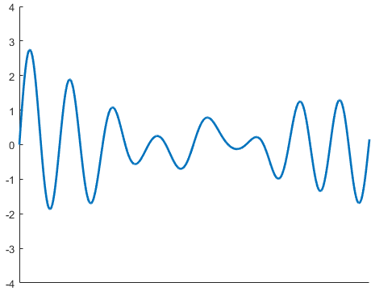
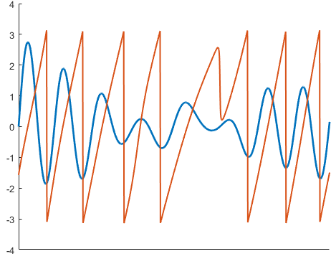
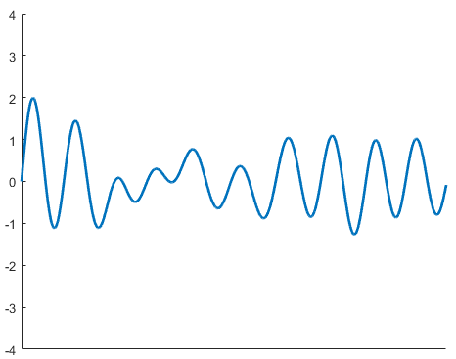
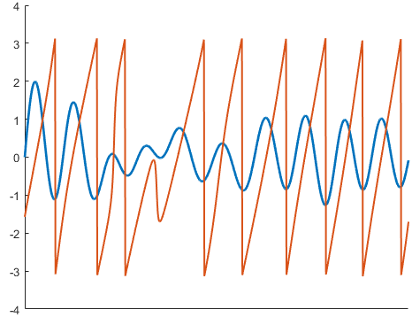
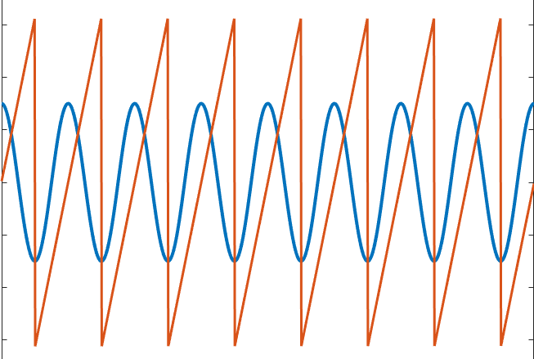
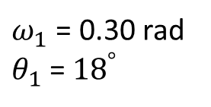








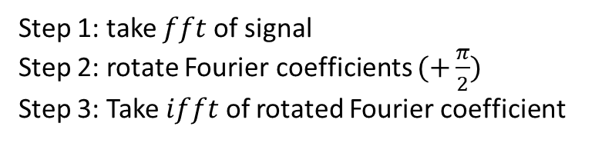
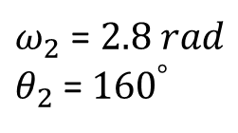

X1
$$+π$$
$$e^{i2πft}=\cos\left(2πft\right)+i sin⁡(2πft)$$
$ω_{1}$ = 0.30 rad
$θ_{1}$= ${18}^{°}$
$$θ=2πft$$
$$−π$$
$$θ= ω∗180/π$$
0
Time (s)
1
$$\hat{x}\left(t\right)=hilbert\left(x\right)$$
Step 1: take $fft$ of signal
Step 2: rotate Fourier coefficients $(+\frac{π}{2})$
Step 3: Take $ifft$ of rotated Fourier coefficient
X2
$ω_{2}$ = $2.8 rad$
$θ_{2}$= ${160}^{°}$
$$+π$$
$$−π$$
$$t_{n}$$
Time (s)

Slide 3
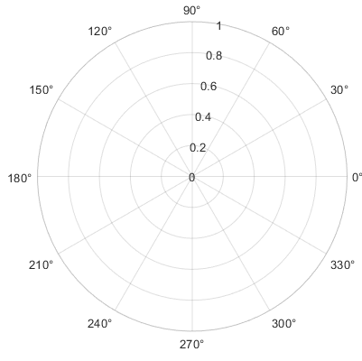
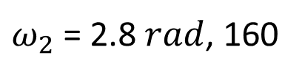

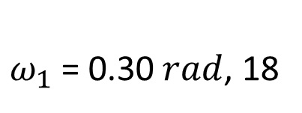
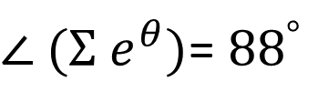
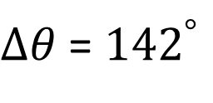
$ω_{1}$ = 0.30$rad$, 18
$ω_{2}$ = 2.8$rad$, 160
$Σ$ $e^{θ_{k}}$
$∆θ$ = ${142}^{°}$
$∠ (Σ$ $e^{θ})$= ${88}^{°}$

Slide 4
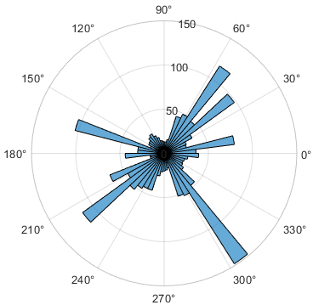



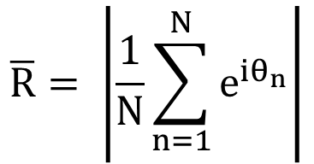
mean resultant vector length:
$$\overline{R}= \left|\frac{1}{N}\sum_{n=1}^{N}{e^{iθ_{n}}}\right|$$
$$R$$
P < 0.001
Variance = 1 - $\overline{R}$
$$p= e^{\sqrt{1+4N+4(N^{2}−{\left(N\overline{R}\right)}^{2} )} −(1+2N)}$$
Rayleigh test for non-uniformity:
H0: the population is uniformly distributed around the circle
H1: the population is not distributed uniformly around the circle
Assumption: the distribution has maximally one mode and the data is sampled from a Von Mises distribution!
Notes:
The Rayleigh test asks how large the resultant vector length R must be to
indicate a non-uniform distribution (Fisher 1995). It is particularly suited for detecting a
unimodal deviation from uniformity.

Slide 5
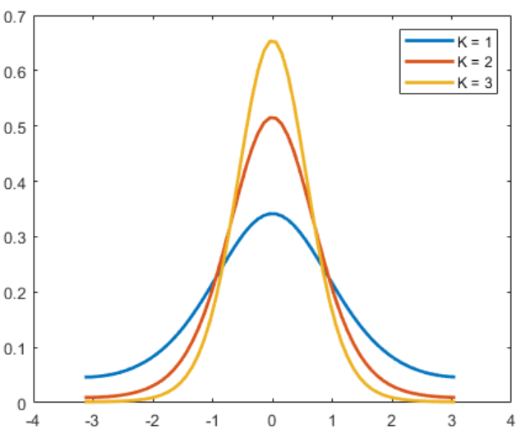

Von Mises distribution
$$μ=0$$

Slide 6
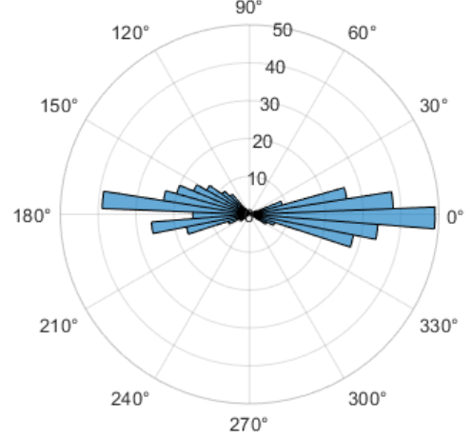
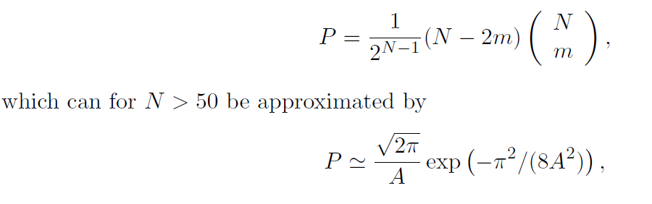

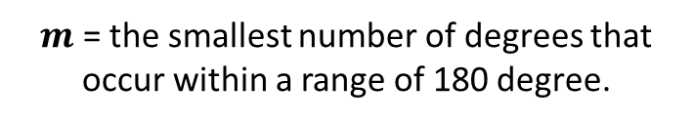
IF samples:
Don’t come from a Von Mises distribution
Come from bimodal or multimodal distribution
H0: the population is uniformly distributed around the circle
H1: the population is not distributed uniformly around the circle
Non-parametric methods:
‘Omnibus test’:
P = .12
Rayleigh test
P < 0.001
Omnibus test
Which can for N > 50 be approximated by
$m$ = the smallest number of degrees that occur within a range of 180 degree.

